Slide 1
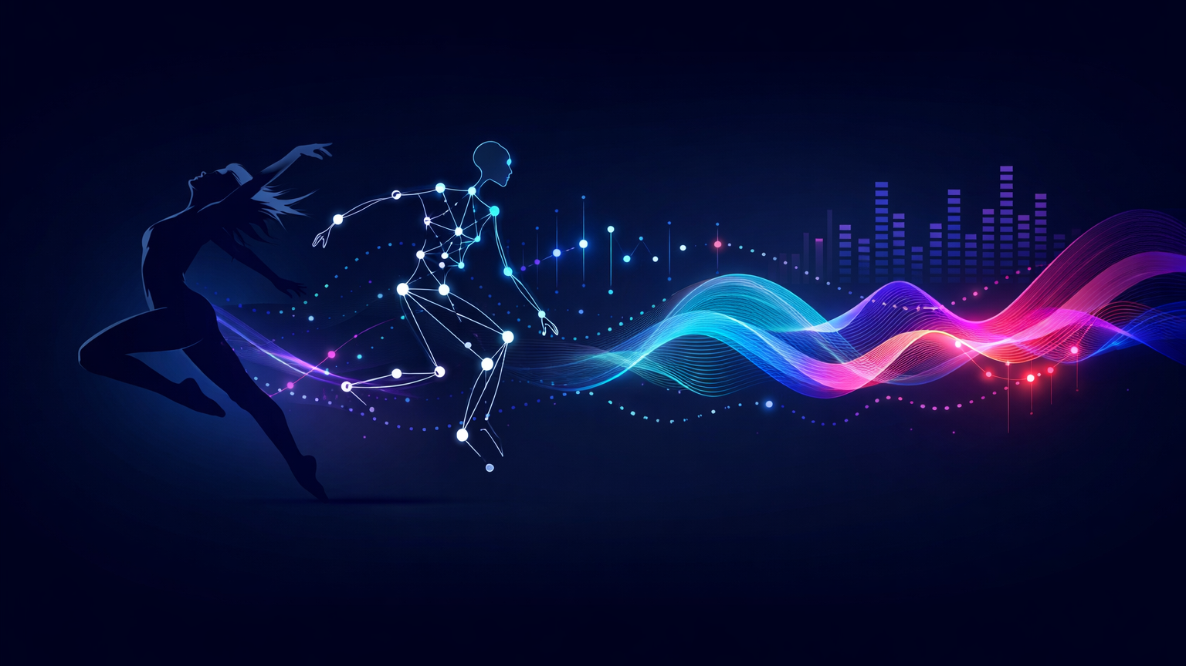
Motion2Music
A multi-stage pipeline for generating music from dance motion using LMA, rhythm, semantics, and CLAP-guided prototypes
Small thesis presentation
Notes:
[Sources]
- Content adapted from the user's thesis prototype document: Motion2Music_Thesis_Doc_Prototype.docx
- Background visual generated with OpenAI image generation on March 19, 2026.

Slide 2
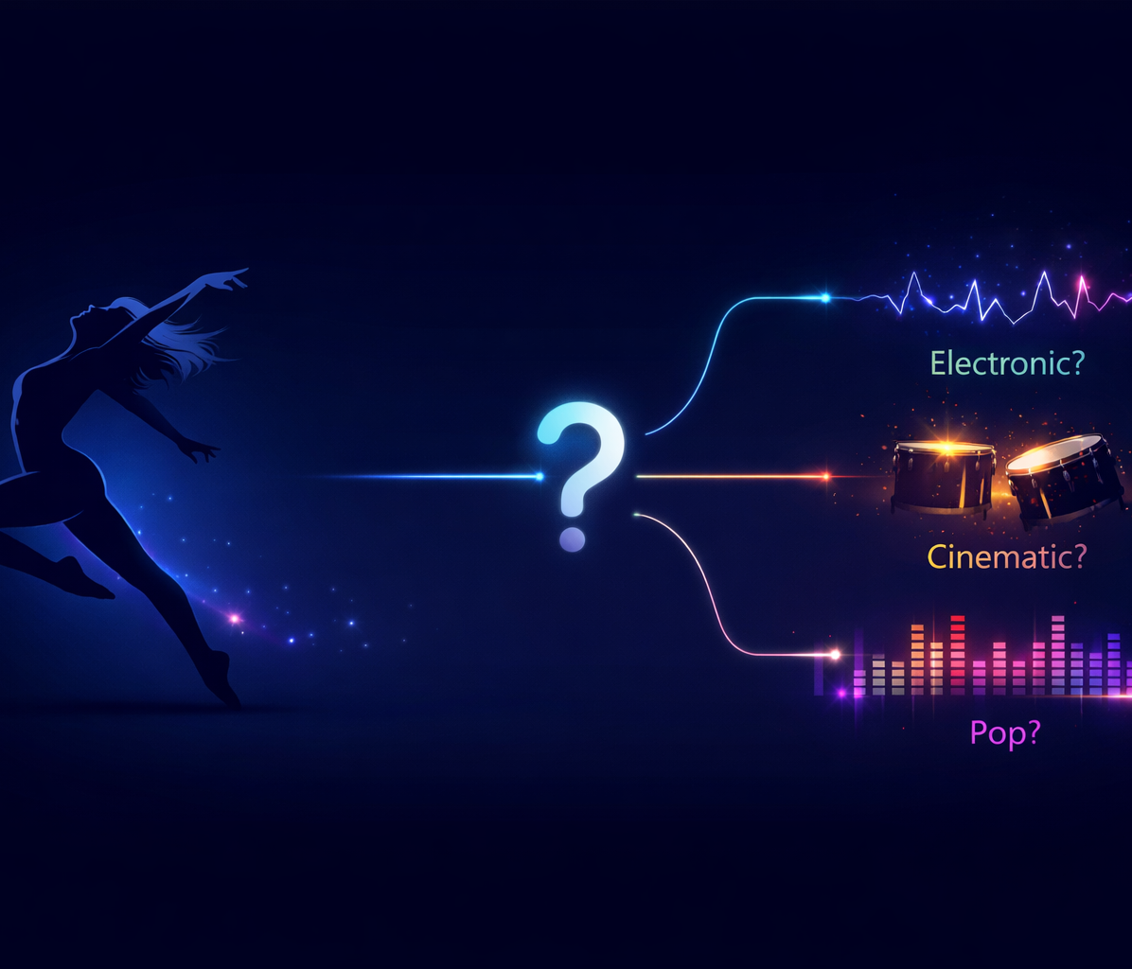
Why motion-to-music is hard
The core challenge is ambiguity, not just prediction accuracy
One dance sequence can match many valid musical outcomes.
• A single motion clip may fit electronic, cinematic, or pop music.
• Directly predicting exact audio is unstable because there is no unique “correct” target.
• The project therefore shifts from raw audio prediction to interpretable intermediate controls.
Key idea
Use motion to predict meaning first, then let a generative music model handle the final synthesis.
Notes:
[Sources]
- Content adapted from the user's thesis prototype document: Motion2Music_Thesis_Doc_Prototype.docx
- Right-side visual generated with OpenAI image generation on March 19, 2026.

Slide 3
Data and evaluation protocol
The thesis emphasizes honest testing, especially under domain shift
Datasets
AIST++
FineDance (converted to BVH)
SimonAlexanderson
Two split settings were used
Strict OOD
Mixed holdout
Main feature tables
Train
Train
meta.csv
X_motion.csv
X_motion_temporal.csv
Y_audio.csv
AIST++ + FineDance
AIST++ + FineDance + some Simon
Test
Test
Leakage prevention
SimonAlexanderson
remaining Simon holdout
Group-aware splits by stem/root keep near-duplicate chunks or views out of both train and test.
Interpretation
Why this matters
Strict OOD is the most realistic test because it asks whether the system transfers across datasets rather than memorizing them.
A good score is only meaningful if train/test separation is strict.
Notes:
[Sources]
- Content adapted from the user's thesis prototype document: Motion2Music_Thesis_Doc_Prototype.docx

Slide 4
Proposed multi-stage pipeline
The system decomposes a hard one-to-many task into interpretable stages
1
Motion analysis
2
Semantic layer
3
Prototype layer
4
Prompt construction
5
Music generation
BVH windows → LMA descriptors, beat events, tempo estimates, and temporal statistics.
Normalized motion features are turned into interpretable controls such as energy, sharpness, control, and rhythm stability.
CLAP-derived prototype classes compress the target space into broad music families rather than exact audio.
Prototype + semantics + BPM/rhythm are converted into a structured text description.
MusicGen produces candidate audio, which is then checked with synchronized BVH + audio playback.
Why this architecture works
Motion usually does not determine one exact waveform. The pipeline predicts meaning and broad musical region first, then uses a generative model to create plausible audio.
Notes:
[Sources]
- Content adapted from the user's thesis prototype document: Motion2Music_Thesis_Doc_Prototype.docx

Slide 5
How motion becomes musical meaning
From movement descriptors to prompt-ready controls
1) LMA-based motion features
2) Rhythm and tempo features
3) Semantic control scores
Examples:
• BODY
• EFFORT_WEIGHT_STRONG
• EFFORT_TIME_SUDDEN
• EFFORT_FLOW_BOUND
• SPACE
These describe how movement feels, not only where joints are.
Beat events are detected from motion cues such as foot-contact timing.
From beat times:
IBI = diff(beat_times)
BPM = 60 / mean(IBI)
CV = std(IBI) / mean(IBI)
This captures both speed and rhythmic regularity.
The system maps motion into 9 higher-level controls, including:
energy, heaviness, sharpness, control, expansiveness, rhythm stability, arousal, valence, and dynamics.
These become tags and prompt phrases for MusicGen.
Result
Instead of predicting raw audio directly, the model predicts a compact language-like description of the dance.
Notes:
[Sources]
- Content adapted from the user's thesis prototype document: Motion2Music_Thesis_Doc_Prototype.docx

Slide 6
What the experiments showed
The thesis evolved by learning from what failed first
Early baseline: direct regression
Intermediate step: semantic tuning
Best practical path: prototype prompting
Motion → audio descriptors
Motion → CLAP embedding
Finding:
Performance under strict OOD was weak; descriptor regression could even show strongly negative mean R².
Takeaway:
Exact audio targets were too ambiguous and brittle.
Hand-crafted semantic rules were tuned using CLAP(prompt) ↔ CLAP(audio) cosine similarity plus a consistency penalty.
Finding:
Test mean cosine improved from about 0.167 to 0.194.
Takeaway:
Prompt quality became more aligned and more stable.
CLAP audio embeddings were clustered into broad prototypes, and motion was used to predict prototype probabilities.
Finding:
Prototype-conditioned prompting was the most robust and controllable approach, especially with longer 30 s context.
Main lesson
The project moved from direct prediction toward interpretable conditioning: semantics + prototypes + text-to-music synthesis.
Notes:
[Sources]
- Content adapted from the user's thesis prototype document: Motion2Music_Thesis_Doc_Prototype.docx

Slide 7
Best current path and takeaway
A compact summary of the thesis contribution
Best current inference flow
Contribution
A defensible end-to-end Motion2Music pipeline with five layers: motion understanding, semantic control, prototype prediction, text-guided generation, and human/metric-based validation.
01
Extract *_lma.csv and *_beats.csv
02
Build temporal motion features
Current limitations
03
Infer top-k prototypes and semantic controls
Cross-dataset domain shift remains strong, some prototypes may reflect dataset structure, and CLAP improvements do not always perfectly match human musical fit.
04
Generate candidate audio with MusicGen and validate with synchronized playback
Takeaway message
Why it is practical
Interpretable controls, top-k variation, and editable prompts.
Motion should guide music through interpretable intermediate representations rather than through direct raw audio regression.
Notes:
[Sources]
- Content adapted from the user's thesis prototype document: Motion2Music_Thesis_Doc_Prototype.docx

