Slide 1
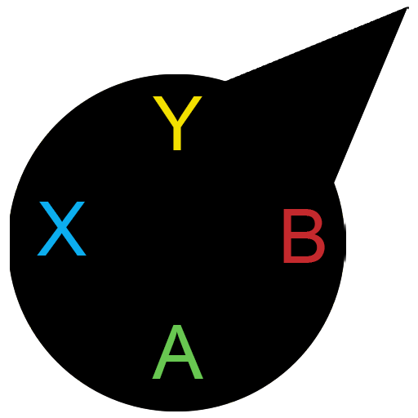
MultiDev-Launcher

Slide 2
Description
MultiDev-Launcher is a simple software launcher aiming to support several devices for software launching and system navigation in Windows operating systems. Users can add or remove directories in which their applications are located (ideally their application shortcuts) and launch them through their preferred device. The application currently supports keyboard, mouse and gamepads.

Slide 3
How to use it
Right after installing the application you will be greeted with a welcome message during the first execution. Then you will be asked to type your user name before accessing the main window. Once you enter the main application window you can add the directories in which your applications are located. You can do that through the “Add Directory” button in “Settings” tab. The application will scan the directory recursively for any executable files or application shortcuts and add them to the known applications list.

Slide 4
Anti-virus false positives
It is possible that your anti-virus software flags this application as a virus and prevents it from running. If that happens, don’t worry, this application is safe to use. Anti-virus software often flag unofficial software as viruses. To prevent it from blocking MultiDev-Launcher make sure to add an exception in your Anti-virus.
In the following slides you can learn the navigation controls.

Slide 5
Controls
You can use the application through a keyboard, mouse or a gamepad.
Mouse usage is straightforward. Point and click. You can open a Virtual Keyboard through the Settings tab to type your input and then copy/paste it to the desired input field.
Pressing LCTRL + Space on a keyboard will display the application finder window which was created for keyboards. Searching an application and then navigating through the found applications list with the arrows is how it works
As for gamepads, the controls are described in the following pages

Slide 6
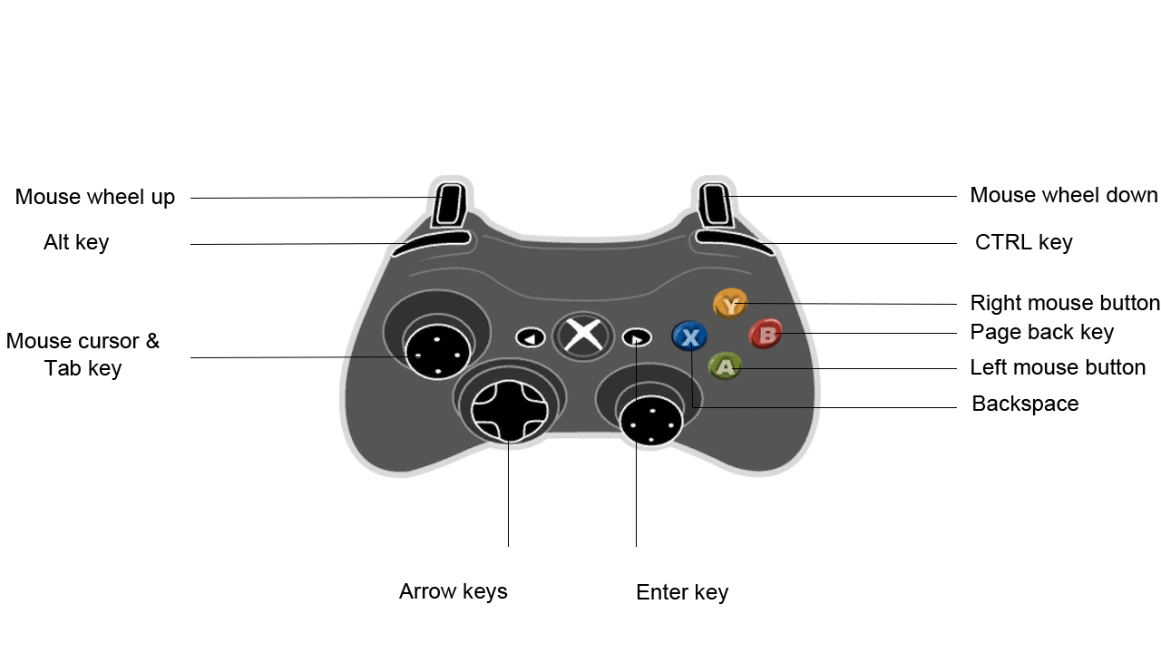
General Gamepad controls

Slide 7
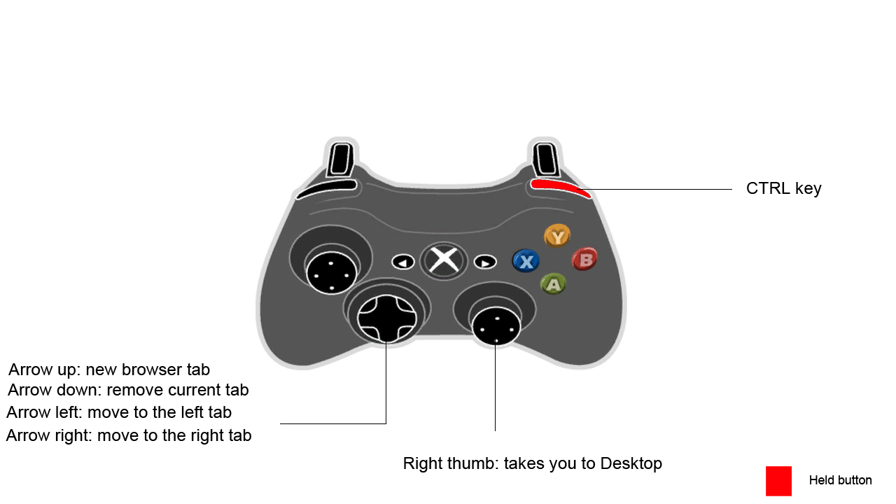
Holding RB (CTRL key)

Slide 8
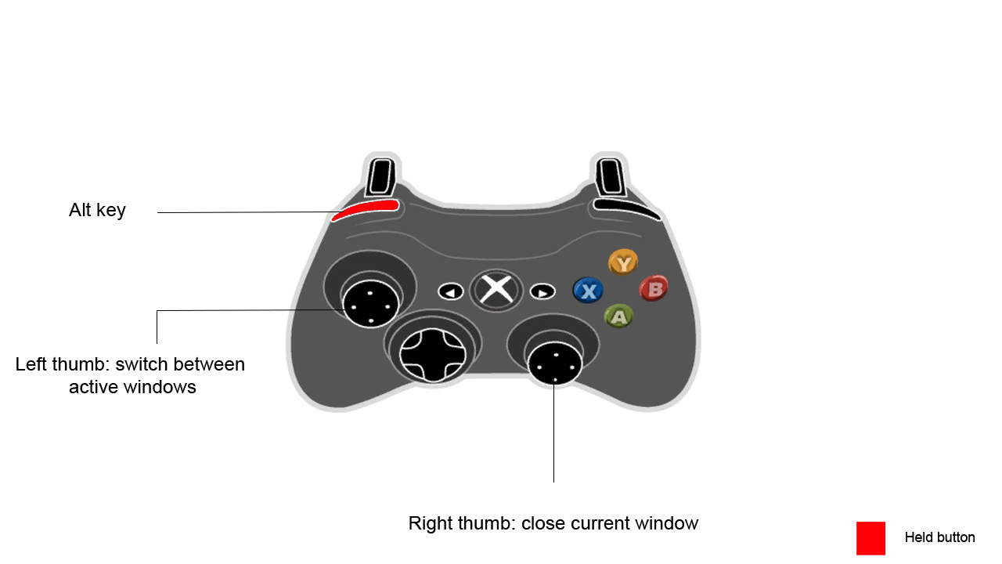
Holding LB (Alt key)

Slide 9
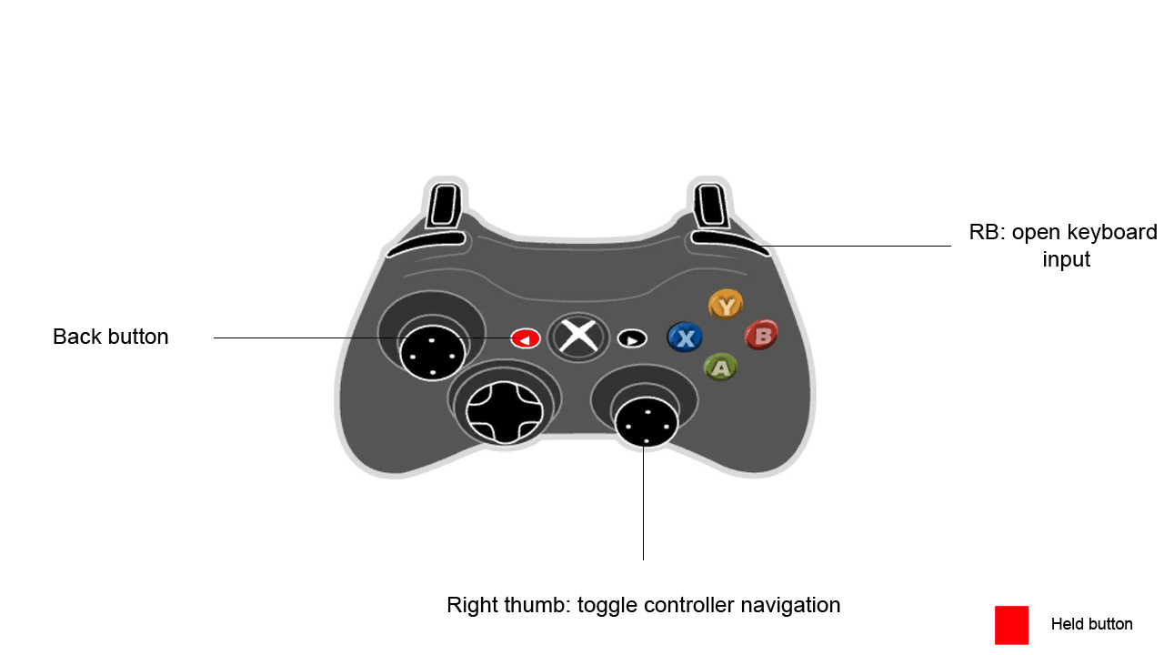
Holding back button

Slide 10
MultiDev-Launcher Gamepad controls
When the application is focused on the main window, gamepad users can use LB and RB to navigate between the application’s tabs and the arrows to switch between the applications, the applications list and the search input fields.

Slide 11
Troubleshooting
If you’re experiencing any problems with the application then make sure to report them to the application’s repository. You can open an issue on GitHub here.

