Slide 1
Coursework
Polymorphic implementation of the dictionary data structure
Yahudin Kostiantyn

Slide 2
What is Dictionary and why do we need different implementations
Polymorphic implementations of dictionary data structures are a key topic in programming and computer science. Dictionaries, also known as associative arrays or maps, are important tools for storing and organizing data, where each element has a unique key associated with a value. Dictionary data structures are widely used in various domains, such as databases, information systems, computer programs, and more.
However, there are situations where the ability to use different dictionary implementations depending on the specific context or requirements is needed. For example, different search or data storage algorithms may be required based on the dictionary's size, key type, or other factors. In such cases, polymorphic implementations become valuable as they allow for flexible adaptation of the data structure to specific needs.

Slide 3
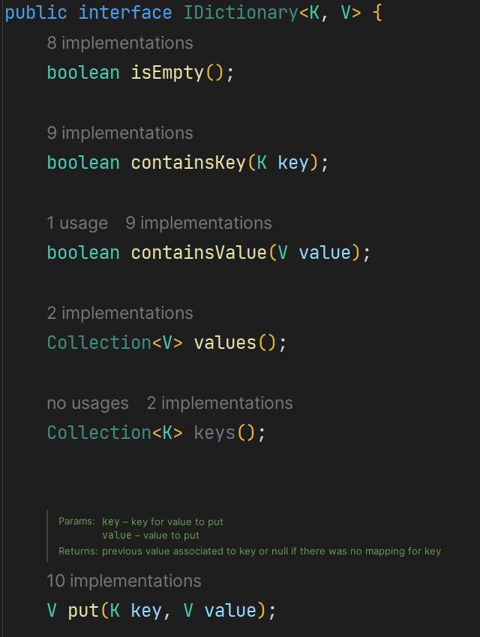
Example of polymorphic implementations based on a hash table and a red-black tree.
Let's consider the "put" method of the IDictionary interface as an example. We defined it’s signature in the interface. And implement in our inheritances.

Slide 4
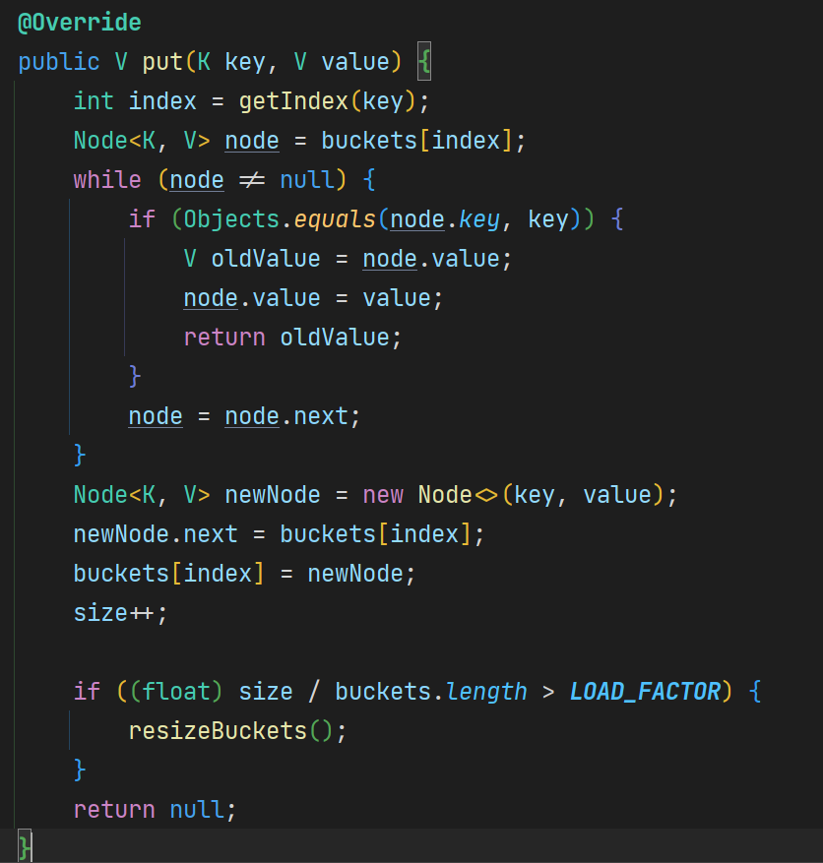
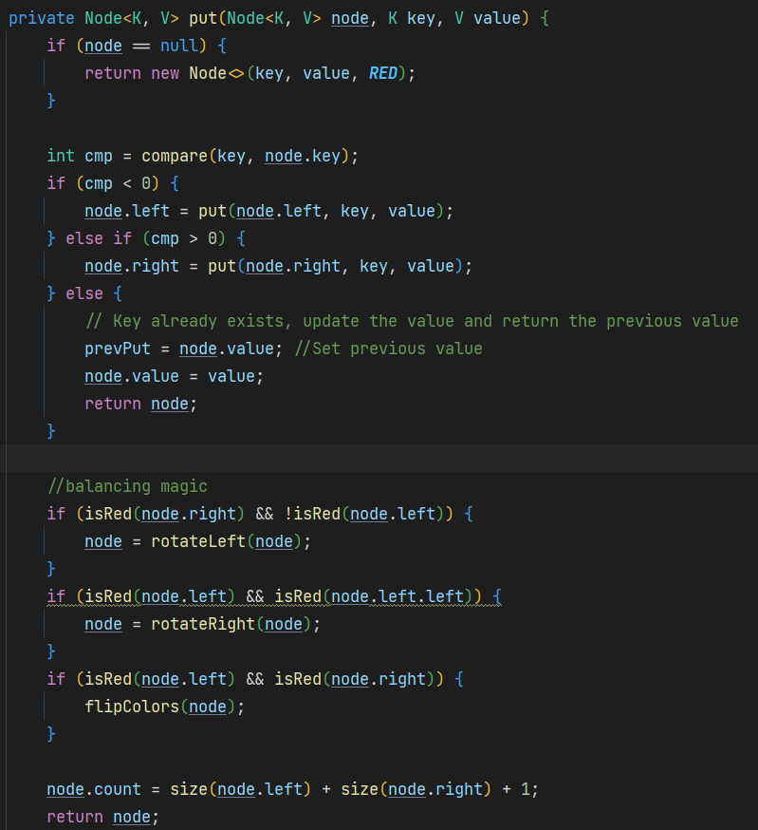
Implementation based on Hash Table and Red-Black Tree

Slide 5
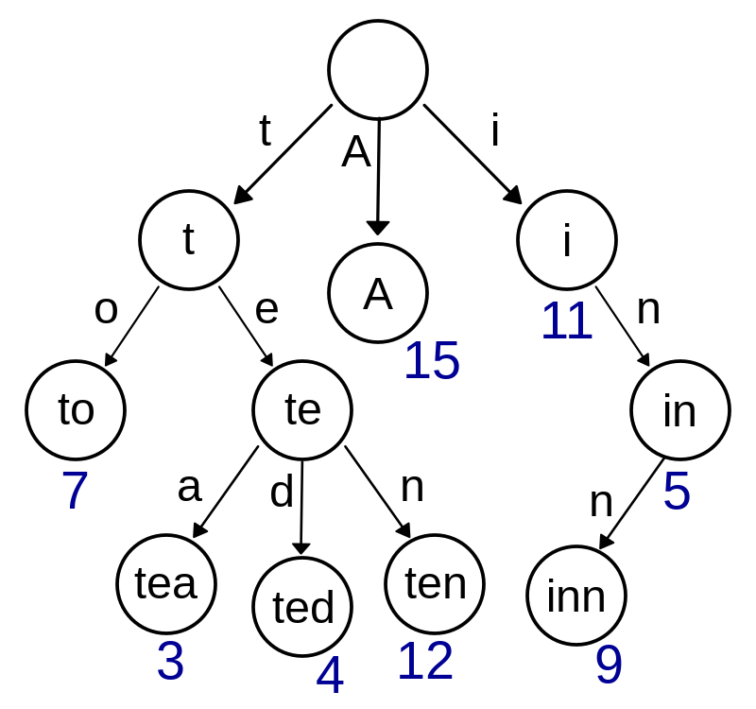
Dictionary based on Trie data structure.
TrieDictionary (Prefix Dictionary): This class implements a dictionary based on the Trie data structure. It extends the abstract class AbstractDictionary and implements the IDictionary interface. The inner class TrieNode represents a Trie node. It implements the IEntry<String, V> interface, which means that each Trie node has a key of type String and a value of type V. Data storage is done using key prefixes. Overall, TrieDictionary provides fast data access, especially in situations where keys have a common prefix. Compared to other data structures like hash tables, Trie often proves to be efficient for dictionary search, insertion, and deletion operations.

Slide 6
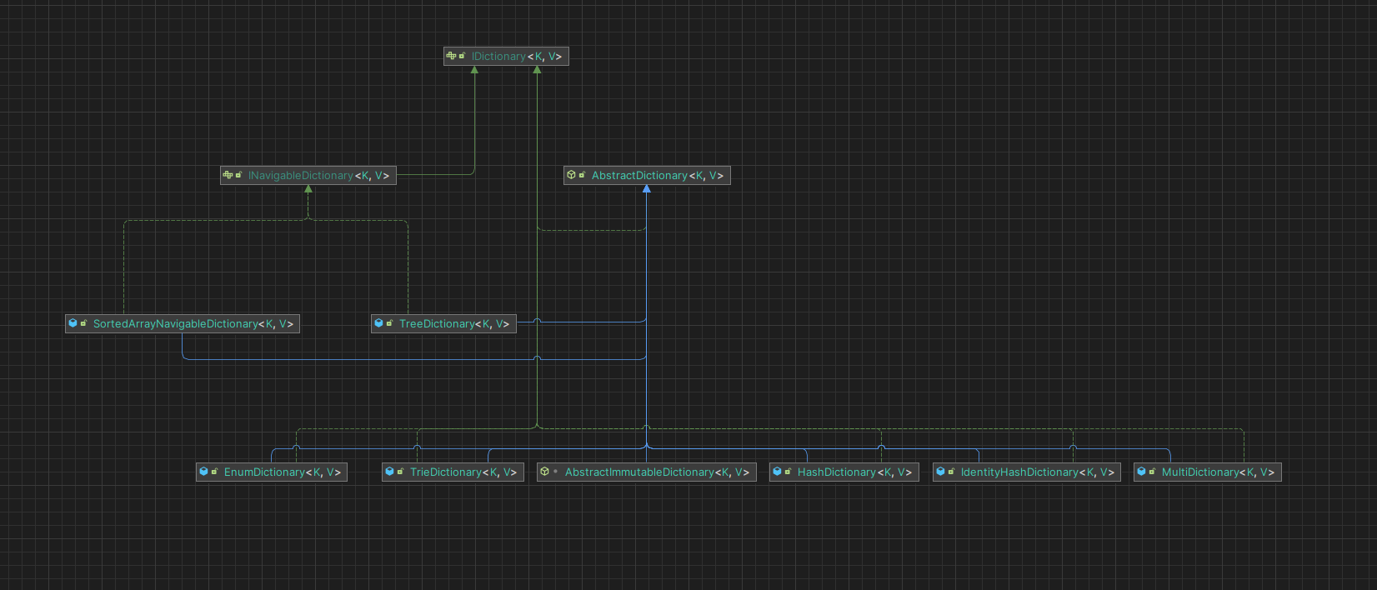
Overall dictionaries classes diagram

Slide 7
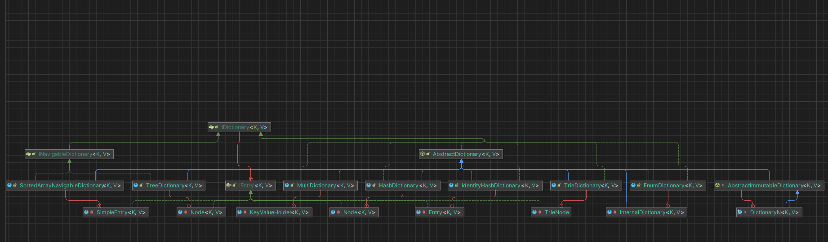
Overall dictionaries with inner classes diagram

Slide 8
Thanks for attention!

