Slide 1
Coursework
Maze generation
Yahudin Kostiantyn

Slide 2
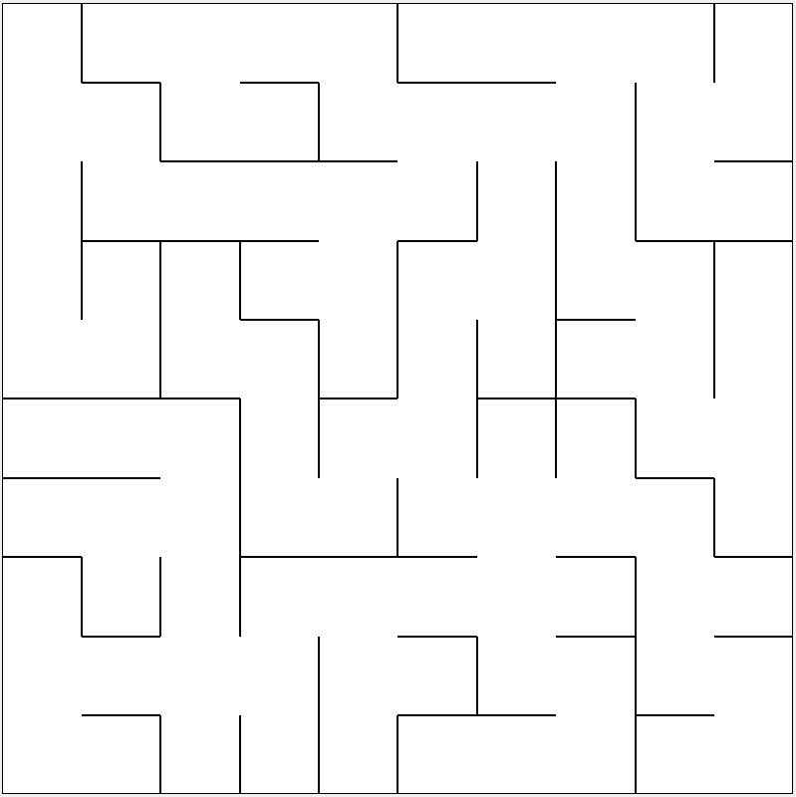
Definition of the perfect maze
A maze where every point is reachable and where there is only one single path from one point in the maze to any other point is called a perfect maze.

Slide 3
Kruskal’s algorithm for maze generation
Kruskal’s algorithm is a method for producing a minimal spanning tree from a weighted graph. The algorithm I’ll cover here is actually a randomized version of Kruskal’s that works like this:

Slide 4
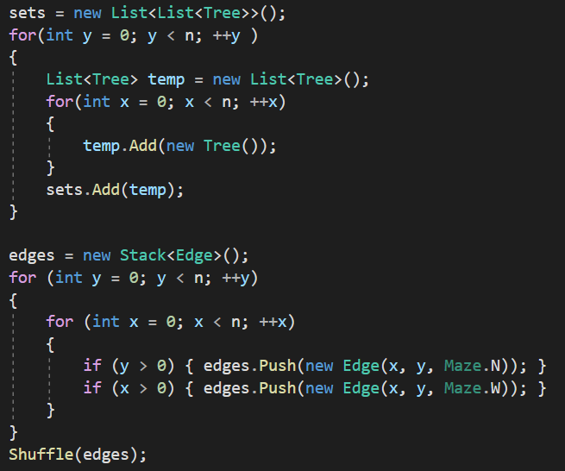
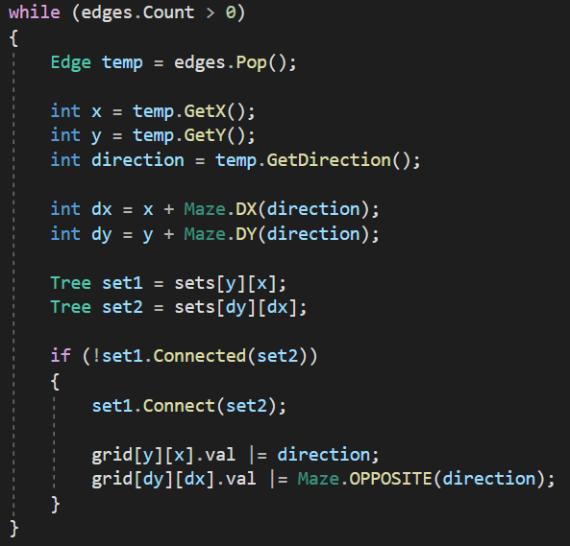
Kruskal’s algorithm implementation

Slide 5
BFS algorithm with path tracing for finding path in the maze
BFS is an algorithm for searching a tree data structure for a node that satisfies a given property. It starts at the tree root and explores all nodes at the present depth prior to moving on to the nodes at the next depth level.

Slide 6
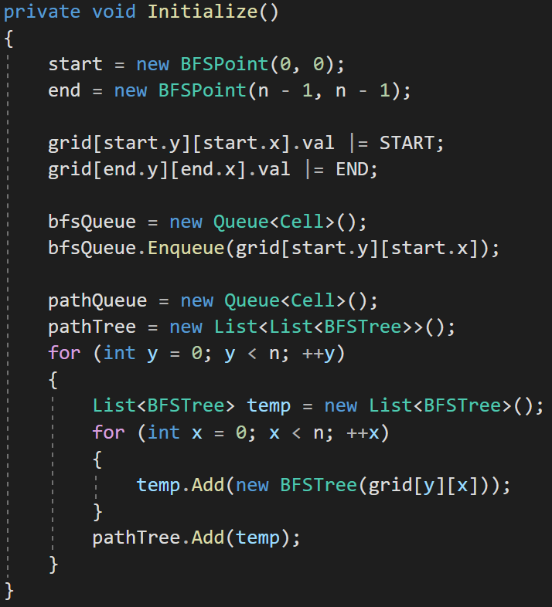
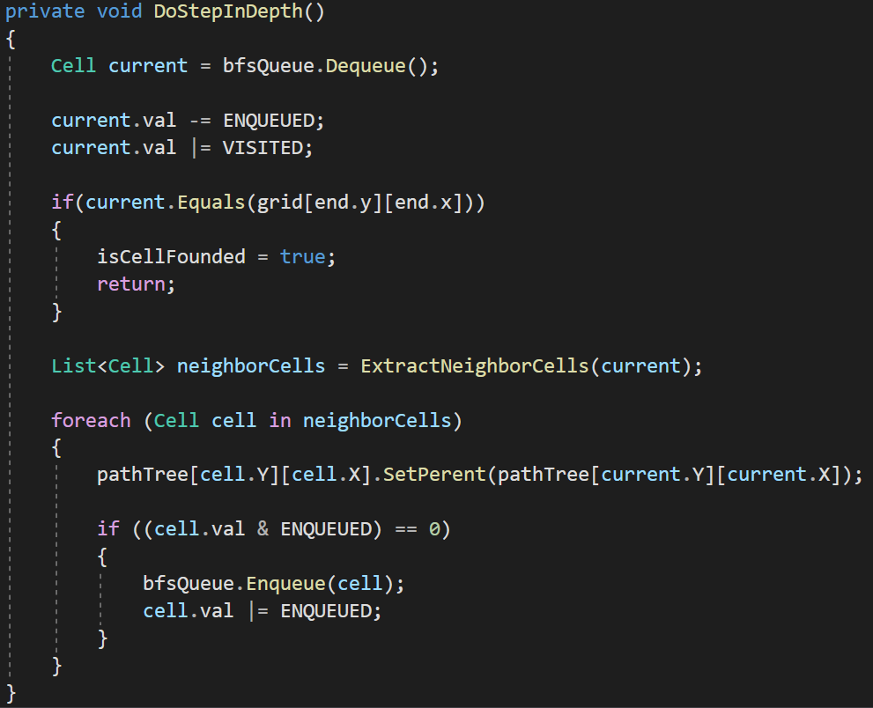
BFS algorithm implementation

Slide 7
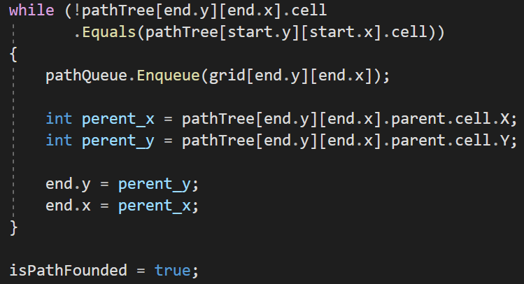
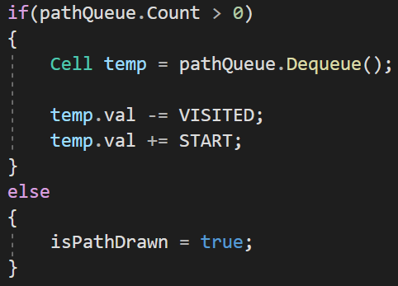
BFS building founded path

Slide 8
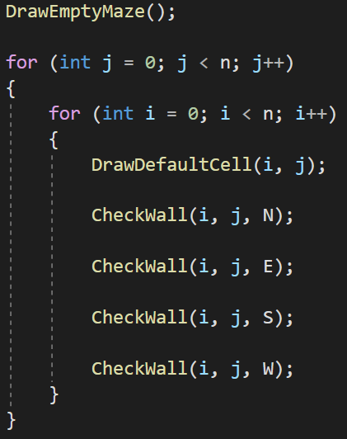
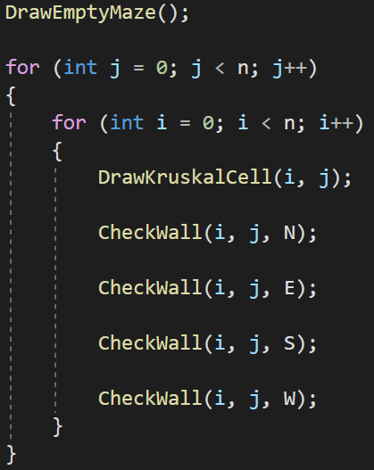
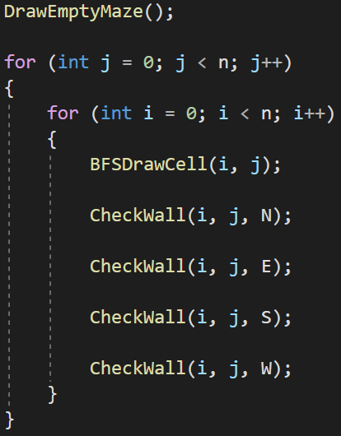
Animating
All algorithms have same logic in animating their work there are tree methods (Draw, Animate, Finish). The main method is Draw() it is responsible for drawing current state of maze. This method draws empty maze and then checks every wall for each cells in the maze. The only difference between Kruskal's and BFS implementation is logic in DrawCell() method.
Default implementation
Kruskal’s implementation
BFS implementation

Slide 9
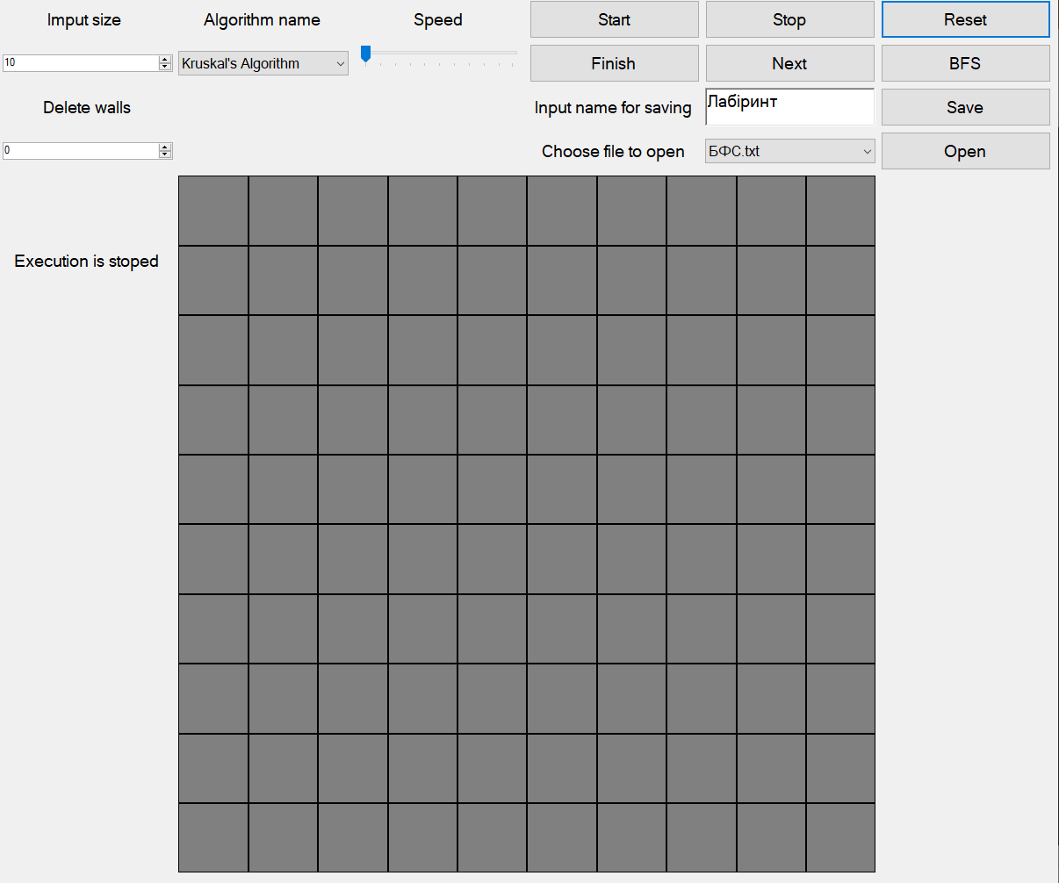
User interface
User interface is simple and nice to use, it has several input fields and buttons to control execution of algorithms.
Speed of the animation
Input size of the maze
Execution controlling buttons
Amount of additionally deleted walls
Saving configuration

Slide 10
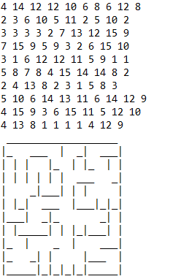
Save format
Mazes save in format convenient for both user and program. We separately save status of every cell and image of maze.

Slide 11
Thanks for attention, have nice experience of using the program.

