Slide 1
New words
Guess what the word means

Slide 2
Spare parts
Extra parts

Slide 3
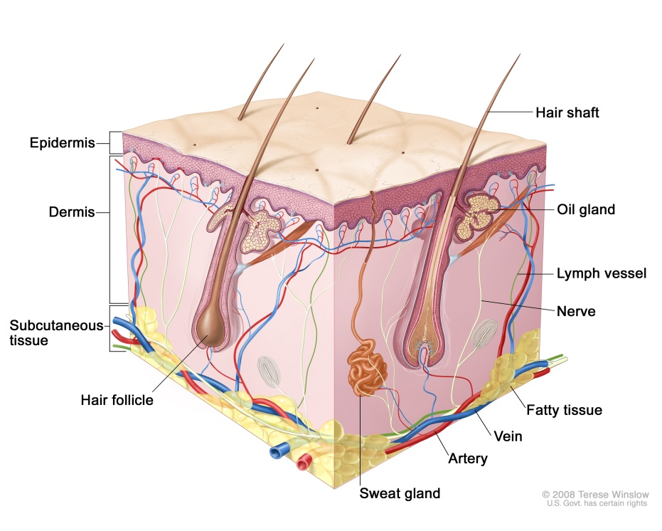
Skin tissue

Slide 4
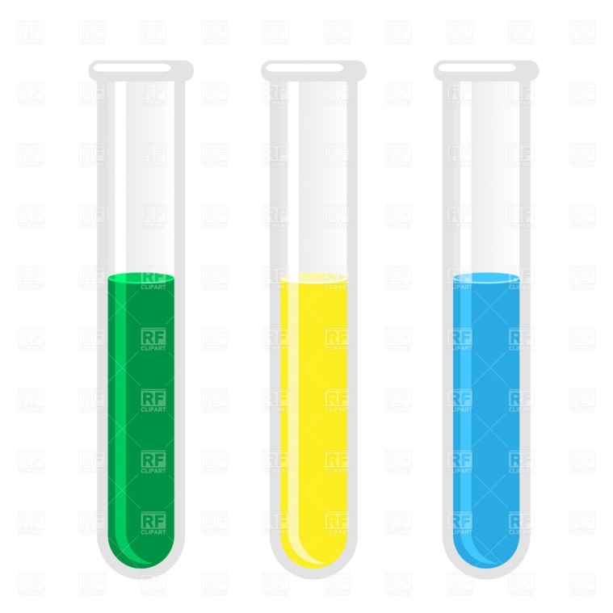
Test tube

Slide 5
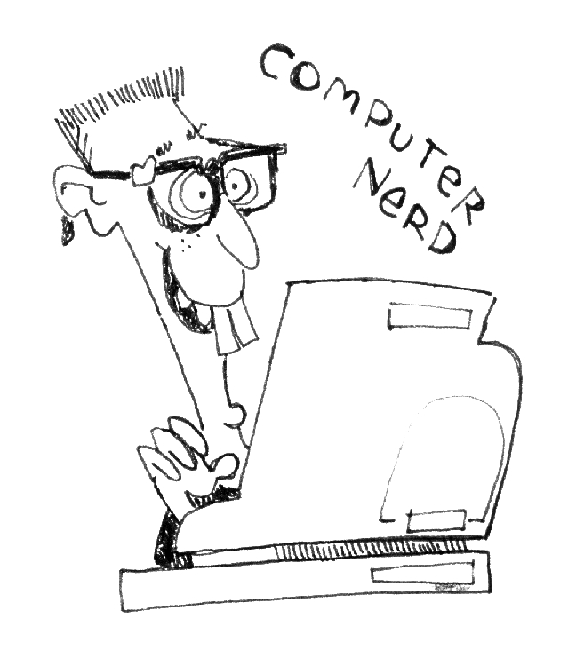
Computer nerd

Slide 6
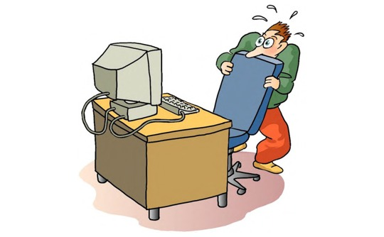
Technophobe

Slide 7
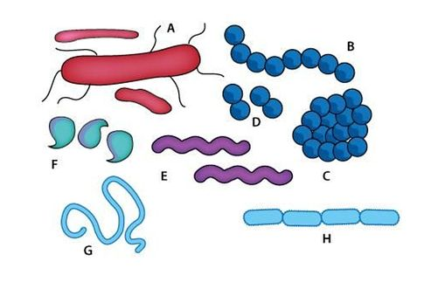
Strain (of bacteria)
Штамм

Slide 8
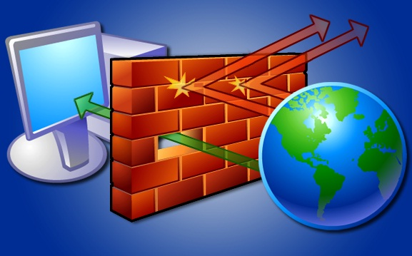
Firewall

Slide 9
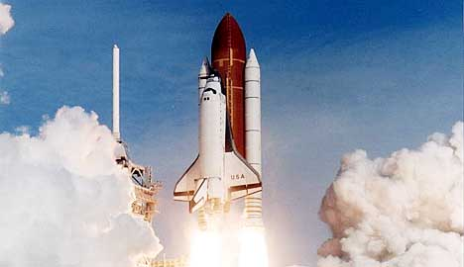
Shuttle

Slide 10

Feat

Slide 11
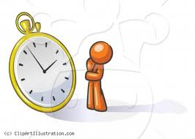
Life expectancy

Slide 12
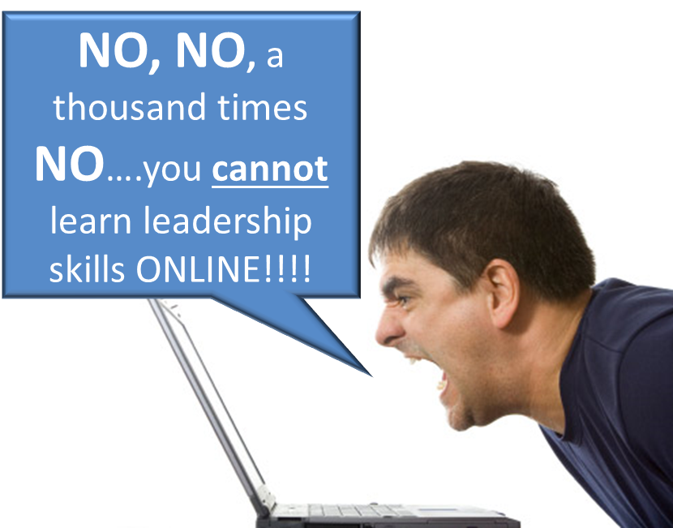
A resounding “no”

Slide 13
Mere mortal
Simple human, only a human, nothing else

Slide 14
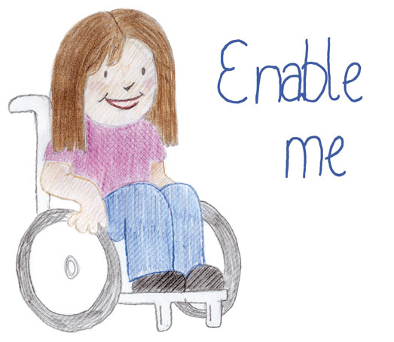
To enable
Give the ability to do something

Slide 15
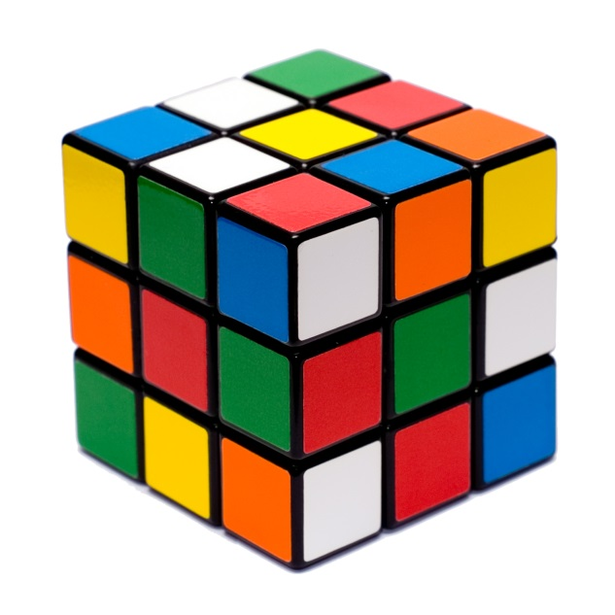
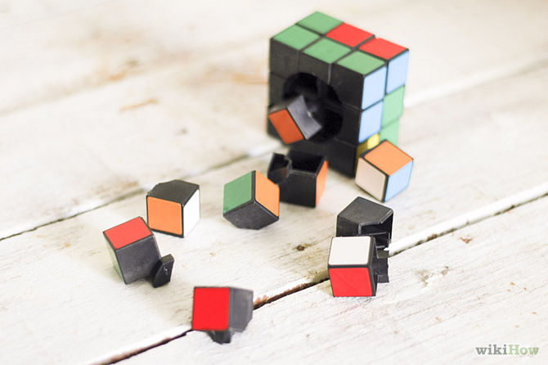

To reassemble
Put back together

Slide 16
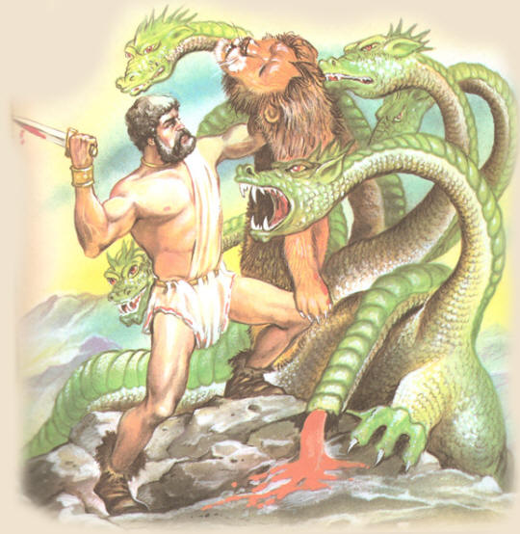
To regenerate
To grow back

Slide 17
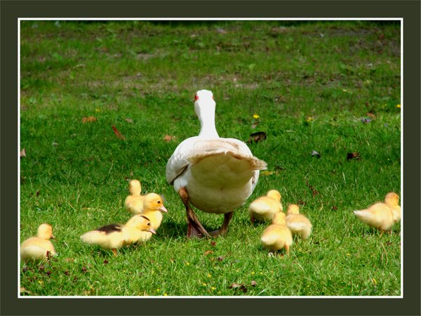
To pioneer
Lead the way to something new

Slide 18
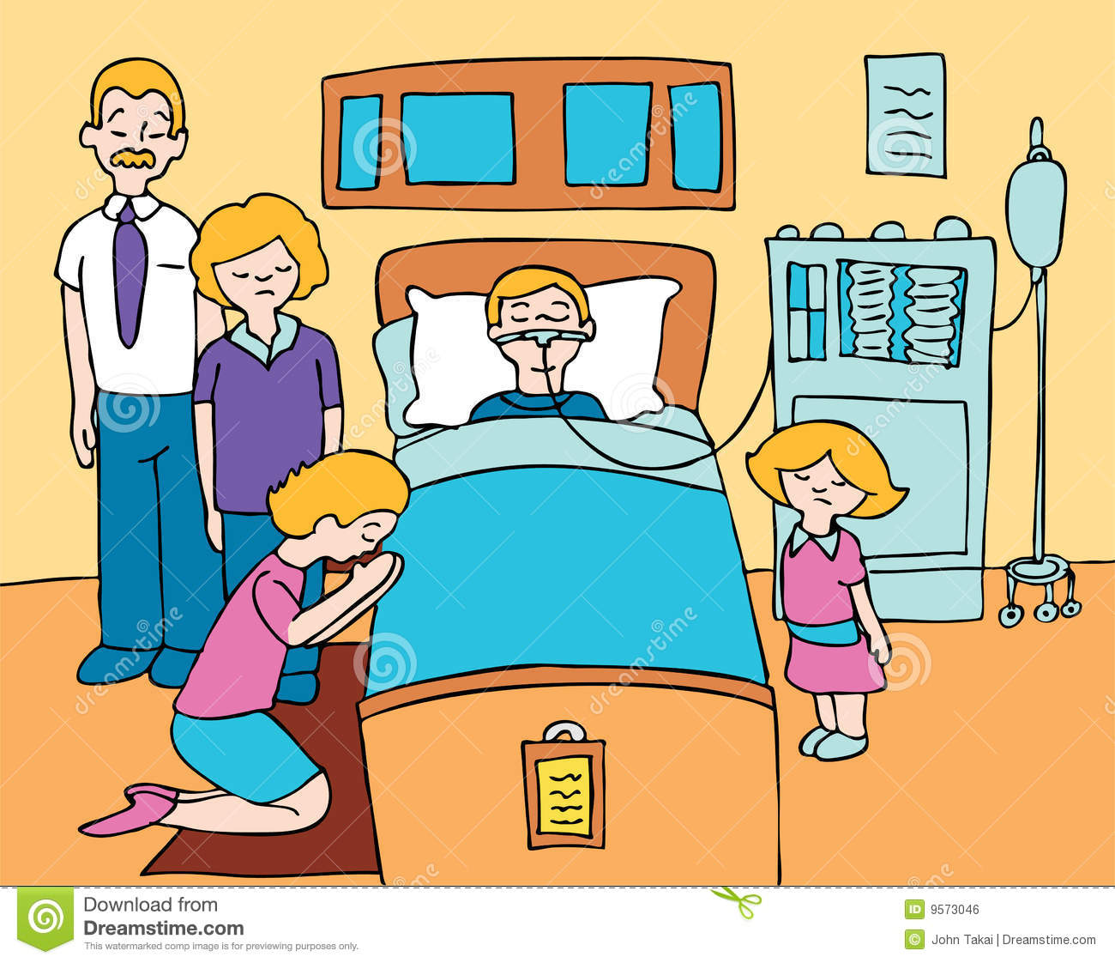
Terminally ill

Slide 19
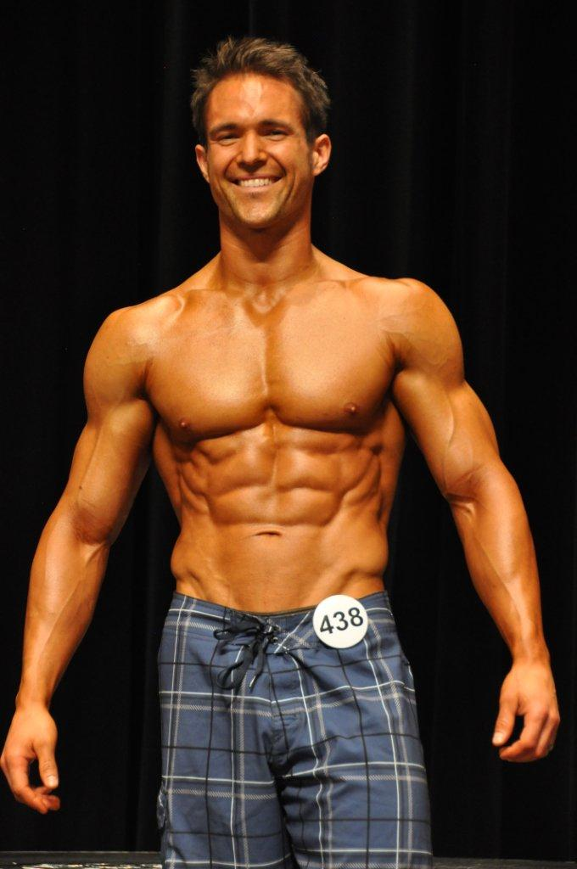
Physique
The form and structure of a person’s body

Slide 20
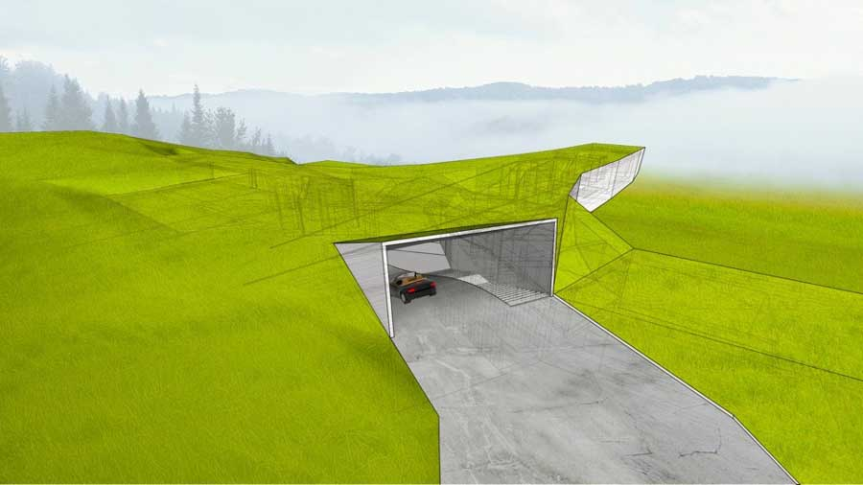
Hideaway
Hidden safe place where you can hide

Slide 21

Foreseeable future
Close future

Slide 22
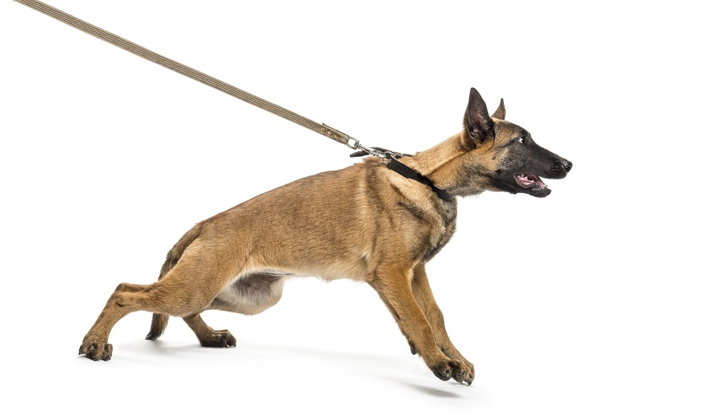
To restrain
To pull back

Slide 23
Fittingly
Appropriately, in a correct way

Slide 24
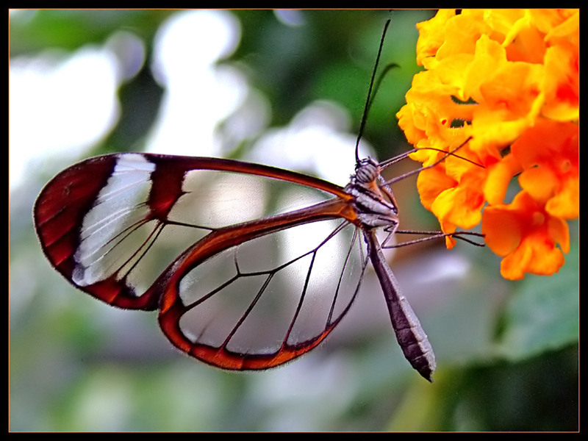
See-through
Transparent

Slide 25
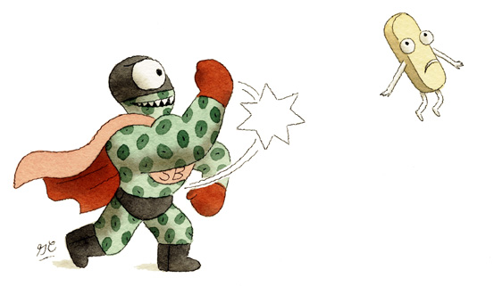
Superbug
A bacteria which is resistant to antibiotics

