Slide 1
April 22nd
Beta-secretase
Gamma-secretase

Slide 2
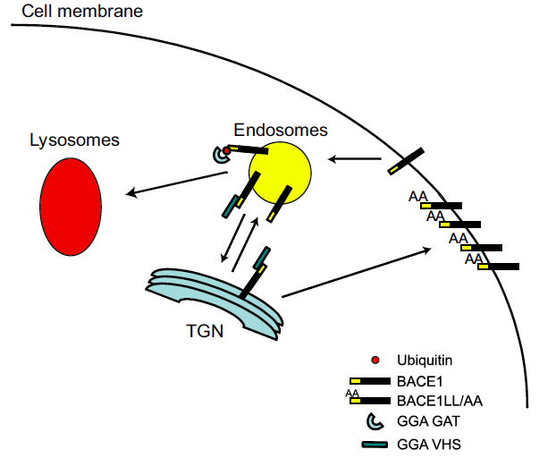
GGA proteins: a crucial role in the regulation
of BACE trafficking and degradation through BACE LL domain

Slide 3
Do GGA3 and BACE levels change during neurodegenerative pathologies

Slide 4
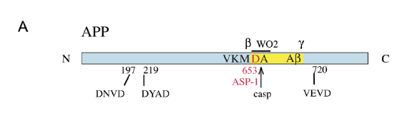
APP contains caspase cleavage sites in its sequence
Tesco et al., Neuron. 2007 Jun 7;54(5):721-37.
However, although apoptosis increases C99 and Aβ levels, this effects do not depend on caspase-mediated cleavage of APP (Tesco et al., 2003).

Slide 5
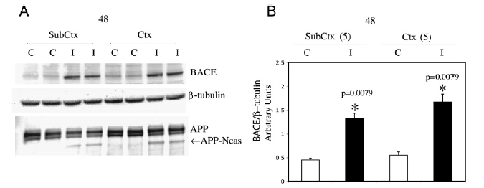
Ischemic patients have increased levels of BACE
in the brain…
Tesco et al., Neuron. 2007 Jun 7;54(5):721-37.

Slide 6
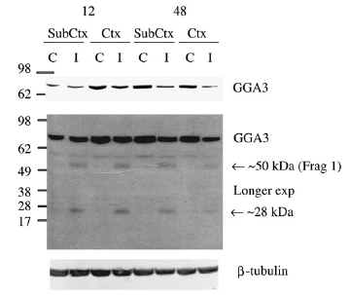
…and decreased levels of GGA3
Tesco et al., Neuron. 2007 Jun 7;54(5):721-37.

Slide 7
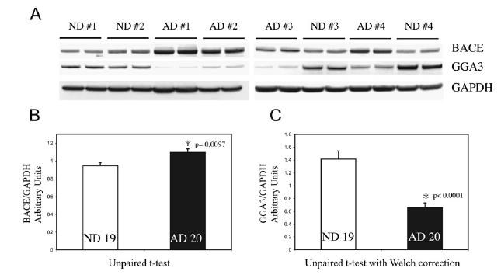
AD patients have increased levels of BACE
and decreased levels of GGA3 in the brain…
Tesco et al., Neuron. 2007 Jun 7;54(5):721-37.

Slide 8
What happens during apoptosis?

Slide 9
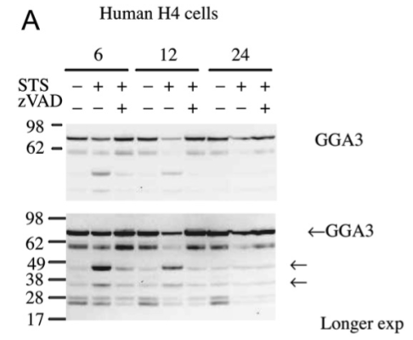
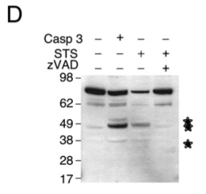
During apoptosis GGA3 levels are destabilized
Tesco et al., Neuron. 2007 Jun 7;54(5):721-37.

Slide 10
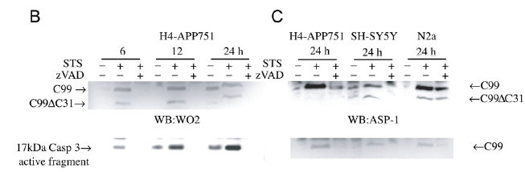
Apoptosis increases levels of C99…..
Tesco et al., Neuron. 2007 Jun 7;54(5):721-37.

Slide 11
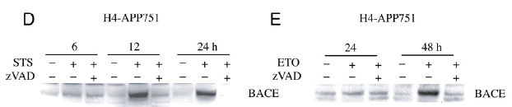
…and BACE
Tesco et al., Neuron. 2007 Jun 7;54(5):721-37.

Slide 12
Apoptotic mechanisms associated with neurodegeneration stabilize BACE via the inhibition of GGA3, therefore inhibiting GGA3-mediated BACE degradation

Slide 13
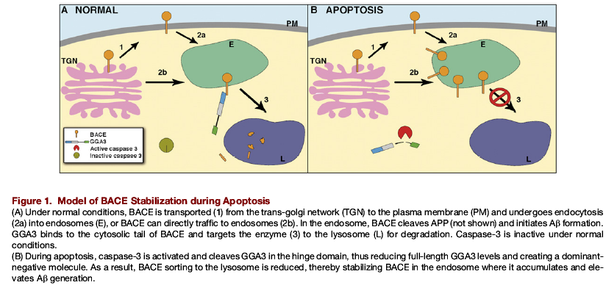
Model of BACE stabilization during apoptosis
Vassar, Neuron. 2007 Jun 7;54(5):671-3. Review.

Slide 14
β-secretase :
possible therapeutic targets in AD?

Slide 15
Could BACE be considered as a therapeutic target for AD?
In favor:
1- BACE is the primary β-secretase aspartyl protease that cleaves APP generating β-amyloid species (secondary role of BACE2)
2-BACE KO mice DO NOT have amyloidogenic processing of APP
Against:
1-BACE^{+/-} heterozygous mice do not show altered production of β-amyloid and APP C-terminal fragments
2-BACE cleaves a number of other substrates, including
*Amyloid Precursor Like Proteins APLP1 and APLP2
*Low-density lipoprotein receptor (LDLR)-related protein LRP
Thus, targeting BACE for the treatment of AD would result in loss of BACE activity towards the other substrates, with possible consequences on their physiological function.

Slide 16
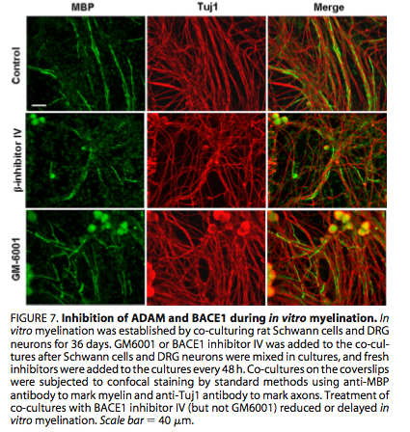
BACE inhibition reduces or delays myelination in vitro
BACE inhibitor
ADAM inhibitor

Slide 17
Thus reducing BACE levels (or activity) may lead to neurodegeneration as side effect

Slide 18
γ-secretase complex and the phenomenon of
INTRAMEMBRANE PROTEOLYSIS

Slide 19
The γ-secretase complex
-PS1 and PS2: 7- to 8- transmebrane domain proteins, are the catalytic unit of the γ-secretase complex (they will cleave the substrates).
-Nicastrin: a type 1a transmembrane protein, approximately 130kDa molecular weight, binds to active PS1, and can sort to the plasma membrane with PS1. Nicastrin has a large extracellular domain crucial for the identification of the substrate.
-APH1: (antherior pharinx defective phenotype). Its knockout leads to developmental deficit in C.elegans. It is required for the correct localization of the mature form of nicastrin at the cell surface.
Pen2: (presenilin enhancer 2). Stabilizes mature presenilin and nicastrin.
The gene knockout for one of any protein of the complex will result in lack of γ-secretase activity.

Slide 20
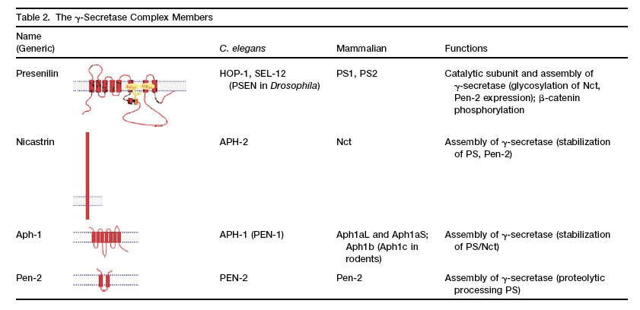
The members of the γ-secretase complex
Bart Der Strooper

Slide 21
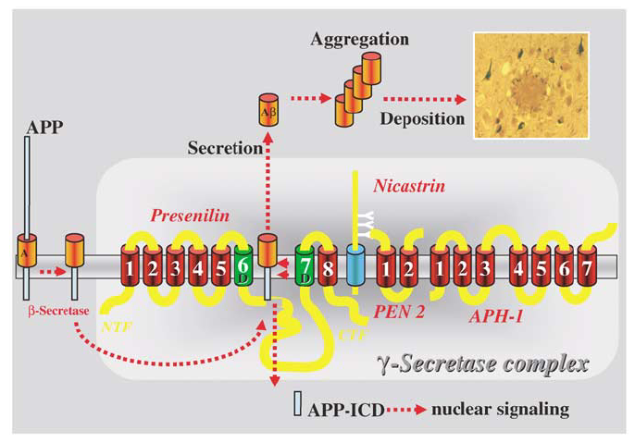
Model for intramembrane proteolysis
Christian Haass

Slide 22
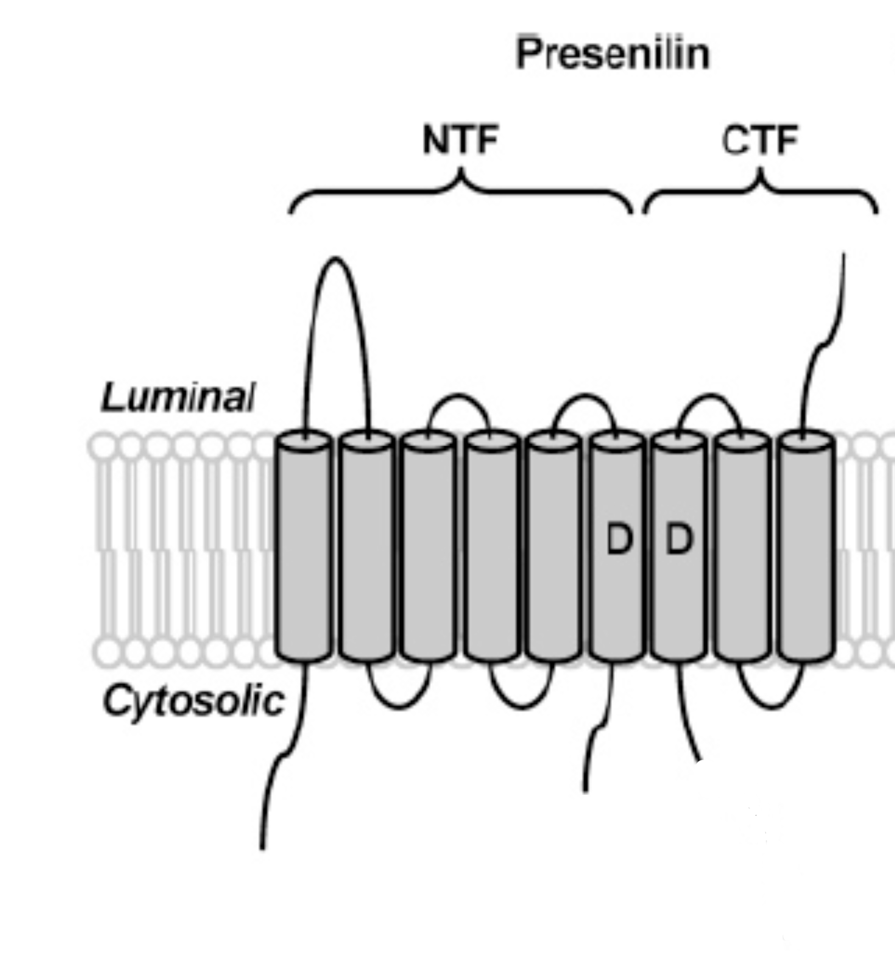
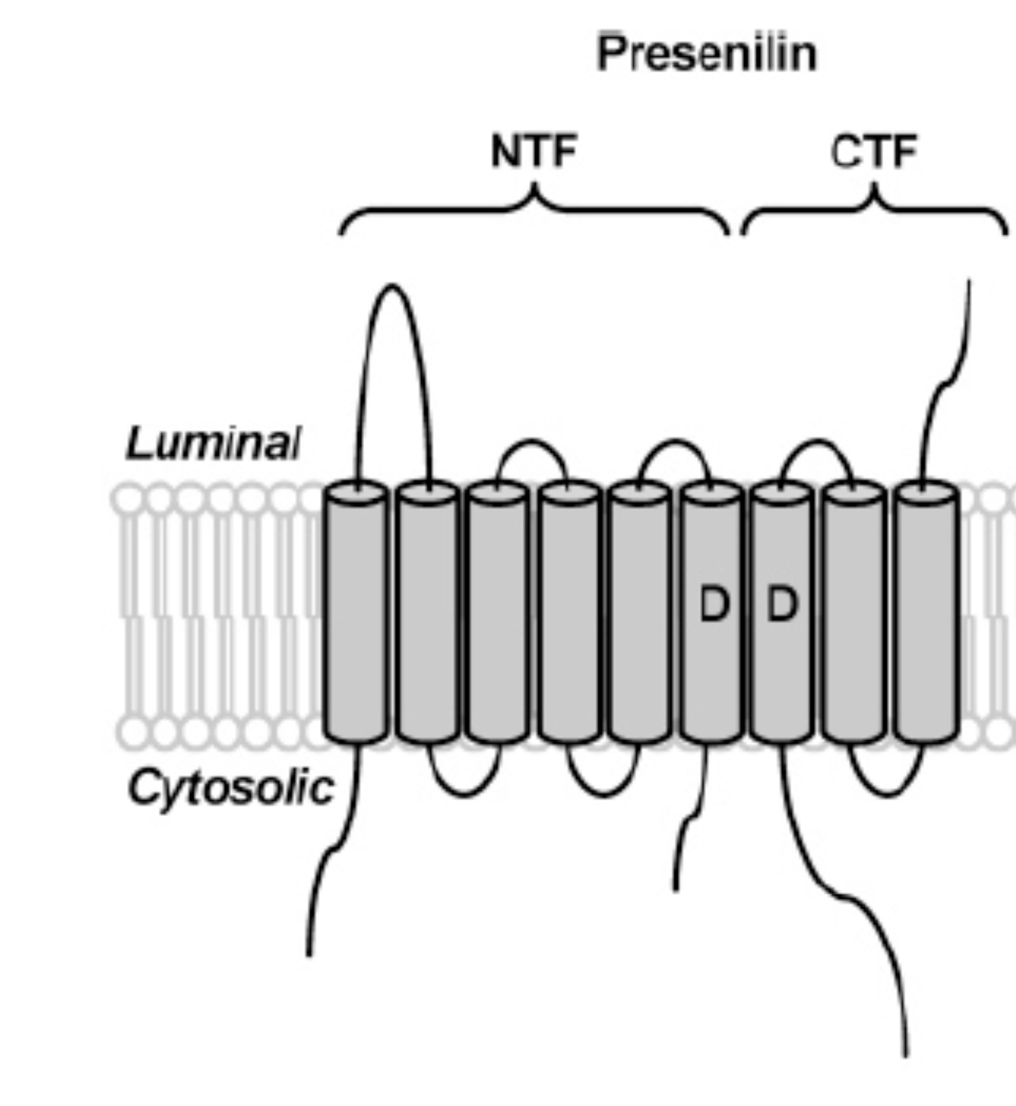
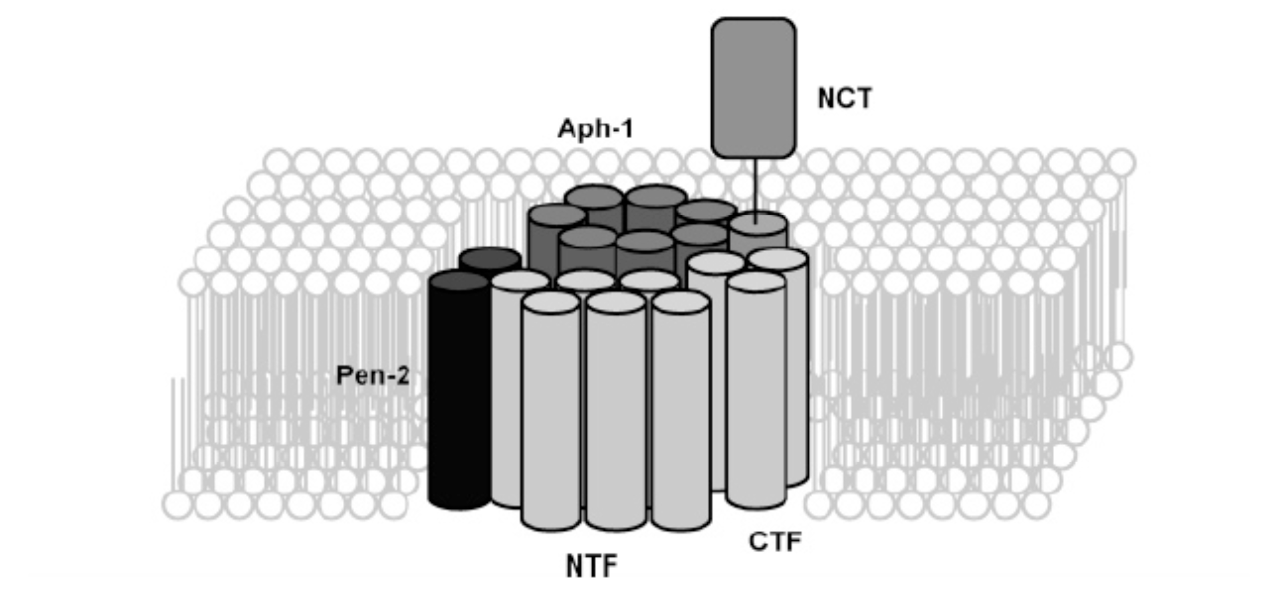
Presenilin: an active heterodimer in the γ-secretase complex
The Regulated Intramembrane Proteolysis
Loop domain
Loop domain
Endoproteolysis
H2O, substrates
Modified from Michael Wolfe

Slide 23
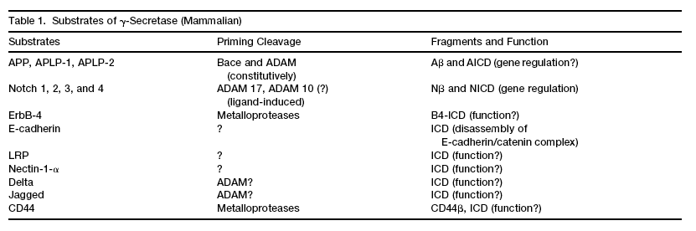
γ-secretase cleaves different substrates
Bart De Strooper

Slide 24
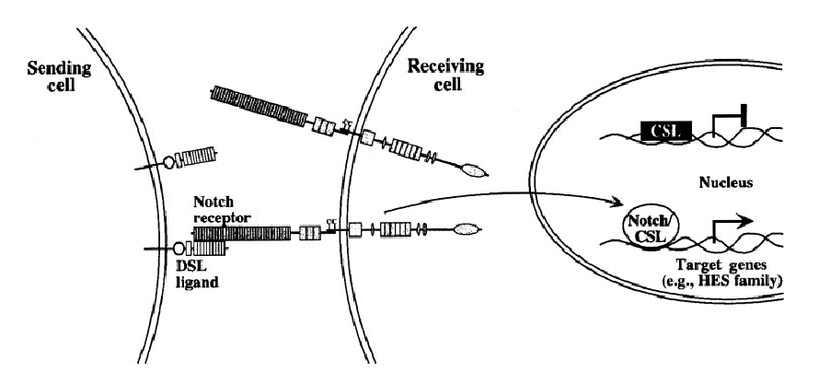
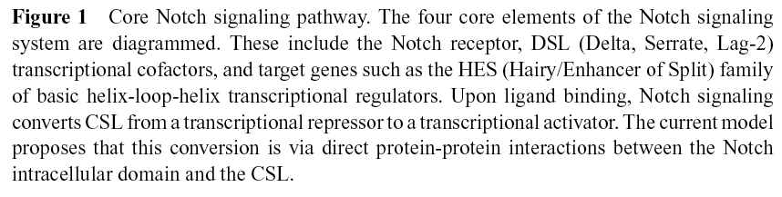
Notch is a protein regulating transcription of proteins crucially involved during early and late stages of development
Selkoe and Kopan

Slide 25
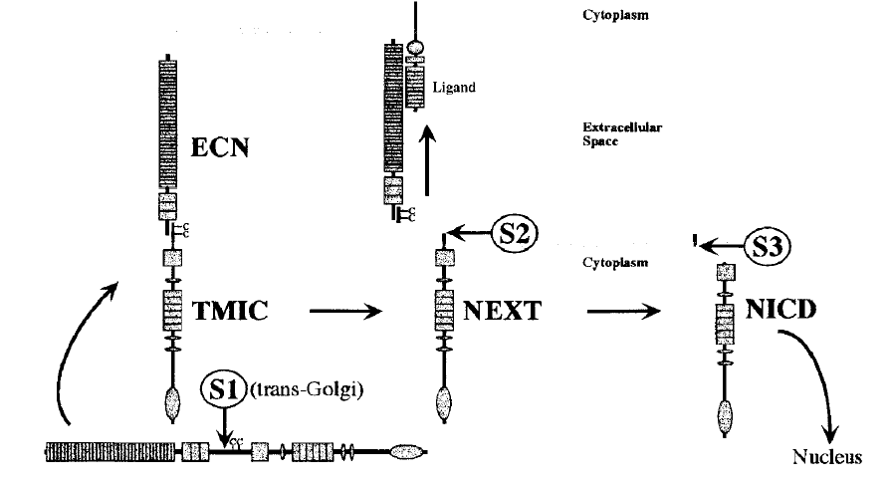
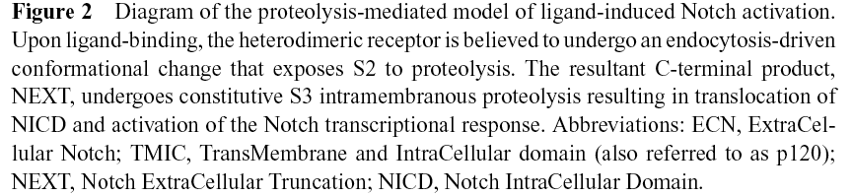
Like APP, Notch is processed via α- and γ-secretase, while trafficking within the cell
At the plasma membrane
α-secretase
After endocytosis
γ-secretase
Selkoe and Kopan

Slide 26
Why gamma-secretase acts downstream of beta-secretase in the generation of Abeta peptides?

Slide 27
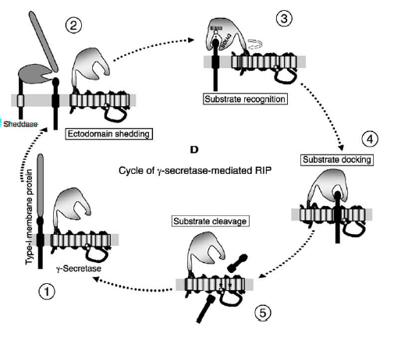
Mechanism by which Nicastrin participates in the “Regulated Intracellular Proteolysis” RIP
BACE
β-secretase
Steps:
1-The substrates gets in close proximity with the γ-secretase complex (i.e. after internalization from the plasma membrane).
2-Nicastrin specifically recognizes the substrate, and binds to it.
3-Presenilin (PS1) cuts the substrate within the exposed sequence (in the case of APP will be the Aβ sequence).
Shah et al.,

