Slide 1
April 6th
Abeta peptides and oligomers

Slide 2
The β-amyloid plaque
1- β-amyloid is DIFFERENT from amyloid. β-amyloid contains specifically the β-amyloid peptide, an approximately 4kDa peptide (Aβ40, Aβ42) deriving from APP.
2- The β-amyloid peptide is insoluble in water. When released from the precursor protein it assumes a β-sheet conformation that makes it hydrophobic.
3- β-amyloid peptides forms oligomers are toxic and will further aggregates into fibrils, forming the core of the β-amyloid plaque.
4- The size of the plaque will increase following the progression of the disease.
Cause or consequence or a cause of AD?

Slide 3
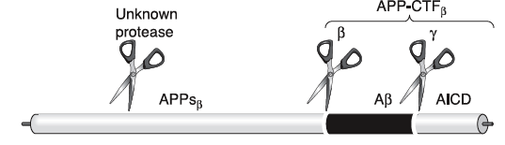
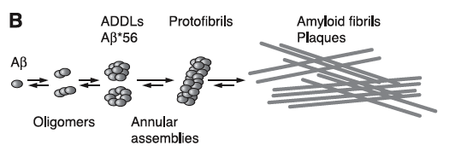
APP processing and formation of aggregates of beta-amyloid

Slide 4
Amyloidogenic processing of APP
β−secretase
γ−secretase
APP
TMD
NH₂
COOH
β−secretase
sβAPP
C99
NH₂
COOH
γ−secretase
Aβ

Slide 5
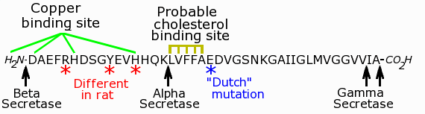
Structure of the β-Amyloid peptide
25-35, the most critical region for the change of conformation from α-helix to β-sheet

Slide 6
Genetic of AD
-Depending on the kind of mutation and on the gene that carries it, the onset of the disease occurs SIGNIFICANTLY EARLIER than in sporadic cases (<before 65 years of age).
All the mutations are autosomal dominant, and involve
*APP protein
*Members of the γ-secretase complex, like Presenilin 1 (PS1) and Presenilin 2 (PS2)

Slide 7
Mutations on APP
Swedish mutation: K670M/N671L, facilitates the amyloidogenic processing of APP by increasing the affinity for and the cleavage by β-secretase of ~100 times.
Dutch Mutation: E693Q, induces cerebral amyloidosis.
Arctic Mutation:E693G enhances β-Amyloid protofibril formation.
London Mutation: V717I, Affects the cleavage of γ-secretase.
K670M/N671L
V717I
London Mutation
E693G
Arctic Mutation
Swedish Mutation

Slide 8
Amyloidogenic processing of APP
!!!β−secretase!!!
!!!γ−secretase!!!
APP
TMD
K670M/N671L
V717I
E693G
NH₂
COOH
β−secretase
sβAPP
C99
NH₂
COOH
γ−secretase
Aβ

Slide 9
Amyloidogenic processing of APP
β−secretase
γ−secretase
APP
TMD
NH₂
COOH
β−secretase
sβAPP
C99
NH₂
COOH
γ−secretase/mutantPS1
Aβ

Slide 10
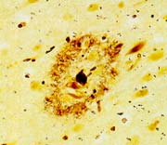
The β-Amyloid Plaque
Alois Alzheimer: “miliary bodies (the plaques) and dense bundles of fibrils (NFT)”

Slide 11
Characteristic of the β-amyloid plaque
-is extracellular
-normally, it has a core composed of the β-amyloid peptide
-it can be cored (with an intensely stained core with a weak periphery stain-halo) or diffused, which do not have a core and the immunoreactivity is uniform over the plaque.
-aggregation is massive in the center, and diffused at the sides (disaggregation hypothesis?)
-diameter ranges between 20μm and 90μm
-is composed of dystrophic neurites, β-amyloid peptides (40/42/43), ubiquitin, tau protein and other proteins, some involved in the generation of β-amyloid, like the secretases.

Slide 12
Amyloid: definition
Insoluble fibrous protein aggregations sharing specific structural traits:
-Insolubility in water
-β-sheet conformation
-largest aggregates deposit extracellularly
-positive to the staining with specific dyes, such as Congo Red
-associated with tissue degeneration (cause or consequence?)
β-Amyloid
Are formations of amyloid formed by β-amyloid peptides.

Slide 13
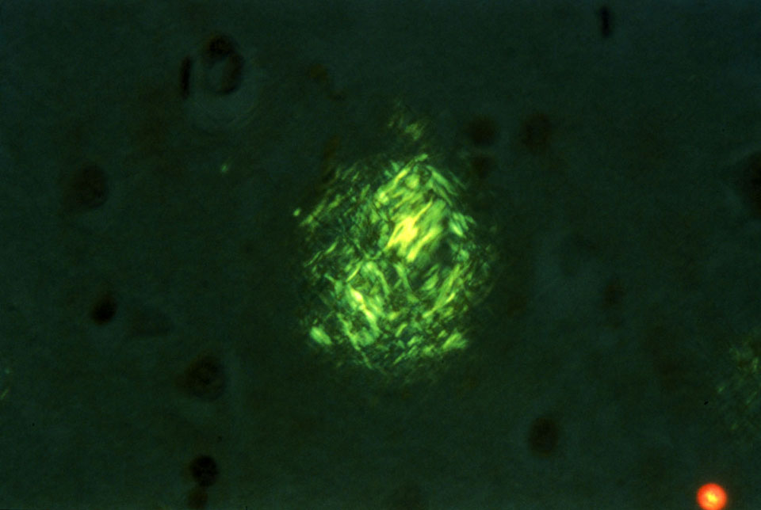
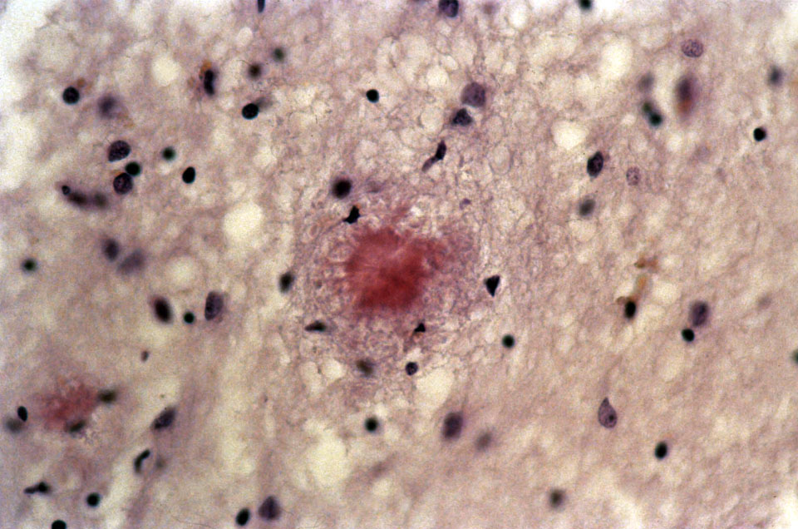
Congo red staining of amyloid plaques
Under polarized light
Under unpolarized light

Slide 14
Can we identify the presence of beta-amyloid plaques for diagnostic purposes?
Pittsburg Compound B versus antibodies specific for β-Amyloid peptides, Aβ 1-40, Aβ 1-42, Aβ 1-43

Slide 15
Antibodies specific for β-Amyloid peptides, Aβ 1-40, Aβ 1-42, Aβ 1-43 for diagnostic purposes
?

Slide 16
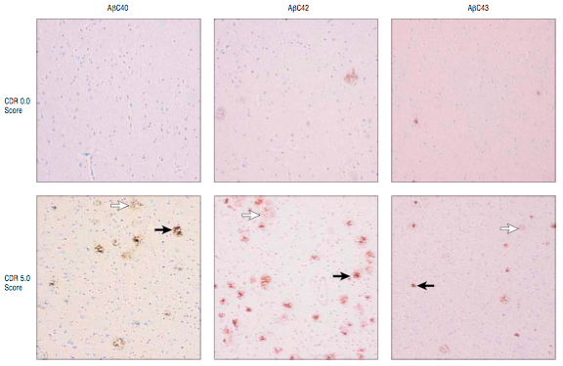
β-Amyloid plaques deposition follows the progression of AD

Slide 17
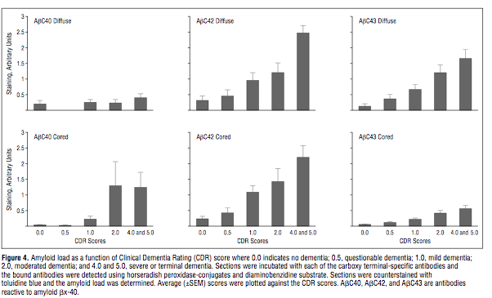
Levels of deposited Aβ40, Aβ42 and Aβ43 follow the progression of the disease

Slide 18
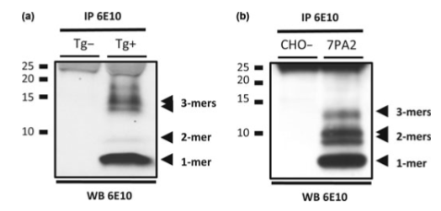

Aβ Oligomers

Slide 19
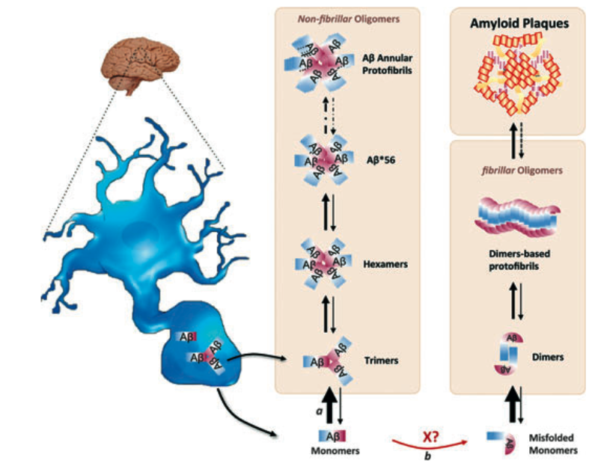
Aβ: Secretion and aggregation into oligomers

Slide 20
Where are Abeta peptides formed?
At an intracellular level, either in late endosomes, ER or in lipid rafts

Slide 21
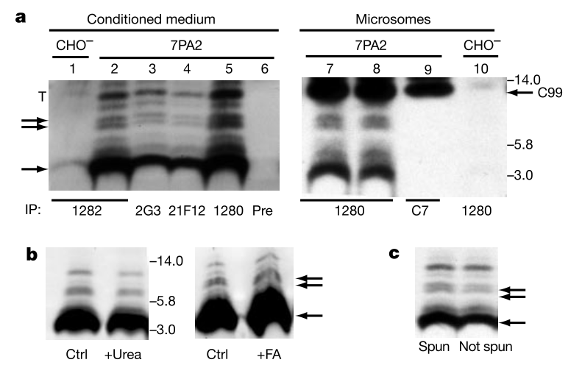
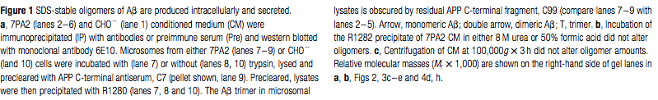
Aβ Oligomers are produced intracellularly and are secreted

Slide 22
How can Aβ peptides reach the extracellular space to form the plaque?
2 hypothesis:
1- Secretion. Aβ peptides are not retained at the phospholipidic membrane, can be secreted in an hydrophilic environment such as the cytosol or the extracellular medium. In vitro, Aβ40 is very well harvetsed in the medium of cultured cells, very low levels of Aβ42 are detectable.
2-Formation of toxic aggregates in the cell. Aβ peptides, formed within the cell, tend to form aggregates (Aβ oligomers) which may have toxic properties and may lead cell death. Intracellualr material including the Aβ aggregates will be released from the cell, and can now be available in the extracellular space to form the core of the plaque.

Slide 23
WHO IS THE ENEMY TO FIGHT IN AD? Plaques or early Aβ formation and deposition?
This is a crucial point in the treatment of AD.

Slide 24
Evidences that Aβ oligomers-induced toxicity is an early event preceding plaque formation
-In humans, levels of cortical soluble Aβ correlate with cognitive decline
-In AD cerebral cortex, monomeric an stable Aβ oligomers (up to ~12kDa in SDS-PAGE).
-Similar oligomers have been detected in the hippocampus and cortex of humans in absence of amyloid plaques, and in many cases in absence of NFT (is Aβ pathology preceding tau pathology?).
-Transgenic animal models overexpressing double mutant forms of APP (Swedish and a modified London mutation, Val717Phe) develop cognitive and behevioral deficit months before the deposition of β-amyloid plaques.
-In neuronal cultures, cell derived soluble Aβ oligomers impair synaptic plasticity.

Slide 25
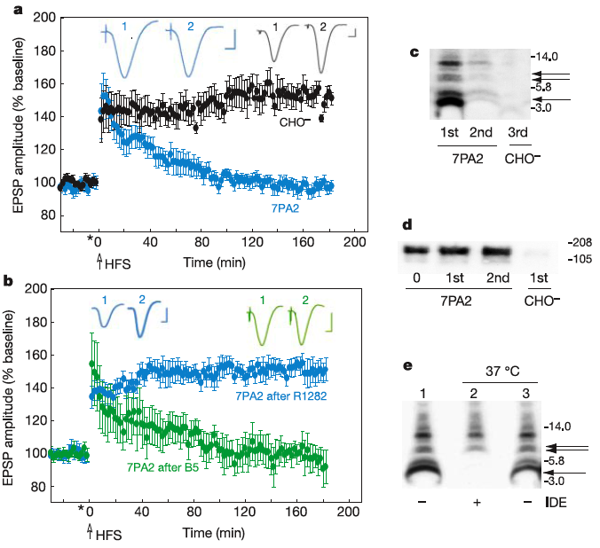
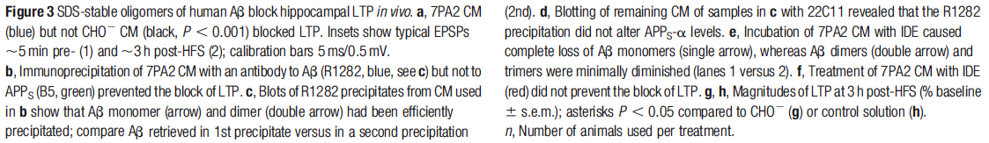
Aβ Oligomers block LTP in vivo
This effect can be reverted in presence of specific Aβ oligomer antibody

Slide 26
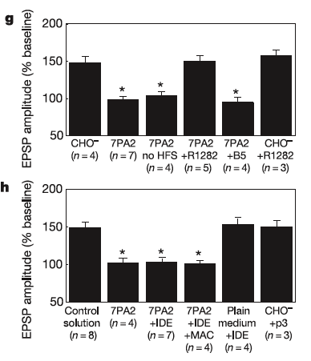
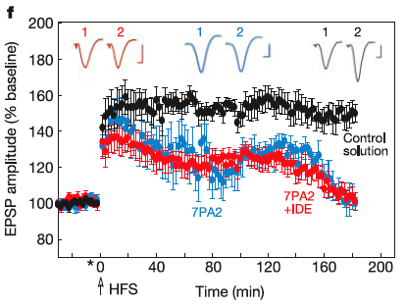

IDE degrades monomers, but NOT oligomers and
DOES NOT rescue LTP

