Slide 1
January 23rd
PROTEIN MISFOLDING, AGGREGATION AND NEURODEGENERATION

Slide 2
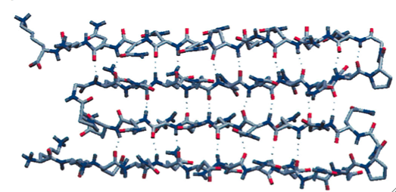
Deposition of fibrillar proteinacious material
in the intracellular or extracellular matrix
Amyloid: amyloid fibrils are filamentous, hydrophobic structures, width ~10nm, length between 0.1-10μM. Ribbon-like β-sheets motifs are formed by β-strands and β-turns. These kind of fibrils are common to different neurodegenerative diseases, from Alzheimer’s to Huntington’s disease.
NH2
COOH
Ross CA, Poirier MA. Nat Med. 2004 Jul;10 Suppl:S10-7. Review.

Slide 3
Aggregates as a consequence of protein misfolding
Toxic or protective? 100,000,000 $$$$$ question!!!
Different hypotheses in the different neurodegenerative diseases
AD: plaques, soluble Aβ, correlate with progression of the disease. However, Aβ oligomers seem to be the more toxic species.
PD: inclusion bodies do not follow the progression of the disease.
HD: aggregates may be present ONLY in surviving neurons.

Slide 4
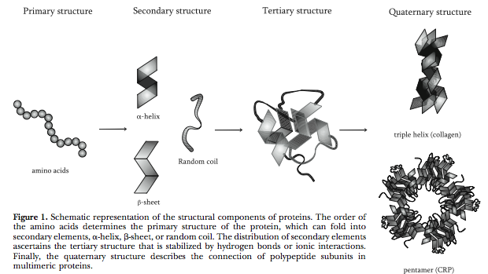
Proteins exists and are functional in a folded state

Slide 5
Protein Structure
Primary structure: amino acid sequence
Secondary structure: α-helix, β-sheet
Tertiary structure: overall shape of the protein; for example globular, fibrous, sheet-like
Quaternary structure: association with other proteins; for example dimers

Slide 6
Free energy: definition
In thermodinamics it is the amount of work that a system can perform.
In protein folding, it is the number of folding possibility.
The higher the number of folding possibility, the less stable the protein will be
In nature, proteins will fold so that they can reach the lowest level of free energy to remain stable

Slide 7
Principles of minimal frustration (Bryngelson et al. 1995)
The aminoacid sequence in a protein is chosen so that it can be very stable in its folded state

Slide 8
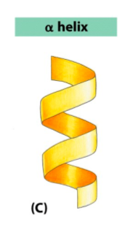
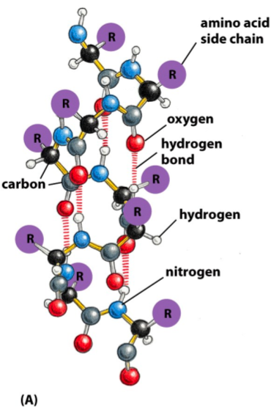
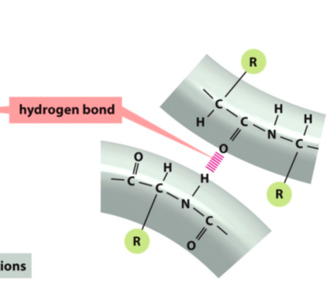
Secondary Structure: alpha-helix
Notes:
Dire che le side chains rimangono fuori

Slide 9
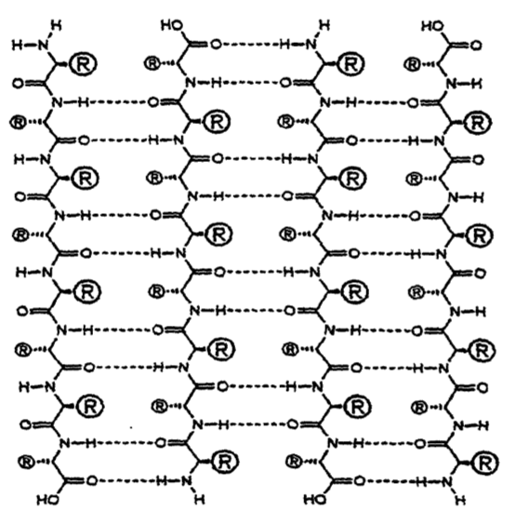
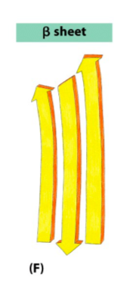
Secondary Structure: beta-sheet

Slide 10
Deposition of fibrillar proteinacious material
in the intracellular or extracellular matrix
Amyloid: amyloid fibrils are filamentous, hydrophobic structures, width ~10nm, length between 0.1-10μM. Ribbon-like β-sheets motifs are formed by β-strands and β-turns. These kind of fibrils are common to different neurodegenerative diseases, from Alzheimer’s to Huntington’s disease.
NH2
COOH
Ross CA, Poirier MA. Nat Med. 2004 Jul;10 Suppl:S10-7. Review.

Slide 11
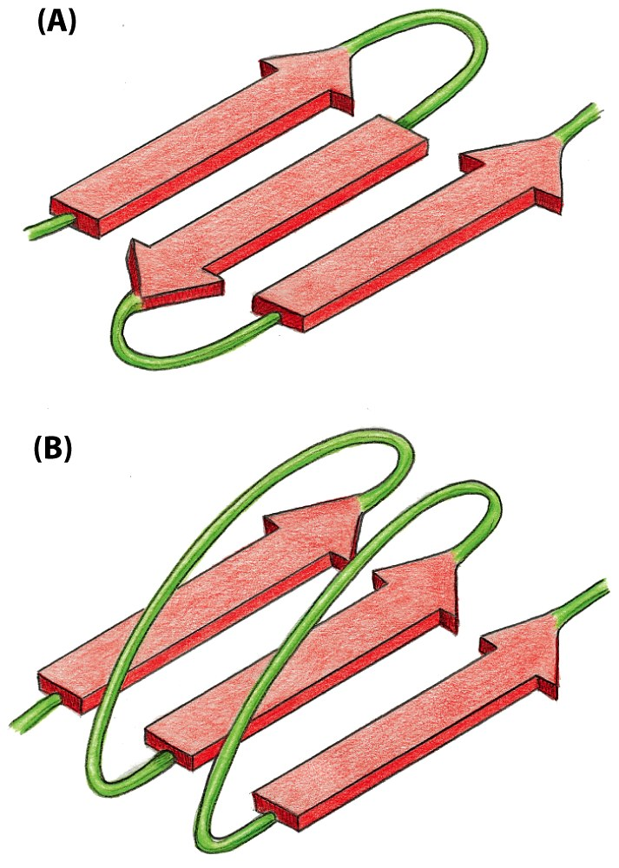
Beta-sheets alignments:
polypetide chains lying in certain direction
Rigid structure
Can occur within ≠ molecules
antiparallel
Insoluble Protein aggregates
parallel
Figure 4-14 4-15 Essential Cell Biology (© Garland Science 2010)

Slide 12
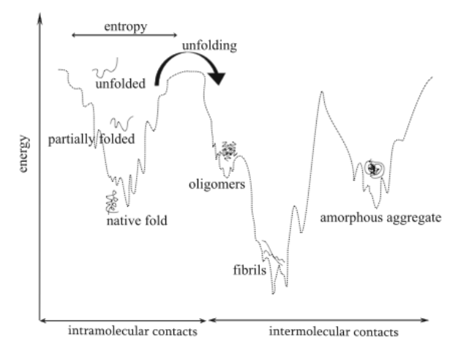
Thermodynamics of protein folding/misfolding
“The energy of the different conformations decreases with the development of organized, native-like proteins”.

Slide 13
Protein folding: a folding funnel to change the structure and the energy of proteins. Only folded, native proteins are functionally active.
Unfolded states: characterized by higher degree of conformational entropy and free energy than native states. This leads to “instability” of proteins when in the unfolded state. As the folding funnel proceeds, conformational entropy decreases as proteins have lower number of conformational states, as well as the free energy decreases. The minimum of the energy level of a protein is reached when it’s in its native/folded state.

Slide 14
Protein misfolding
A common and continuously happening phenomenon in the life of a protein
Denaturation: the process by which the native structure of proteins is disrupted. It results in the unfolding of the protein, which then loses the state of lower energy level.
The protein is then in a highly disorganized structure and tends to form aggregates to reduce the state of high energy, in a word to stabilize.

Slide 15
Steps that lead to formation of aggregates
Unfolding
Nucleation: when proteins attach REVERSIBLY to a growing core.
Aggregation: when proteins attach IRREVERSIBLY to the core forming larger aggregates. Aggregation can be triggered by hydrophobic residues in the sequence of the protein and by β-sheet structure. Amyloid is one of the forms of protein aggregates that occurs in nature, is very stable but its formation can be still reversible. This is not true, unfortunately, for most of the protein aggregates that are responsible of neurodegenerative diseases.

Slide 16
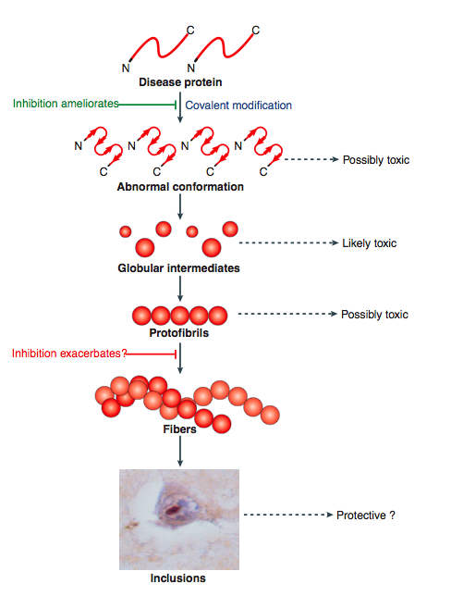
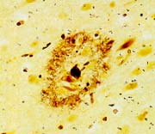
Proteins aggregate and amyloid/insoluble fibrils
Modifications
Early
Phosphorylation
TOXIC
Cleavage/proteolysis
pH
Metal chelation
Plaque
AD
INCLUSIONS PD
Late
Inclusions PD
Ross CA, Poirier MA. Nat Med. 2004 Jul;10 Suppl:S10-7. Review.

Slide 17
Factors that might influence protein denaturation and misfolding
-Mutations
-Glucose levels
-Oxidation
-changes in the physiological pH
-Binding to ions
-Levels/concentration of monomers: if low the protein tends not to aggregate, if high the protein tends to form aggregates

Slide 18
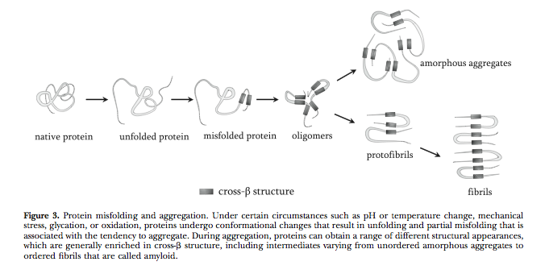
Schematic representation of protein misfolding

Slide 19
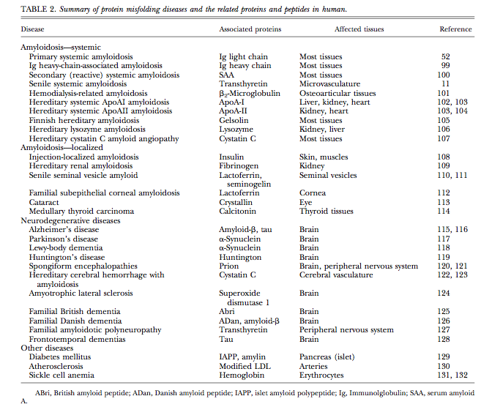
Summary of protein folding diseases

Slide 20
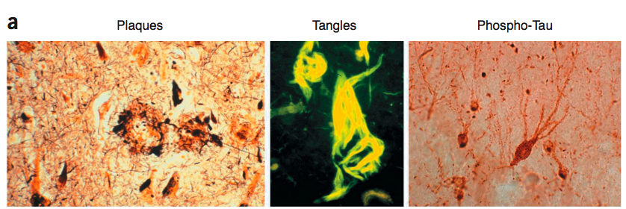
Deposition of fibrillar proteinacious material in Alzheimer’s disease
Alzheimer’s disease: characterized by extracellular depositions, the β-amyloid plaque, and intracellular depositions, the Neurofibrillary Tangles (NFT) comprised of Paired Helical Filaments (PHF), aggregates of hyperphosphorylated protein tau.
Bossy-Wetzel E, et al., Nat Med. 2004 Jul;10 Suppl:S2-9. Review.

Slide 21
Origin of β-amyloid and plaques:
Amyloid Precursor protein APP
APP
TMD
Aβ Oligomers Fibrils Plaques
Abeta levels as well as number and size of plaques increase with the progression of the disease
Origin of tau
Microtubule-associated protein that regulates cytoskeleton structure. When highly phosphorylated, tau is sequestered into PHF, and causes disruption of microtubules, leading to cell death.
ptau
PHF
Paired Helical Filaments
NFTs
Neurofibrillary tangles

Slide 22
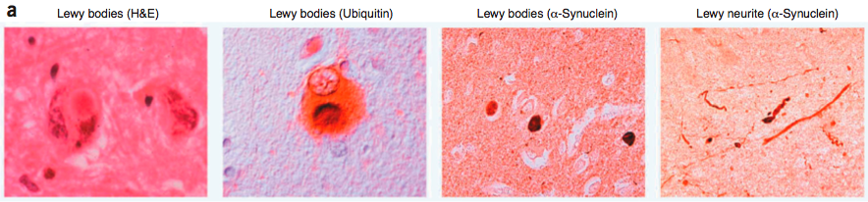
Deposition of fibrillar proteinacious material in Parkinson’s disease
Parkinson’s disease: characterized by dopaminergic neuronal loss and by intracellular depositions, the Lewy bodies, comprised of α-synuclein and ubiquitin, as the major components. Other components are proteasome and cytoskeletal proteins and other proteins that interact with α-synuclein.
Bossy-Wetzel E, et al., Nat Med. 2004 Jul;10 Suppl:S2-9. Review.

Slide 23
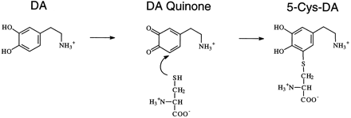
How α-synuclein is involved in Lewy bodies formation
Oxidation of Dopamine and subsequent interaction with α-synuclein or with Cys residues on different substrates: first step to the formation of
protofibrils
O₂
α-synuclein
on Tyr, Met or Lys
+ H₂O₂ + O₂⁻
Long-lived protofibrillar intermediate

Slide 24
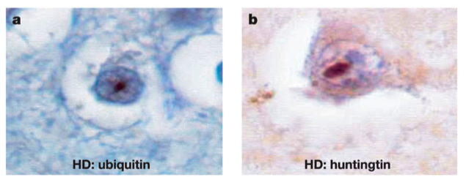
Deposition of fibrillar proteinacious material
in Huntington’s disease
Huntington’s disease: a progressive neurodegenerative disease characterized by CAG repeats causing glutamine expansion motifs (polyQ) in the N-terminal region of the protein huntingtin. Onset of the disease inversely correlates with the number of CAG repeats. In the HD, huntingtin forms intracellular inclusion bodies, containing material of cellular origin.
Ross CA, Poirier MA. Nat Med. 2004 Jul;10 Suppl:S10-7. Review.

Slide 25
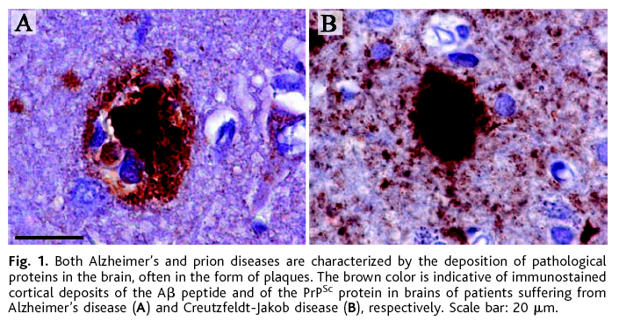
Deposition of fibrillar proteinacious material
in Creutzfeldt-Jakob’s disease (Prion’s disease)
Prion’s disease: neurodegenerative disorder caused by prions, via environmental stimuli or genetic mutations. Alterations in the prion protein lead to both intracellular and extracellular accumulation of amyloid aggregates, plaques, similar to those characteristic of AD, and positive to prion protein staining. Probably, replication and accumulation of the protease insensitive PrP^{sc} results in fibril formation and plaque deposition.
Alzheimer’s
Creutzfeldt-Jakob’s

Slide 26
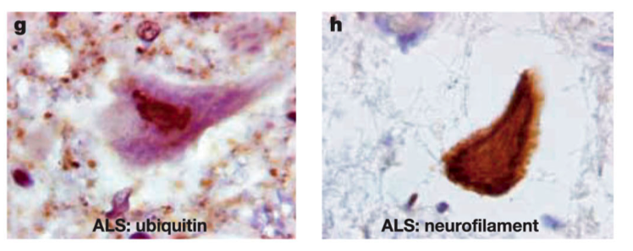
Deposition of fibrillar proteinacious material
in Amyotrophic Lateral Sclerosis (ALS)
ALS: a progressive fatal disease caused by the degeneration of lower motor neurons in the lateral horn of the spinal cord and the upper motor neurons of the cortex. Insoluble cytoplasmic inclusions are observed in the brain of ALS patients. These inclusions are composed also of SOD1 protein and ubiquitin.
Ross CA, Poirier MA. Nat Med. 2004 Jul;10 Suppl:S10-7. Review.

Slide 27
Common cellular pathways involved in the formation of insoluble aggregates
Many of them are related to aging, or can be triggered by particular toxins or by loss-of-function or gain-of-function protein mutants.
1- Mitochondrial dysfunction and increased oxidative stress, increased production of ROS
2-Decreased chaperones and proteasomal activity
3-Decreased protein degradation

