Slide 1
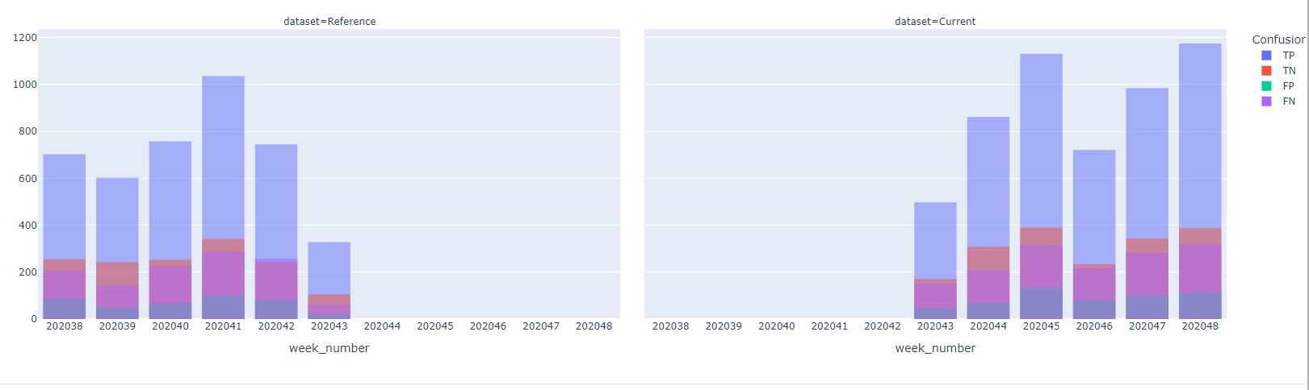
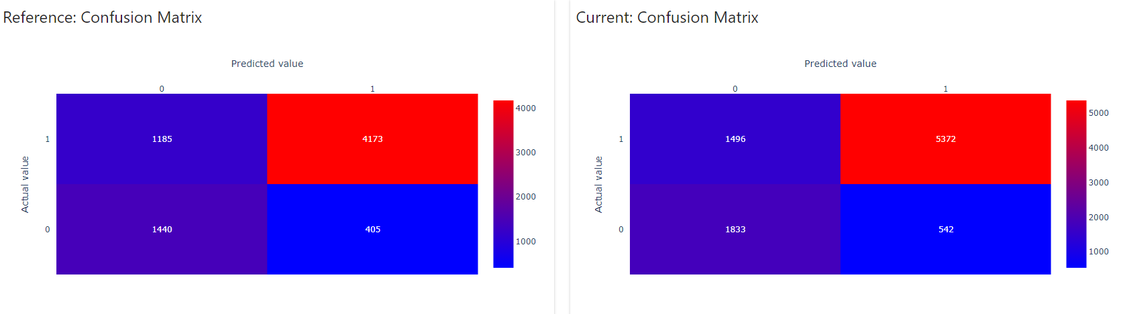
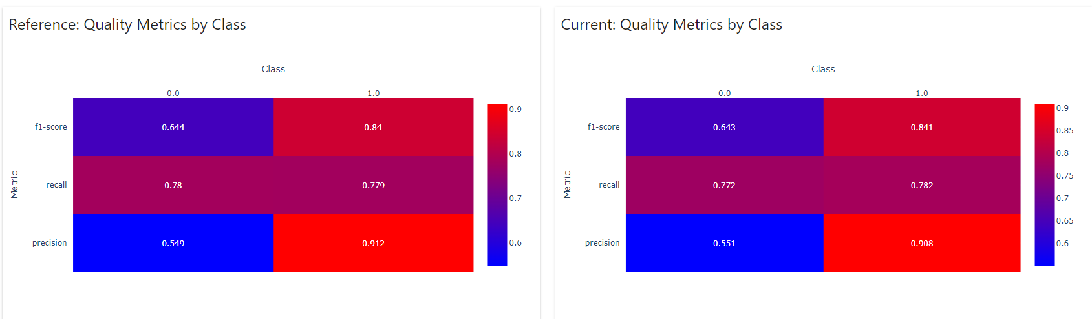
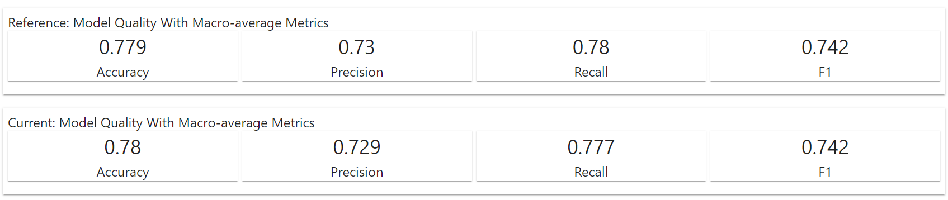
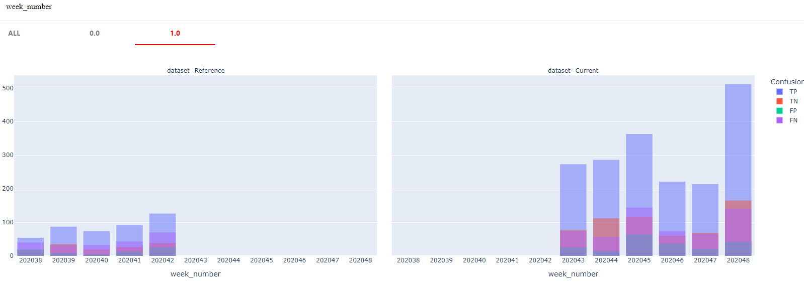
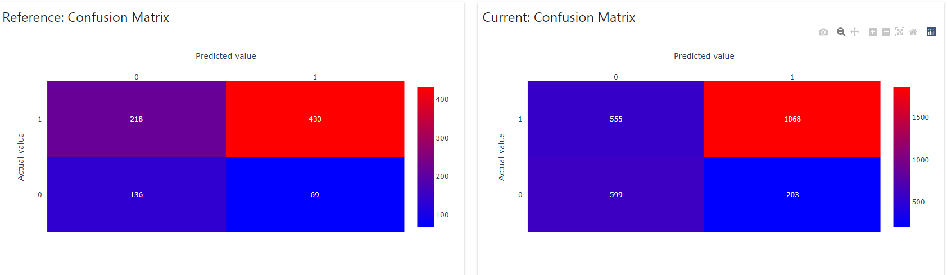
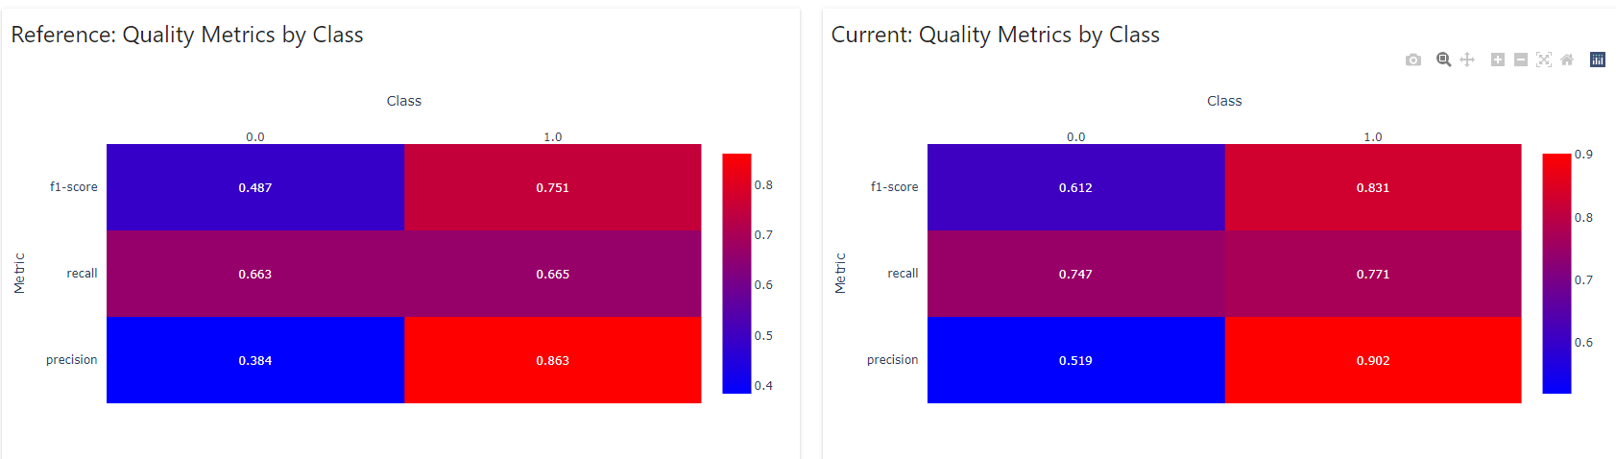
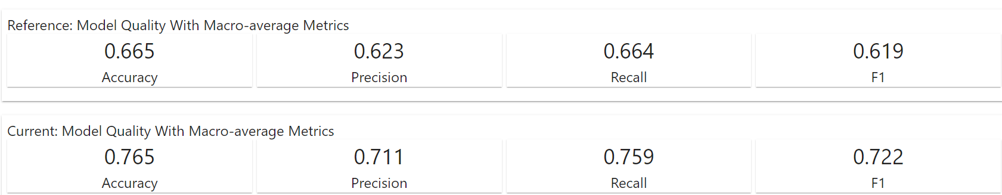
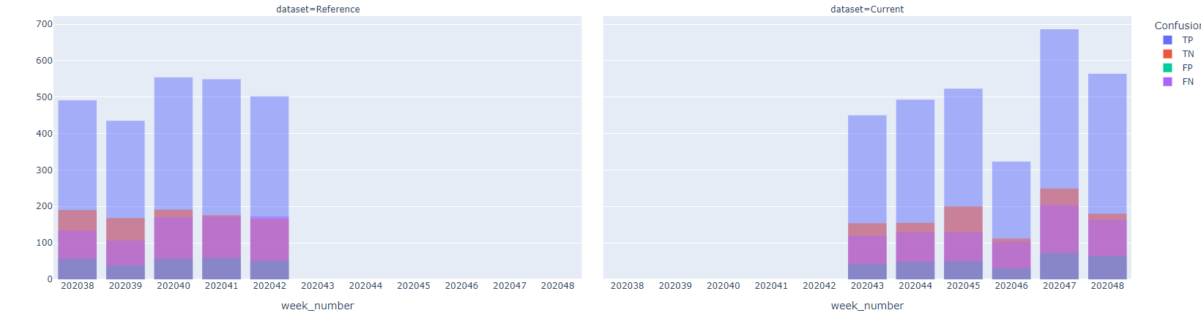
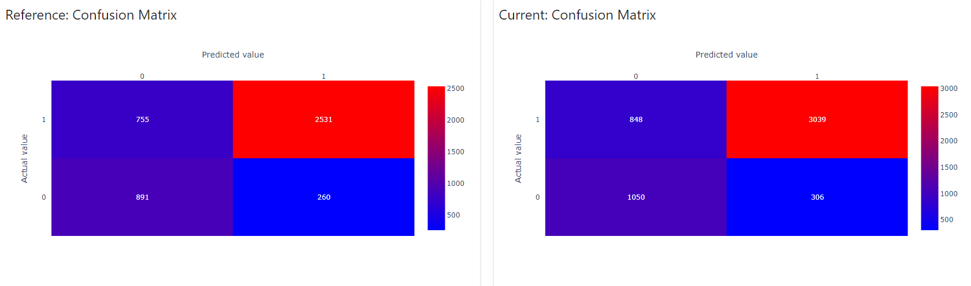
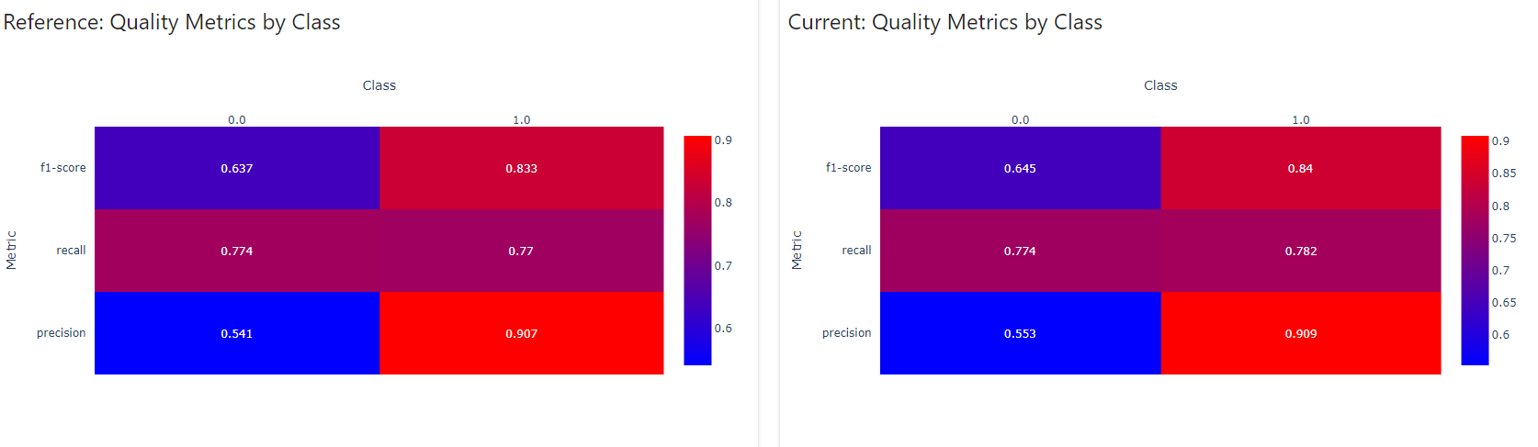
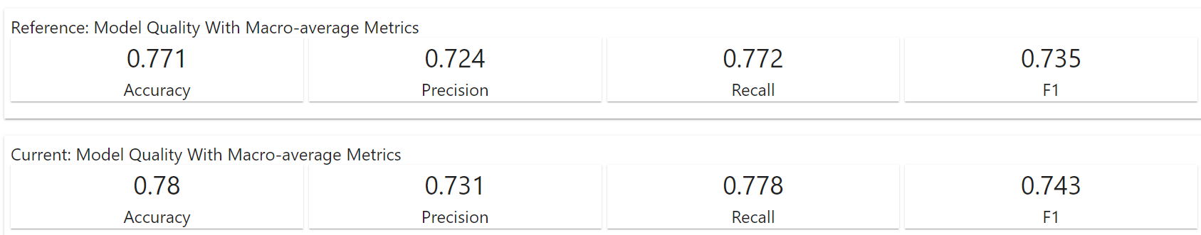
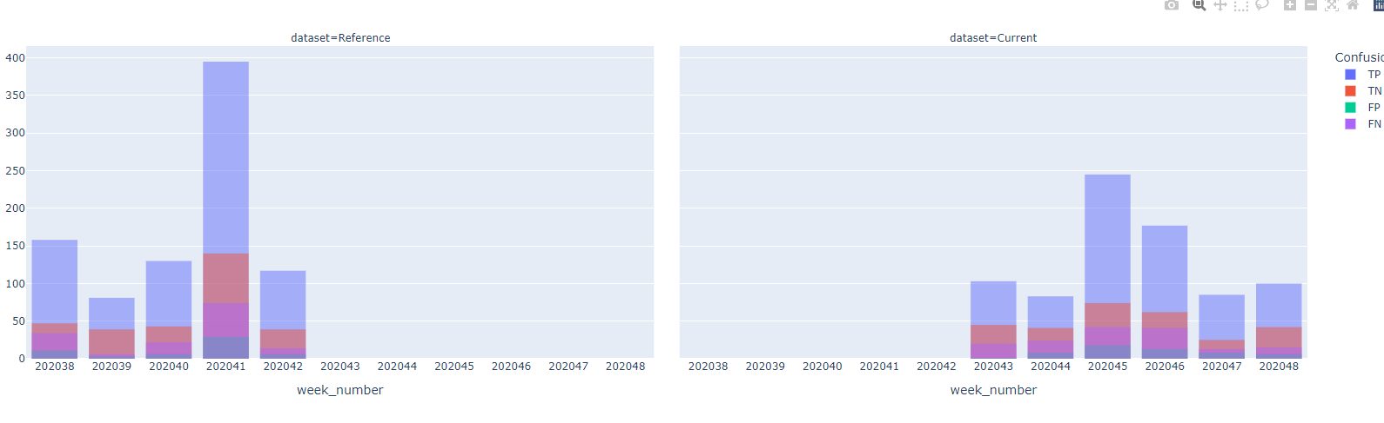
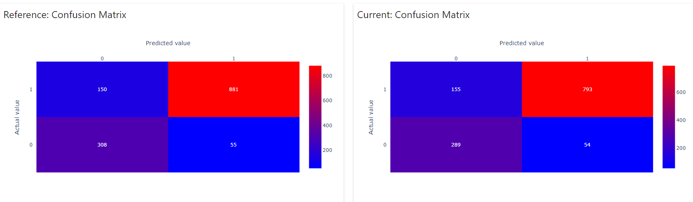
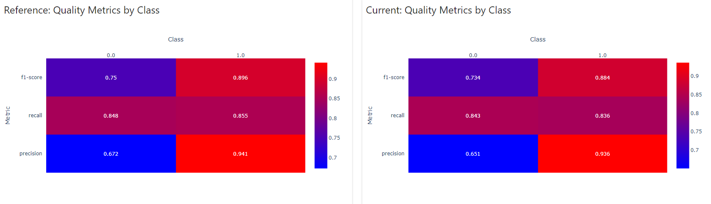
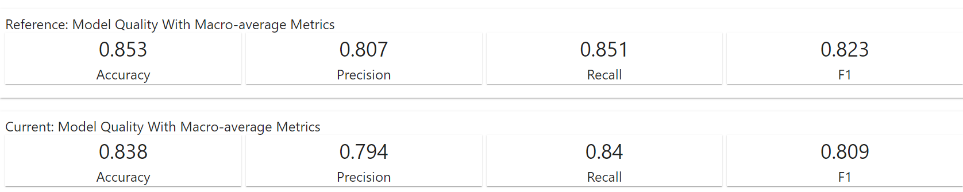
# CLASSIFICATION PERFORMANCE - produce custom report get_classification_performance_report_custom( data_frame=df, target=config['MODEL']['TARGET'], prediction=config['MODEL']['PREDICTION'], datetime=config['MODEL']['DATETIME'], categorical_fatures=config['INPUTS']['CATEGORICAL_FEATURES'], columns_to_exclude=config['OUTPUTS']['COLUMNS_TO_EXCLUDE'], date_from=datetime.date(2020, 9, 14), date_to=datetime.date(2020, 11, 27), breaking_point_dt=datetime.date(2020, 10, 19) ) logging.info('CLASSIFICATION PERFORMANCE - produced custom report')
# CLASSIFICATION PERFORMANCE - produce custom report prod_gr_id=413 get_classification_performance_report_custom( data_frame=df, target=config['MODEL']['TARGET'], prediction=config['MODEL']['PREDICTION'], datetime=config['MODEL']['DATETIME'], categorical_fatures=config['INPUTS']['CATEGORICAL_FEATURES'], columns_to_exclude=config['OUTPUTS']['COLUMNS_TO_EXCLUDE'], date_from=datetime.date(2020, 9, 14), date_to=datetime.date(2020, 11, 27), breaking_point_dt=datetime.date(2020, 10, 19), prod_gr_id=413 ) logging.info('CLASSIFICATION PERFORMANCE - produced custom report prod_gr_id=413')
# CLASSIFICATION PERFORMANCE - produce custom report prod_gr_id=426 get_classification_performance_report_custom( data_frame=df, target=config['MODEL']['TARGET'], prediction=config['MODEL']['PREDICTION'], datetime=config['MODEL']['DATETIME'], categorical_fatures=config['INPUTS']['CATEGORICAL_FEATURES'], columns_to_exclude=config['OUTPUTS']['COLUMNS_TO_EXCLUDE'], date_from=datetime.date(2020, 9, 14), date_to=datetime.date(2020, 11, 27), breaking_point_dt=datetime.date(2020, 10, 19), prod_gr_id=426 ) logging.info('CLASSIFICATION PERFORMANCE - produced custom report prod_gr_id=426')
# CLASSIFICATION PERFORMANCE - produce custom report prod_gr_id=427 get_classification_performance_report_custom( data_frame=df, target=config['MODEL']['TARGET'], prediction=config['MODEL']['PREDICTION'], datetime=config['MODEL']['DATETIME'], categorical_fatures=config['INPUTS']['CATEGORICAL_FEATURES'], columns_to_exclude=config['OUTPUTS']['COLUMNS_TO_EXCLUDE'], date_from=datetime.date(2020, 9, 14), date_to=datetime.date(2020, 11, 27), breaking_point_dt=datetime.date(2020, 10, 19), prod_gr_id=427 ) logging.info('CLASSIFICATION PERFORMANCE - produced custom report prod_gr_id=427')
The model seems to suffer from large amount of FN.
Observation 1: metrics related to Classification Performance when prod_gr_id == 427 are looking good.
Possible recommendation 1: develop three separate models; one per each level of prod_gr_id.
Possible recommendation 2: develop two separate models; one for prod_gr_id==413 and the second for others IDs.
Possible recommendation 3: rebalance data set used for training the model.
Possible recommendation 4: lower probability cutoff to capture more FN during classification.

