Slide 1
Gender detection by voice
KONZI SAMUEL
F17/22951/2008

Slide 2
OBJECTIVES
Identify useful features of speech for gender detection
Extract some of the speech features from speech files
Develop a gender recognition system

Slide 3
WHY GENDER DETECTION BY SPEECH?
Human machine interaction - e.g voice commands.
Application in gender sensitive surveys
Speaker recognition systems – incorporating AGD
Sorting telephone calls by gender for gender sensitive surveys

Slide 4
REVIEW
Nature of speech - human frequency range
Speech signal processing –sampling, Fourier analysis(dft-fft,dct)
Speech enhancement – removal of noise, Snr, vad
Features of speech – pitch, MFCC, other acoustic features
Machine learning classification techniques

Slide 5

AGD flowchart
Signal Processing
Feature Extraction
Classification
Is result =1?
No
Result=female
Yes
Result=male
STOP

Slide 6
DESIGN Feature Extraction
Pitch – obvious feature discriminator
Pitch detection algorithms
Zero crossing rate, harmonic product spectrum, autocorrelation etc
Autocorrelation – Finds correlation in a signal using a delayed copy of itself. The main peak is saved as the pitch period.
Steps - filtering, framing, center clipping, energy threshold, autocorrelation, average pitch

Slide 7
Feature Extraction cont…
MFCC – represent short term power spectrum of sound
Based on human ear perception of sound
Stages – Framing-frames of speech
Windowing-remove discontinuity
FFT-spectrum
Mel Frequency wrapping- in mel scale
Cesptrum – log spectrum back to time using DCT
MFCCs are the amplitudes of the resulting spectrum and consists of the first 12coefficients

Slide 8
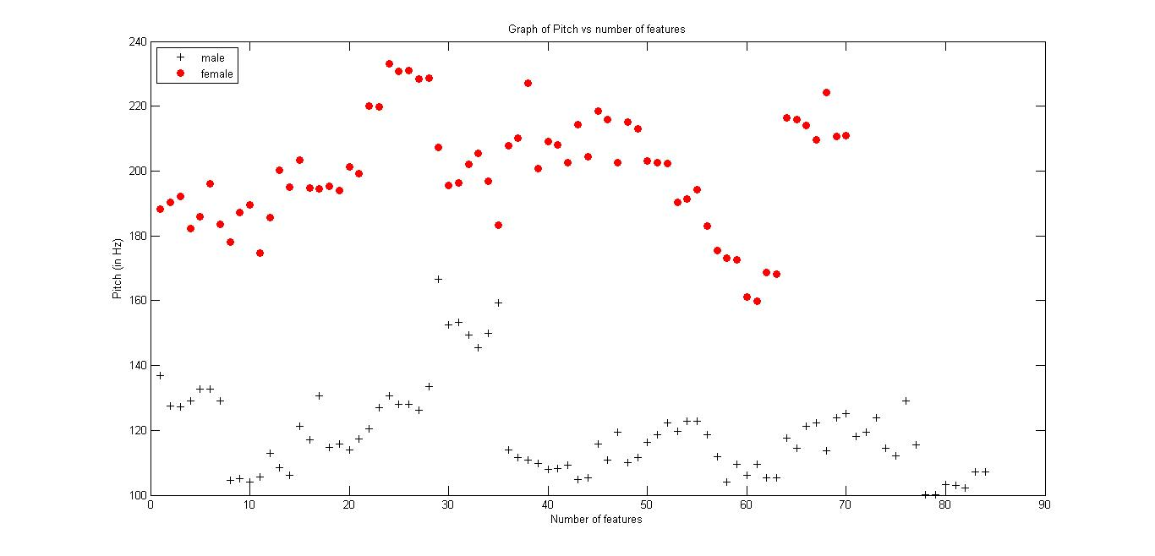
VISUALIZING DATA

Slide 9
CLASSIFICATION Machine Learning
Is a field of study that gives computers ability to learn without being explicitly being programmed
Types of machine learning
Supervised
Unsupervised
Reinforcement
Algorithms Examples– Neural networks, naive bayes, support vector machines(SVM),logistic regression,Linear Regression, K Means Clustering

Slide 10
CLASSIFICATION CONT...
Why support vector machines?
For different possible outcome, averaging performance of different algorithm gives an equivalent overall performance
Datong cheng (‘comparison on support vector machine and neural network’) SVM better for classification problem
Tries to minimize generalization error of model in higher dimension as opposed to minimize error over dataset

Slide 11
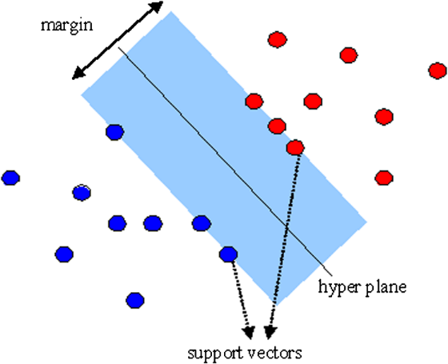
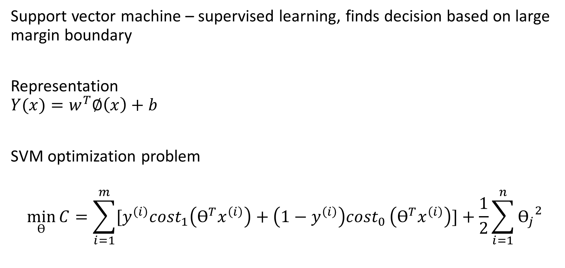
CLASSICATION CONT…
Support vector machine – supervised learning, finds decision based on large margin boundary
Representation
$$Y(x)=w^{T}∅\left(x\right)+b$$
SVM optimization problem
$$\min_{Ө}{C}=\sum_{i=1}^{m}{{[y}^{\left(i\right)}{cost}_{1}\left(Ө^{T}x^{\left(i\right)}\right)+\left(1−y^{\left(i\right)}\right){cost}_{0}}\left(Ө^{T}x^{\left(i\right)}\right)]+\frac{1}{2}\sum_{i=1}^{n}{{Ө_{j}}^{2}}$$

Slide 12
CLASSIFICATION CONT…
SVM Kernels-linear, RBF(gaussian), sigmoid, polynomial kernel
Kernel maps dataset to higher dimension space
Parameters – regularization(C), sigma(g), need to be adjusted accordingly for optimal hyperplane
Feature scaling – same distance metric

Slide 13
RESULTS
Results from combination of different extracted features.
Test accuracies in (%) for c=0.1, g=0.1, Training set = 2533, Test set =635
 | Kernel
Feature | Linear | Gaussian
Meanfun+IQR | 93.54 | 93.22
Meanfun+IQR+Q25 | 93.85 | 92.1
Meanfun+IQR+Q25+sd | 94.48 | 92.91
Meanfun+IQR+Q25+sd+meanfreq | 94.64 | 92.59
Meanfun+IQR+Q25+sd+meanfreq+sfm | 93.5 | 91.07
Meanfun+sd+IQR | 94.33 | 92.38
Meanfun+sd+IQR+meanfreq | 94.33 | 92.44
Meanfun+sd+IQR+meanfreq+Q25 | 94.33 | 92.28
Meanfun+sd+IQR+meanfreq+Q25+median | 94.33 | 91.81
All 20 features | 94.33 | 90.7

Slide 14
RESULTS CONT… Results using different features
 | MODEL
 | PITCH |  | MFCC |  | MFCC+PITCH
 | LINEAR | GAUSSIAN | LINEAR | GAUSSIAN | LINEAR | GAUSSIAN
CLEAN SPEECH FILES | 98.70 | 96.10 | 98.70 | 99.35 | 100 | 100
RAW SPEECH FILES | 83.33 | 83.33 | 77.77 | 83.33 | 83.33 | 88.88

Slide 15
CONCLUSION
Combination of pitch and mfcc give a more robust gender detection system
MFCC are sensitive to noise hence not effective for noisy speech
SVM classifier performs well even on small data however a larger dataset is recommended

