Slide 1




On Privacy Weaknesses and Vulnerabilities in Software Systems
ICSE 2023
Pattaraporn Sangaroonsilp
ps642@uowmail.edu.au
Hoa Khanh Dam
hoa@uow.edu.au
Aditya Ghose
aditya@uow.edu.au
University of Wollongong, Australia
Notes:
Good afternoon, everyone!
My name is Pattaraporn. I’m a PhD student at the University of Wollongong.
Today, I’m pleased to share with you about our work entitled “On privacy weaknesses and vulnerabilities in software systems”.
I’ve been working with Prof. Hoa Dam and Prof. Aditya Ghose on this paper.

Slide 2
agenda
Importance of privacy
Motivating example
Approach
Privacy-related vulnerabilities identification
Common privacy threats in software applications
New common privacy weaknesses proposal
Limitations
Future work
Notes:
In this presentation, I’m going to discuss on the motivation of our work, approach we used, limitations and opportunities to continue this work.
Let’s get into detail.

Slide 3
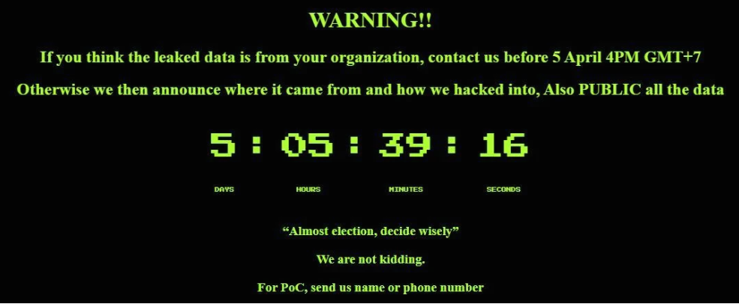
Importance of privacy
Data fields:
Identification numbers
Full names
Birthdates
Addresses
Phone numbers
Reference: https://thethaiger.com/news/national/hacker-threatens-to-publish-data-of-55-million-thai-citizens
Notes:
We’ve seen many news about personal data breaches across the world.
Some of you might have already been victims in personal data breaches.
We’ve received so many scam calls here in Australia. Recently in Thailand, there was a big news about personal data breach.
The hacker threatened to publish 50 million records of personal data of Thai citizens, which is almost 70% of the whole population in Thailand. This kind of incidents poses a serious privacy threat to individuals.
----
* It was found out later that the personal data was acquired from the Mor Prom application, which is used for vaccination services during Covid-19 breakout.

Slide 4






Importance of privacy (cont.)
Protecting personal data
Protecting data and systems
Granting data subject rights
Governing how personal data is processed (e.g., collection, use, transfer, storage, dissemination, etc.)
vs
Ensuring confidentiality, integrity and availability
Complying with data protection laws and regulations
Applying security mechanisms and controls
Icons are from Freepik
Notes:
Security and privacy are sometimes discussed together, but they are not the same.
Privacy focuses more on personal data, data subject rights, how personal data is processed, and about data protection compliance, while security emphasises on protecting data and systems from attackers, ensuring confidentiality, integrity and availability of the data and how to apply security mechanisms and controls in the systems.
Therefore, this motivates us to investigate more on privacy in software systems.

Slide 5
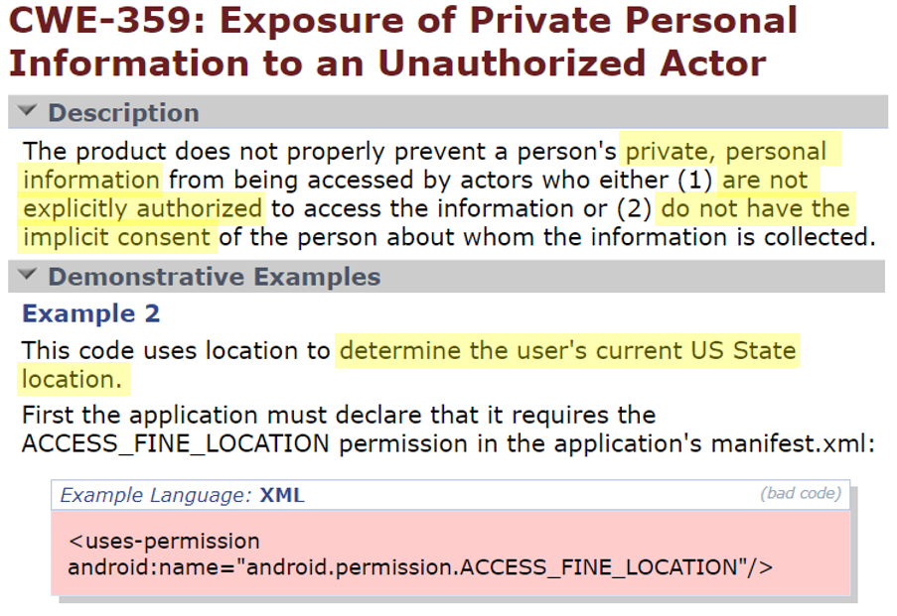

Motivating example
To what extent privacy concerns are covered in CWE and CVE?
Reference: https://cwe.mitre.org/data/definitions/359.html
CWE = Common Weakness Enumeration, CVE = Common Vulnerabilities and Exposures
Notes:
Common Weakness Enumeration or CWE contains a list of weakness types found when developing software. It explains the weakness in detail and provides some examples to illustrate that weakness.
On the screen, I’m showing you one of the CWEs. This weakness describes the exposure of private personal information to an unauthorized actor. You can see that privacy is hidden inside this security weakness as it involves personal data. Although, the developers research for security and privacy-related weaknesses and vulnerabilities in the CWE and CVE systems, it is not clear to what extent privacy concerns are covered in those systems, and whether privacy receives adequate attention it deserves.

Slide 6
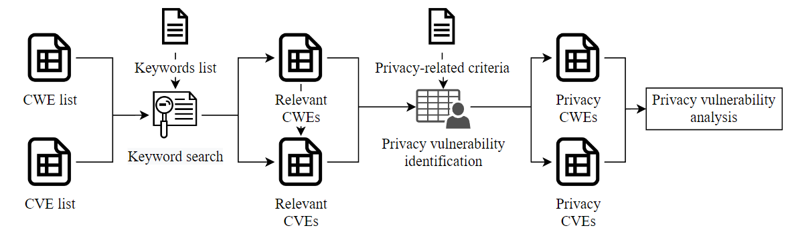
Privacy-related vulnerabilities identification
Notes:
To investigate into this, we first developed an approach to identify privacy-related vulnerabilities in the CWE and CVE systems.

Slide 7
Privacy-related vulnerabilities identification
1
922 records
156,537 records
Notes:
First step, we obtained all CWE and CVE records from their websites. Those are the number of the records at the time of collection.

Slide 8
Privacy-related vulnerabilities identification
2
Notes:
After obtaining the CWEs and CVEs, we performed keyword searches to filter out the records that do not have privacy-related keywords.

Slide 9
Privacy-related vulnerabilities identification
2
Group | Keywords
1 | privacy, violation, leak and leakage
2 | personal information, personal data, sensitive information, sensitive data, private information, private personal information, personally identifiable information, PII, protected health information, PHI, health information and health data
3 | General Data Protection Regulation, GDPR, California Consumer Privacy Act, CCPA, Health Insurance Portability and Accountability Act, HIPAA, Gramm-Leach Bliley Act, GLBA, Safe Harbor Privacy Framework, ISO/IEC 29100, regulation, data protection, privacy act, privacy framework and privacy standard
4 | right(s), consent, opt in/opt-in, opt out/opt-out, preference and breach
Notes:
A set of keywords consists of 37 terms, categorised into 4 groups as shown in this table.
--------
Group 1 is general terms related to weaknesses and vulnerabilities in privacy.
Group 2 contains the used to refer to personal data or personally identifiable data.
They are sometimes used interchangeably across regulations, standards and industry sources.
The keywords in Group 3 relate to privacy and data protection regulations/standards/frameworks.
And Group 4 contains the terms that are frequently seen in the privacy policies and literature when discussing personal data protection and user privacy.

Slide 10
Privacy-related vulnerabilities identification
3
922 records
185 records
156,537 records
1,088 records
Notes:
We found 185 CWE and 1,088 CVE records that contain at least one of the specified keywords.

Slide 11
Privacy-related vulnerabilities identification
4
Notes:
Next, we manually examined each of those records to identify privacy-related vulnerabilities.

Slide 12
Privacy-related vulnerabilities identification
4
Criteria
A weakness or vulnerability involves with any processing of personal data (e.g. collection, use, storage, transfer, alteration, erasure and disclosure).
A weakness or vulnerability which may lead to the violations of the individual rights (e.g. right to be informed, right of access and right of erasure).
Notes:
A vulnerability is considered as privacy-related if it either involves with any processing of personal data or a vulnerability that leads to violations of the individual rights.
We went through the shortlisted CWE and CVE records from the previous step to determine the vulnerabilities that meet the criteria.

Slide 13
Privacy-related vulnerabilities identification
5
922 records
185 records
41 records
156,537 records
1,088 records
157 records
Notes:
Finally, we got 41 and 157 privacy-related CWE and CVE respectively. You can see that the coverage of the privacy-related vulnerabilities in both CWE and CVE is quite limited.

Slide 14
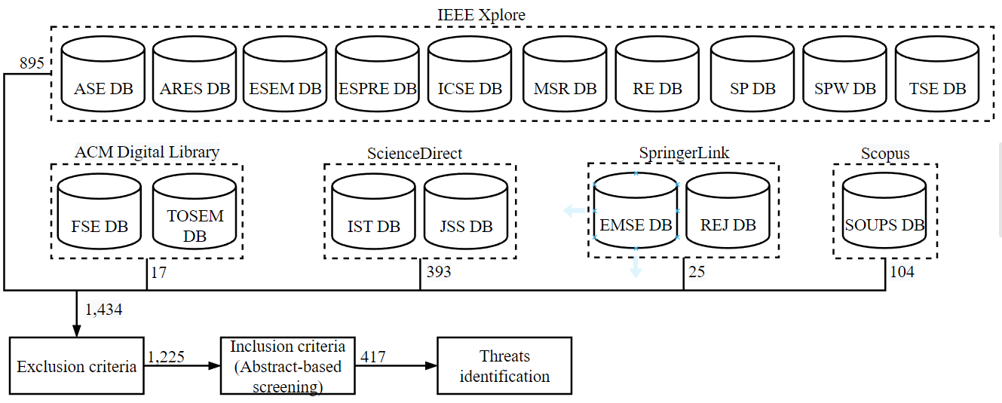



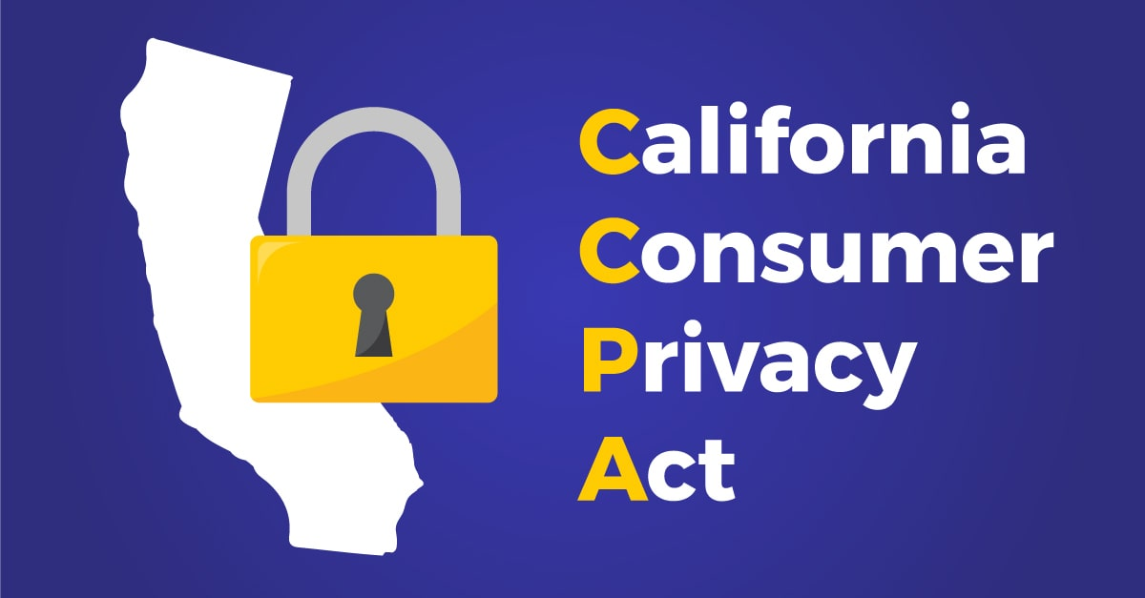

Explanatory study
Privacy engineering research
Privacy regulations and frameworks
GDPR [1], CCPA [2], HIPAA [3], GLBA [4], USPA [5], APA [6] and ISO/IEC 29100 [7].
Additional sources
OWASP [8] and Norton [9]
Photos are from https://emerging-europe.com, https://wiiisdom.com, https://www.iso.org/, https://owasp.org, https://au.norton.com
Please refer to the replication package for more details at https://figshare.com/articles/conference contribution/icse2023-paper908-replication-pkg/21922731
Notes:
We then investigated how those privacy-related vulnerabilities identified in CWE and CVE address common privacy threats in software applications. To identify the common privacy threats in practice, we conducted an explanatory study on the literature of the privacy engineering research, privacy regulations and frameworks, and additional sources.
For the privacy engineering research, we performed a systematic literature review to identify privacy threats in software engineering publications that were published from 2001 to 2020 in 17 highly recognised software engineering publication venues. We first acquired 1,434 papers from the search. After applying the inclusion and exclusion criteria, there were 417 papers left in our study.
For the privacy regulations and frameworks, we have studied 7 well-known data protection regulations and privacy frameworks such as GDPR and HIPAA. We identified the privacy threats related to the rights of individuals on their personal data processing from these materials.
Lastly, we also investigated the privacy threats included in several reputable organisations like OWASP and Norton. These sources cover the recent trends of privacy risks and attacks.
--------
These include 7 conferences, 6 journals, 2 symposiums and 2 workshops.
To identify the privacy threats, we examine each paper and shortlist the ones that focus specifically on privacy vulnerabilities and attacks. The papers must study the cause that leads to privacy-related problem in software and that cause is not caused by users.

Slide 15
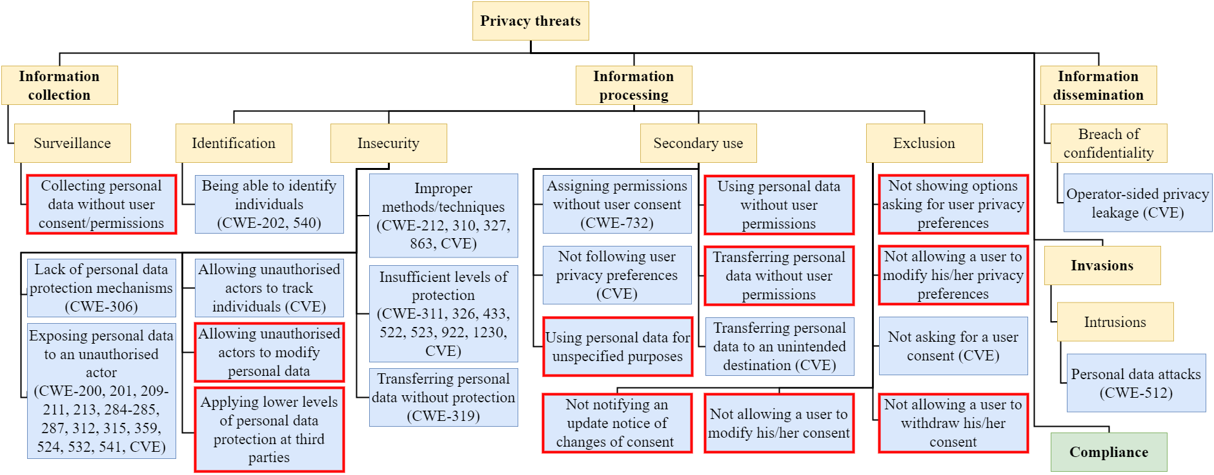
Common privacy threats
= not covered by existing privacy vulnerabilities in CWE and CVE
A taxonomy of common privacy threats was built on top of W. Stallings [10].
Notes:
After identifying the privacy threats in the explanatory study, we have built a taxonomy of common privacy threats upon the well-known privacy threats taxonomy developed by Stallings. We tailored this taxonomy and refined it into a more concrete version that addresses privacy threats in software engineering.
The taxonomy consists of four categories of privacy threats: information collection, information processing, information dissemination and invasions. The yellow boxes in this figure represent the categories and subcategories included in the original taxonomy. Those blue boxes are the privacy vulnerabilities we have identified in the explanatory study.
We mapped the privacy-related vulnerabilities identified in CWE and CVE in the first step to the privacy threats identified in this taxonomy. After these processes, we found that only 13 out of 24 common privacy vulnerabilities were covered by CWE and CVE. The boxes with red outline are the privacy threats that are not covered in those systems.
The green box represents the common privacy compliance in software applications. The privacy threats in this group have not been addressed in the original taxonomy, so we propose the compliance group as an extension to
the original taxonomy.
---
This process was done by two coders. Inter-rater reliability assessment and disagreement resolution processes were also employed to ensure the reliability of the classifications.

Slide 16
New common privacy weaknesses proposal
Propose 11 new common privacy weaknesses
Define those weaknesses with CWE schema [11]
Demonstrate with code fragments
Name
Description
Mode of introduction
Common consequence
Detection method
Potential mitigation
Demonstrative example
Please refer to the replication package for more details at https://figshare.com/articles/conference contribution/icse2023-paper908-replication-pkg/21922731
Notes:
To fill the gaps we discussed in the previous step, our study proposes 11 new common privacy weaknesses. We chose to propose these weaknesses as CWE instead of CVE because CWE is more generic and similar to our taxonomy of privacy threats.
We followed the CWE schema to define the new CWE entries which include attributes such as name, description, mode of introduction, common consequence, detection method, potential mitigation and demonstrative example. We provide a demonstrative example of the new weaknesses by extracting code fragments, issue reports and commits from real software repositories hosted on GitHub.
---------
These attributes provide an overview of a privacy weakness in terms of its causes, consequences, and mitigation methods.

Slide 17
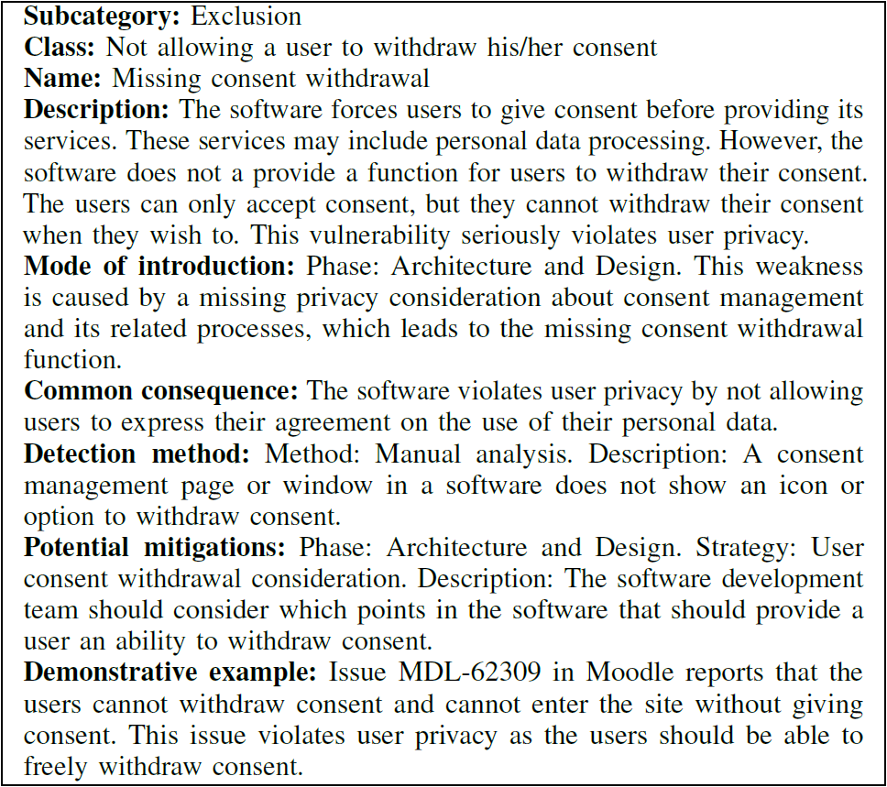
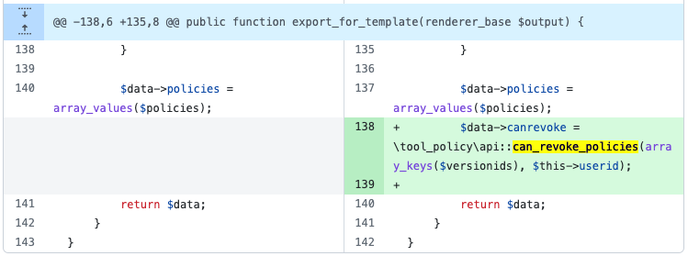
Example: missing consent withdrawal
Source: GitHub repository (Commit ad5e213)
Project: Moodle (Issue MDL-62309)
References: https://github.com/moodle/moodle/commit/ad5e213
https://tracker.moodle.org/browse/MDL-62309
Notes:
I'm now showing you one example of the new common privacy weaknesses we proposed. This weakness is about not allowing users to withdraw their consent. We describe the weakness following the CWE schema as shown in your left-handed side. The code snippet on your right-handed side demonstrates this weakness.

Slide 18
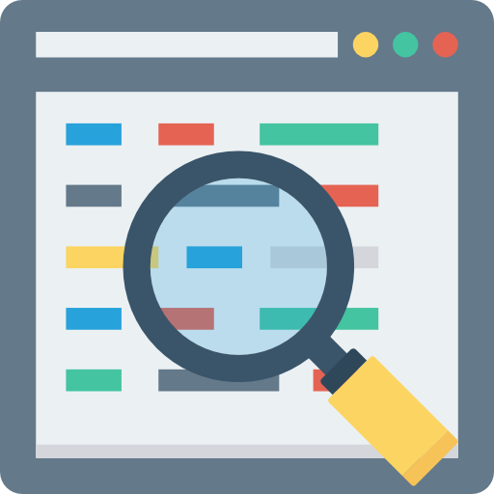

limitations
Keywords might not result in the complete list.
Other sources of privacy threats might have not been identified.
Icons are from Freepik
Notes:
We are aware that there are several limitations in our work. Firstly, the keywords might not result in the complete list and secondly there might be other sources of other privacy threats that we have not identified. However, we have applied several strategies to mitigate those limitations.
For keywords, we used the frequent terms and general terms to make sure that we cover privacy-related CWE and CVE as many as possible. We also defined a set of inclusion and exclusion criteria to select the relevant papers.
-------------
Keywords
Determined the keywords based on alternative terms described in CWE
Used the frequent terms identified in the studies
Considered general terms to cover unseen materials
Threats
Defined a set of inclusion and exclusion criteria to select the relevant papers

Slide 19


Future work
Expand our explanatory study to increase the generalisability of our taxonomy for common privacy threats
Develop new techniques and tools for automatically detecting privacy vulnerabilities in software and suggesting fixes.
Icons are from Freepik
Notes:
Our future work would include the extension of our explanatory study to increase the generalizability of our taxonomy and to develop new techniques and tools for automatically detecting privacy vulnerabilities in software and suggesting fixes.

Slide 20
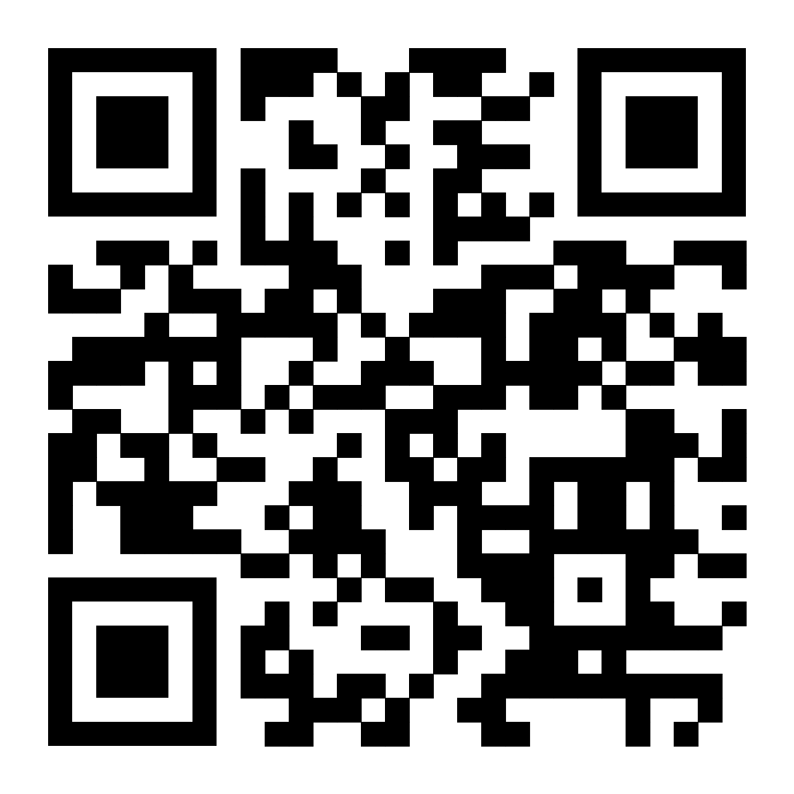
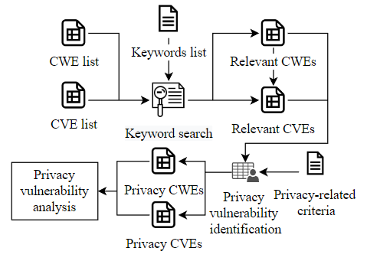
Research contribution summary
Privacy-related vulnerabilities identification
Common privacy threats taxonomy development
New common privacy weaknesses proposal
Research artefacts
Notes:
And that’s the entire journey for our paper. Thank you for your attention.
---------------
we started from identifying privacy-related vulnerabilities in CWE and CVE, we then conducted the explanatory study to gather the privacy threats in software engineering. We constructed the taxonomy of privacy threats and found the threats that have not been covered in the CWE and CVE. Finally, we propose the new common privacy weaknesses.

Slide 21
references
[1] Office Journal of the European Union. (2016). General Data Protection Regulation (GDPR). https://eur-lex.europa.eu/legal-content/EN/TXT/PDF/?uri=CELEX:32016R0679
[2] California State Legislature, “California Consumer Privacy Act of 2018,” 2018.
[3] Department of Health and Human Services, “HIPAA administrative simplification regulation text,” pp. 1–115, 2013. [Online]. Available: https://www.hhs.gov/sites/default/files/hipaa-simplification-201303.pdf
[4] United State Congress, “GRAMMLEACH-BLILEY ACT,” 1999. [Online]. Available: https://www.govinfo.gov/content/pkg/PLAW-106publ102/pdf/PLAW-106publ102.pdf
[5] U.S. Department of Justice, “The Privacy Act of 1974,” 1974.
[6] Federal Register of Legislation, “Privacy Act 1988,” 2017. [Online]. Available: https://www.legislation.gov.au/Details/C2016C00979
[7] ISO/IEC, “International Standard ISO/IEC 29100,” ISO/IEC, Tech. Rep., 2011.
[8] The OWASP Foundation, “OWASP Top 10 Privacy Risks Survey,” 2015.
[9] Norton, “Why Your Online Privacy Matters,” 2021. [Online]. Available: https://us.norton.com/internetsecurity-privacy-why-your-online-privacy-matters.html
[10] Stallings, W. (2019). Information Privacy Engineering and Privacy by Design: Understanding Privacy Threats, Technology, and Regulations Based on Standards and Best Practices. Addison-Wesley.
[11] CWE Team, “CWE - Schema Documentation -Schema Version 6.5,” 2021. [Online]. Available: https://cwe.mitre.org/documents/schema/

Slide 22
Related work
Taxonomies of privacy threats
Solove, D. J. (2006). A taxonomy of privacy. University of Pennsylvania Law Review, 154(3), 477–564.
Deng, M., Wuyts, K., Scandariato, R., Preneel, B., & Joosen, W. (2011). A privacy threat analysis framework: Supporting the elicitation and fulfillment of privacy requirements. Requirements Engineering, 16(1), 3–32.
Wuyts, K., Scandariato, R., & Joosen, W. (2014). Empirical evaluation of a privacy-focused threat modeling methodology. Journal of Systems and Software, 96, 122–138.
MITRE privacy threat modeling
Bloom, C. (2022). Privacy Threat Modeling. In 2022 USENIX Conference on Privacy Engineering Practice and Respect. Available: https://www.usenix.org/system/files/pepr22_slides_bloom.pdf
Identified privacy attacks from different sources (i.e., Federal Trade Commission (FTC) and Federal Communications Commission (FCC) closed cases)
Main differences: scope, coverage and classification of privacy threats
Notes:
We also acknowledge that groups of researchers and organisations have been working on privacy threats and developing privacy threats taxonomies. However, the main differences between their works and our work are scope, coverage and classification of privacy threats.

