Slide 1


Android password manager
COMP.SEC.300 Secure Programming

Slide 2
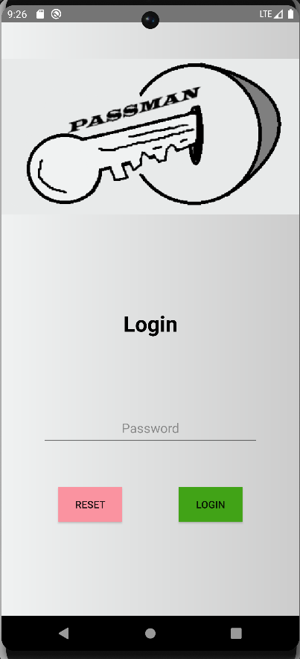
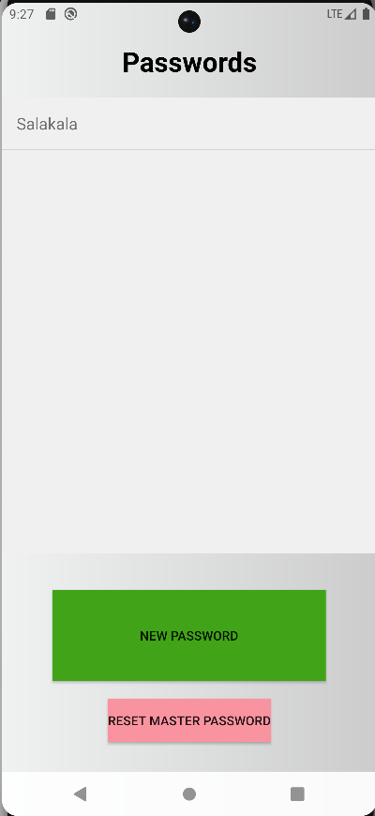
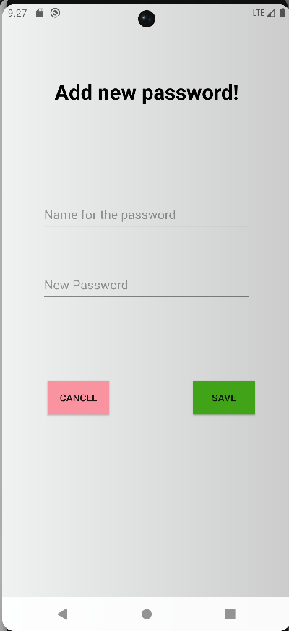
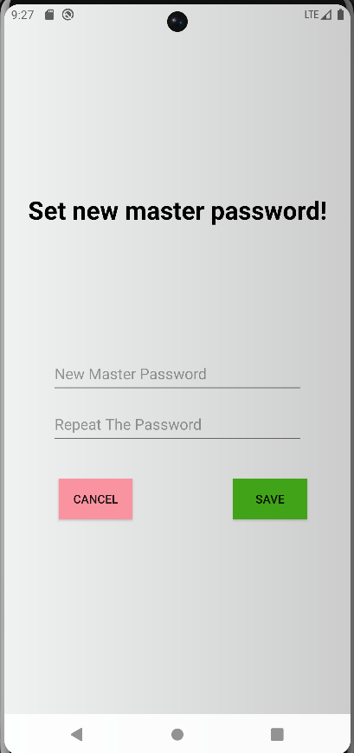
How it works

Slide 3
How it is made
Language: Kotlin
Libraries: Android Jetpack libraries, jbcrypt, gson, javax libraries
AI: Copilot
No architectural design choices

Slide 4
Secure programming solutions
Master password hashing (bcrypt)
Safe hash comparison
Safe master password change
Requirements for master password
Safe fail messages when providing wrong password
Biometric option
Encryption of the passwords (AES256 GCM)
Safe storage of encryption key
Hiding the password as it is being written

Slide 5
Testing
Missing implementations
Reset the encryption key?
Current security issues
Next steps
-improve visuals
-improve the user experience
-password grouping

