Slide 1

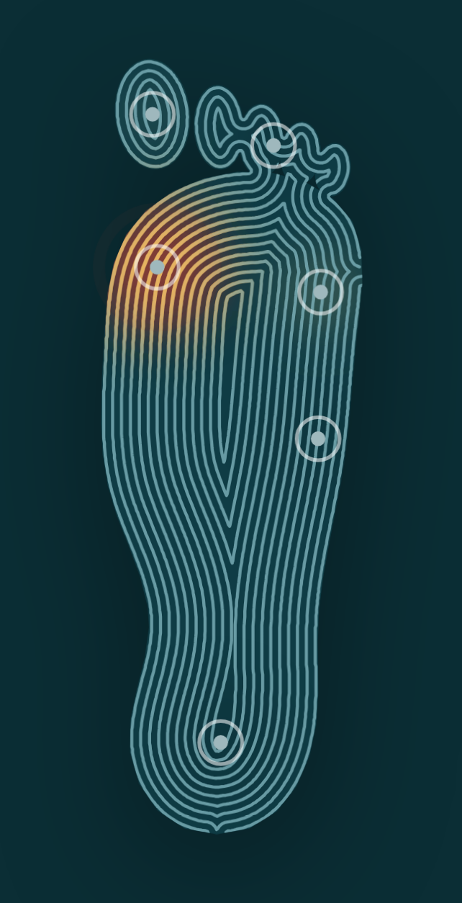
SPARSH
The warning your feet can no longer give you.
A sensing insole that times how long each part of the foot stays loaded, and buzzes before the skin breaks down.
VMEDITHON 3.0 · Bio × Engineering · Buildathon
Team [Team name]
Notes:
Open with the person, not the tech. People with diabetic neuropathy lose the pain that makes the rest of us shift our weight. SPARSH gives that warning back: it times how long each part of the foot carries load and buzzes before damage starts.

Slide 2

Neuropathy takes away the pain that makes people shift their weight
Ulcers form under repeated pressure on skin that can no longer feel it. Clinicians call what patients lose the gift of pain.
101 M
19–34%
~40%
Indians live with diabetes
of people with diabetes will develop a foot ulcer in their lifetime
of healed foot ulcers come back within a year
About 1 in 5 diabetic foot ulcers ends in a lower-limb amputation.
Sources: ICMR-INDIAB-17, Lancet Diabetes & Endocrinology 2023 (2021 estimate) · Armstrong, Boulton & Bus, NEJM 2017 · Abbott et al., Lancet Digital Health 2019
SPARSH VMEDITHON 3.0
2
Notes:
Three numbers. 101 million Indians have diabetes. Between a fifth and a third of people with diabetes will get a foot ulcer. Once healed, roughly 40% come back within a year, and about one ulcer in five ends in amputation. The cause is simple: pressure that nobody feels.

Slide 3



Pressure alerts are proven to help
SPARSH rebuilds the idea from off-the-shelf parts, with an alert that needs no screen.
The evidence
What SPARSH changes
71%
fewer ulcers over 18 months in the group that received pressure alerts
The trial system alerted through a smartwatch.
SPARSH buzzes by itself. No phone, watch or app.
Randomised trial: 58 people with neuropathy and a past plantar ulcer
Alerts fired on sustained high pressure, with advice to offload
The paper names pressure held for over 15 minutes, sitting or standing, as an important variable
Commercial versions are sold into US insurance billing.
SPARSH is built from off-the-shelf parts.
Continuous monitoring creates personal health data.
SPARSH keeps readings on the local network. No cloud, no account.
Abbott et al., Lancet Digital Health 2019; trial sponsor Orpyx reported the 71% figure
SPARSH VMEDITHON 3.0
3
Notes:
This is not an untested idea. A randomised trial showed that alerting patients to sustained plantar pressure reduced ulcer recurrence at plantar sites. The same paper names pressure held for more than 15 minutes as a key variable, which is exactly what SPARSH measures. Our contribution is making it cheap, local and screen-free.

Slide 4
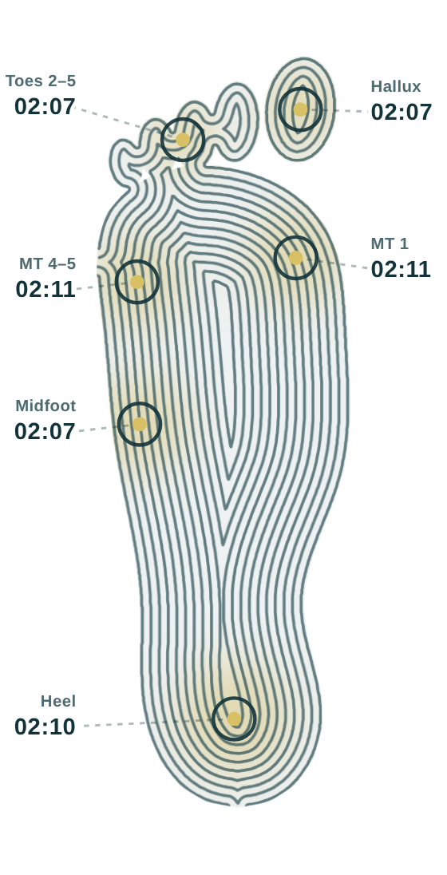



How SPARSH works
Sense
Six pressure zones sit under high-risk sites: big toe, lesser toes, first and outer metatarsal heads, midfoot and heel.
Time
Each zone runs its own clock while it stays loaded. Lifting it for half a second resets that clock.
Warn
Past the limit, the device buzzes and the dashboard names the zone. Moving clears both.
Limit 15 minutes in the product, 10 seconds in today's demo. Same timing rule.
SPARSH VMEDITHON 3.0
4
Notes:
Three steps. Sense: six zones under the sites where plantar ulcers form. Time: each zone keeps its own clock while loaded, and a lift of half a second resets it, so walking does not count. Warn: past the limit the device buzzes and the dashboard names the zone. For the demo the limit is 10 seconds instead of 15 minutes.

Slide 5


What is new in SPARSH
Load time, not peak pressure
The warning needs no screen
Everyone's pressure spikes when they walk. Damage comes from load that never moves, so SPARSH times each zone.
The device buzzes by itself. No phone, watch or app is needed to receive the alert.
CURRENT
CURRENT
Six zones on one analog pin
The device keeps the only clock
Each zone is powered in turn and read on a shared line: one ADC channel and no multiplexer.
The dashboard shows the firmware's own timers, so the screen and the buzz cannot disagree.
CURRENT
CURRENT
SPARSH VMEDITHON 3.0
5
Notes:
Four things are new. We time sustained load per zone instead of chasing peak pressure. The alert needs no phone or watch. Six zones are read through one analog pin by powering each in turn. And the device is the only source of truth: the dashboard displays the firmware's own counters, so the screen can never contradict the buzz. All four are working in today's build.

Slide 6
Architecture and tech stack
Insole
ESP32 device
Laptop bridge
Dashboard
Six pressure zones at high-risk sites
Scans zones, runs the timers, drives the buzzer
Python 3: UDP in, live stream out
Any browser, nothing to install
Wi-Fi UDP, port 4210: readings and load timers per zone, every 100 ms and on change
Hardware
Firmware
Software
Frameworks
ESP32 DevKit with Wi-Fi
12-bit ADC on GPIO34
Six drive pins, one per zone
Buzzer on GPIO27
Arduino C++ on the ESP32 core
One state machine per zone
Bounded waits: it never freezes
UDP broadcast
Python 3 standard library only
Server-Sent Events stream
HTML, CSS, JavaScript, SVG
No framework, no cloud
Arduino-ESP32 on ESP-IDF
W3C Server-Sent Events
IWGDF-reviewed evidence on pressure relief
India MDR 2017 route, class to be confirmed
SPARSH VMEDITHON 3.0
6
Notes:
The insole feeds an ESP32 that scans the six zones, runs one timer per zone and drives the buzzer. It broadcasts six counters over Wi-Fi. A small Python bridge, standard library only, turns those packets into a live stream for a browser dashboard. No frameworks, no cloud, nothing to install. Clinically we build on the IWGDF-reviewed evidence that relieving plantar pressure prevents recurrence; the regulatory route is India's Medical Devices Rules, 2017.

Slide 7








From raw readings to a warning
Read
Clean
Decide
Debounce
Engineer
Share
How fast each zone charges the shared line, in microseconds
Every wait has a time limit; interrupted timings are dropped
Charging 4× faster than at rest means loaded
Drops shorter than half a second are ignored
Time under load, per zone, in milliseconds
Readings and counters go out; the dashboard maps load and logs alerts
Synthetic data
CURRENT
Privacy
CURRENT
Next
NEXT
A built-in simulator creates standing and walking load, scaled to body weight, so the dashboard runs without the insole. A circuit model and a scripted fake insole tested the firmware.
No cloud and no account. Readings stay on the local network, and the wearer's details stay in the browser tab.
Calibrate each zone against known weights, then use pilot recordings to tune the 15-minute limit.
SPARSH VMEDITHON 3.0
7
Notes:
Every reading goes through the same pipeline. Discharge and a fixed settle make readings repeatable; time limits mean a loose wire gives zero, not a frozen device. Above 3000 the zone counts as loaded; drops under half a second are ignored; the feature we engineer is time under load per zone. For data we did not have, we generated it: a simulator for standing and walking, and a circuit model plus a fake insole to test the firmware. Nothing goes to a cloud.

Slide 8
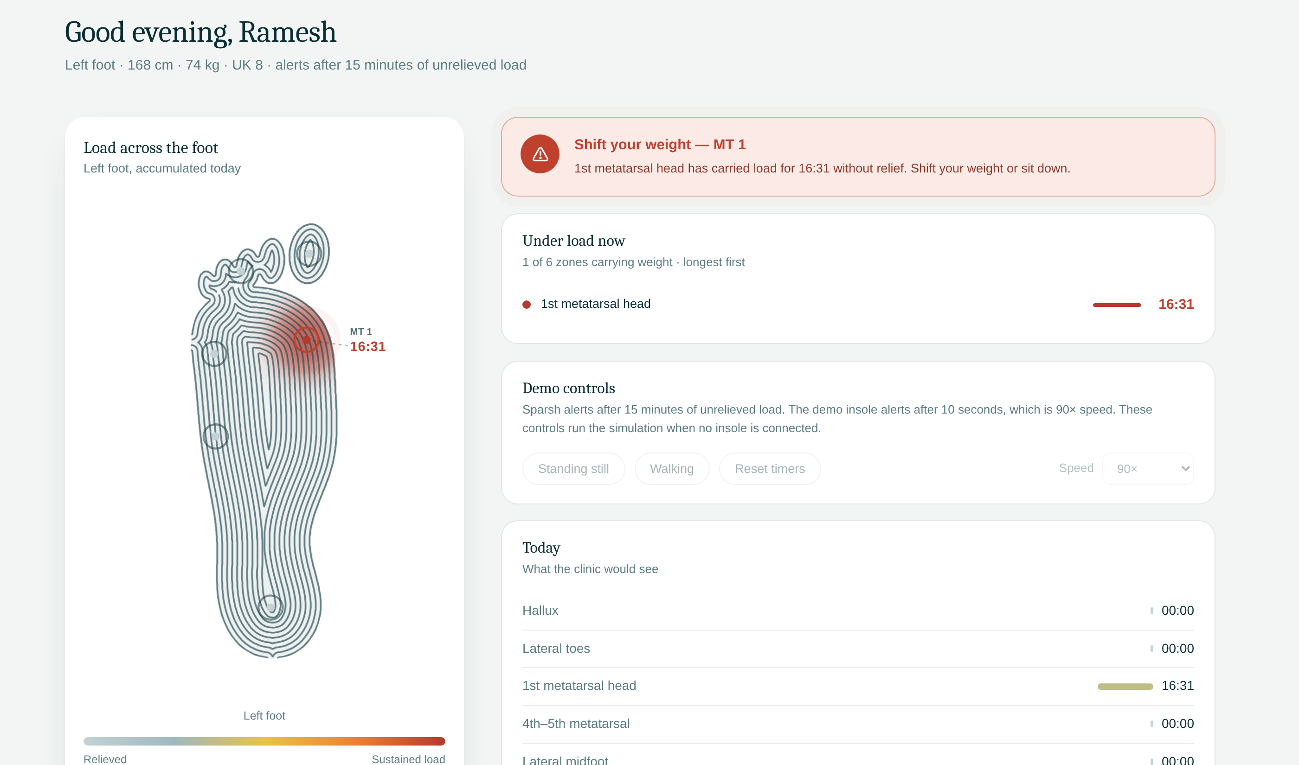





Built for someone who will never open an app
The wearer does nothing. The insole watches and the device buzzes.
Alerts say what to do and where: “Shift your weight — MT 1”.
Setup takes three short steps: wearer, foot, emergency contact.
Opens in any browser, with no install and no account.
A day view per zone for the clinic.
Live dashboard during testing, moments after the device alerted
SPARSH VMEDITHON 3.0
8
Notes:
Our users are often older and not app people, so the product works with zero interaction: the insole watches and the device buzzes. For carers and clinicians the dashboard speaks plainly and names the zone. Setup is three screens, it opens in any browser, and the day view shows which zones carried load for how long.

Slide 9
Working today, pilot-ready in 12 weeks
CURRENT
NEXT
Calibrate each zone with known weights. Seal the insole. Move the electronics into a battery-powered ankle pod.
Working today
Weeks 1–4
Six-zone insole on an ESP32, all off-the-shelf parts
Per-zone timers with half-second grace, buzzer alert
Dashboard that follows the device live
Parts cost: [₹ fill in]
NEXT
Bluetooth phone app for carers. A printable day report for clinics.
Weeks 5–8
NEXT
Needed for the pilot
NEXT
Usability sessions with volunteers. Ethics application for a 20-person patient pilot. Build 20 pilot units.
A diabetic-foot clinic partner
Institutional ethics approval
Budget for 20 units: [₹ fill in]
Weeks 9–12
Clinical use first needs a patient pilot and device classification under India's Medical Devices Rules, 2017.
SPARSH VMEDITHON 3.0
9
Notes:
Be precise about what exists. Today: the insole, the device logic and the live dashboard. In twelve weeks we can be pilot-ready: calibrated zones, a sealed insole and a battery ankle pod in the first month, a carer phone app and clinic report in the second, and usability sessions plus an ethics application and 20 pilot units in the third. We are not claiming clinical readiness; that needs the pilot and device classification.

Slide 10


Impact, scale and research value
Industry impact
Scales cheaply
Research value
FUTURE
CURRENT
NEXT
Sold through diabetic-foot clinics and screening camps
Each update is 18 numbers, small enough for Bluetooth or Wi-Fi
Test whether a 15-minute limit suits Indian footwear and daily habits
FUTURE
CURRENT
FUTURE
Gives clinicians loading data between visits
No server needed beyond a laptop
Per-zone time-under-load recordings from Indian patients
CURRENT
FUTURE
FUTURE
Built from off-the-shelf parts
Flexible printed insole and a sealed pod
Link loading patterns to callus and ulcer sites
SPARSH VMEDITHON 3.0
10
Notes:
Impact comes through clinics and screening programmes, which already see these patients; that is future work and labelled so. Scaling is cheap today because each update is only six numbers and the software needs nothing but a laptop. The research value is real: time-under-load data from Indian patients would let us test whether the 15-minute limit from UK research fits local footwear and habits.

Slide 11


One team, several disciplines
[Name]
[Name]
[Name]
Firmware and sensing
Hardware and fabrication
Data and dashboard
[Department, college]
[Department, college]
[Department, college]
How we worked together
[Colleges and departments on the team, how you split the work, and any doctor or podiatrist you consulted]
SPARSH VMEDITHON 3.0
11
Notes:
Name each member, their role and their department and college. If the team spans colleges or disciplines, say so explicitly: the judges score it. Mention any clinician you spoke to. Add cards if you have a fourth or fifth member.

Slide 12

What changed since the last review
Round 1 submission | Final build
Designed and costed; nothing built yet | Working insole, firmware and live dashboard
Eight zones through a 16-channel multiplexer | Six zones read directly by the ESP32
Alert logic described on a slide | Per-zone timers with a half-second grace period, running on the device
Live heatmap planned | Dashboard shows the device's own timers, 5–18 ms behind the buzz in a one-laptop test
Reviewer feedback and what we did
[Suggestion 1] → [What we changed]
[Suggestion 2] → [What we changed]
SPARSH VMEDITHON 3.0
12
Notes:
Show the jump from paper to product: in Round 1 nothing was built. Then quote the reviewers' actual suggestions word for word and say what you changed for each. This criterion is worth ten marks, so fill it in precisely.

Slide 13

Tested before it touched the hardware
Design contract
Payload | Six readings, six resting times, six load timers (ms)
Transport | UDP broadcast, port 4210, every 100 ms and on change
Alert | Any zone loaded 10 s in the demo, 15 min in the product
Grace | Half a second, checked early so it is never late
Zone order | Hallux, Toes 2–5, MT 1, MT 4–5, Midfoot, Heel
5–18 ms
Dashboard lag behind the buzz: firmware to UDP to browser on one laptop, simulated sensors
0 of 276
Packets whose data disagreed with the buzz, in the circuit-model test
2 bugs
Found in simulation and fixed: a scan that could freeze when a zone never charged, and a buzz with nobody standing
Live demo
Press a zone and its timer runs. At 10 s the device buzzes and the screen alerts. Lift the foot and both clear.
SPARSH VMEDITHON 3.0
13
Notes:
We tested everything in software before flashing. Compiling the real firmware against a model of the circuit exposed two bugs in our earlier sketch, a scan freeze and a false alarm, which we fixed. An end-to-end run with real UDP packets on one laptop showed the dashboard trailing the buzz by 5 to 18 milliseconds; real Wi-Fi will add some delay. The design contract on the right is the whole interface between the three programs. Then switch to the live demo.

Slide 14
SPARSH gives the
warning back.
CURRENT
Sensing insole, device alert and live dashboard, working today.
NEXT
Calibration, a sealed ankle pod and a clinic pilot.
FUTURE
Fewer ulcers and amputations among people with numb feet.
Thank you
Team [Team name] · [email]
Notes:
Close on the one-line promise, then state plainly what is built, what is next and what the long-term goal is. Thank the judges and invite questions.

Slide 15
Appendix: questions we expect
How is this different from commercial pressure insoles? | Same proven idea. SPARSH alerts without a watch or phone, keeps data local and uses off-the-shelf parts. It has not been clinically tested yet.
Why 10 seconds? | Demo only. The product limit is 15 minutes, the duration the trial authors flag. A pilot will tune it.
How accurate are the sensors? | Uncalibrated. Each zone is compared with its own resting reading, not measured in kPa. Calibration against known weights comes first.
Won't walking trigger alerts? | Each zone lifts during every step, and a gap over half a second resets its timer. Gait recordings will confirm this.
What if Wi-Fi drops? | The alert runs on the device. Wi-Fi only feeds the dashboard, which says when data stops.
Why not put the electronics in the sole? | A rigid board under a numb foot creates the very pressure point we prevent, so the design moves them to an ankle pod.
What happens to the data? | No cloud or account. Readings stay on the local network; profile details stay in the browser tab.
Is it a medical device? | A monitoring aid with no diagnostic claim. Its class under India's MDR 2017 is still to be confirmed.
What does it cost, and how is it powered? | [₹ parts cost for the demo unit; power source and runtime]
SPARSH VMEDITHON 3.0
15
Notes:
Backup slide. Keep answers short and honest; saying what is not yet validated earns more trust than overclaiming.

Slide 16
Appendix: technical design summary
Zones and pins | Hallux 23 · Toes 2–5 22 · MT 1 21 · MT 4–5 19 · Midfoot 18 · Heel 5
Sense line | GPIO34 (ADC1, usable with Wi-Fi on), with a capacitor to GND
Buzzer | GPIO27
Read cycle per zone | All drive pins low → this zone high, others floating → time how fast the line rises (10 ms max)
Loaded | 4× faster than its resting time; stays loaded until only 2× faster
Timer and grace | One per zone. Resets after half a second unloaded, checked one scan early so it is never late
Alert | Any zone loaded continuously for 10 s (demo) → buzzer on until relief
Payload | Six readings | six resting times | six counters (ms, 0 = unloaded), UDP broadcast on port 4210, every 100 ms and on change
Bridge | Python 3 standard library. Serves the dashboard at localhost:8000, streams /events, turns readings into heat
Dashboard | Counters at 90× (10 s reads as 15:00), heat from readings. Without an insole it simulates the same rule
Serial monitor | 115200 baud: charge times | resting times | counters
SPARSH VMEDITHON 3.0
16
Notes:
Backup slide for the code quality and technical design criterion. Everything here matches the firmware, bridge and dashboard exactly.

