Slide 1

Princess Sumaya University for Technology
King Abdullah II Faculty of Engineering
Computer Engineering Department
Hand Controlled RC Vehicle
Microprocessors and Embedded Systems Project
Supervisor
Doctor Belal Sababha
Name | ID | Major | Email
Omar Hussein | 20190221 | Networks and Information Security Engineering | oma20190221@std.psut.edu.jo
Victor Dawood | 20190616 | Electrical Power and Energy Engineering | vic20190616@std.psut.edu.jo
Badi Abu al Ghanam | 20190211 | Networks and Information Security Engineering | bad20190211@std.psut.edu.jo

Slide 2
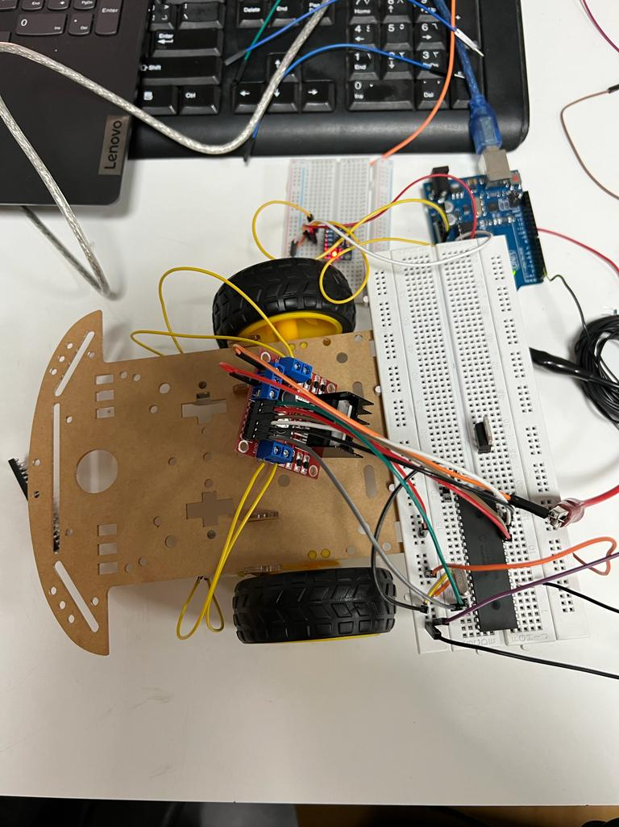
Introduction
RC (Radio Controlled) Vehicles are used nowadays in game stores and applications in their wide and different ways of design and creativity. Sensors, signal processing and communication techniques, and the availability of coding nowadays play a huge role in developing compact systems that vastly contribute to our daily lives. Radio controlled vehicles and machinery are one of the most notable and useful systems that save us a lot of time and effort, the creativity of design and ideas can be a great factor in marketing these devices in game stores which boosts someone’s business financially.
In this project, a way of establishing a Hand controlled RC vehicle will be designed in order to control the movement and speed of it by someone’s hand moving relying on the hand’s direction and tilt without the need for wiring connection. After interfacing an accelerometer with an Arduino UNO placed on someone’s hand, the movement will become a main factor in controlling the car’s speed and direction which will be the main concentration and goal to be achieved.
The project will begin by connecting the inputs of a H-bridge with a 16F877A pic while the outputs of the H-bridge will be connected to the terminals of two DC motors that will move the car. Later on, the accelerometer sensor which will capture the tilt values will be interfaced with an Arduino UNO in order to store the tilt values so the RF sensor can transmit information to be received on the PIC from the Arduino UNO board. All these components will be explained in deep details in this report.

Slide 3
The components which will be used in this project
Dc Motor
PIC16F877A
H-Bridge
Accelerometer Sensor
Arduino UNO
RF Sensor
Batteries and voltage regulators

Slide 4
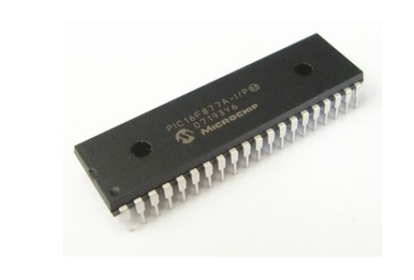
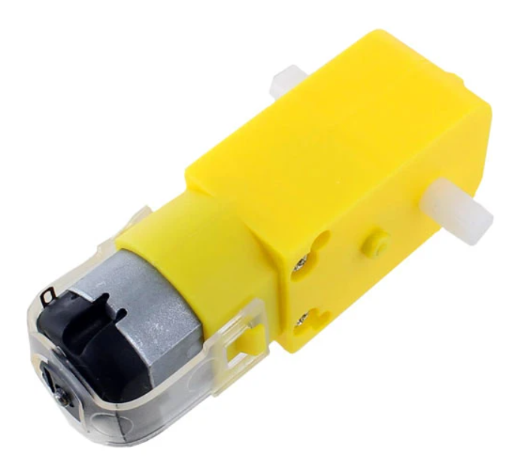
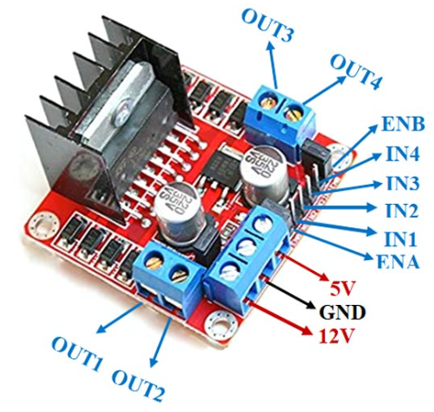
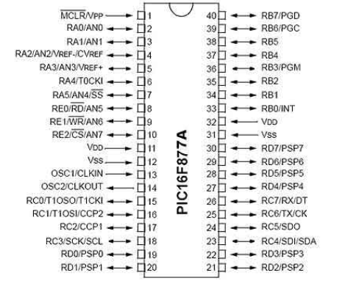
DC Motor PIC16F877A H-BRIDGE

Slide 5
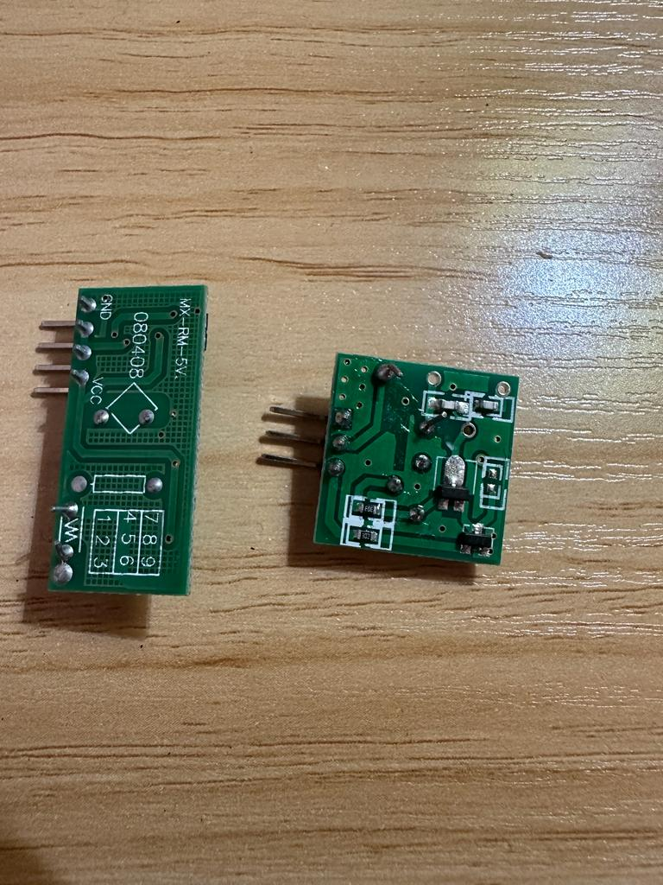
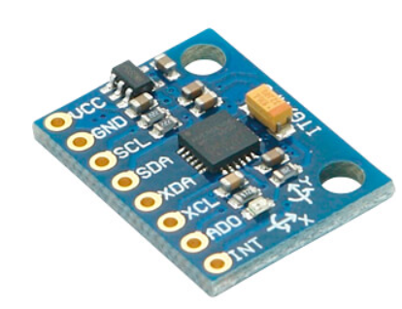
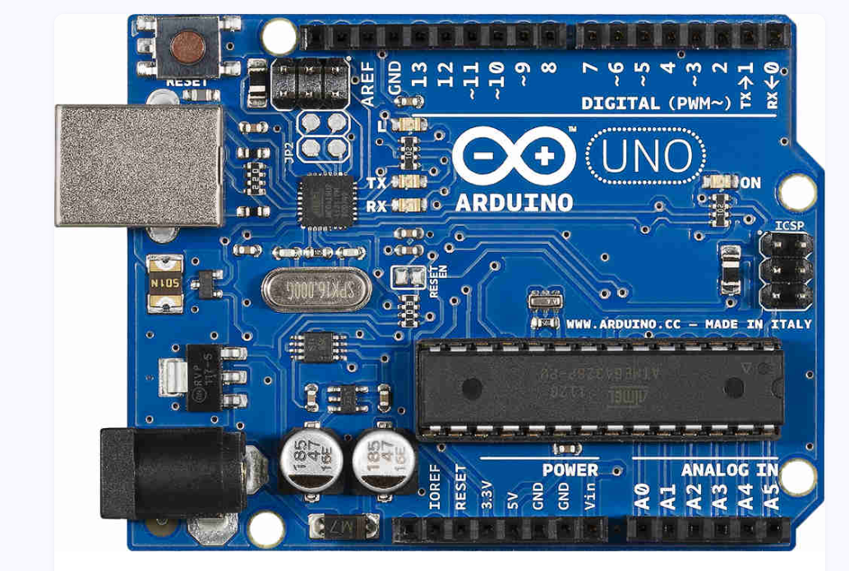
RF Sensor Accelerometer Arduino UNO

Slide 6
Design
Hardware:
After writing the code on the PIC16F877A microcontroller, using a breadboard, connect the input terminals of the H-Bridge to the Port B pins of the pic (RB0,RB1,RB2,RB3), also, connect the enable pins of the H-Bridge to RC2 pin of the pic.
Connect the output terminals of the H-Bridge to the terminals of the two DC motors.
Connect the 9V battery to the input terminal of the voltage regulator and connect the ground pin to a common ground node, then connect the output terminal of it to a common node (VDD) so, this node can be considered 5V in order to connect the (VDD) pin of the pic to it. Then, connect the ground pin to a common ground on the breadboard.
Connect a wire between RC6 pin from the pic (as it is considered to be the receiver) and Transmitter pin of the Arduino, it can be replaced with the RF sensor after making sure it is working.
Connect the 9V battery to the input terminal of the voltage regulator and connect the ground pin to a common ground node, then connect the output terminal of it to a common node (VDD) so, this node can be considered 5V in order to connect the (VDD) pin of the Arduino Uno board to it. Then, connect the ground pin to a common ground on the breadboard.
Connect the pins [SCL and SDA] between the accelerometer sensor and the Arduino UNO board, so they can communicate with each other.
Make sure to connect the voltage and ground pins of the accelerometer.

Slide 7
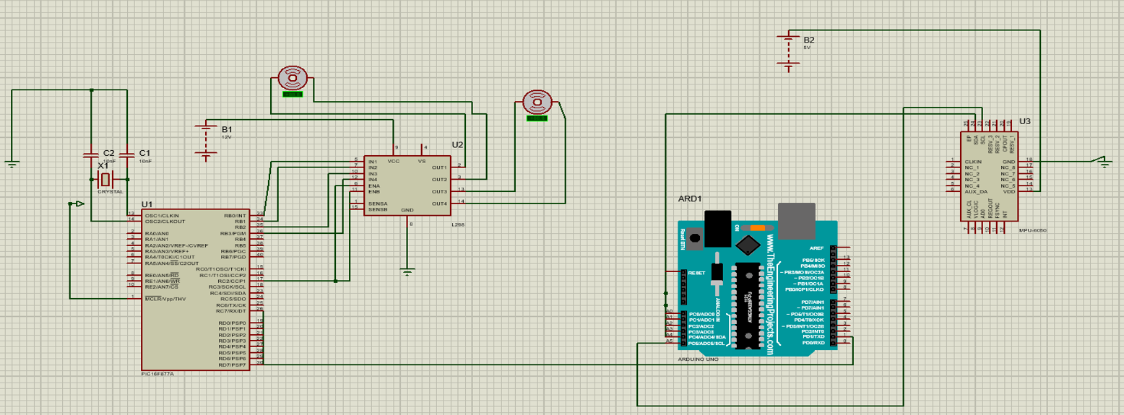
Hardware Design

Slide 8
Flow Chart (Software)

Slide 9
Generated Code for the pic

Slide 10
Generated Code for Arduino UNO

Slide 11
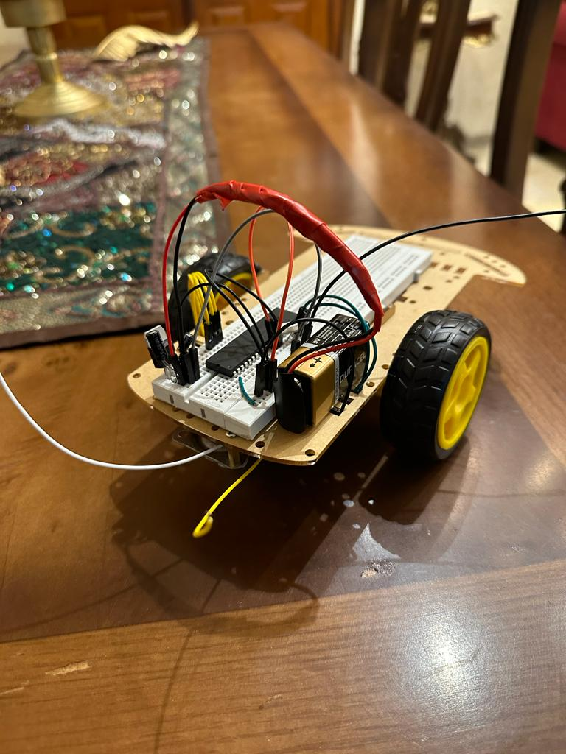
The Connection between the H-Bridge, the pic and the DC motors

Slide 12
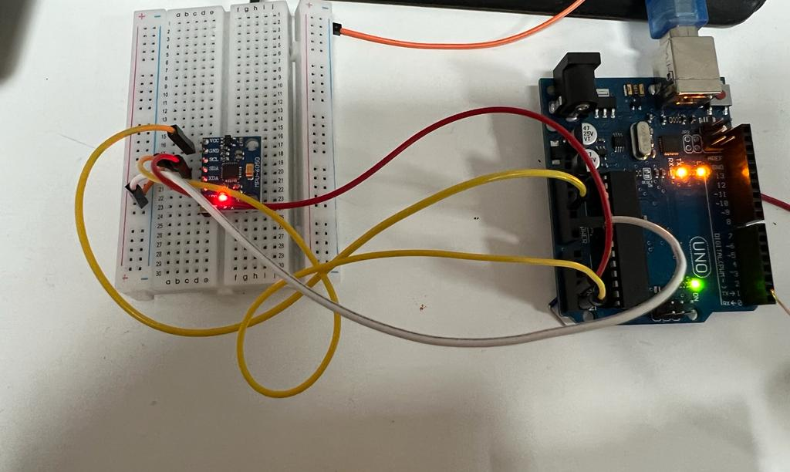
The connection between the accelerometer sensor and Arduino UNO

Slide 13
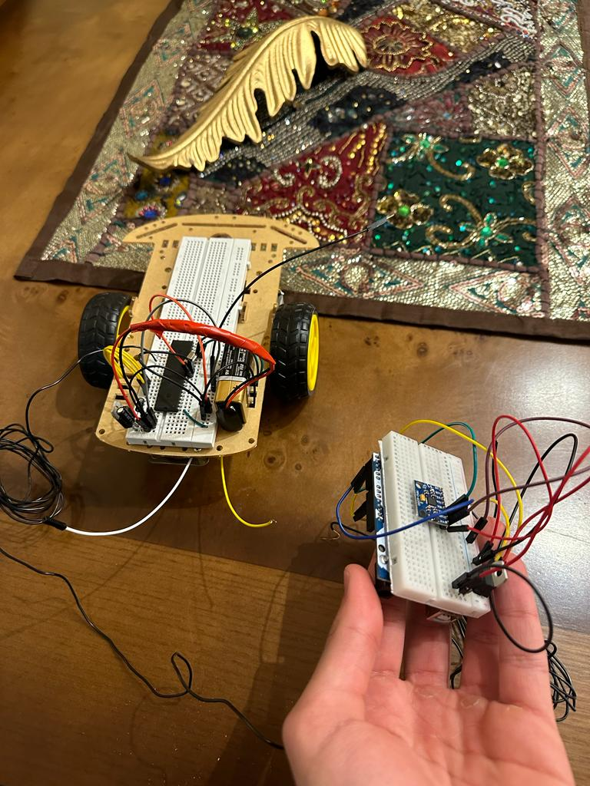
The Overall Design, the movement of the sensor affects the car movement and direction

Slide 14
Results
When the sensor is being moved down, the car will go forward, the more the sensor goes down the faster the car becomes.
When the sensor is being moved backwards, the car will go backwards, the more the sensor goes back the faster the car becomes.
When the sensor is being moved to the right, the car will go to the right, the more the sensor goes right the faster the car becomes.
When the sensor is being moved to the left, the car will go to the left, the more the sensor goes to the left the faster the car becomes.
If the sensor is put in the middle with no movement, the car stops.
The accelerometer sensor tilt values are being transmitted to duty cycle values so, the signal would go a certain percentage on and a certain percentage off and that is what affects the speed.

Slide 15
YouTube Link for Project Demonstration
https://youtu.be/YEkX9SElL4M

Slide 16
Recommendations/Problems
• Problem 1 (The unavailability of 12V and 5V Batteries):
In order for the "L298" Dual H-Bridge Driver used in this project to function, a 12V Battery has to be connected with it but there was not a 12V Battery available, so, the best recommendation is to use three 3.7V Batteries to be connected in series in order to sum almost 12V. 0.9V Difference won't cause an affect as the H-Bridge would still run however it should not cross 12V or it would damage the bridge.
Furthermore, the 16F877A needs 5 Volts but there was not a 5V battery available so, 9 Volts battery would be recommended to be used with a voltage regulator in order to convert it to 5 Volts, this would also be done for Arduino UNO as the board has to be connected with a 5V supply as well so, in this project, two 9V batteries and two voltage regulators were used.

Slide 17
• Problem 2 (RF Sensor functionality and quality):
The Radio Frequency sensor which included a transmitter and receiver in this project lacked good quality and connection, a wire was used to transmit data from the Arduino UNO board to the pic and with the code used in the design section, everything seemed to be correct but replacing the wire with the sensor and the signal was not being transmitted in the correct way, as a result of the weak functionality of this sensor. So, a long wire between the transmitter pin in the Arduino and the receiver pin in the PIC16F877A could be used instead, or the Bluetooth module would have helped as well in order to control the car’s speed and direction remotely. The best recommendation to be given is to use a better RF sensor but it might cost money as good RF sensor is supposed to be expensive, so, the long wire is still a better option or the Bluetooth Module.

Slide 18
• Problem 3 (The weak movement of the car)
After connecting everything together for the first time, it was noticed that the car barely moves despite everything being correct, the accelerometer sensor is giving signal but the car’s movement seemed like it was responding slowly; the reason behind this was the absence of two capacitors for the voltage regulator. Between the voltage input pin of the voltage regulator and the ground, a 0.22Micro farad capacitor has to be connected while between the voltage output pin and the ground, a 0.1Micro farad capacitor has to be connected. After doing this, the car responded as it should; because the capacitors reduce the ripple on the output by improving the transient response, also, they reduce the source impedance and resistance on the input. So, the best recommendation is to never forget to bring capacitors in order to improve the output response required.

Slide 19
Problem 4 (Complexity in communicating with the MPU6050 Sensor)
Due to the complexity of the MPU6050 sensor that uses the I2C communication protocol, it was hard to establish communication between the PIC and the MPU6050 sensor without using special libraries. However, even when using an I2C library in the code, it didn't work. So to overcome this problem, we used an Arduino to communicate with the sensor and send the data from the sensor to the PIC.

Slide 20
Conclusion
In conclusion, game stores are always competing with each other in order to deliver the best products, the more creative and different the outcome is, the more attractive it becomes for customers to buy it. RC (Radio Controlled) Cars are widely used in current game stores and different applications, the creativity of design and ideas can be a great factor in marketing these devices in game stores which boosts someone’s business financially. The process of design relies on many factors, starting with understanding each electrical and physical component and sensor’s background wisely and deeply in order to interface them together properly. In this project, the control of a car’s movement and direction was successfully achieved by the tilt values of a person’s hand, this new creative idea was fully done by using an accelerometer sensor, Arduino UNO and PIC16F877A and other components and sensors. Finally, using a RF sensor helped a lot in transmitting the information between Arduino UNO (after capturing the tilt data from the accelerometer sensor) and the pic. A PWM Code was generated in order to control the motor’s speed and direction, a code that connected the information between the accelerometer sensor and Arduino UNO was also generated, and finally, a serial communication code was generated in order to transmit information between the Arduino UNO board and the pic.

Slide 21
References
[1] Sen “Principles of Electric Machines and Power Electronics.” John Wiley and Sons.
[2] M. Lab, “PIC16F877A microcontroller introduction and features,” Microcontrollers Lab, 10-Aug-2015. [Online]. Available: https://microcontrollerslab.com/pic16f877a-introduction-features/. [Accessed: 20-Jan-2023].
[3] K. Franz, “What is an H-bridge?,” Digilent Blog, 09-Dec-2014. [Online]. Available: https://digilent.com/blog/what-is-an-h-bridge/. [Accessed: 20-Jan-2023].
[4] Utmel.com. [Online]. Available: https://www.utmel.com/blog/categories/motors/h-bridge-working-circuits-and-applications. [Accessed: 20-Jan-2023].
[5] “L298, a Dual H-Bridge Motor Driver module,” Latest Open Tech From Seeed, 08-Oct-2019. [Online]. Available: https://www.seeedstudio.com/blog/2019/10/08/l298-all-about-l298-motor-driver/. [Accessed: 20-Jan-2023].
[6] N. Renuga Devi, T. Suganya, S. Vignesh, R. J. Rathish, T. A. Nguyen, and S. Rajendran, “Animal health monitoring using nanosensor networks,” in Nanosensors for Smart Agriculture, Elsevier, 2022, pp. 573–608.
[7] N. Zaman, “Arduino UNO: A short review,” EduGonist, 11-Oct-2021. [Online]. Available: https://www.edugonist.com/arduino-uno/. [Accessed: 20-Jan-2023].
[8] “Arduino Uno Rev3,” Arduino Official Store. [Online]. Available: https://store.arduino.cc/products/arduino-uno-rev3. [Accessed: 20-Jan-2023].
[9] B. Butterfly, “Radio Frequency Sensors for long distance detection,” FindLight Blog, 20-Oct-2019. [Online]. Available: https://www.findlight.net/blog/radio-frequency-sensors-for-long-distance-detection/. [Accessed: 20-Jan-2023].
[10] “Generating PWM using PIC microcontroller with MPLAB and XC8,” Circuitdigest.com. [Online]. Available: https://circuitdigest.com/microcontroller-projects/pic-microcontroller-pic16f877a-pwm-tutorial. [Accessed: 20-Jan-2023].
[11] Robu.in. [Online]. Available: https://robu.in/mpu6050-with-arduino/. [Accessed: 20-Jan-2023].
[12] T. Wilmshurst, Designing embedded systems with PIC microcontrollers: Principles and applications, 2nd ed. London, England: Newnes, 2009.

