Slide 1

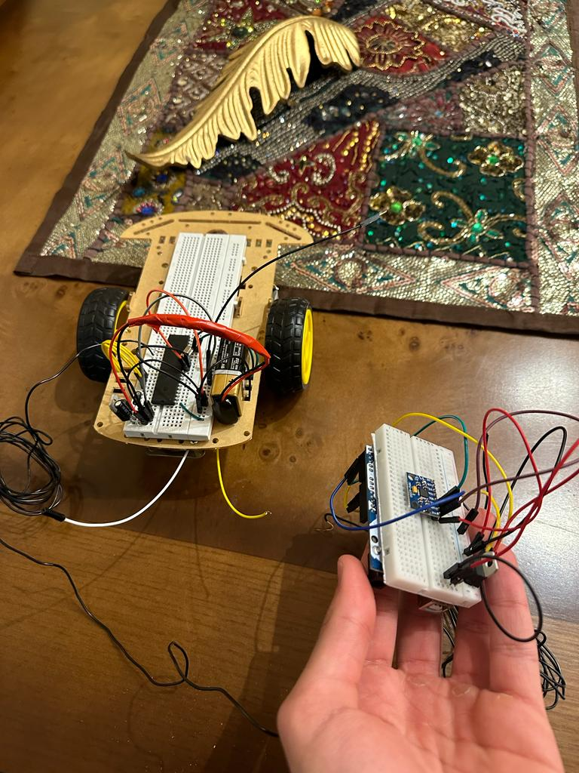
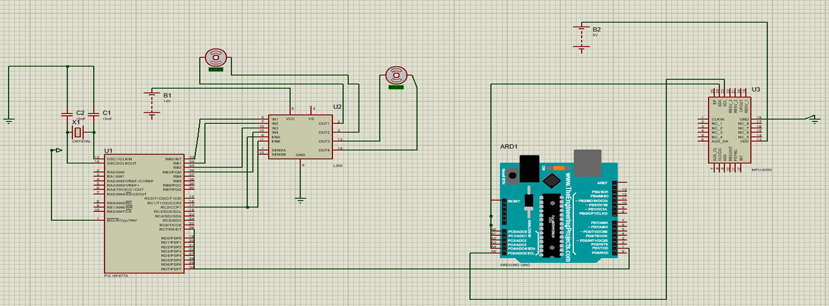
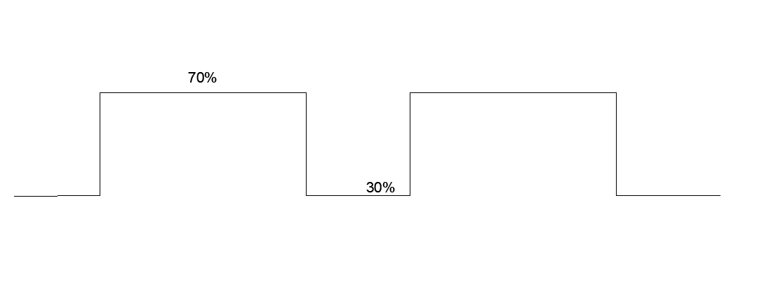
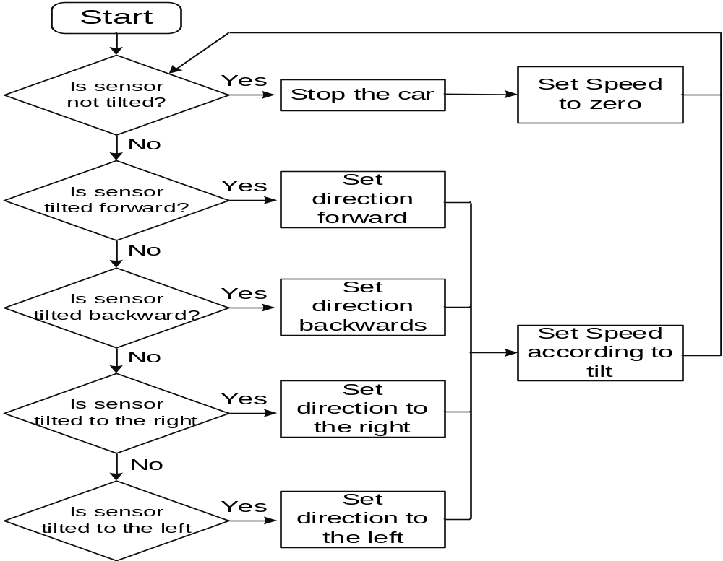
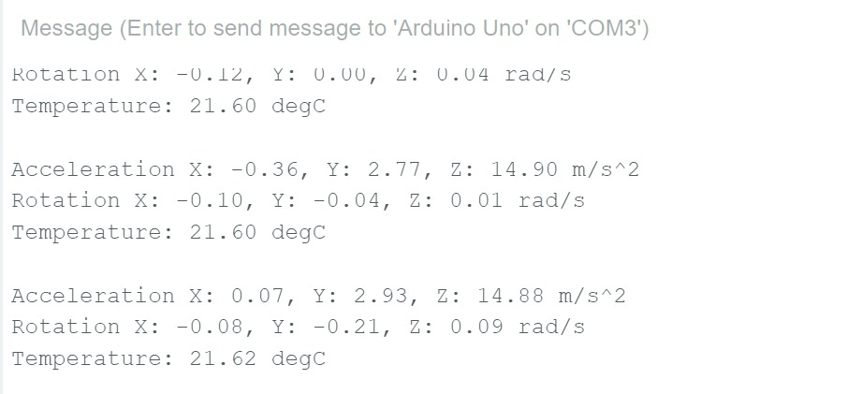
Hand Controlled RC Vehicle
Omar Hussein, Victor Dawood, Badi Abu Al Ghanam
Supervisor: Dr. Belal Sababha
Embedded Systems Final Design Project, Fall 2022
King Abdullah II School of Engineering
Princess Sumaya University for Technology
Introduction
RC (Radio Controlled) Vehicles are used nowadays in game stores and applications in their wide and different ways of design and creativity. Sensors, signal processing and communication techniques play a huge role in developing compact systems that vastly contribute to our daily lives. Radio controlled vehicles and machinery are one of the most notable and useful systems that save us a lot of time and effort, the creativity of design and ideas can be a great factor in marketing these devices in game stores which boosts someone’s business financially. In this project, a way of establishing a Hand controlled RC vehicle will be designed in order to control the direction and speed of it by someone’s hand movement relying on the hand’s direction and tilt without the need for wiring connection.
Results
The car’s movement is controlled by the accelerometer sensor, no matter what direction (forward, backward, right, left) the sensor goes, the car goes with it. The more the sensor’s tilt increases, the faster the car becomes, also, if the sensor is put in the middle with no movement, the car stops. It is now possible to put the sensor on someone’s hand and its movement can control the car’s speed and direction.
Figure 3: The final design, the car is moving depending on the accelerometer sensor
Figure 4: PWM (Pulse-Width Modulation) Signal.
The accelerometer sensor tilt values are being transmitted to duty cycle values so, the signal would go a certain percentage on and a certain percentage off and that is what affects the speed of the car.
Figure 5: The accelerometer sensor values
These are the tilt values of the accelerometer sensor, the x-y-z axis values are changing as a result of moving the sensor.
Design
The project will begin by connecting the inputs of the H-bridge with a 16F877A pic while the outputs of the H-bridge will be connected to the terminals of the two DC motors which will move the car. Also, a 9V battery with a voltage regulator will be used on the breadboard in order to give 5V to the pic.
Figure 1: The Design
Later on, the Arduino UNO board would be connected to the accelerometer sensor by connecting the pins [SCL and SDA] between both of them, then, a wire between the receiver pin from the pic and the transmitter pin of the Arduino will be connected in order to transmit data between them, then, the RF sensor can replace the wire. After generating the codes, moving the accelerometer sensor should affect in the speed and direction of the car.
Figure 2:Flowchart
Conclusion
In conclusion, game stores are always competing with each other in order to deliver the best products, the more creative and different the outcome is, the more attractive it becomes for customers to buy it. RC (Radio Controlled) Cars are widely used in current game stores and different applications, the creativity of design and ideas can be a great factor in marketing these devices in game stores which boosts someone’s business financially. The process of design relies on many factors, starting with understanding each electrical and physical component and sensor’s background wisely and deeply in order to interface them together properly. In this project, the control of a car’s movement and direction was successfully achieved by the tilt values of a person’s hand, this new creative idea was fully done by using an accelerometer sensor, Arduino UNO and PIC16F877A and other components and sensors. Finally, using a RF sensor helped a lot in transmitting the information between Arduino UNO (after capturing the tilt data from the accelerometer sensor) and the pic.

