Slide 1

About me
I completed M.Sc in Statistics
My Graduation and Post Graduation both are specialization in Statistics only, because of that I choose Data Science
Not only that to choose Data Science, is the subject for Data which is boom for the future perspective and I have very much interested in dealing with data with using Machine Learning concepts
When I was a lecturer in past 3 years I know the concepts of statistics but I don’t know where to use and how to use those concepts
Now I full fill my concepts of thoughts which I learn in the statistics though i use in Data Science.
In Innomatics Research lab atmosphere to learn subject is very good, The administration and the teaching staff was very cooperative with the students who want to grew up in the subject.
I never thought that a institution like this before came to Innomatics Research lab
KOORIMI KIRAN KUMAR

Slide 2
Problem Statement: - The data set explains about AfD (Alternative for Germany) is a political party in Germany - AfD having changes in 2014 and 2019elections due to some effected reasons - We are finding that what are the due effectors change in voting percent as 2014 to 2019

Slide 3

Agenda:
Exporting the libraries.
Importing the Dataset.
Reading the dataset.
Feature Engineering for the Dataset.
Data Visualization of each variable.
Distribution of Dependent variable.
Selecting features for future analysis using Correlation method.
Finding Multi-collinearity using VIF.
Fitting the OLS Model and finding the significant variables.
Interpritations of Model.

Slide 4
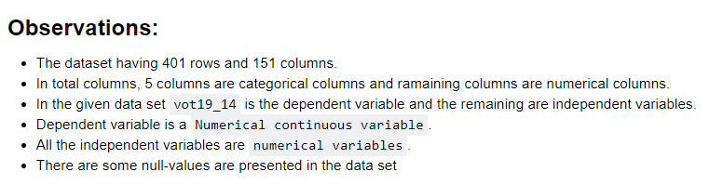

Slide 5
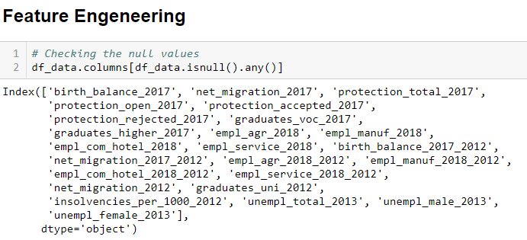

Slide 6

Checking NaN Values: Imputing NaN Values with Median:

Slide 7
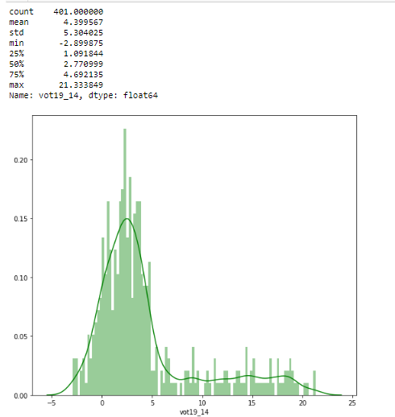
Distribution of Dependent Variable:

Slide 8
Observations for Dependent variable: - Dependent variable having positive skewness. - 0 to 5 values are are having high. - It is a Right Skewed Distribution.

Slide 9
Visualizing the Variables with respect to Dependent variable

Slide 10
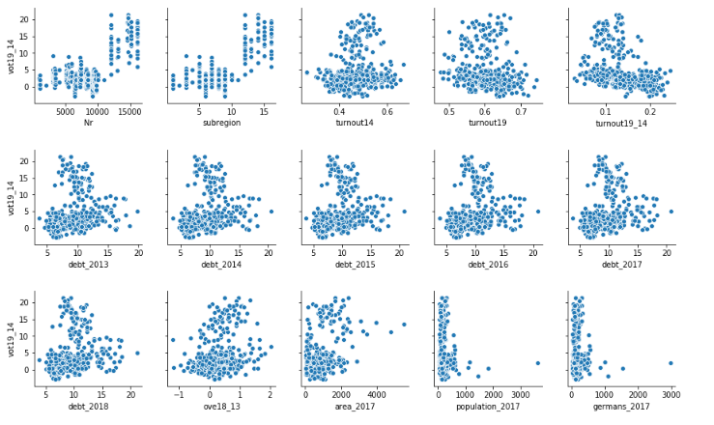

Slide 11
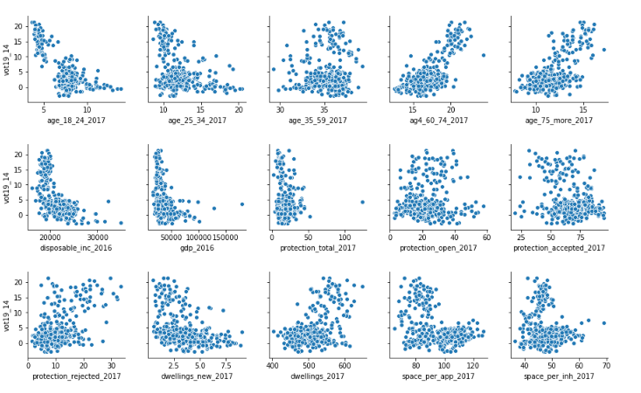

Slide 12
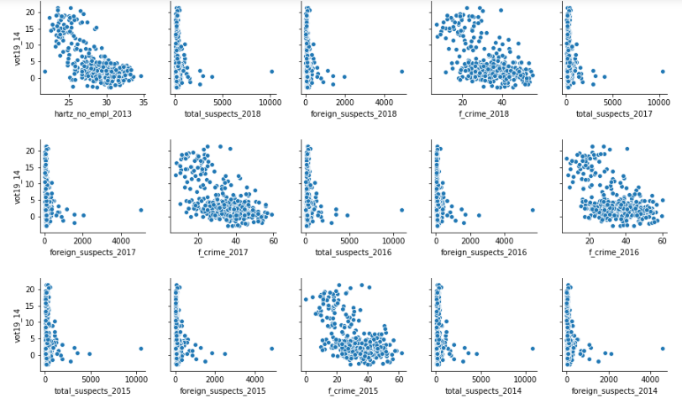

Slide 13
Outliers are presented in the DataFrame:

Slide 14
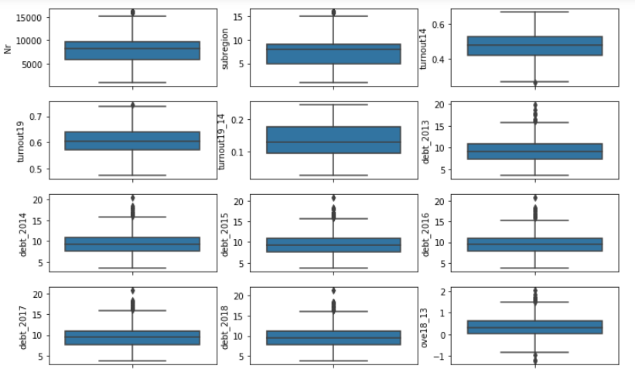

Slide 15
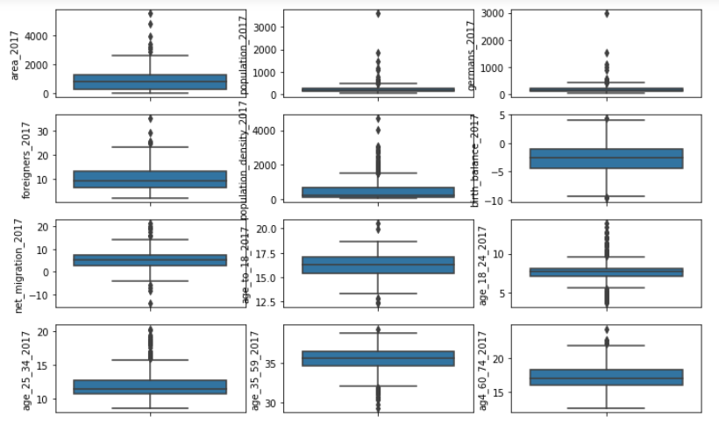

Slide 16
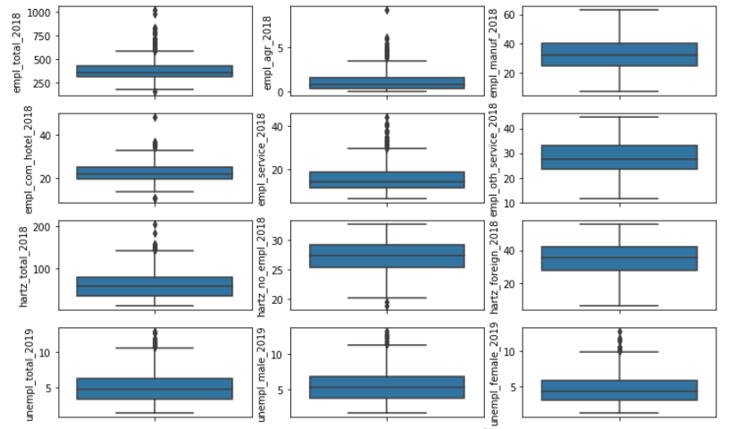

Slide 17
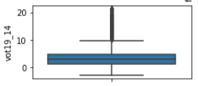
The Dependent variable also having the outliers:

Slide 18
Observations for Numerical Independent variables to the dependent variable(vot19_14): 1. Only few Independent variables are relation with the Dependent Varible. 2. There are huge independent variables are there, so, first we calculate the relations of Independent and dependent variable which of the values are greater than 0.5 correlation (correlation always in between -1 and 1) 3. If the correlation between two variables is -1 to 0, then it is negative correlation 4. If the correlation between two variables is 0 to 1, then it is positive correlation

Slide 19
Selecting features based on correlation: Correlation Method: * How does correlation help in feature selection? Features with high correlation are more linearly dependent and hence have almost the same effect on the dependent variable. So, when two features have high correlation, we can drop one of the two features.

Slide 20
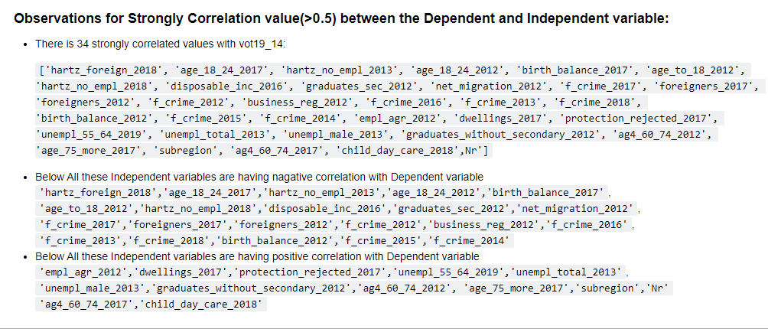

Slide 21
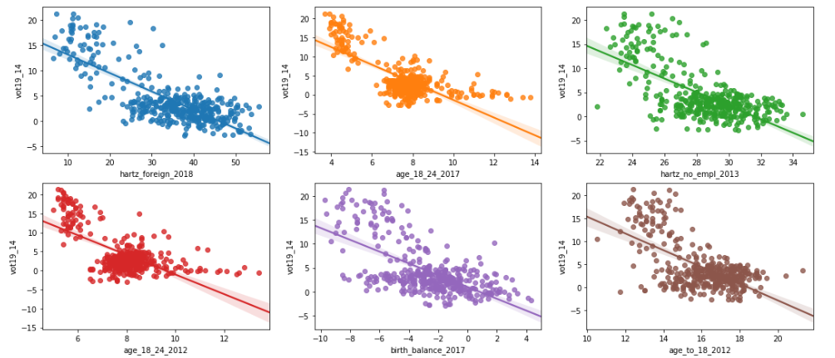

Slide 22
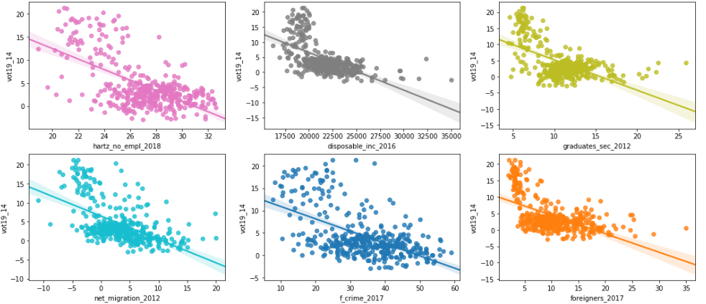

Slide 23
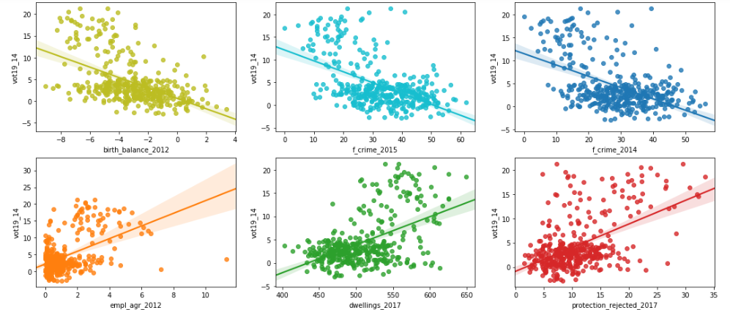

Slide 24
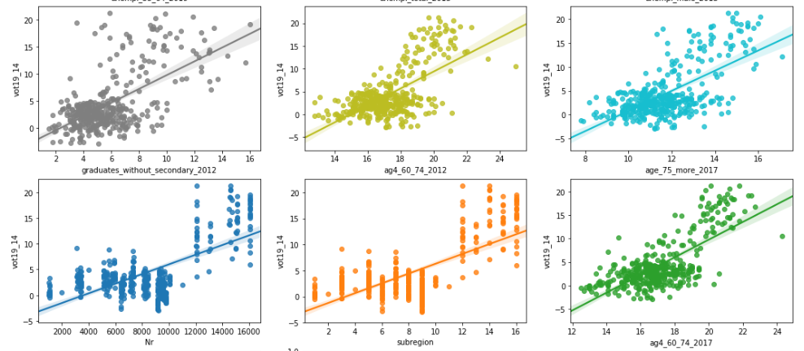

Slide 25
Distribution of feature Analysis Variables:

Slide 26
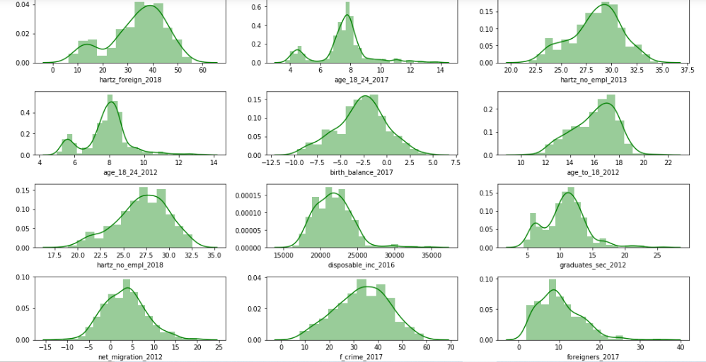

Slide 27
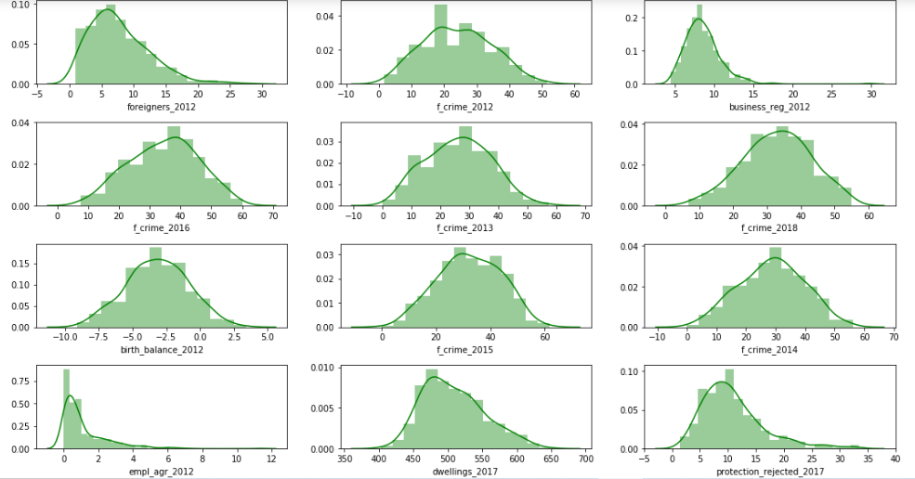

Slide 28
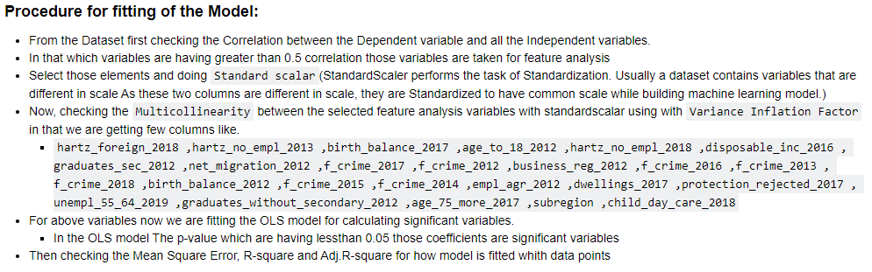

Slide 29
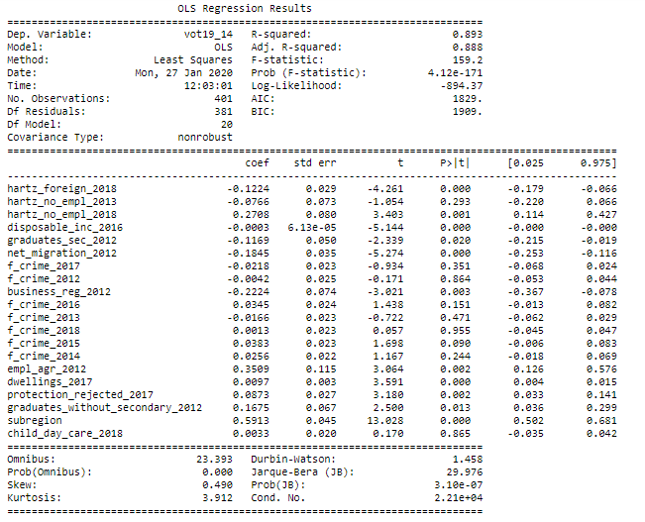

Slide 32
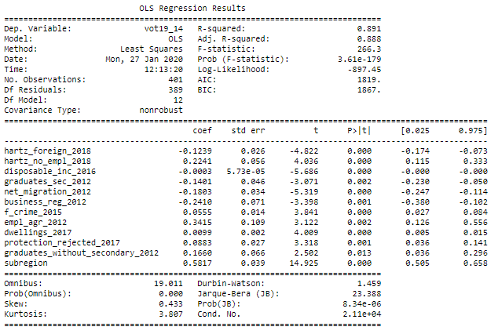

Slide 33
Observations for the model: - For this model the significant variables are: hartz_foreign_2018 , hartz_no_empl_2018 , disposable_inc_2016 , graduates_sec_2012 , net_migration_2012, business_reg_2012 , f_crime_2015 , empl_agr_2012 ,dwellings_2017 , subregion protection_rejected_2017, graduates_without_secondary_2012 - For this model R-square is 0.81 for train data and 0.80 for test data Mean Squared Error is 5.400248571680483

Slide 34
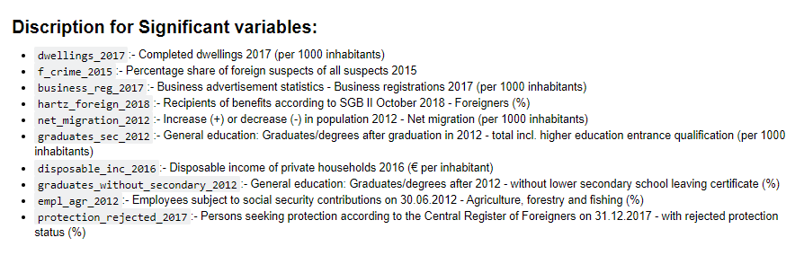

Slide 35
Procedure for OLS model: 1. This is the second method without using any Correlation and Multi-collinearity. 2. Directly we finding the significant variables with using OLS model for all variables at a time with using for loop then which variables are having greater than 0.05 p-value those variables are deleted one by one and remaining variables are append to the new data set which we are given

Slide 36
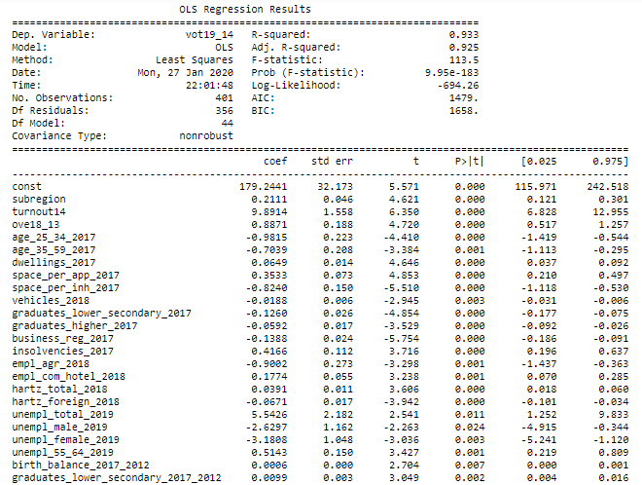

Slide 37
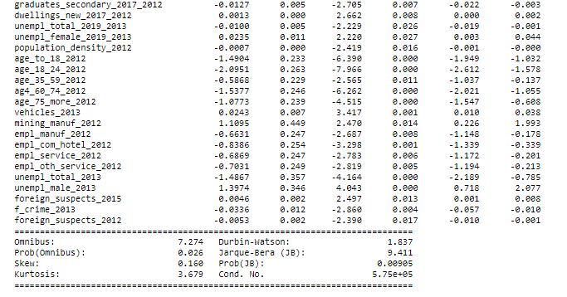

Slide 38
Observations for the Model: For this model the significant variables are : 'subregion', ‘turnout14', 'ove18_13', 'age_25_34_2017', 'age_35_59_2017', 'dwellings_2017', 'space_per_app_2017', 'space_per_inh_2017', 'vehicles_2018', 'graduates_lower_secondary_2017', 'graduates_higher_2017', 'business_reg_2017', 'insolvencies_2017', 'empl_agr_2018', 'empl_com_hotel_2018', 'hartz_total_2018', 'hartz_foreign_2018', 'unempl_total_2019', 'unempl_male_2019', 'unempl_female_2019', 'unempl_55_64_2019', 'birth_balance_2017_2012', 'graduates_lower_secondary_2017_2012',

Slide 39
hartz_foreign_2018 , hartz_no_empl_2018 , disposable_inc_2016 , graduates_sec_2012 , net_migration_2012, business_reg_2012 , f_crime_2015 , empl_agr_2012 ,dwellings_2017 , subregion protection_rejected_2017, graduates_without_secondary_2012
'graduates_secondary_2017_2012', 'dwellings_new_2017_2012', 'unempl_total_2019_2013', 'unempl_female_2019_2013', 'population_density_2012', 'age_to_18_2012', 'age_18_24_2012', 'age_35_59_2012', 'ag4_60_74_2012', 'age_75_more_2012', 'vehicles_2013', 'mining_manuf_2012', 'empl_manuf_2012', 'empl_com_hotel_2012', 'empl_service_2012', 'empl_oth_service_2012', 'unempl_total_2013', 'unempl_male_2013', 'foreign_suspects_2015', 'f_crime_2013', 'foreign_suspects_2012

Slide 40
- Mean Absolute Error: 1.3109914 - Mean Squared Error: 2.8656173 - Root Mean Squared Error: 1.692813 - R-Squared for Train: 0.933252 - R-Squared for Test: 0.89688
Mean Absolute Error: 1.621346 - Mean Squared Error: 5.40024 - Root Mean Squared Error: 2.32384
R-Squared for Train Data: 0.891 - R-Squared for Test Data: 0.8056

Slide 41
Final Interpretations: - Among these two models, the model which is build with VIF is the Best Model in that we are getting 12 variables as significant variables. - For the future predictions it is simple to build a model for the machine taking a less memory.

Slide 42
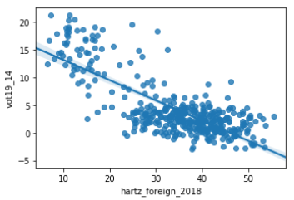
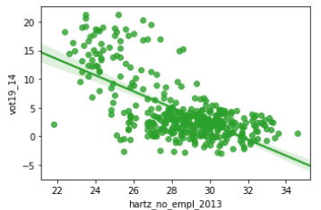
- If Decreasing Recipients of benefits according to SGB II October 2018 - Foreigners (%), then Increase in Vot19_14 and viceversa. - If Decreasing Recipients of SGB II benefits on 30.09.2013 - Persons in need of assistance who are not capable of gainful employment (%) , then Increase in Vot19_14

Slide 43
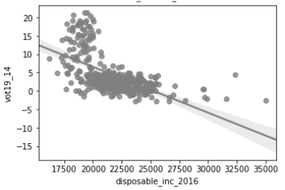
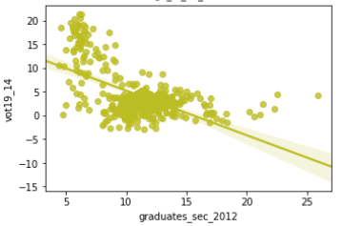
- If Decreasing Disposable income of private households 2016 (€ per inhabitant), then Decrese in Vot19_14 and viceversa. - If General education: Graduates/degrees after graduation in 2012 - total incl. higher education entrance qualification (per 1000 inhabitants), then Increase in Vot19_14

Slide 44
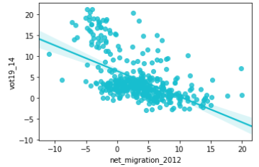
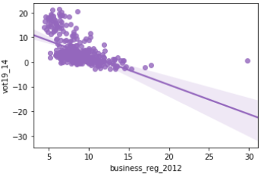
- If Decreasing Increase (+) or decrease (-) in population 2012 - Net migration (per 1000 inhabitants), then Decrease in Vot19_14 and vice-versa. - If Business advertisement statistics - Business registrations 2017 (per 1000 inhabitants), then Increase in Vot19_14

Slide 45
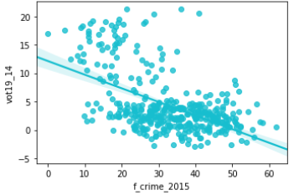
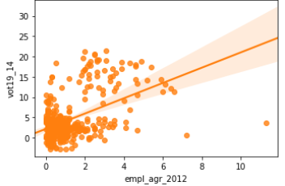
- If Decreasing Percentage share of foreign suspects of all suspects 2015, then Decrease in Vot19_14 and vice-versa. - If Increasing in Employees subject to social security contributions on 30.06.2012 - Agriculture, forestry and fishing (%), then Increase in Vot19_14

Slide 46
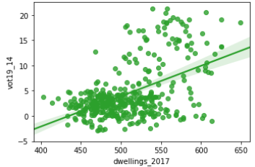
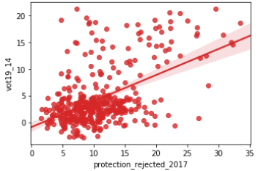
- If Increasing Completed dwellings 2017 (per 1000 inhabitants), then Increase in Vot19_14 and vice-versa. - If Increasing in Persons seeking protection according to the Central Register of Foreigners on 31.12.2017 - with rejected protection status (%), then Increase in Vot19_14 and vice-versa.

Slide 47
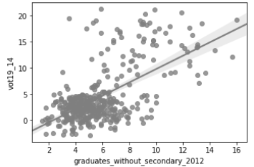
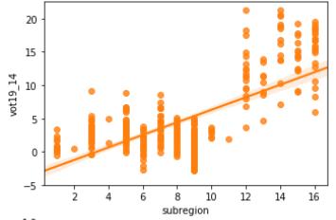
- If Increasing General education: Graduates/degrees after 2012 - without lower secondary school leaving certificate (%), then Increase in Vot19_14 and vice-versa. - If Increasing in Sub-region value, then Increase in Vot19_14 and vice-versa.

Slide 48
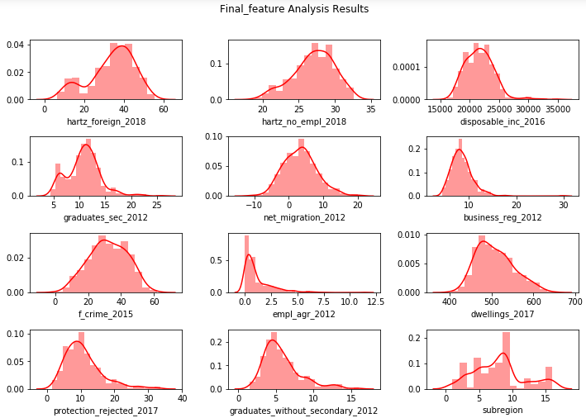

Slide 49
THANK YOU!

