Slide 1
PATH-RAG: reasoning over knowledge paths
By Koorosh Asil

Slide 2
Introduction:
RAG empowers LLMs to access domain-specific knowledge from external databases, enhancing the response quality without additional training.
Most RAG approaches divide the text database into chunks, organizing them in a flat structure to facilitate efficient and precise searches
To better capture the inherent dependencies and structured relationships across texts in a database, researchers use graph-based RAG, which organizes textual information into an indexing graph.
In this graph, nodes represent entities extracted from the text, while edges denote the relationships between these entities.

Slide 3
graph-rag VS traditional rag ?
Traditional RAG usually focuses on questions that can be answered with local information about a single entity or relationship.
In contrast, graph-based RAG targets on global-level questions that need the information across a database to generate a summary-like response.
For example, GraphRAG first applies community detection on the graph, and then gradually summarizes the information in each community.
However, we argue that the information considered in previous graph-based RAG methods is often redundant, which can introduce noise, degrade model performance, and increase token consumption.

Slide 4
Figure 1: Comparison between different graph-based RAG methods.
Notes:
Figure 1: GraphRAG uses all the information within certain communities, while LightRAG uses all the immediate neighbors of query-related nodes. In contrast, our PathRAG focuses on key relational paths between query-related nodes to alleviate noise and reduce token consumption.
However, we argue that the information considered in previous graph-based RAG methods is often redundant, which can introduce noise, degrade model performance, and increase token consumption.

Slide 5
Solution: path-rag
To overcome the above limitations, we propose PathRAG, which performs key path retrieval among retrieved nodes and converts these paths into textual form for LLM prompting.
we focus on the key relational paths between retrieved nodes to alleviate noise and re- duce token consumption.
Specifically, we first retrieve relevant nodes from the indexing graph based on the keywords in the query. Then we design a flow-based pruning algorithm with distance awareness to identify the key relational paths between each pair of retrieved nodes.
Notes:
The pruning algorithm enjoys low time complexity, and can assign a reliability score to each retrieved path.

Slide 6
“LOST IN THE MIDDLE” problem
The lost in the middle problem is when language models focus more on the start and end of long inputs and ignore important information in the middle.
As context length increases, mid-document facts are less likely to affect the output. This hurts long-document QA and RAG, motivating chunking and structured retrieval.
HOW TO SOLVE IN PATH-RAG?
  we sequentially concatenate the node and edge information alongside each path as textual relational paths. we place the textual paths into the prompt in ascending order of reliability. scores for better answer generation.
Notes:
PathRAG consistently outperforms state-of-the-art baselines across six datasets and five eval- uation dimensions. Extensive experiments further validate the design of PathRAG.

Slide 7
Knowledge Sources for RAG
A knowledge base is an external repository that stores structured or unstructured information used by retrieval-augmented generation systems to support language models.
Instead of relying solely on parametric memory, LLMs query these knowledge sources to obtain relevant facts, context, or relationships at inference time.
Knowledge bases can take different forms—such as text collections, knowledge graphs, or graph datasets—each offering distinct ways of organizing and accessing information for downstream reasoning and generation tasks.

Slide 8
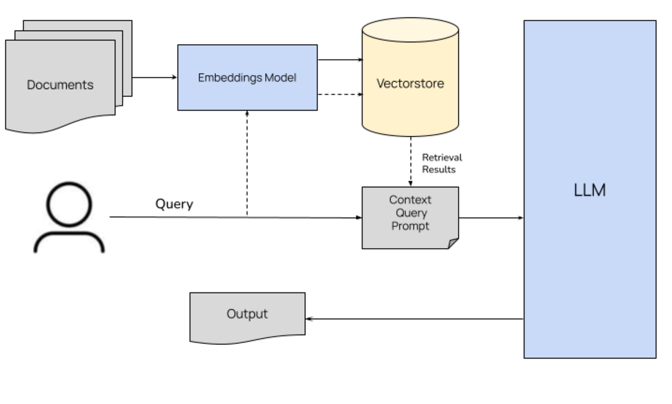
Text-Based RAG
Text-based RAG is widely used in LLMs to improve text quality and reduce hallucinations by retrieving information from external textual databases that store large amounts of domain knowledge.
Text-based RAG systems rely on textual data only, allowing LLMs to directly retrieve and condition on retrieved text chunks.

Slide 9
Based on retrieval mechanisms, text-based RAG is divided into two categories:
  Sparse vector retrieval: identifies representative words using word frequency and retrieves text via keyword matching.
  Dense vector retrieval: encodes queries and text into vector embeddings and retrieves content based on embedding similarity, addressing lexical mismatch and synonym issues.
Most existing text-based RAG methods use a flat organization of text chunks and do not model relationships or contextual dependencies between chunks, which limits the quality of LLM-generated responses.

Slide 10
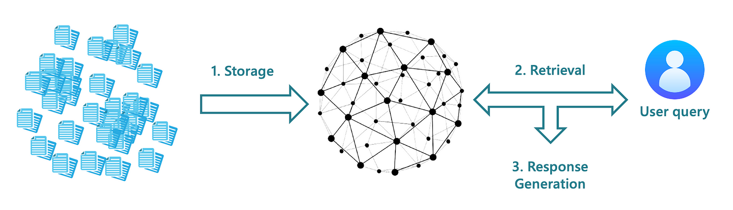
KG-RAG
KG-RAG retrieves information from knowledge graphs (KGs) instead of text databases.
It can use existing KGs or optimized/enhanced versions of KGs.
KG-RAG enables LLMs to retrieve entities and their relationships, providing structured knowledge for generation

Slide 11
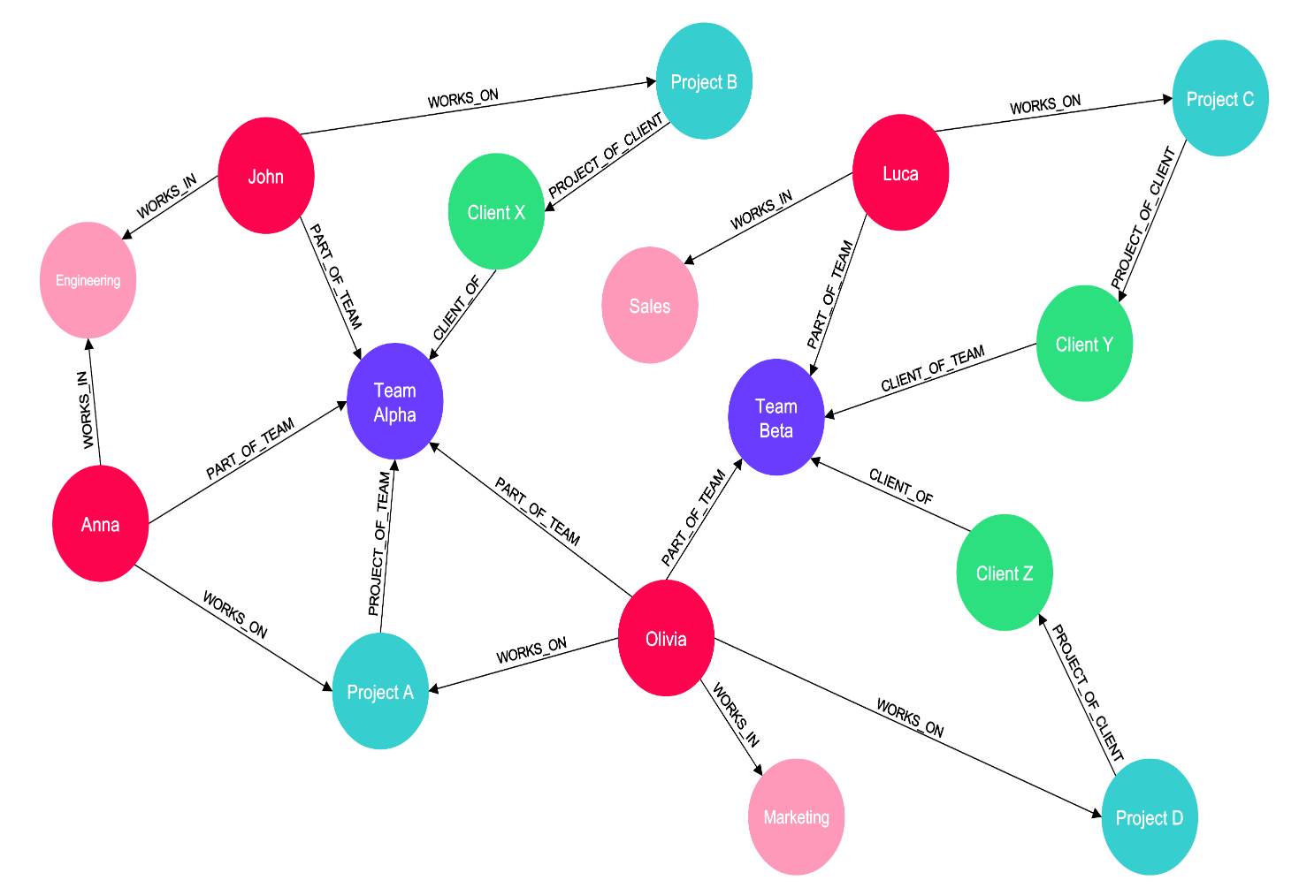
KG-RAG methods typically extract a local subgraph from the KG, such as immediate neighbors of queried entities.
This approach focuses on entity-centric retrieval.
Most KG-RAG methods handle questions involving a single entity or relation, which limits their applicability to more complex, multi-hop reasoning tasks.
Notes:
KG-RAG example
Knowledge graph (triples)
(Transformer, used_in, RAG)
(Graph-RAG, type_of, RAG)
(Transformer, improves, Long-Range Dependency)
Entities
Transformer
RAG
Graph-RAG
Long-Range Dependency
User query
“How do transformers relate to RAG?”
Entity linking
Transformer
RAG
Retrieved local subgraph
Transformer → used_in → RAG
Transformer → improves → Long-Range Dependency
Context sent to LLM
Retrieved entities + relations (triples)
Output
Answer based on KG facts (entity–relation level)
In this example, the knowledge base is a knowledge graph containing facts expressed as triples, such as (Transformer, used_in, RAG) and (Transformer, improves, Long-Range Dependency). When the user asks “How do transformers relate to RAG?”, the system first links the query to the relevant entities Transformer and RAG. KG-RAG then retrieves a local subgraph around these entities, capturing only the directly connected relations. The retrieved entities and triples are passed to the language model, which generates an answer strictly grounded in these structured facts, reasoning at the entity–relation level rather than over raw text.

Slide 12
Graph-based RAG
Graph-based RAG organizes text databases as text-associated graphs instead of using preconstructed knowledge graphs.
It targets global-level questions that require information from multiple text segments across a database.
Graph construction involves extracting entities from text and identifying relationships between them.
Contextual text is preserved as descriptions to reduce information loss during text-to-graph conversion.

Slide 13
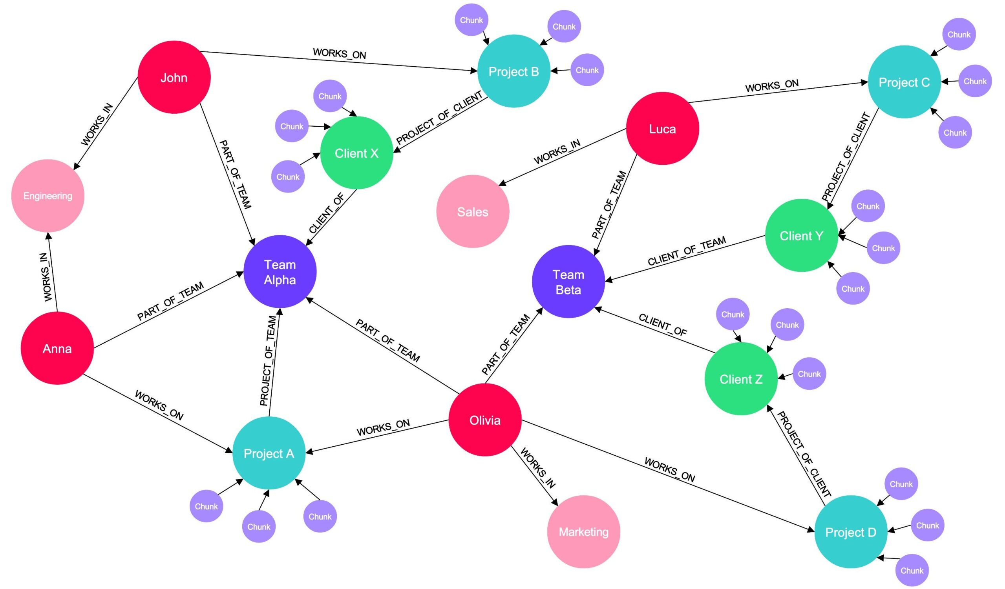
GraphRAG applies community detection algorithms on the constructed graph.
Information is aggregated hierarchically, from sub-communities to higher-level communities.
This enables multi-segment and global information integration for downstream generation.
Notes:
Graph-RAG example (step-by-step, minimal explanation)
Text chunks in database
C1: “Transformers model long-range dependencies in NLP.”
C2: “Graph-RAG connects related text chunks using entity links.”
C3: “Transformers are used in modern RAG systems.”
Entities extracted
Transformers
Graph-RAG
RAG systems
Graph edges
Transformers ↔ RAG systems
RAG systems ↔ Graph-RAG
User query
“How are transformers used in Graph-RAG?”
Retrieved subgraph
Transformers → RAG systems → Graph-RAG
Attached text: C1 + C2 + C3
Context sent to LLM
Combined information from all connected chunks
Output
Answer integrates all three chunks, not a single passage.
In this example, the database consists of multiple text chunks that are organized into a text-associated graph. Each chunk contributes entities such as Transformers, RAG systems, and Graph-RAG, which are linked based on their relationships across documents. When the user asks “How are transformers used in Graph-RAG?”, the system retrieves a connected subgraph spanning these entities rather than isolated text passages. The text attached to all connected nodes—C1, C2, and C3—is aggregated and provided to the language model, enabling it to generate an answer that integrates information across multiple chunks and captures the global context of the query.

Slide 14
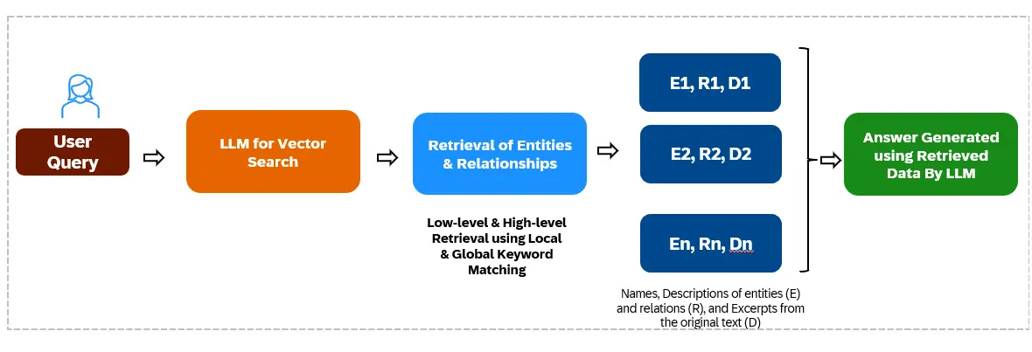
LightRAG adopts a dual-stage retrieval framework to accelerate the retrieval process.
It extracts both local and global keywords from the input question.
Relevant nodes and edges are retrieved using these keywords.

Slide 15
The ego-network of retrieved nodes is treated as the final retrieval result.
This approach simplifies retrieval and effectively supports global-level tasks.
However, retrieving all immediate neighbors may introduce noise, which can negatively affect answer quality
Notes:
LightRAG example
Text-associated graph
Nodes: Transformers, RAG, Graph-RAG, Attention
Edges: usage, improves, related_to
User query
“How do transformers help global reasoning in RAG?”
Stage 1: Keyword extraction
Local keywords: transformers, RAG
Global keywords: global reasoning
Stage 2: Keyword-based retrieval
Retrieved nodes: Transformers, RAG
Retrieved edges: all edges connected to these nodes
Retrieved ego-networks
Transformers → used_in → RAG
Transformers → improves → Attention
RAG → related_to → Graph-RAG
Context sent to LLM
All nodes and edges in the ego-networks
Output
Answer generated from full neighborhood information (may include irrelevant relations).

Slide 16
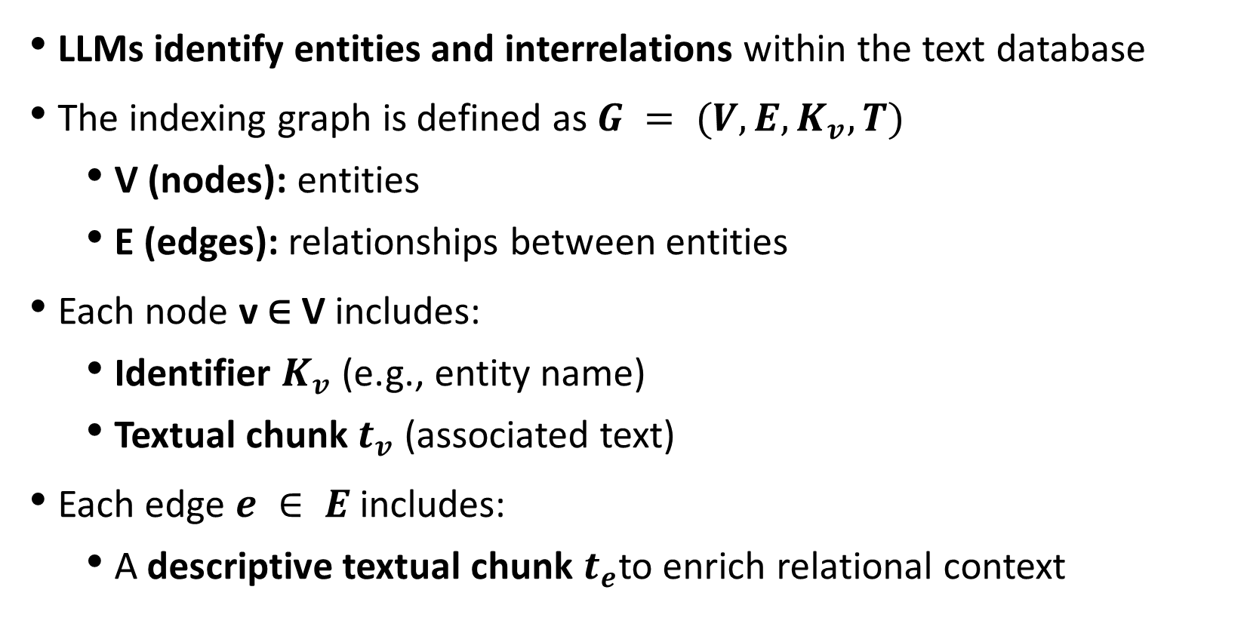
Indexing-Graph construction
LLMs identify entities and interrelations within the text database
The indexing graph is defined as $G = (V, E, K_{v}, T)$
  V (nodes): entities
  E (edges): relationships between entities
Each node v ∈ V includes:
  Identifier $K_{v}$ (e.g., entity name)
  Textual chunk $t_{v}$ (associated text)
Each edge $e ∈ E$includes:
  A descriptive textual chunk $t_{e}$to enrich relational context

Slide 17
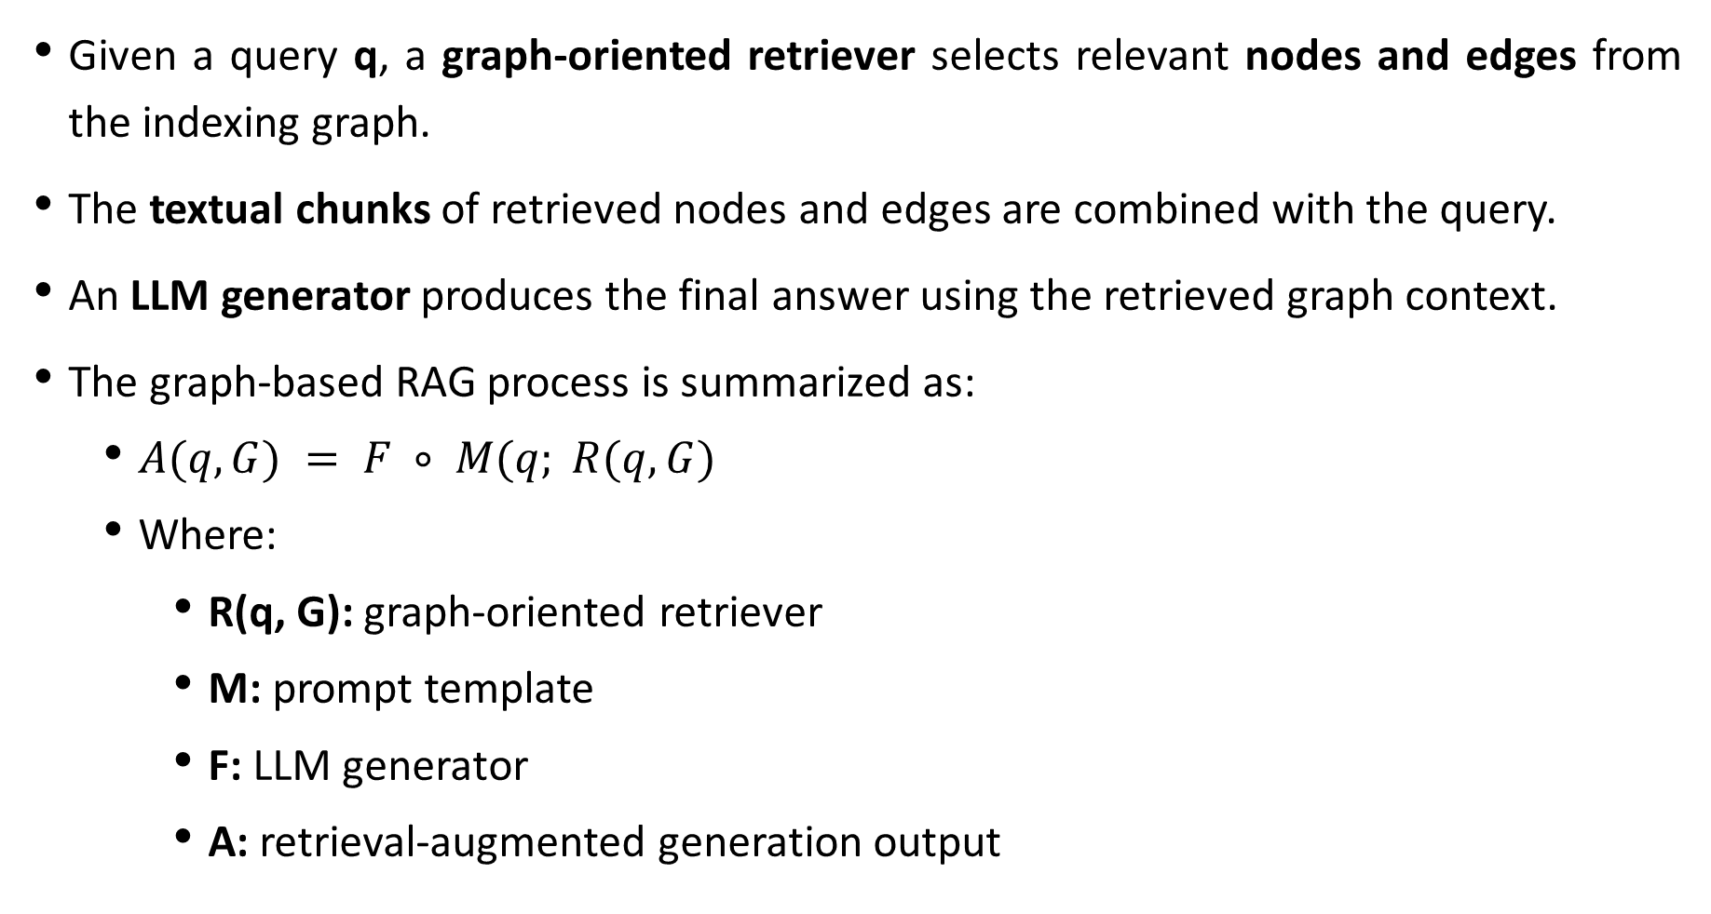
Given a query q, a graph-oriented retriever selects relevant nodes and edges from the indexing graph.
The textual chunks of retrieved nodes and edges are combined with the query.
An LLM generator produces the final answer using the retrieved graph context.
The graph-based RAG process is summarized as:
  $A(q, G) = F ∘ M(q; R(q, G)$
  Where:
    R(q, G): graph-oriented retriever
    M: prompt template
    F: LLM generator
    A: retrieval-augmented generation output
Notes:
Graph-based RAG workflow example
Text database
D1: “Transformers are widely used in modern NLP models.”
D2: “RAG systems retrieve external knowledge for generation.”
D3: “Graph-based RAG connects entities across documents.”
Entity extraction
Transformers
NLP models
RAG systems
Graph-based RAG
Indexing graph construction
Nodes (V):
v₁: (Transformers, t₁ = D1)
v₂: (RAG systems, t₂ = D2)
v₃: (Graph-based RAG, t₃ = D3)
Edges (E):
Transformers → used_in → NLP models
RAG systems → related_to → Graph-based RAG
Edge text (tₑ):
“used in”, “related to”
Indexing graph
G = (V, E, Kᵥ, T)
User query
“How are transformers used in graph-based RAG?”
Graph-oriented retrieval
Retrieved nodes: Transformers, RAG systems, Graph-based RAG
Retrieved edges: Transformers → NLP models, RAG systems → Graph-based RAG
Retrieved text chunks
t₁ + t₂ + t₃ + edge descriptions
Context sent to LLM
Query + retrieved node text + retrieved edge text
Output`
Answer generated using structured graph context.
In this example, the user query explicitly mentions “transformers” and “graph-based RAG”, which are first linked to their corresponding nodes in the indexing graph. The graph-oriented retriever then expands beyond these exact matches by following the graph structure, identifying nodes that connect the queried entities. As a result, “RAG systems” is retrieved because it lies on the path between Transformers and Graph-based RAG, capturing an implicit relationship that is not stated directly in the query. This graph-based expansion allows the system to retrieve structurally relevant context, enabling multi-hop reasoning and producing an answer grounded in how concepts are connected, rather than relying only on keyword overlap.

Slide 18
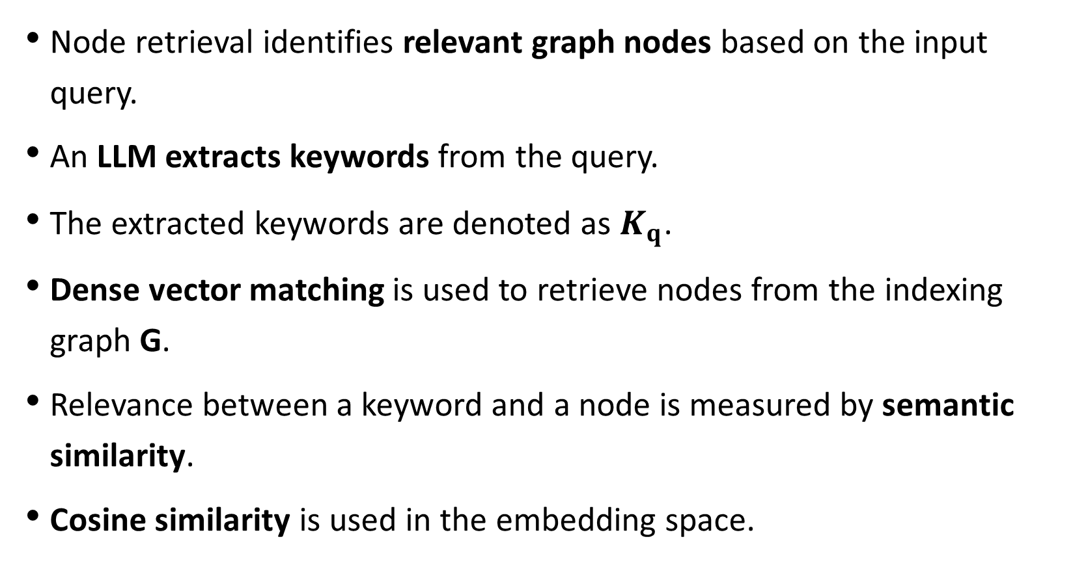
Node Retrieval
Node retrieval identifies relevant graph nodes based on the input query.
An LLM extracts keywords from the query.
The extracted keywords are denoted as $K_{q}$.
Dense vector matching is used to retrieve nodes from the indexing graph G.
Relevance between a keyword and a node is measured by semantic similarity.
Cosine similarity is used in the embedding space.

Slide 19
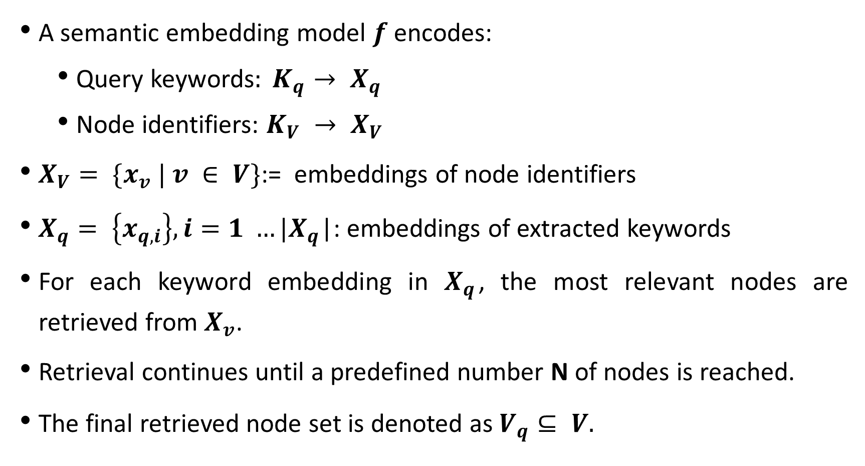
A semantic embedding model $f$encodes:
  Query keywords$: K_{q}→ X_{q}$
  Node identifiers: $K_{V} → X_{V}$
$X_{V}= \{x_{v} | v ∈ V\}$:= embeddings of node identifiers
$X_{q}= \left\{x_{q,i}\right\}, i=1 …|X_{q}$|: embeddings of extracted keywords
For each keyword embedding in $X_{q}$, the most relevant nodes are retrieved from $X_{v}$.
Retrieval continues until a predefined number N of nodes is reached.
The final retrieved node set is denoted as $V_{q}⊆ V.$

Slide 20
Node Retrieval
Multiple paths may exist between retrieved nodes.
Not all paths are useful for answering the query.
A flow-based pruning algorithm is used to extract key paths efficiently.
The method incorporates distance awareness to favor closer and stronger connections.

Slide 21
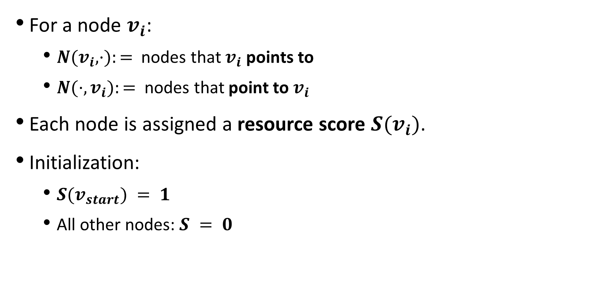
Definitions
For a node $v_{i}$:
  $N(v_{i}, ·):=$ nodes that $v_{i}$ points to
  $N(·,v_{i}):=$ nodes that point to $v_{i}$
Each node is assigned a resource score $S(v_{i})$.
Initialization:
  $S(v_{start}) = 1$
  All other nodes: $S = 0$
Notes:
Nodes closer to the start node receive more resource, while distant nodes receive less.

Slide 22
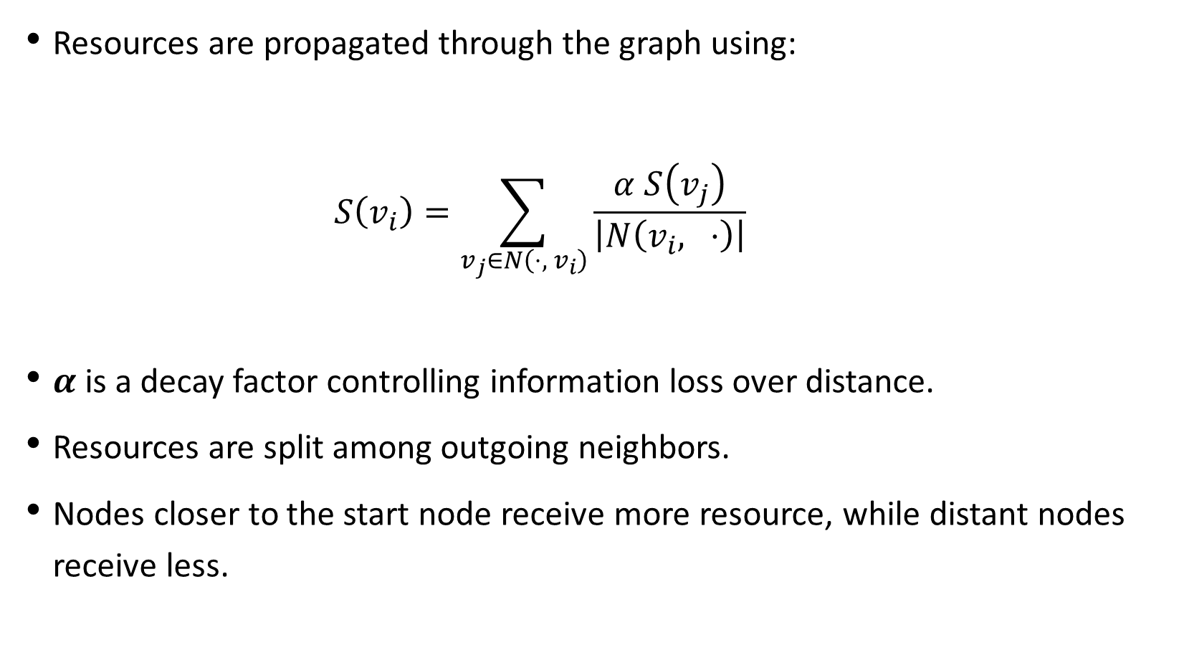
Resource propagation rule
Resources are propagated through the graph using:
    $$S\left(v_{i}​\right)=\sum_{v_{j}​∈N\left(⋅,{ v}_{i​}\right)}{\frac{α S\left(v_{j}\right)}{\left|N\left(v_{i​}, ⋅\right)\right|}}​$$
$α$is a decay factor controlling information loss over distance.$​$
Resources are split among outgoing neighbors.
Nodes closer to the start node receive more resource, while distant nodes receive less.
Notes:
At each hop, the resource is multiplied by the decay factor α < 1.
The resource is also divided by the out-degree of the previous node.
So for a single path, resource roughly scales like:
S ≈ αᵈ / (product of out-degrees), where d is path length.

Slide 23
The decay factor penalizes distant nodes, making the retriever sensitive to graph distance.
Stronger, shorter connections accumulate more resource.
Paths with higher total resource are considered more important.
This method does not rely on fixed hop limits.
Path importance is determined by connection strength, not just path length.
Enables flexible and effective pruning for complex graph structures.

Slide 24
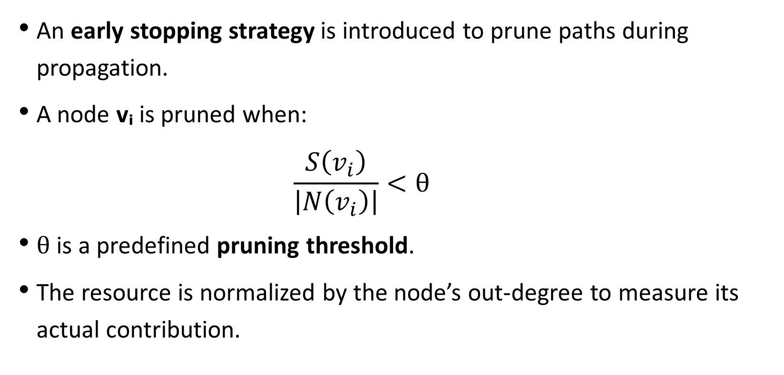
Stopping criterion
An early stopping strategy is introduced to prune paths during propagation.
A node vᵢ is pruned when:
    $$\frac{S\left(v_{i}\right)}{\left|N\left(v_{i}\right)\right|}<θ$$
$θ$ is a predefined pruning threshold.
The resource is normalized by the node’s out-degree to measure its actual contribution.
Notes:
Slide 3: Effect of Early Stopping
Nodes with low contribution are removed early.
Prevents propagation through deep or weakly connected regions of the graph.
Improves both efficiency and retrieval quality.
Slide 4: Key Benefit
Ensures the algorithm terminates early for unimportant paths.
Focuses retrieval on high-impact nodes and paths.
Works naturally with the distance-aware resource propagation mechanism.

Slide 25
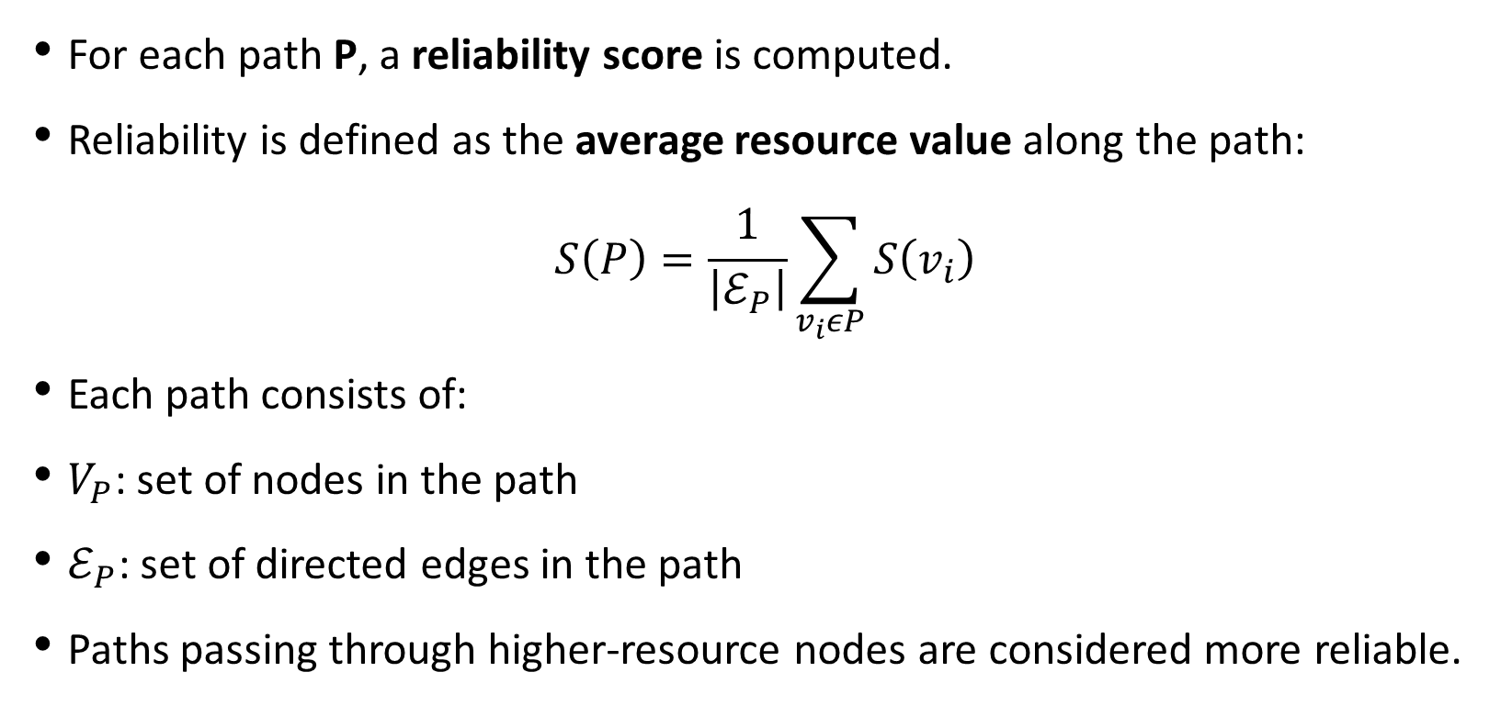
Path reliability measurement
For each path P, a reliability score is computed.
Reliability is defined as the average resource value along the path:
$$S\left(P\right)=\frac{1}{\left|ℰ_{P}\right|}\sum_{v_{i}εP}{S\left(v_{i}\right)}$$
Each path consists of:
$V_{P}$: set of nodes in the path
$ℰ_{P}$: set of directed edges in the path
Paths passing through higher-resource nodes are considered more reliable.
Notes:
Intuitively, S(P)S(P)S(P) answers one simple question:
“How strong is this path overall?”
Here’s how to think about it step by step.
Each node viv_ivi​ already has a resource score S(vi)S(v_i)S(vi​) that tells us how relevant or important it is with respect to the query.
A path P is just a chain of these nodes. Some paths pass through high-resource nodes, others go through weak, low-resource ones.
The formula adds up the resource values of all nodes on the path and then divides by the number of edges.
So:
If a path goes through consistently strong nodes, its average stays high → reliable path.
If a path includes weak or distant nodes, the average drops → unreliable path.
Longer paths are naturally penalized, because spreading the same total resource over more edges lowers the average.
In short, S(P)S(P)S(P) prefers paths that are short, well-connected, and pass through important nodes, without needing a hard hop limit.

Slide 26
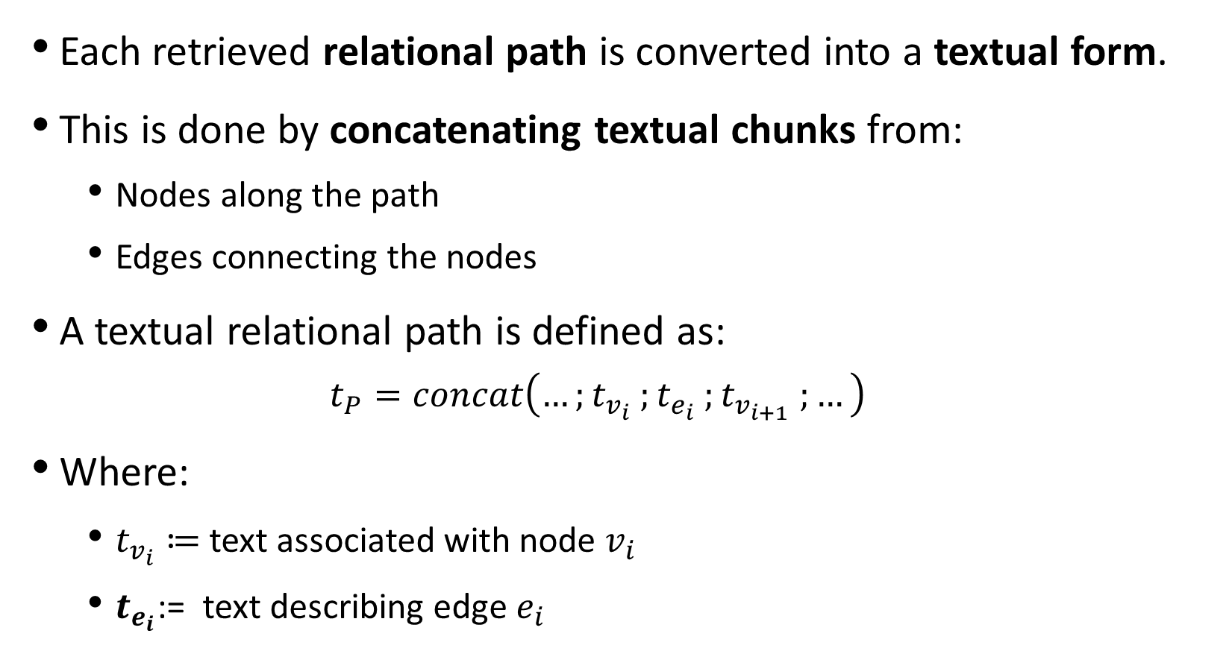
Textual relational path construction
Each retrieved relational path is converted into a textual form.
This is done by concatenating textual chunks from:
  Nodes along the path
  Edges connecting the nodes
A textual relational path is defined as:
  $$t_{P}=concat\left(…;t_{v_{i}} ;t_{e_{i}} ;t_{v_{i+1}} ;…\right)$$
Where:
  $t_{v_{i}}≔$text associated with node $v_{i}$
  $t_{e_{i}}$​​:= text describing edge $e_{i}$
Notes:
Node text provides entity-specific information.
Edge text provides relational context.
Concatenation preserves the order of the path, forming a coherent relational narrative

Slide 27
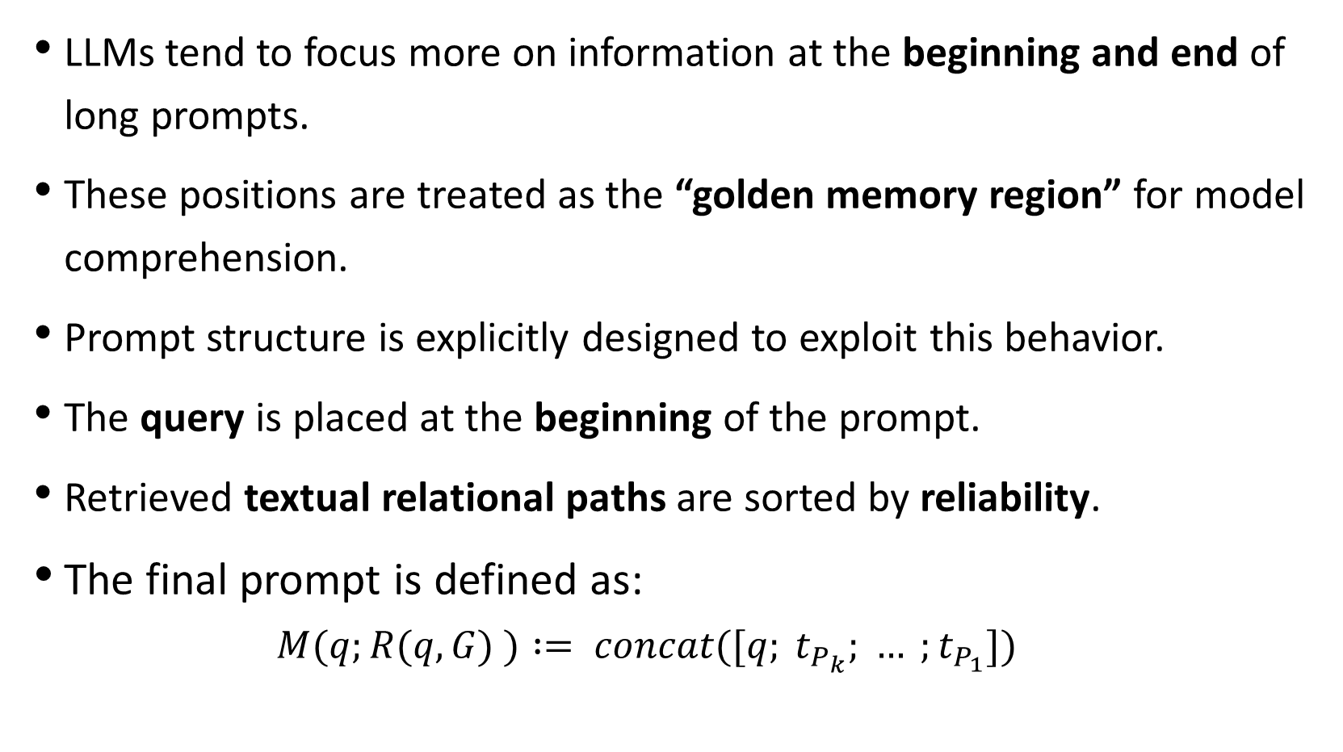
LLMs tend to focus more on information at the beginning and end of long prompts.
These positions are treated as the “golden memory region” for model comprehension.
Prompt structure is explicitly designed to exploit this behavior.
The query is placed at the beginning of the prompt.
Retrieved textual relational paths are sorted by reliability.
The final prompt is defined as:
  $$M(q;R(q, G) ) := concat([q; t_{P_{k}}; … ;t_{P_{1}}])$$

Slide 28
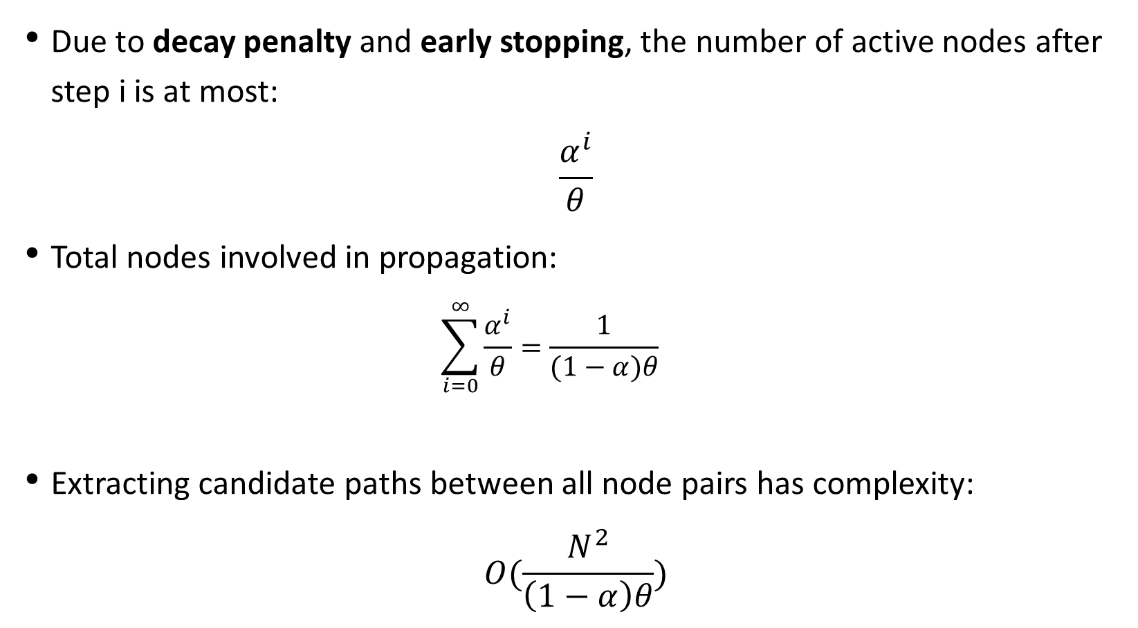
complexity analysis – node propagation
Due to decay penalty and early stopping, the number of active nodes after step i is at most:
$$\frac{α^{i}}{θ}$$
Total nodes involved in propagation:
  $$\sum_{i=0}^{∞}{\frac{α^{i}}{θ}}=\frac{1}{(1−α)θ}$$
Extracting candidate paths between all node pairs has complexity:
$$O(\frac{N^{2}}{\left(1−α\right)θ})$$

Slide 29
Evaluation
Due to the absence of ground truth answers, we follow the LLM-based evaluation procedures. we utilize“GPT-4o-mini” to evaluate the generated answers across multiple dimensions.
We compare the answers generated by each baseline and our method and conduct win-rate statistics. A higher win rate indicates a greater performance advantage over the other.
PathRAG consistently outperforms the baselines across all evaluation dimensions and datasets.

Slide 30
PathRag win Rate across all metrics
Comprehensiveness | Diversity | Logicality | Relevance | Coherence
60.88% | 62.75% | 59.78% | 60.47% | 59.93%
Comprehensiveness: how fully the answer covers all important aspects of the question, without missing key points.
Diversity: how well the answer incorporates different perspectives, facts, or reasoning paths instead of repeating the same idea.
Logicality: how logically sound and well-reasoned the answer is, with clear cause-and-effect or step-by-step reasoning.
Relevance: how directly the answer addresses the question and avoids unnecessary or off-topic information.
Coherence: how clear, fluent, and well-structured the answer is as a whole, with ideas flowing naturally.

Slide 31
hyperparameter analysis: (legal dataset)
Number of retrieved nodes (N):
Performance improves as N increases, peaks at N = 40, then slightly declines because extra nodes become less relevant and introduce noise.
Number of retrieved paths (K):
Performance peaks at K = 15; adding more paths (e.g., K = 25) does not help and can hurt performance, though larger datasets may benefit from larger K.
Decay rate (α):
Best performance occurs at α = 0.8; too small α over-prioritizes short paths, while α = 1.0 ignores distance and significantly degrades performance.

Slide 32
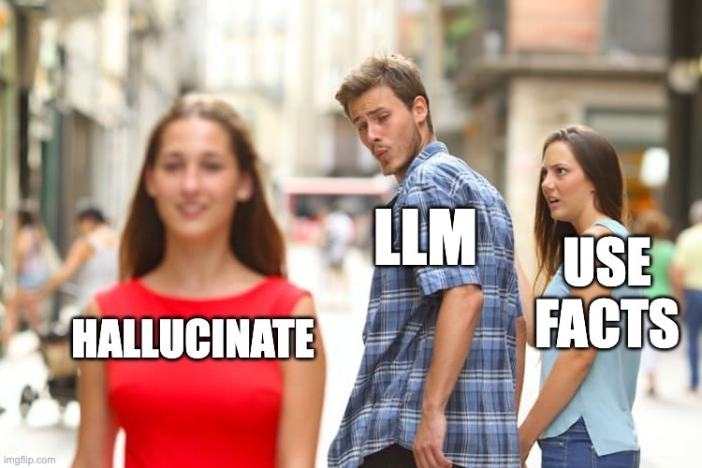
Thanks for listening.

