Slide 1
Specifications
Metric | value
cycles for encrytion/decryption | 513
cycles for round key generation | 2574
clock frequency | 135MHz (on-board) 76.8MHz (timing analysis)
utilization (LUTs) | 3.27%
test cases for functional | 1000*3 + 10*100
test cases for timing | 5*3 + 2*5

Slide 2
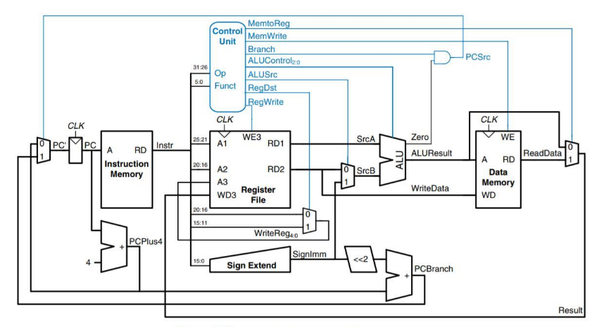
Jump
2
<<2
25:0
&
lt
w_A
R29
w_clk
R31
R30
31:28
Programmer
UART
TX RX
On-board Leds
7-segment Controller
On-board Buttons&Switches
Computer
reserved |  | buttons |  | switches
31 | 21 | 20 | 16 | 15 | 0
On-board 7-segment display

Slide 3
Critical path delay
funct
PC
Instruction memory
rs
rt
rd1
rd2
reg_file
ALU
+
addr
wd
data
+
PC
Instruction memory
rs
rt
rd1
rd2
reg_file
ALU
+
addr
wd
data

Slide 4
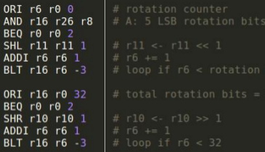
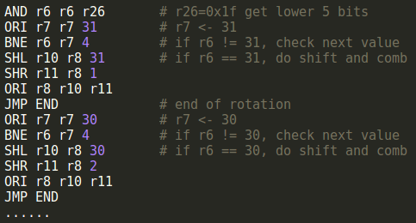
Rotation optimization
SHL
32-x bits
zero
x bits
32-x bits
=>
=>
OR
32-x bits
x bits
SHR
zero
x bits
2*16+4 cycles
in average
3*32 cycles!
shift by 1 iteratively
shift only once using
sequential comparison

Slide 5
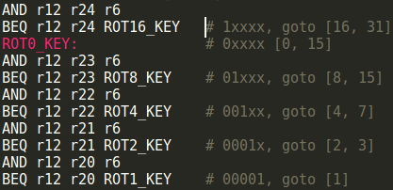
Rotation optimization
[0, 31]
0
1
XXXXX
[0, 15]
[16, 31]
0
1
0
1
XXXXX
[0, 7]
[8, 15]
0
1
......
XXXXX
[0, 3]
[4, 7]
......
2 * log(32) + 4 = 14 cycles/rotation !
Method | Average cycles | lines of code
Iteration | 96 | 10
Sequential Comp. | 36 | 192
Binary Search | 14 | 157

Slide 6
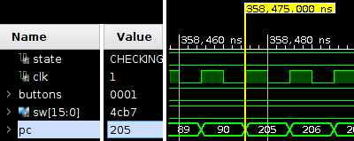
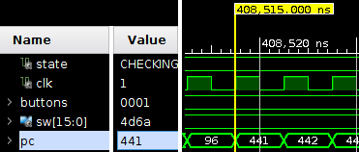
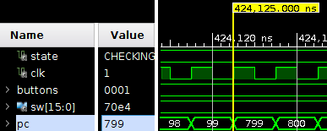
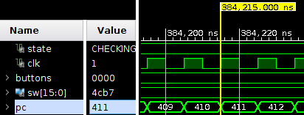
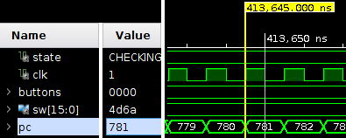
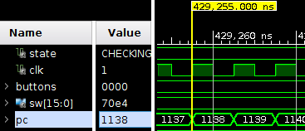
Cycles for skey enc dec

Slide 7
Cycles for skey enc dec
function | Start at | End at | Cycles
key expansion | 358475 | 384215 | 2574
encryption | 408515 | 413645 | 513
decryption | 424125 | 429255 | 513

Slide 8
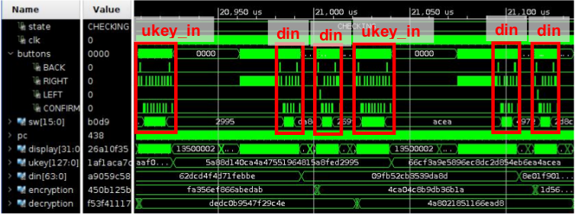
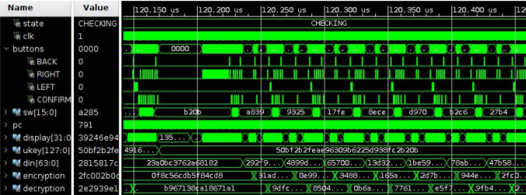
Fuctional Simulation

Slide 9
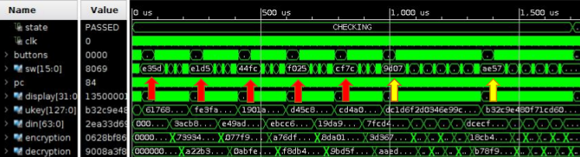
Timing simulation

Slide 10
RC5 program FSM
B
Menu 1
C
ukey_in
L/R
B
Menu 2
C
key_exp
display
L/R to switch bits
L/R
B
Menu 3
C
text_in
L/R
B
Menu 4
C
enc
display
L/R to switch bits
L/R
B
Menu 5
C
dec
display
L/R to switch bits

Slide 11
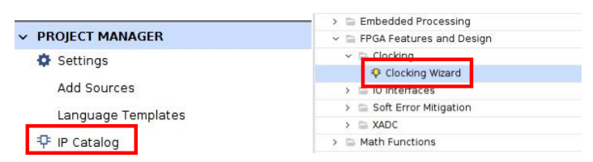


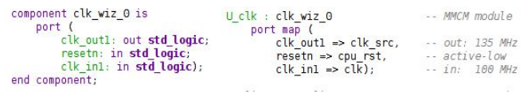

Clock configuration
100MHz => 135MHz

Slide 12
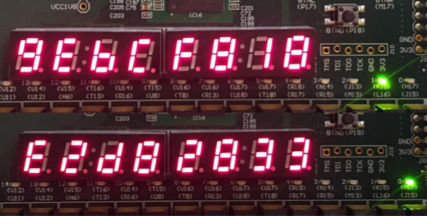
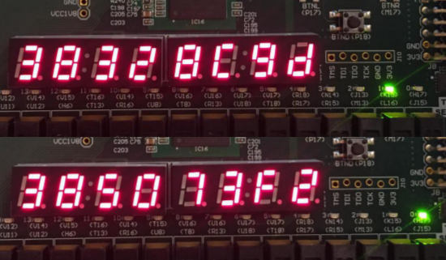
ukey:
12341111
0000abcd
11001111
33001111
Encryption:
9ebcf818
e2d82833
din:
cc0000cc
0000ee88
Decryption:
38328c9d
385073f2

