Slide 1
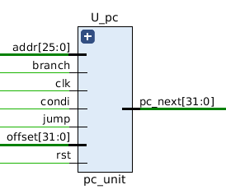
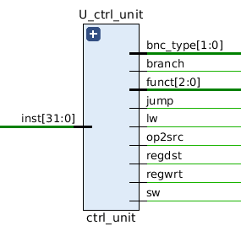
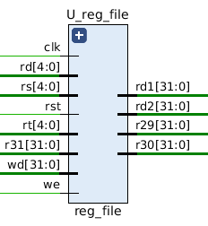
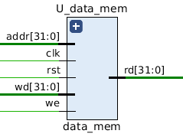
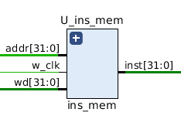
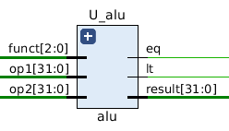
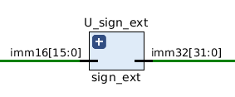
Processor components

Slide 2
Processor components
Created the Top Module (CPU)
Designed the components (PC, Ctrl Unit, Inst Mem, Reg File, ALU, Data Mem)
1000 random test cases for each components
Added useful modules for hardware implementation (Rst Unit, Sign-ext, Seg-LED, BTN_Debounce)
Simulation on the sample codes
Simulations on other self-created codes
Completed RC5 codes.

