Slide 1
SHL
32-x bits
zero
x bits
32-x bits
=>
=>
OR
32-x bits
x bits
SHR
zero
x bits

Slide 2
B
Menu 1
C
ukey_in
L/R
B
Menu 2
C
key_exp
display
L/R to switch bits
L/R
B
Menu 3
C
text_in
L/R
B
Menu 4
C
enc
display
L/R to switch bits
L/R
B
Menu 5
C
dec
display
L/R to switch bits

Slide 3
[0, 31]
0
1
XXXXX
[0, 15]
[16, 31]
0
1
0
1
XXXXX
[0, 7]
[8, 15]
......

Slide 4
AND | 0 | 1
0 | 0 | 0
1 | 0 | 1
NOR | 0 | 1
0 | 1 | 0
1 | 0 | 0
XOR | 0 | 1
0 | 0 | 1
1 | 1 | 0

Slide 5
funct
PC
Instruction memory
rs
rt
rd1
rd2
reg_file
ALU
+
addr
wd
data

Slide 6
+
PC
Instruction memory
rs
rt
rd1
rd2
reg_file
ALU
+
addr
wd
data

Slide 7
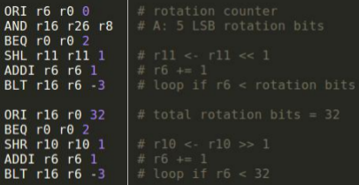
in total 3*32 cycles!

Slide 8
