Slide 1
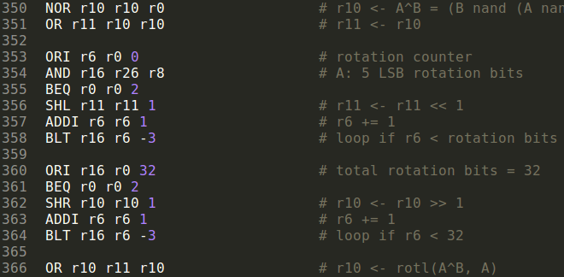
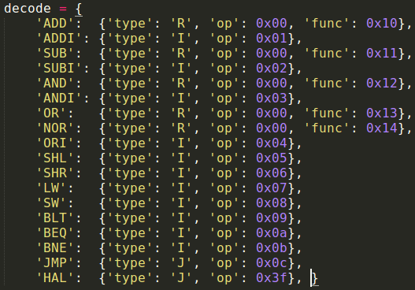
RC5 Assembly to Binary
Part of RC5 assembly
(rotate operation)
Decoding table

Slide 2
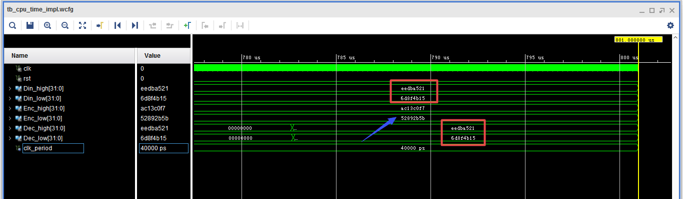
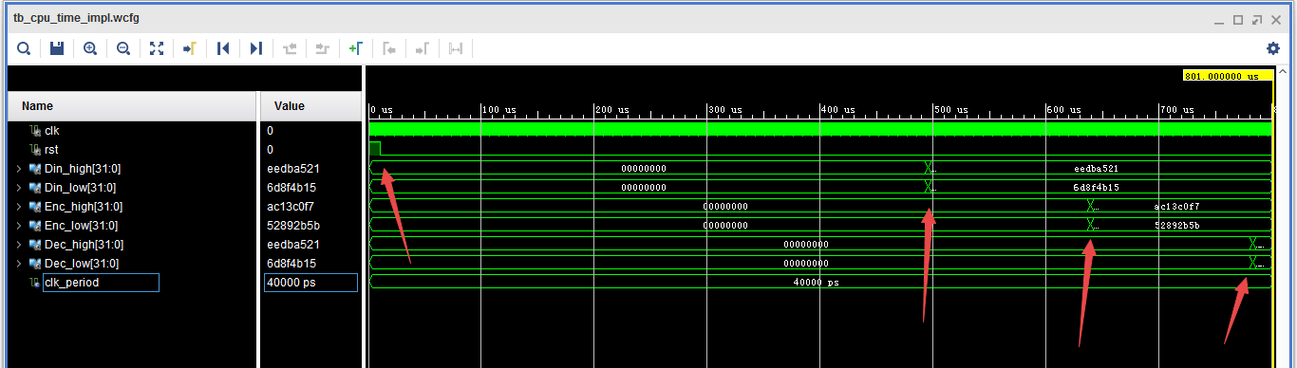
RC5 Timing
Critial path delay: 38 ns
Clock frequency: 25 MHz
Latency (cycles used in key-gen, encryption and decryption):
 | Start | End | Time-Diff | Latency | clk period
Key-Gen | 10460 | 495860 | 485400 | 12135 | 40
Encryption | 495860 | 639260 | 143400 | 3585
Decryption | 639260 | 782700 | 143440 | 3586

Slide 3
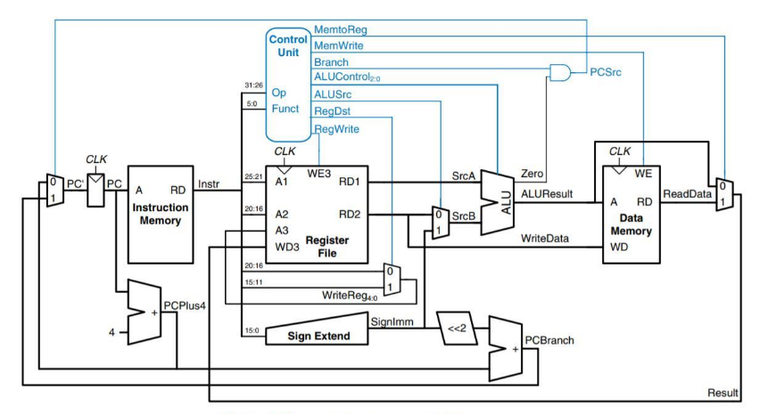
Jump
2
<<2
25:0
&
lt
w_A
R29
w_clk
R31
R30
31:28
Programmer
UART
TX RX
On-board Leds
7-segment Controller
On-board Buttons&Switches
Computer
reserved |  | buttons |  | switches
31 | 21 | 20 | 16 | 15 | 0
On-board 7-segment display

Slide 4
Leds and 7-segment display
reg_file
r29
r30
Example code:
# Turn on led(7)
# r0 = 0, r1 = 1
SHL r28, r1, 7 # r28(7) = 1
OR r29, r29, r28
# display data[30]
LW r30 r0 30
7-segment Controller
VHD pseudocode:
led <= r29(15 downto 0);
U_7seg_ctrl(r30, seg, an);
On-board 7-segment display
On-board Leds

Slide 5
Buttons & Switches
Example code:
# Wait for btn0
# r22 = 1<<16 for picking up r31(16)
LOOP:
AND r28, r22, r31 # pick r31(16)
BNE r28, r22, LOOP
# Do something here...
reg_file
r31
On-board Buttons&Switches
If btn0 is not pressed, r31 = '0'. BNE becomes True. The code will keep looping.
If btn0 is pressed, r31 = '1'. BNE becomes False. The code will continue.
reserved |  | buttons |  | switches
31 | 21 | 20 | 16 | 15 | 0
VHD pseudocode:
r31(20 downto 0) <= btn&sw;

Slide 6
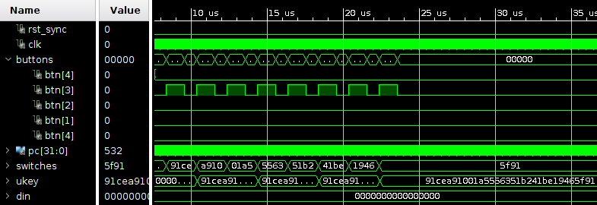
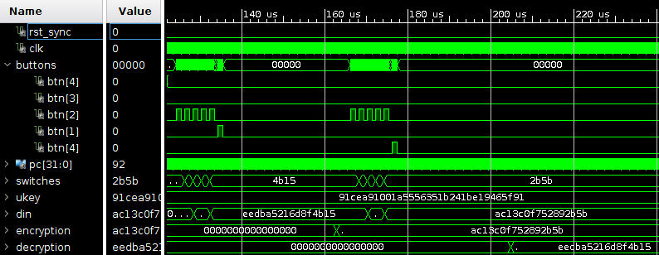
Buttons & Switches
Input Ukey using btn3:
Input Din (btn3); start encryption/decryption (btn1/btn0)

Slide 7
RC5 Timing
Critial path delay: 38 ns
Clock frequency: 25 MHz
Latency (cycles used in key-gen, encryption and decryption):
 | Start | End | Time-Diff | Latency | clk period
Key-Gen | 10460 | 495860 | 485400 | 12135 | 40
Encryption | 495860 | 639260 | 143400 | 3585
Decryption | 639260 | 782700 | 143440 | 3586

