Slide 1
GitHub
Unreal Foundations

Slide 2

Why?
Project 1
Project 1.2
Project 1.1
Project 1.9999

Slide 3
Storage
Project
GitHub

Slide 4
Stores snapshots, not changes!!!

Slide 5
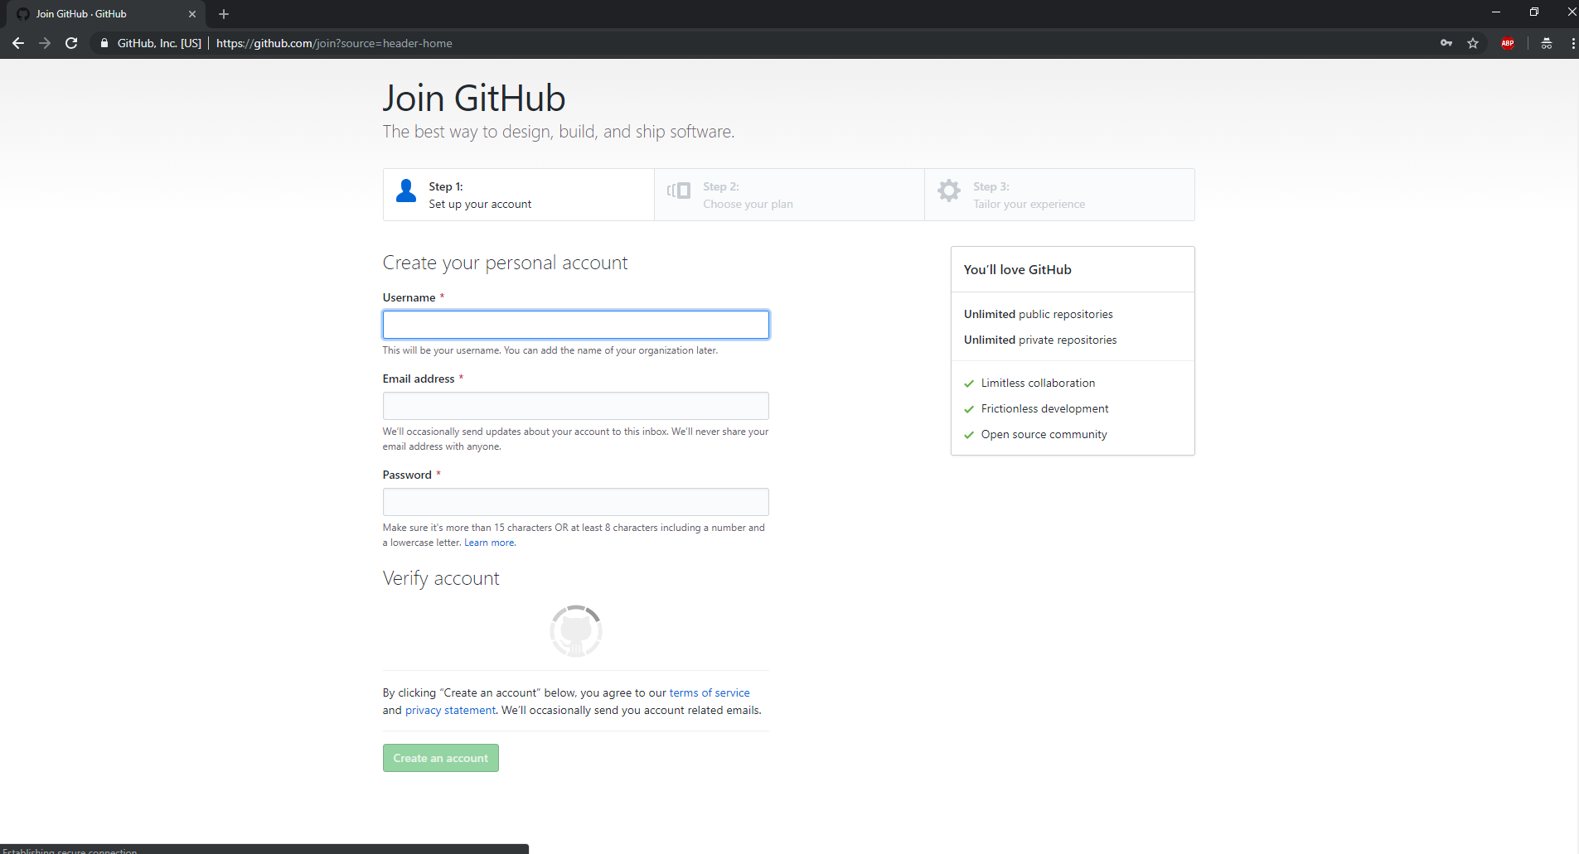
Sign up

Slide 6



Git and github

Slide 7
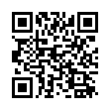
Git
https://git-scm.com/downloads

Slide 8
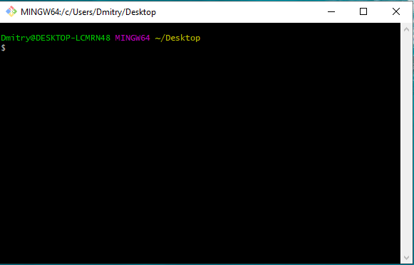
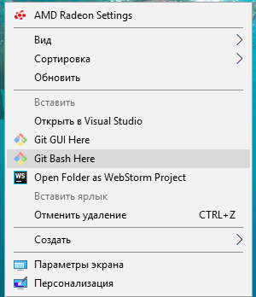
Git

Slide 9
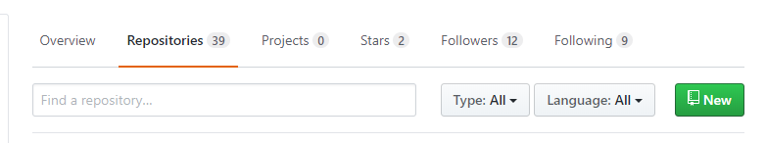
Create

Slide 10
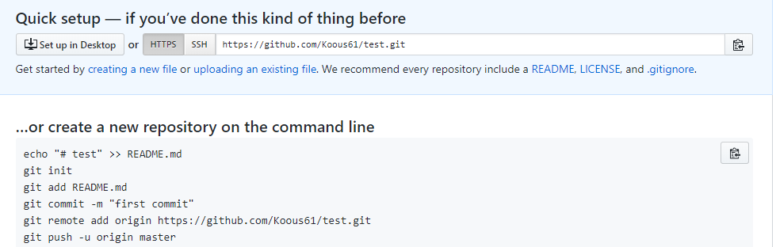
Create

Slide 11
Files
Untracked, Tracked
Tracked (unmodified, modified, staged)

Slide 12
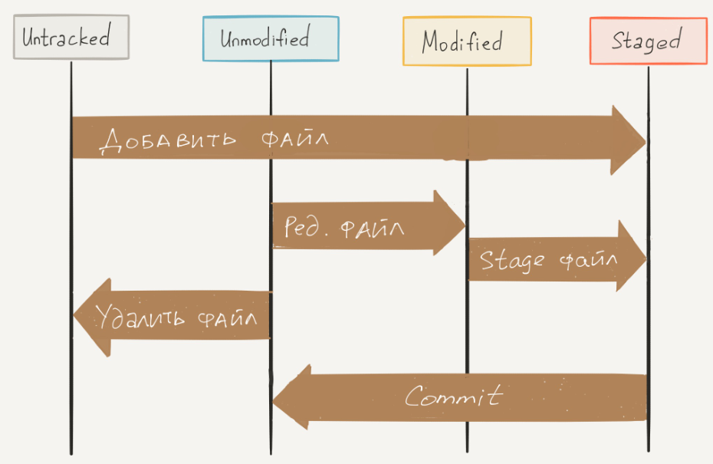

Slide 13
Basic
Commands | Notes
Git clone | Create a working copy
Git commit –a –m “text” | Commit your changes
Git pull | Updating a project from github
Git status | Check project status
Git push | Submit changes
Git add | Add to tracker

Slide 14
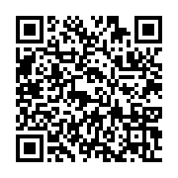
https://confluence.atlassian.com/bitbucketserver/basic-git-commands-776639767.html

Slide 15
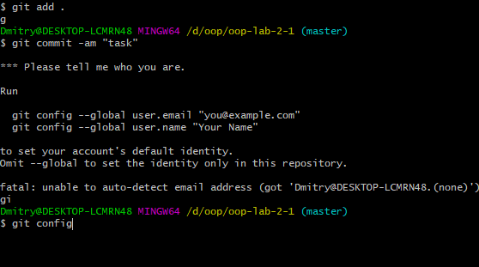
Git

Slide 16
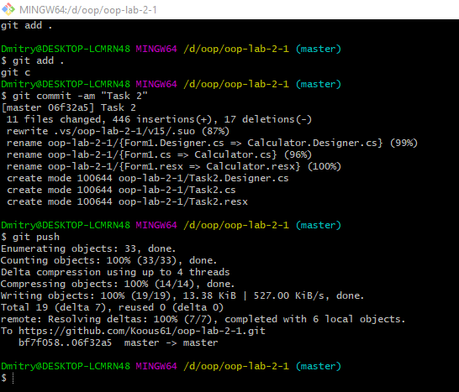
Git

Slide 17
Gitignore
Create the text file gitignore.txt
Open it in a text editor and add your rules, then save and close
Hold SHIFT, right click the folder you're in, then select Open command window here
Then rename the file in the command line, with ren gitignore.txt .gitignore

Slide 18
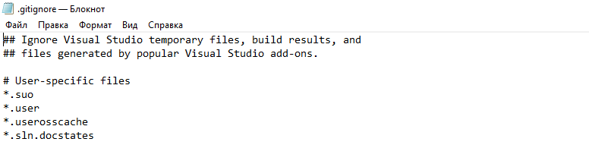
Gitignore

Slide 19
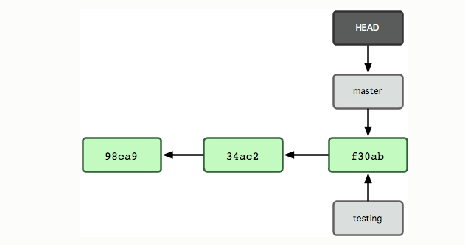
Branches
$ git branch testing

Slide 20
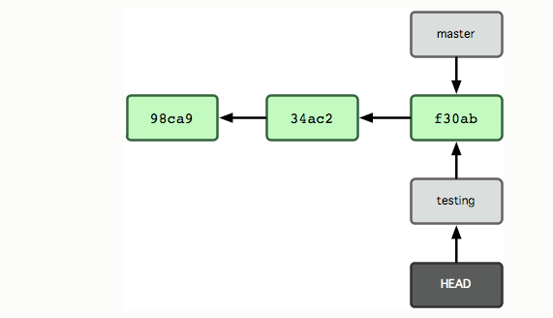
Branches
$ git checkout testing

Slide 21
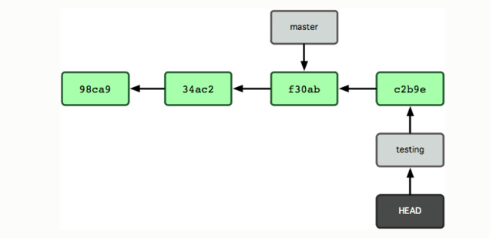
Branches
$ git commit -a -m 'made a change’
$ git merge testing

Slide 22
Questions
Git
GitHub
Add, commit, push, pull
Branches

Slide 23
Documentation
https://git-scm.com/doc
https://learn.javascript.ru/screencast/git
https://www.google.com/

