Slide 1

GOLDEN
GUIDELINE-GROUNDED ORCHESTRATED LLM DISPATCH FOR EMERGENCY NETWORKS
An India-Grounded, Guideline-Compliant Decision-Support Framework for Pre-Hospital Emergency Coordination Using Orchestrated LLM Agents
FRAMEWORK STACK
INTEROPERABILITY
TEAM
Orchestration – LangGraph (Python)
HL7 FHIR R4 / ABDM
Koppesh P (23BAI1113)
Abdul Khader (23BAI1123)
Santhosh Kumar (23BAI1236)

Slide 2

TECHNICAL RELEVANCE & PROBLEM STATEMENT
MULTI-AGENT ORCHESTRATION
STANDARDS-COMPLIANT
LangGraph orchestrator–specialist pattern · shared Pydantic v2 state · conditional edges · retry cycles · durable checkpointing
HL7 FHIR R4 / ABDM · real FHIR bundle (Patient + Encounter + Condition) via HAPI FHIR server
INDIA-GROUNDED (NOT US-CENTRIC)
THE PROBLEM
~1.99 lakh traffic deaths in India, 2024 (546/day, NCRB ADSI 2024) · Golden hour lost to fragmented, serial, manual dispatcher coordination between 108, 112 ERSS, and hospitals
Built around 108/112 services · ABDM/ABHA · MoRTH Cashless Treatment of Road Accident Victims Scheme, 2025
LEGAL DRIVER
Supreme Court ruling S. Rajaseekaran v. Union of India (2025 INSC 45) tied golden-hour care to Article 21 right to life

Slide 3
ABSTRACT & CORE IDEA
One multi-agent AI system that PARALLELIZES tasks currently done serially by a human dispatcher on the phone.
FOUR-AGENT CORE
WHAT IT PARALLELIZES
ECONOMIC STAKES
GOLDEN HOUR CRISIS
Coordinator · Triage/Dispatcher · Hospital & Bed · Family-Notification Voice Agent
Emergency triage · Hospital & bed selection · FHIR patient pre-registration · Autonomous family notification
MoRTH estimates socio-economic cost ≈ INR 1,47,114 crore (0.77% GDP); up to INR 5,96,820 crore (3.14% GDP) adjusted for underreporting (World Bank)
Fewer than 1 in 4 RTA victims reach care within the golden hour
POSITIONING
Explicitly decision support for human dispatchers — NOT autonomous medical decision-making

Slide 4

OBJECTIVES & EXPECTED OUTCOMES
PRIMARY OBJECTIVES
SECONDARY OBJECTIVES & KEY OUTCOMES
1
END-TO-END LANGGRAPH PIPELINE
Code-mixed Tamil–English input handling (accuracy delta vs. English-only)
Mitigate cascading hallucination across agent handoffs (schema validation + inter-agent verification)
Model tiering: hosted 70B vs. local 7–8B under simulated degraded connectivity
Benchmark against MedAgentBench
Ingest report → triage → hospital/bed match → FHIR pre-registration → family voice call, within target latency
2
AI VOICE-CALLING AGENT
Exotel telephony + Gemini Live via custom Python audio bridge, async webhook-based state resumption
EXPECTED OUTCOMES
3
Working end-to-end demo + ablation results (E1–E6)
Working hard-SOS bypass + offline fallback
MedAgentBench score vs. published baselines
Standards-compliant FHIR artifact + rehearsed live demo script
GUIDELINE-GROUNDED TRIAGE + HARD-SOS BYPASS
Deterministic bypass skips LLM latency for life-threatening cases entirely

Slide 5
SCOPE & FEASIBILITY
IN SCOPE
FEASIBILITY CORRECTIONS MADE
LangGraph orchestration + Triage Agent
Hospital/Bed Agent + FHIR server (HAPI + Synthea)
FHIR pre-registration + voice-call integration
Live dashboard + evaluation/ablation harness
India-grounded prompting + safety layer
Simulated ambulance/traffic visualization
SCOPE REDUCTION
7-agent system → focused 4-agent core (biggest correction)
MODEL HOSTING
Dropped self-hosted 70B (~2×80GB GPUs) → free-tier hosted inference (Groq Llama 3.3 70B, Gemini 2.5 Flash, OpenRouter); Llama 3.1 8B / Qwen 2.5 7B via Ollama for offline-fallback only
OUT OF SCOPE
Real patient data / unconsented call recipients
Production hospital APIs / ABDM certification
Autonomous diagnosis / real traffic-signal control
VLM trauma diagnosis
TELEPHONY
Exotel 8kHz ↔ Gemini Live 16kHz/24kHz resampled via Python/numpy/scipy — technically verified; calls restricted to consented team members (TRAI TCCCPR 2018)
OPTIONAL AGENTS
Route/ambulance visualization + accident-detection vision gated — added only if core is stable

Slide 6

PRELIMINARY WORK PLAN — 5 PHASES
PHASE 0 – FOUNDATIONS
1
PhysioNet/CITI + ABDM sandbox registration, API keys, HAPI FHIR + Synthea setup, freeze architecture
Deliverable: Working FHIR store + LLM calls + doc v1
2
PHASE 1 – CORE AGENTS
Triage Agent, Hospital/Bed Agent, LangGraph orchestrator + hard-SOS bypass, Voice Agent
Deliverable: End-to-end "happy path" demo
PHASE 2 – INTEGRATION, SAFETY & DASHBOARD
3
Guardrail/validation layer, live dashboard, code-mixed STT (Whisper), offline fallback (Ollama)
Deliverable: Integrated demo v1
4
PHASE 3 – EVALUATION & EXPERIMENTS
5
Evaluation harness, ablations E1–E6 incl. MedAgentBench; optional agents if time allows
Deliverable: Results tables & charts
PHASE 4 – WRITING & POLISH
arXiv paper draft, final report, rehearsed demo
Deliverable: Submission-ready paper + viva package
Decision Gate: After Phase 1–2, add ONE optional agent only if core is stable — else reinvest effort into evaluation depth.

Slide 7


LITERATURE REVIEW HIGHLIGHTS & RESEARCH GAP
TRIAGENT: AN ADAPTIVE MULTI-AGENT ARCHITECTURE FOR CRISIS CLINICAL DECISION SUPPORT, 2026
(Ibrahim et al.)
DIAGNOSTIC ACCURACY OF LARGE LANGUAGE MODELS FOR EMERGENCY DEPARTMENT TRIAGE: A SYSTEMATIC REVIEW AND META-ANALYSIS, 2026
(Limei Cui et al.)
MEDAGENTBENCH: A VIRTUAL EHR ENVIRONMENT TO BENCHMARK MEDICAL LLM AGENTS, 2025
(Yixing Jiang, Andrew Y. Ng, Jonathan H. Chen et al.)
AI (MDPI)
Core Contribution: Decomposes crisis clinical reasoning into dynamic specialist agents for intake, iterative retrieval, clinical assessment, and safety critique.
Key Finding: Reported 85.0% critical-case recall and 65.7% triage accuracy under incomplete data, versus $≤$14.7% recall in single-model baselines.
Validates the orchestrator–specialist architecture (Ablation E1); GOLDEN expands this from an in-hospital decision sandbox to active pre-hospital dispatch, live telephony, and FHIR interoperability.
NEJM AI
BMC Emergency Medicine
Core Contribution: Interactive evaluation benchmark testing medical LLM agents on 300 physician-written tasks in a live, FHIR-compliant EHR environment.
Key Finding: Top models achieved 69.67% overall success (Claude 3.5 Sonnet v2) with a significant gap between query tasks (85.33%) and action execution (54.00%).
Primary benchmark for evaluating the Hospital & Bed Agent’s ability to query beds and execute standards-compliant FHIR R4 pre-registration bundles (Ablation E6).
Core Contribution: Meta-analysis evaluating the reliability and safety boundaries of standalone LLMs across emergency department triage workflows.
Key Finding: Pooled sensitivity for highest-acuity emergency cases was only 61% (48%–73%), showing high risk of under-triaging critical patients.
Provides empirical proof that pure LLM triage is unsafe for acute trauma, directly justifying GOLDEN’s zero-latency Hard-SOS deterministic bypass (Ablation E3).

Slide 8
LITERATURE REVIEW HIGHLIGHTS & RESEARCH GAP
DISPATCHMAS: FUSING TAXONOMY AND ARTIFICIAL INTELLIGENCE AGENTS FOR EMERGENCY MEDICAL SERVICES, 2026
(Xiang Li et al.)
"GOLDEN HOUR" IN ROAD TRAFFIC ACCIDENT VICTIMS: HURDLES AND IMPACT ON MORTALITY, 2025
(Shilpa A. Gaikwad, Vaibhav D. Shinde, Sachin P. Kothavale)
AGENTCLINIC: A MULTIMODAL BENCHMARK FOR TOOL-USING CLINICAL AI AGENTS, 2026
(Samuel Schmidgall et al.)
BMC Emergency Medicine
Core Contribution: Multi-agent emergency dispatch simulator integrating clinical taxonomies and a 6-phase call protocol across 32 chief-complaint categories.
Key Finding: Achieved 94% correct agent routing and 91% protocol-compliant guidance with high inter-rater agreement (Gwet AC1 >0.70).
Precedent for taxonomy-grounded dispatch dialogue; establishes the gap that prior systems rely on simulated English calls rather than live code-mixed Indian telephony.
Cureus
npj Digital Medicine
Core Contribution: Clinical study quantifying pre-hospital delays and systemic barriers to emergency trauma care in India.
Key Finding: Only 20.6% of trauma victims reached care within the golden hour; transport delays (33%) and facility unawareness (14.6%) were leading operational bottlenecks.
Provides clinical motivation for India's 108/112 coordination delays, highlighting why automated parallel dispatch and bed matching are vital.
Core Contribution: Interactive clinical benchmark evaluating sequential tool-use, multimodal reasoning, and language robustness across simulated patient–doctor encounters.
Key Finding: Constraining interaction turns caused task accuracy to drop from 52% to 25%, proving that persistent tool memory and structured state management dominate clinical success.
Justifies LangGraph's durable state graph and bilingual (Tamil–English) code-mixed evaluation under conversational constraints (Ablation E4).

Slide 9
PROPOSED METHODOLOGY & EVALUATION
Hybrid safety-first methodology: deterministic rules for safety-critical decisions + LLM agents for open-ended reasoning, evaluated through six controlled ablations.
E1 — CORE ARCHITECTURE
E2 — PROMPT GROUNDING
E4 — MULTILINGUAL ROBUSTNESS
E5 — OFFLINE RESILIENCE
Single Agent vs Multi-Agent
Measures: Triage accuracy / F1 · hallucination rate · latency
Does multi-agent decomposition actually improve the system?
Guideline-Grounded vs Open Prompting
Measures: Triage F1 · high-risk recall
Does clinical guideline grounding improve triage?
Hosted 70B vs Local 7–8B
Measures: Output quality · latency · availability during connectivity loss
Can the system degrade gracefully?
English vs Tamil–English
Measures: Accuracy delta · Whisper WER
How much does performance change with code-mixed emergency input?
E3 — SAFETY BYPASS
Hard-SOS vs LLM-only
Measures: Latency · critical-case miss rate
Can deterministic routing make critical-case handling safer and faster?
E6 — EXTERNAL VALIDATION
MedAgentBench
Measures: EHR interaction success
Compared against: Claude 3.5 Sonnet v2 · GPT-4o · DeepSeek-V3 · Published baselines
How does the Hospital/FHIR Agent perform against an established benchmark?

Slide 10
SYSTEM DESIGN
SHARED STATE
HARD-SOS RULE ENGINE
TRIAGE AGENT
HOSPITAL & BED AGENT
All agents communicate through a strongly typed Pydantic v2 state object — enabling LangGraph to pause during the voice call and resume from the webhook callback.
Input: Emergency report
Method: Deterministic keyword/pattern matching — zero LLM calls, sub-second response
Triggers: Unresponsive · Not breathing · No pulse · Severe bleeding · Cardiac arrest
Design accepts some false positives to minimise false negatives.
Incident → guideline-grounded prompt → LLM reasoning → fixed JSON schema → Pydantic validation → retry if invalid → shared state
Outputs: Acuity · Confidence · Rationale · Guideline reference
FHIR queries → candidate hospitals → bed availability → acuity + distance + availability ranking → FHIR pre-registration
Targeted iterative FHIR queries — not single-shot full-bundle retrieval. Consistent with FHIR-AgentBench multi-turn finding.
CASE IDENTITY & INPUT
Case ID · raw input · language · modality
TRIAGE OUTPUT
Acuity · Hard-SOS flag · confidence · guideline reference
VOICE AGENT
HOSPITAL / FHIR
Coordinator → non-blocking call → Exotel → Python audio bridge → Gemini Live → family interaction → webhook → checkpoint resume
Failure path: Persist payload → manual recovery (no silent data loss)
Candidates · selected hospital · bed status · bundle ID
VOICE / FAMILY
DESIGN PATTERNS
Call status · consent · allergies · medications · blood group
CONTROL & AUDIT
ORCHESTRATOR–WORKER
CIRCUIT BREAKER / FALLBACK
IDEMPOTENT WRITER
Current node · errors · checkpoint · timestamps
Coordinator owns control flow; specialist agents remain independently testable
FHIR writes and calls can safely retry without duplicates
Hosted model failure → local model fallback
CHECKPOINT & RESUME
Graph survives the multi-minute voice interaction and resumes from the callback

Slide 11
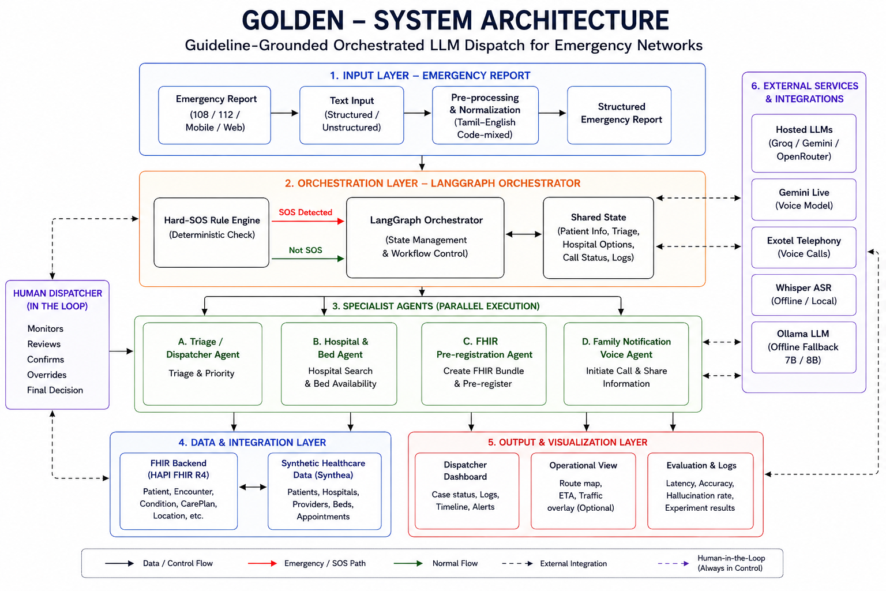

Slide 12
BIBLIOGRAPHY:
X. Li et al., "DispatchMAS: Fusing Taxonomy and Artificial Intelligence Agents for Emergency Medical Services," BMC Emergency Medicine, 2026.
DOI: 10.1186/s12873-026-01540-9
Y. Jiang, K. C. Black, G. Geng, D. Park, J. Zou, A. Y. Ng, J. H. Chen et al., "MedAgentBench: A Virtual EHR Environment to Benchmark Medical LLM Agents," NEJM AI, 2025.
DOI: 10.1056/AIdbp2500144
S. Schmidgall, R. Ziaei, C. Harris et al., "AgentClinic: A Multimodal Benchmark for Tool-Using Clinical AI Agents," npj Digital Medicine, 2026.
DOI: 10.1038/s41746-026-02674-7
G. Lee, E. Bach, E. Yang, T. Pollard, A. Johnson, E. Choi, Y. Jia, and J. H. Lee, "FHIR-AgentBench: Benchmarking LLM Agents for Realistic Interoperable EHR Question Answering," in Machine Learning for Health (ML4H), Proceedings of Machine Learning Research (PMLR), vol. 297, 2025/2026.
Available: https://proceedings.mlr.press/v297/lee26a.html
S. A. Gaikwad, V. D. Shinde, and S. P. Kothavale, ""Golden Hour" in Road Traffic Accident Victims: Hurdles and Impact on Mortality," Cureus, vol. 17, 2025.
DOI: 10.7759/cureus.78772
B. N. Jena, D. Shelke, and S. Saunik, "Can the Emergency Medical Service (EMS) System Help in Improving Healthcare Access – Evidence from Maharashtra EMS," Indian Journal of Community Medicine, 2024.
DOI: 10.4103/ijcm.ijcm_448_23

Slide 13
BIBLIOGRAPHY:
P. D. Modi et al., "Public Awareness of the Emergency Medical Services in Maharashtra, India: A Questionnaire-based Survey," Cureus, 2018.
DOI: 10.7759/cureus.3309
A. C. Shekhar et al., "Use of a Large Language Model (LLM) for Ambulance Dispatch and Triage," American Journal of Emergency Medicine, 2025.
DOI: 10.1016/j.ajem.2024.12.032
L. Cui et al., "Diagnostic Accuracy of Large Language Models for Emergency Department Triage: A Systematic Review and Meta-analysis," BMC Emergency Medicine, 2026.
DOI: 10.1186/s12873-026-01639-z
Q. Shen, X. Zhang, H. Ren, Q. Guo, and Z. Yi, "Knowledge-Embedded Large Language Models for Emergency Triage," Knowledge-Based Systems, 2025.
DOI: 10.1016/j.knosys.2025.113431
C. Wang, F. Wang, S. Li et al., "Patient Triage and Guidance in Emergency Departments Using Large Language Models: Multimetric Study," Journal of Medical Internet Research, 2025.
DOI: 10.2196/71613
F. Gaber, M. Shaik, F. Allega et al., "Evaluating Large Language Model Workflows in Clinical Decision Support for Triage and Referral and Diagnosis," npj Digital Medicine, 2025.
DOI: 10.1038/s41746-025-01684-1

Slide 14
BIBLIOGRAPHY:
J. Walonoski et al., "Synthea: An Approach, Method, and Software Mechanism for Generating Synthetic Patients and the Synthetic Electronic Health Care Record," Journal of the American Medical Informatics Association, vol. 25, no. 3, pp. 230–238, 2018.
DOI: 10.1093/jamia/ocx079
B. Lin et al., "AgentAsk: Multi-Agent Systems Need to Ask," in Proceedings of the Association for Computational Linguistics (ACL), 2026.
DOI: 10.18653/v1/2026.acl-long.1294
A. Ibrahim, A. AlSanousi, and A. Serag, "TriAgent: An Adaptive Multi-Agent Architecture for Crisis Clinical Decision Support Under Incomplete Information," AI (MDPI), 2026.
DOI: 10.3390/ai7060230

