Slide 1
OUC-CGE · Video Engagement
Exploratory Data Analysis
of the OUC-CGE Dataset
Open University Classroom Group Engagement · Video Classification
Presenter Koppesh P
Engagement Levels High · Medium · Low
Research-Grade EDA · 16 Analysis Sections · 10 Visualisations

Slide 2
Dataset Introduction — OUC-CGE
🎓 What is OUC-CGE?
🎬 Data Type
🔍 EDA Objectives
Open University Classroom Group Engagement dataset
Classroom video recordings from lecture/tutorial settings
Designed for automated student engagement recognition
Widely used in educational AI & affective computing research
MP4 video clips of classroom scenes
Three engagement levels: High, Medium, Low
Organised into sub-folders by engagement class
Recursive structure: class → batch sub-folders → *.mp4
Audit class balance and imbalance ratio
Profile duration, resolution, FPS, file size
Inspect frame-level brightness & contrast
Estimate motion patterns and face visibility
2 / 20

Slide 3
EDA Scope — 16 Analysis Sections
1
Setup & Imports
9
File Size Analysis
Environment, libraries, reproducibility (seed=42)
Storage profile; violin plots by class
2
Dataset Loading
10
Visual Sample Inspection
Recursive scan, catalogue building, class mapping
Key-frame grids per class
3
Class Distribution
11
Frame-Level Analysis
Bar + pie charts; imbalance ratio analysis
Brightness & contrast per class
4
Video Metadata Extraction
12
Motion Analysis
Width, height, FPS, frames, duration, file size
Inter-frame absolute difference proxy
5
Duration Analysis
13
Face Detection
Histogram + box plots; CV; per-class stats
Haar-cascade face counts per class
6
Frame Count Analysis
14
Dataset Quality Checks
Per-class frame statistics and distributions
Corrupted files, duplicates, zero-metadata
7
Resolution Analysis
15
Research Summary
Unique resolutions; standardisation check
Auto-generated EDA findings markdown
8
FPS Analysis
16
Export Results
Frame-rate distribution; temporal consistency
CSVs + publication-ready PNG figures
3 / 20

Slide 4
EDA Workflow — From Raw Videos to Insights
01
02
03
04
05
06
Load Dataset
Extract
Metadata
Statistical
Analysis
Visualise
Distributions
Frame-Level
Inspection
Quality
Audit & Export
Recursively scan
MP4 files, assign
class labels
OpenCV: resolution,
FPS, duration,
file size
Per-class stats,
imbalance ratio,
CV analysis
10 publication-ready
PNG figures
saved to disk
Brightness, contrast,
motion score,
face detection
Corruption check,
metadata.csv,
research summary
Each analysis block produces both statistical outputs and publication-ready visualisations saved to eda_results/
4 / 20

Slide 5
Metadata Schema — What the Dataset Catalogue Contains
Column | Type | Description | Notes
video_path | string | Absolute path to MP4 file | Used for OpenCV loading
filename | string | Basename of the video | view*.mp4 naming pattern
class_label | string | High / Medium / Low | Engagement level label
class_id | int | 0 / 1 / 2 | Numeric encoding of class
width | int | Frame width in pixels | Extracted via OpenCV
height | int | Frame height in pixels | Extracted via OpenCV
fps | float | Frames per second | CAP_PROP_FPS
total_frames | int | Total frame count | CAP_PROP_FRAME_COUNT
duration_sec | float | Duration (seconds) | total_frames / fps
file_size_mb | float | File size in megabytes | os.path.getsize / 1024²
resolution | string | WIDTHxHEIGHT string | Convenience concatenation
is_corrupted | bool | True if file unreadable | Quality flag — exclude from analysis
5 / 20

Slide 6
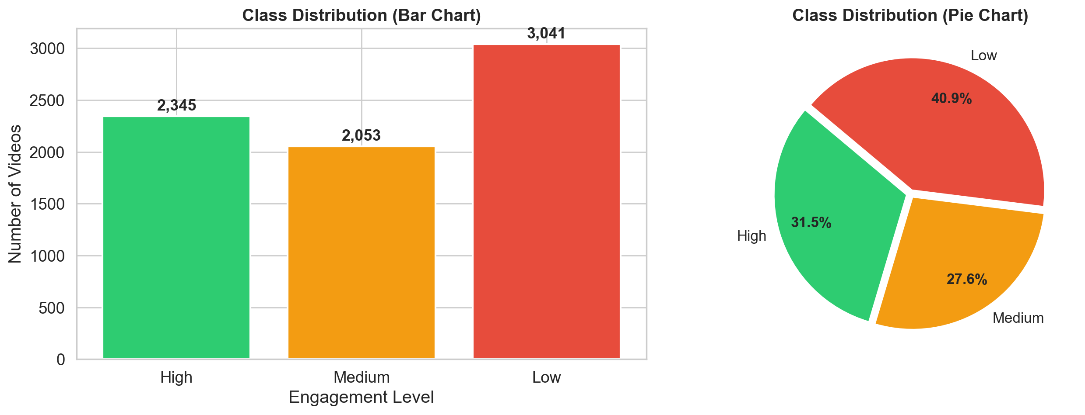
Class Distribution — Engagement Level Balance
Key Observations
Three-class problem: High, Medium, and Low engagement levels
Bar + pie charts reveal the relative proportion of each class across the dataset
Imbalance ratio (max ÷ min) quantifies how skewed the distribution is
A ratio < 1.5 = balanced; 1.5–3.0 = moderate; >3.0 = high imbalance
Balanced datasets allow standard cross-entropy loss; imbalanced ones require weighted loss or oversampling
📊 Class Distribution
Replace with: eda_results/class_distribution.png
Why it matters: Class distribution is the first diagnostic for any supervised learning task. Significant imbalance in engagement levels can bias a model toward the majority class, inflating accuracy while degrading recall for under-represented classes. Mitigation strategies (focal loss, SMOTE, stratified splits) should be selected based on the measured imbalance ratio.
6 / 20

Slide 7
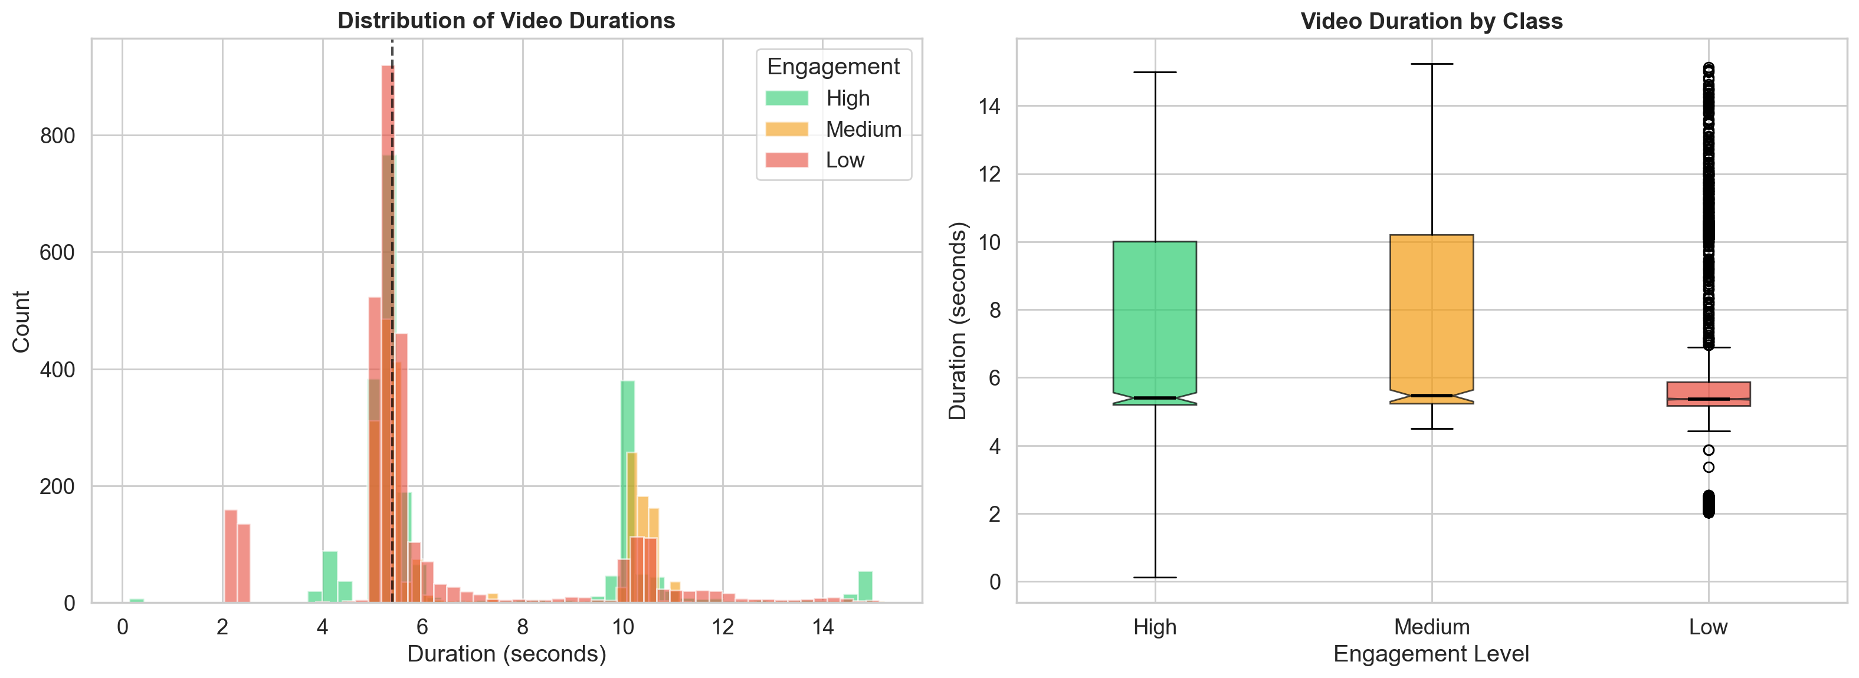
Duration Analysis — Temporal Properties of Clips
Key Observations
Histogram reveals the spread of clip durations across the full dataset
Box plots expose per-class median duration and outlier clips
Coefficient of Variation (CV) < 0.05 = uniform; > 0.3 = high variability
Per-class duration stats (min, max, mean, median, std) highlight temporal consistency
High variability in clip lengths may require padding or truncation during batch formation
📊 Duration Analysis
Replace with: eda_results/duration_analysis.png
Why it matters: Clip duration directly controls temporal receptive field in video models. Variable-length clips require either fixed-length sampling (uniform frame selection) or variable-length architectures. Per-class duration differences could introduce spurious correlations if not handled during preprocessing.
7 / 20

Slide 8
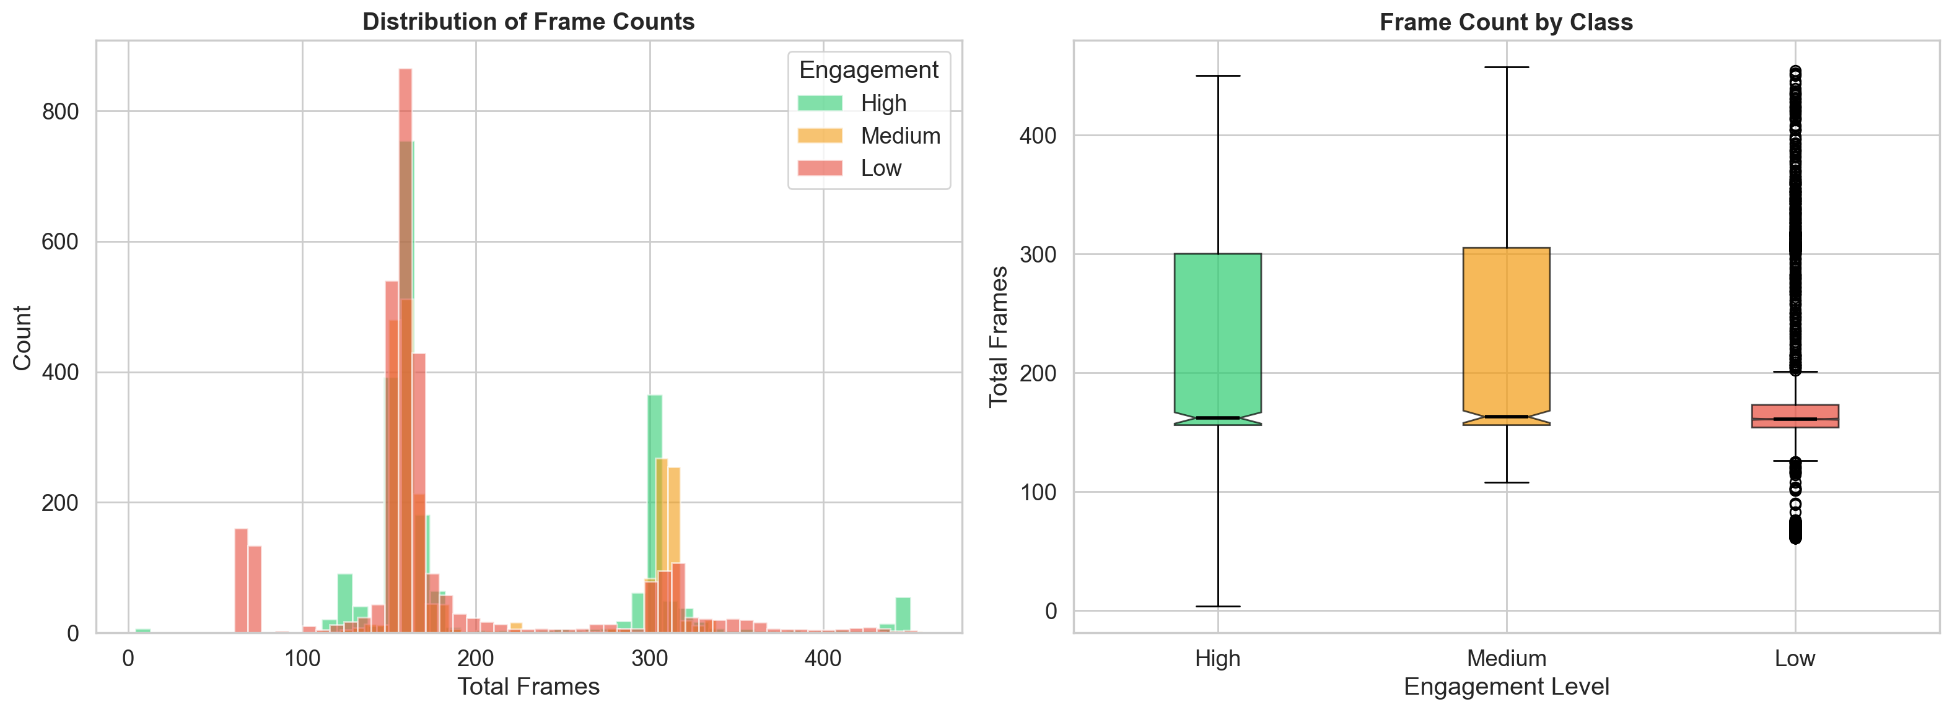
Frame Count Analysis — Depth of Temporal Coverage
Key Observations
Frame count is the product of duration × FPS, capturing raw temporal depth
Histogram reveals whether clips are predominantly short or long
Box plots highlight class-wise spread and median frame counts
Large frame counts increase memory footprint during training
Uniform frame counts enable fixed-size batches without padding
📊 Frame Count Analysis
Replace with: eda_results/frame_count_analysis.png
Why it matters: Frame count determines the number of temporal samples available for a model. Sparse sampling (e.g., 8 or 16 uniformly distributed frames) is common for 3D-CNNs and Video Transformers. Knowing the distribution allows selection of an optimal clip length that maximises coverage without excessive computation.
8 / 20

Slide 9
Resolution Analysis — Spatial Consistency of Videos
Key Observations
Bar chart shows frequency of each unique WIDTHxHEIGHT combination
A single dominant resolution indicates a standardised dataset
Multiple resolutions signal mixed acquisition conditions
Resolution diversity requires resize preprocessing to a common input size
Aspect ratio consistency is important to avoid distortion during resizing
📊 Resolution Analysis
Replace with: eda_results/resolution_analysis.png
Why it matters: Neural network architectures expect fixed spatial input dimensions. If the dataset contains multiple resolutions, a resize transform (e.g., to 224×224 or 256×256) must be applied consistently. Using centre-crop + resize vs. stretch-resize affects information loss and should be a conscious preprocessing decision.
9 / 20

Slide 10
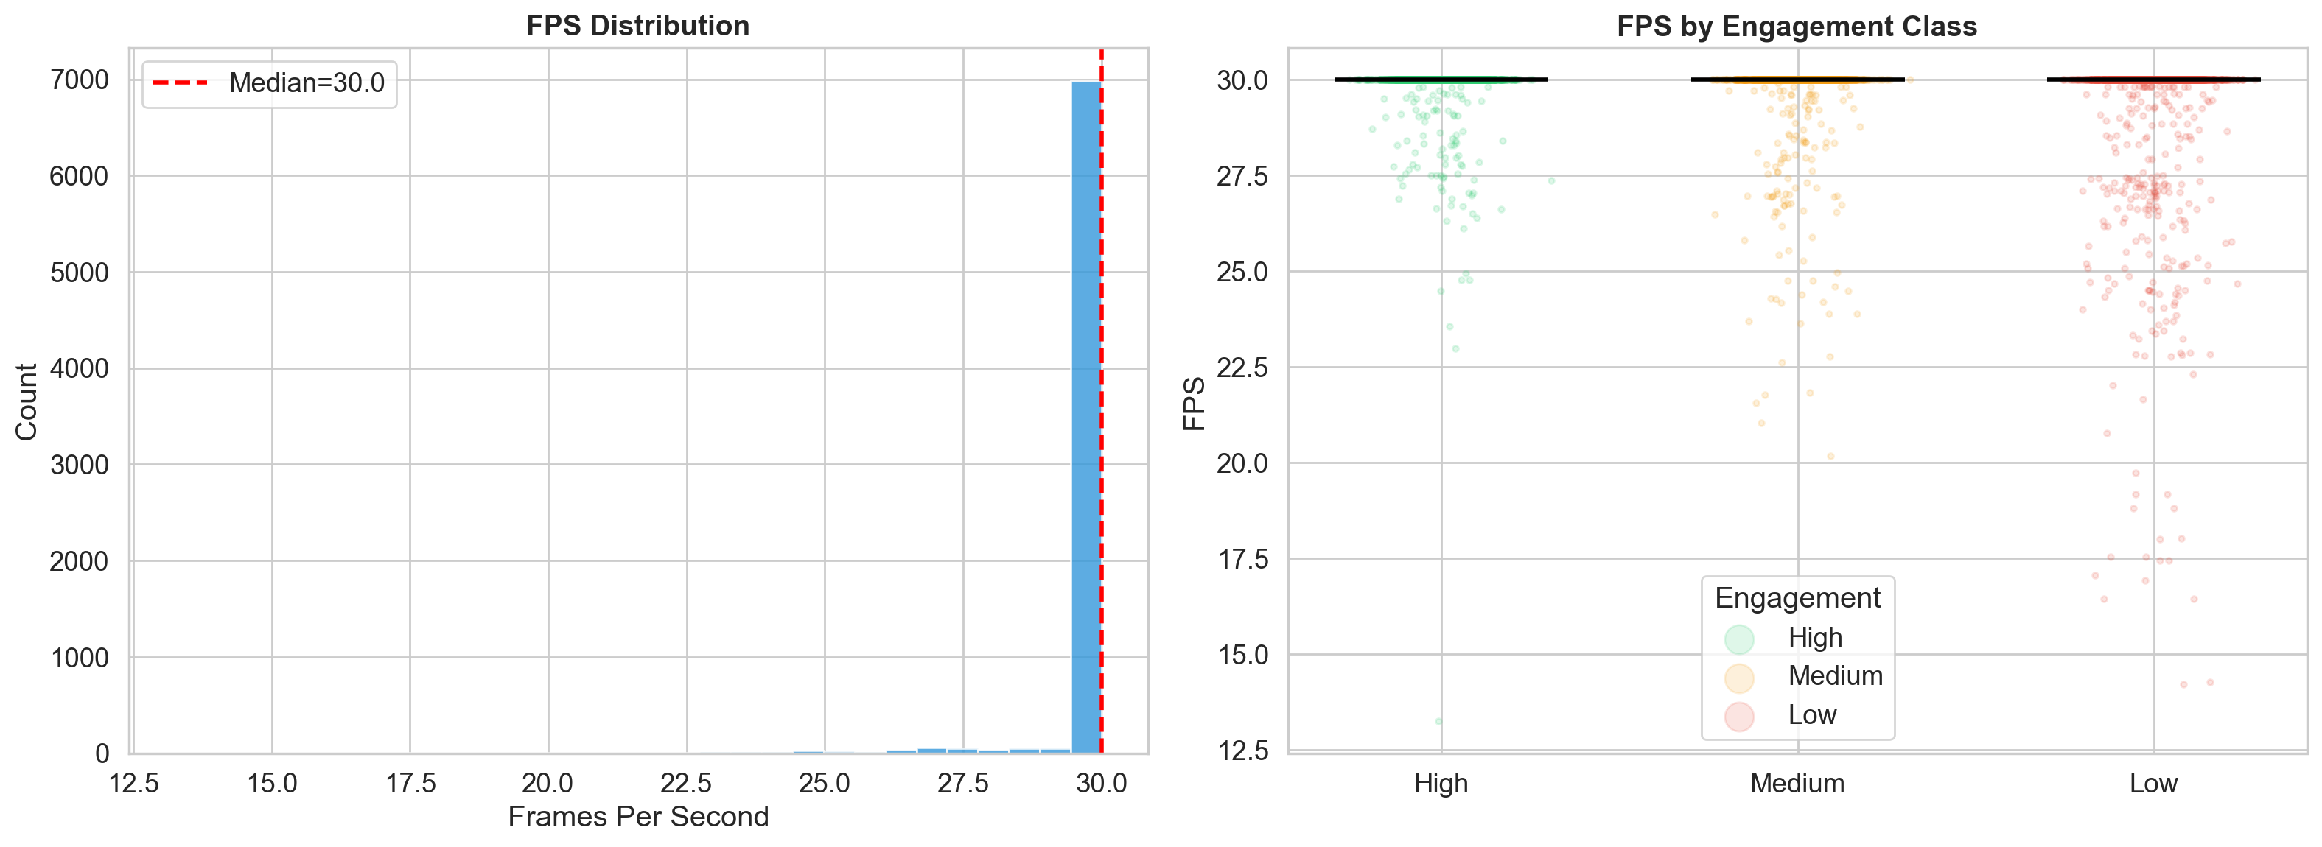
FPS Analysis — Temporal Sampling Rate Distribution
Key Observations
FPS distribution plot reveals how many unique frame rates exist in the dataset
Strip plots show per-class FPS spread — consistent FPS across classes is ideal
Common values: 25 fps (PAL) or 30 fps (NTSC) for standard webcam/lecture capture
Mixed FPS requires temporal resampling to a target rate before model input
FPS affects the number of frames per second sampled; lower FPS = sparser temporal signal
📊 FPS Analysis
Replace with: eda_results/fps_analysis.png
Why it matters: FPS governs the temporal density of video data. Inconsistent frame rates across the dataset create challenges for time-sensitive architectures (e.g., optical flow, 3D convolutions). Normalising to a fixed FPS ensures that models receive comparable temporal context per second of video, regardless of the original capture rate.
10 / 20

Slide 11
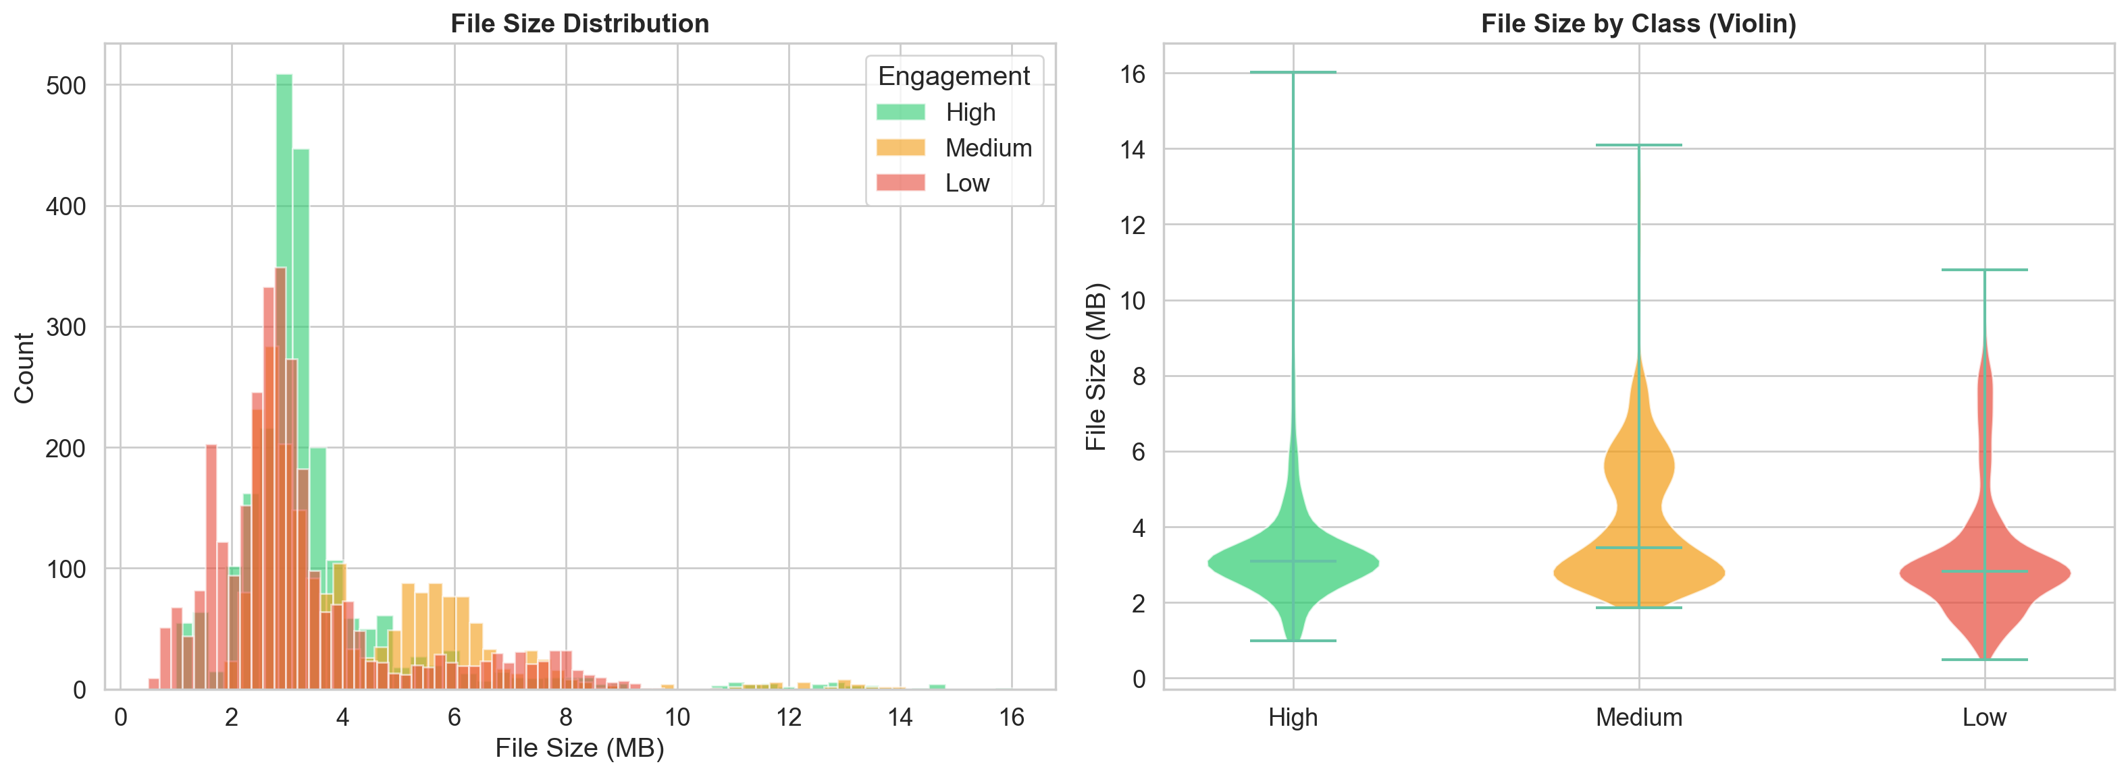
File Size Analysis — Storage Footprint per Class
Key Observations
Histogram shows distribution of file sizes (MB) across the full dataset
Violin plots reveal per-class storage profiles including density shape
Large outlier files may indicate recording artifacts or encoding differences
Total dataset storage (sum of all file sizes) quantifies infrastructure requirements
Abnormally small files may indicate truncated or corrupted recordings
📊 File Size Analysis
Replace with: eda_results/file_size_analysis.png
Why it matters: File size is a practical indicator of dataset manageability. Large total storage requirements affect I/O-bound training throughput. Correlated with duration and resolution, file size helps estimate per-sample decode time and informs choices around data sharding, caching, or on-the-fly decoding vs. pre-extracted frame storage.
11 / 20

Slide 12
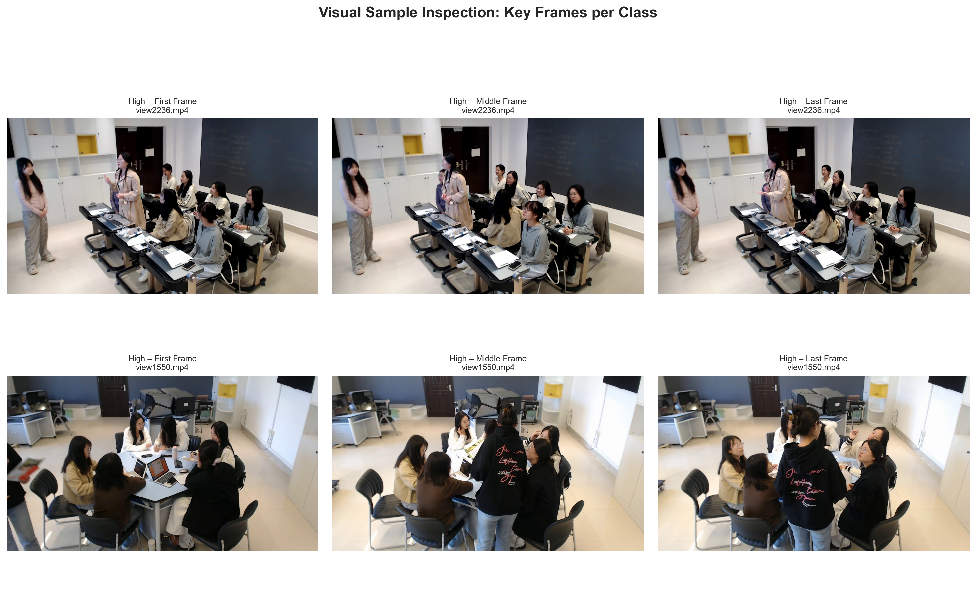
Visual Sample Inspection — Key Frames per Engagement Class
📊 Visual Samples
Replace with: eda_results/visual_samples.png
Interpretation: Frame grids allow qualitative inspection of visual variety within each class. High engagement frames may show attentive body language; Low engagement may show distracted or absent students. Lighting, camera angle, and scene clutter differ across clips and represent real-world diversity the model must generalise to.
12 / 20

Slide 13
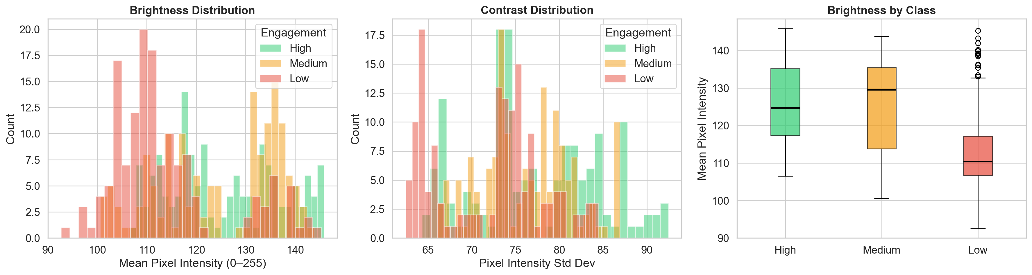
Frame-Level Analysis — Brightness & Contrast per Class
Key Observations
Brightness = mean pixel intensity (0–255); higher = brighter frames
Contrast = standard deviation of pixel intensities; higher = more visual variation
Histogram overlaps show whether classes differ in visual appearance
Box plot of brightness by class reveals per-class lighting conditions
Similar brightness across classes suggests consistent recording environments
📊 Frame-Level Analysis
Replace with: eda_results/frame_level_analysis.png
Why it matters: Brightness and contrast characteristics of a dataset directly influence normalisation choices. If classes differ significantly in mean intensity, the model may inadvertently use lighting as a proxy for engagement — a spurious correlation. Colour normalisation (e.g., mean/std subtraction per channel) mitigates this bias.
13 / 20

Slide 14
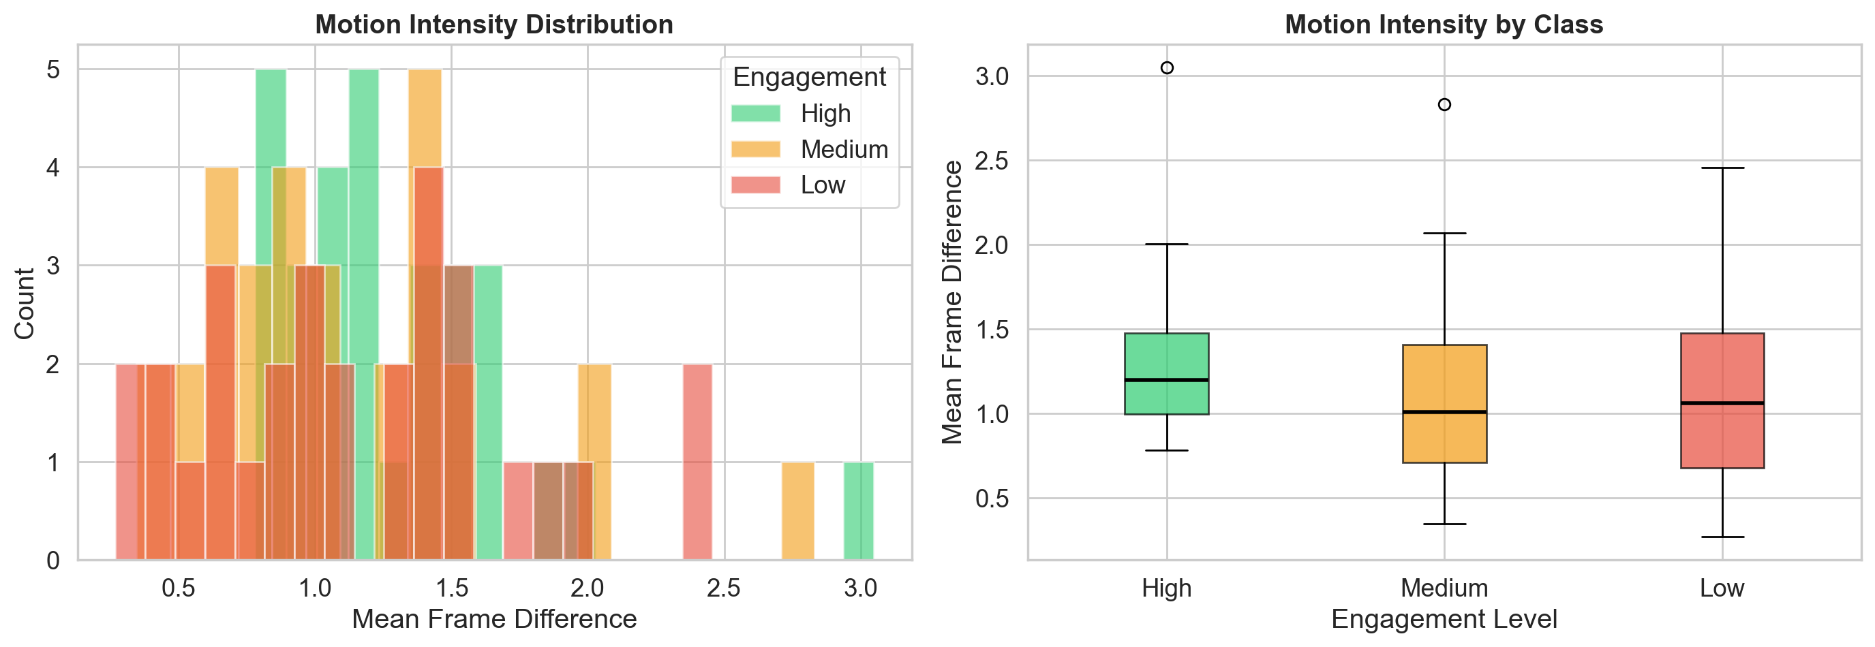
Motion Analysis — Inter-Frame Movement by Engagement Level
Key Observations
Motion score = mean absolute difference between consecutive grayscale frame pairs
Histogram shows whether motion is concentrated or spread across classes
Box plots expose median motion and outlier clips per engagement level
Higher motion in High-engagement clips may reflect interactive classroom activity
Higher motion in Low-engagement clips may indicate restlessness or distraction
📊 Motion Analysis
Replace with: eda_results/motion_analysis.png
Why it matters: Motion is a potentially discriminative feature for engagement classification. If classes show statistically distinct motion profiles, optical flow or frame-difference features could improve model performance. Conversely, if motion is class-independent, the model must rely on spatial or pose-based cues rather than dynamics.
14 / 20

Slide 15
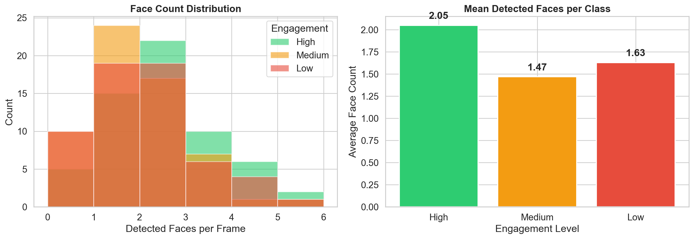
Face Detection Analysis — Visible People per Engagement Level
Key Observations
Haar cascade detector applied to 3 sampled frames per video (20 videos/class)
Histogram shows frequency of detected face counts per frame across classes
Bar chart of mean face counts reveals how many students are typically visible
Results are approximate — Haar cascades may miss occluded or turned faces
Face count serves as a proxy for group size and classroom occupancy
📊 Face Detection Analysis
Replace with: eda_results/face_detection_analysis.png
Why it matters: Student visibility is central to engagement estimation. If High-engagement clips consistently show more visible faces, face density becomes a useful auxiliary feature. For deep-learning pipelines, this motivates face-track extraction or person-detection preprocessing to isolate student regions before classification.
15 / 20

Slide 16
Cross-Analysis Findings — Synthesising the EDA
⚖️ Class Balance
🎥 Media Consistency
⏱️ Temporal Variation
The dataset contains three engagement classes. The imbalance ratio determines whether standard or weighted training is appropriate. Stratified splits must be used to preserve class proportions across train/val/test.
Resolution and FPS profiles determine the required standardisation effort. If most videos share the same resolution and FPS, preprocessing is minimal. Mixed properties require a robust normalisation pipeline.
Duration and frame-count variability determine clip sampling strategy. High CV (>0.3) across durations necessitates truncation or padding. Consistent durations simplify batch construction.
🖼️ Visual Diversity
🏃 Motion Patterns
👥 Face Visibility
Brightness and contrast variability reflect real classroom diversity. Overlapping per-class distributions suggest that low-level photometric features alone are insufficient — the model must learn higher-order semantic cues.
Inter-frame motion scores indicate dynamic activity in classroom scenes. Class-discriminative motion distributions justify incorporating temporal difference channels or optical flow as complementary model inputs.
Face detection results quantify student visibility across classes. Differences in mean face count across engagement levels support person-centric feature extraction as a preprocessing or auxiliary task.
16 / 20

Slide 17
Preprocessing Recommendations — Based on EDA Evidence
1
Resize to Common Resolution
2
Normalise FPS
Standardise all frames to a target size (e.g., 224×224 or 256×256). Use centre-crop + resize to preserve aspect ratio. Prevents spatial dimension mismatch in batched training.
Resample all videos to a consistent target FPS (e.g., 25 fps). Ensures that temporal stride in frame sampling corresponds to the same real-world time interval across all clips.
3
Fixed-Length Temporal Sampling
4
Colour Normalisation
Select N uniformly spaced frames (e.g., 8 or 16) per clip. Handles duration variability without padding. Supports fixed-size tensor batches required by 3D-CNN and Transformer architectures.
Apply ImageNet mean/std normalisation per channel. Reduces brightness and contrast bias identified in frame-level analysis. Ensures stable gradient flow during training.
5
Class Imbalance Mitigation
6
Data Augmentation
Measure imbalance ratio from class distribution analysis. If ratio ≥ 1.5, apply class-weighted loss or SMOTE oversampling. Always use stratified train/val/test splits to preserve class proportions.
Apply random horizontal flip, colour jitter, random crop, and temporal jittering. Augmentation should be informed by EDA: brightness jitter range guided by observed mean ± std; temporal jitter guided by duration CV.
17 / 20

Slide 18
Data Quality Assessment — Strengths, Limitations & Risks
✅ Strengths
⚠️ Limitations
🚨 Risks for Modelling
Multi-class labelling (3 levels) enables nuanced engagement modelling beyond binary classification
Video format preserves full temporal dynamics — richer than frame-level datasets
Systematic folder structure supports reproducible dataset scanning
Metadata extraction via OpenCV is non-destructive and computationally lightweight
Diverse classroom scenes improve generalisation across different recording conditions
Engagement labels are coarse — three levels may not capture nuanced engagement states
No temporal annotation — labels apply to entire clips, not moment-by-moment
Haar cascade face detection is approximate; deep detectors would be more accurate
Motion scores computed on a 30-video sample per class — may not be fully representative
No demographic metadata — analysis cannot control for student population variation
Class imbalance (if present) can bias the model toward the majority engagement class
Lighting differences across recordings may create spurious photometric correlations
Duplicate filenames across classes (identified in quality check) risk data leakage in splits
Variable FPS and resolution increase preprocessing complexity and risk of inconsistency
Corrupted files (if any) must be excluded before training to avoid silent NaN propagation
18 / 20

Slide 19
Modelling Implications — From EDA to Deep Learning
Architecture Choice
Input Pipeline
Training Strategy
3D-CNN (C3D, I3D) for short, fixed-length clips
Video Transformers (TimeSformer, ViViT) for long-range temporal modelling
2D-CNN + LSTM/GRU for lightweight sequential processing
Choice guided by available duration and frame counts from EDA
Resize to 224×224 (or 256×256), centre-crop
Normalise to ImageNet mean/std per channel
Sample N frames uniformly (8–16 per clip)
Resample to 25 fps before sampling
Use class-weighted cross-entropy if imbalance ratio ≥ 1.5
Stratified k-fold splitting to preserve class proportions
Focal loss as an alternative for high imbalance (ratio > 3)
Batch with equal class representation where feasible
Augmentation Policy
Evaluation Protocol
Feature Considerations
Random horizontal flip, colour jitter (guided by EDA brightness range)
Random temporal crop / temporal jittering for duration variation
Random spatial crop after resize (e.g., 224 crop from 256 resize)
No vertical flip — classroom orientation is semantically meaningful
Report per-class precision, recall, and F1 — not just accuracy
Use confusion matrix to identify class-specific failure modes
Report macro-average F1 for imbalanced-class fairness
Evaluate on unseen recordings (not just unseen clips) to test generalisation
Motion features (optical flow, frame diff) — motivated by motion analysis
Face detection / body pose as auxiliary spatial features
Brightness normalisation to mitigate photometric class bias
Temporal attention mechanism to focus on high-motion engagement cues
19 / 20

Slide 20
Conclusion — What the EDA Reveals
EDA Summary
📊 Rich Multi-Modal Profile
The OUC-CGE dataset is a video-based, three-class engagement recognition benchmark from real university classroom recordings
All 16 EDA analysis sections were executed, producing 10 publication-ready visualisations and a complete metadata CSV
Class distribution, duration, FPS, resolution, file size, brightness, contrast, motion, and face visibility were all quantified
Key preprocessing requirements identified: standardise resolution, normalise FPS, apply stratified splitting, and address class imbalance
Motion and face detection analyses reveal dataset-level behavioural signals that may serve as discriminative features for engagement models
Dataset quality check confirmed integrity — corrupted or zero-metadata files were flagged and excluded from statistical analysis
16 analysis dimensions — temporal, spatial, visual, motion, and facial — provide comprehensive dataset understanding.
🎯 Actionable Insights
Every EDA finding maps directly to a preprocessing or training decision, making this analysis immediately useful for model development.
🚀 Model-Ready Foundation
Following EDA-informed preprocessing, the dataset is ready for 3D-CNN or Transformer-based engagement classifiers.
20 / 20
Thank you · Koppesh P · OUC-CGE EDA · Questions welcome

