Slide 1
Bluemote

Slide 2
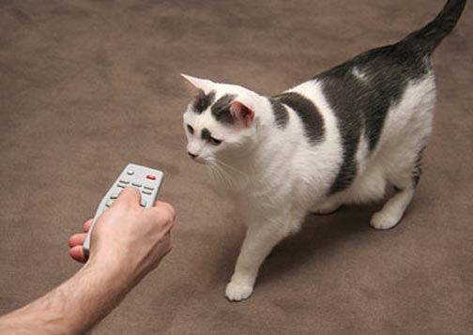
Bluemote

Slide 3
Idea
Bluetooth remote for presentations and media player
  seamless integration
  intuitive to use
  easy to develop
  extensible

Slide 4
Seamless Integration
Plan: act as bluetooth keyboard – it's a standard!
Why this didn't work:
  Android SDK doesn't support bluetooth HID profile
  one possible way: access Bluez with Android NDK
    High complexity
    Coding in C++, JNI → :(
  WTF????!!! pptx?!!

Slide 5
Seamless Integration
What we actually do:
  Python bluetooth daemon on pc
  emulating key codes
  pairing via bluetooth
  communicating over bluetooth RFCOMM

Slide 6
Intuitive to use
It's a remote...
  buttons
  service discovery
  no configuration needed

Slide 7
Extensible
Easy adding of new remote control functionality
Use context information to choose device and functionality
Different transmission protocols for remote control signals

Slide 8
Work plan
Implement GUI design
Work on bluetooth connection problems

