Slide 1
Project Presentation
Name: Pavani Korada
Domain: Machine Learning and Python

Slide 2
Customer Churn Prediction
- A Machine Learning Project

Slide 3
Introduction
Customer churn refers to customers leaving a service.
Retention is cheaper than acquisition.
Goal: Predict churn using ML.

Slide 4
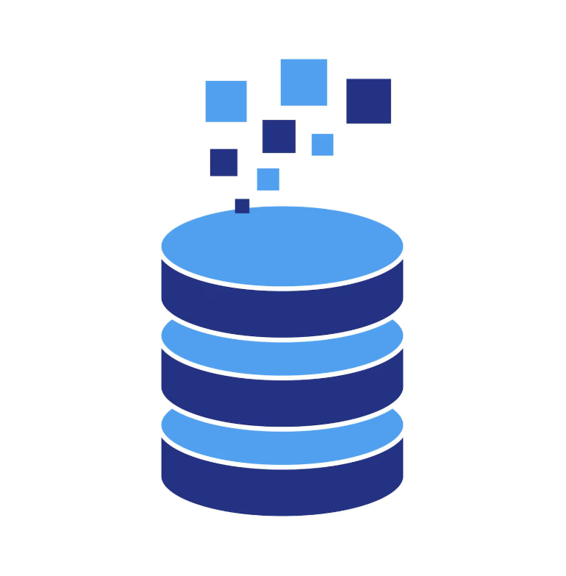
Dataset
Telco Customer Churn Dataset
7043 records, 21 features
Target: Churn

Slide 5
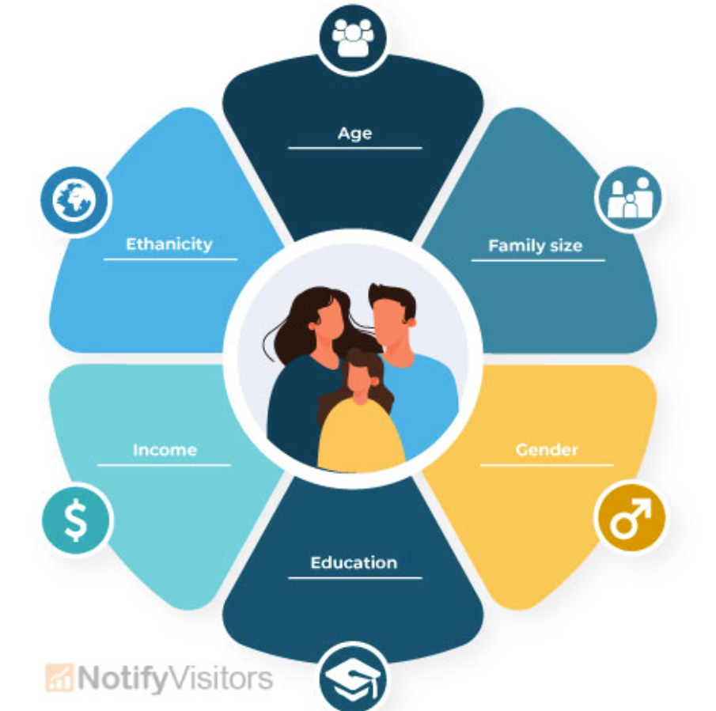
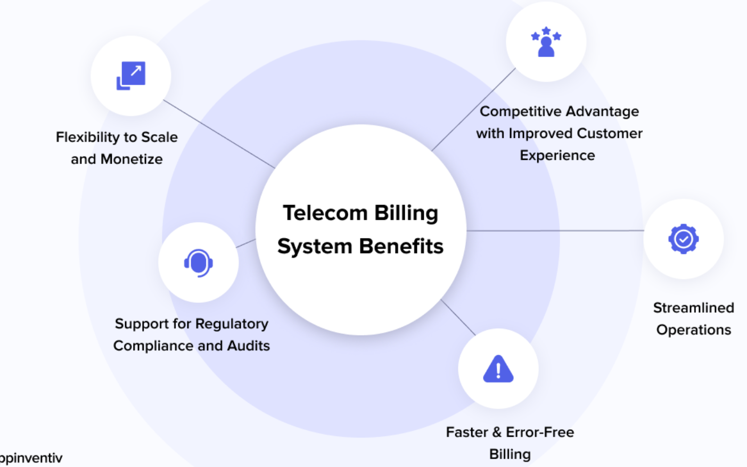
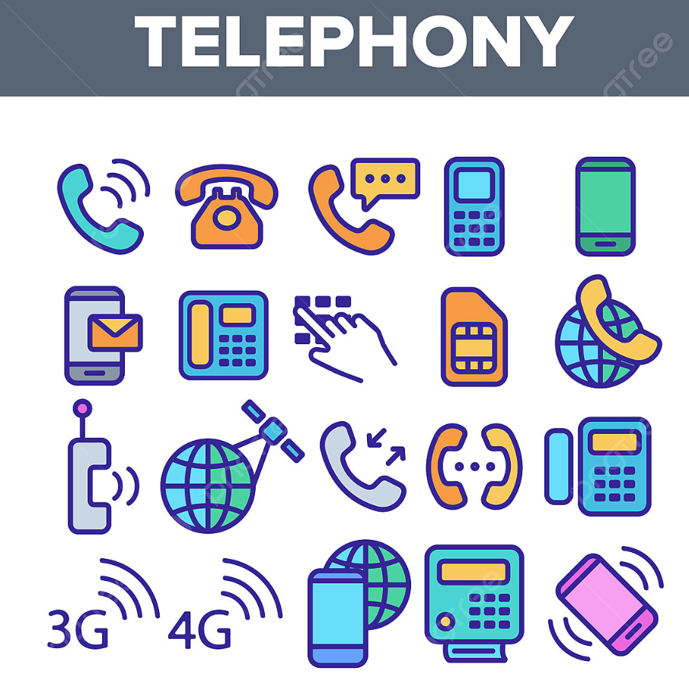
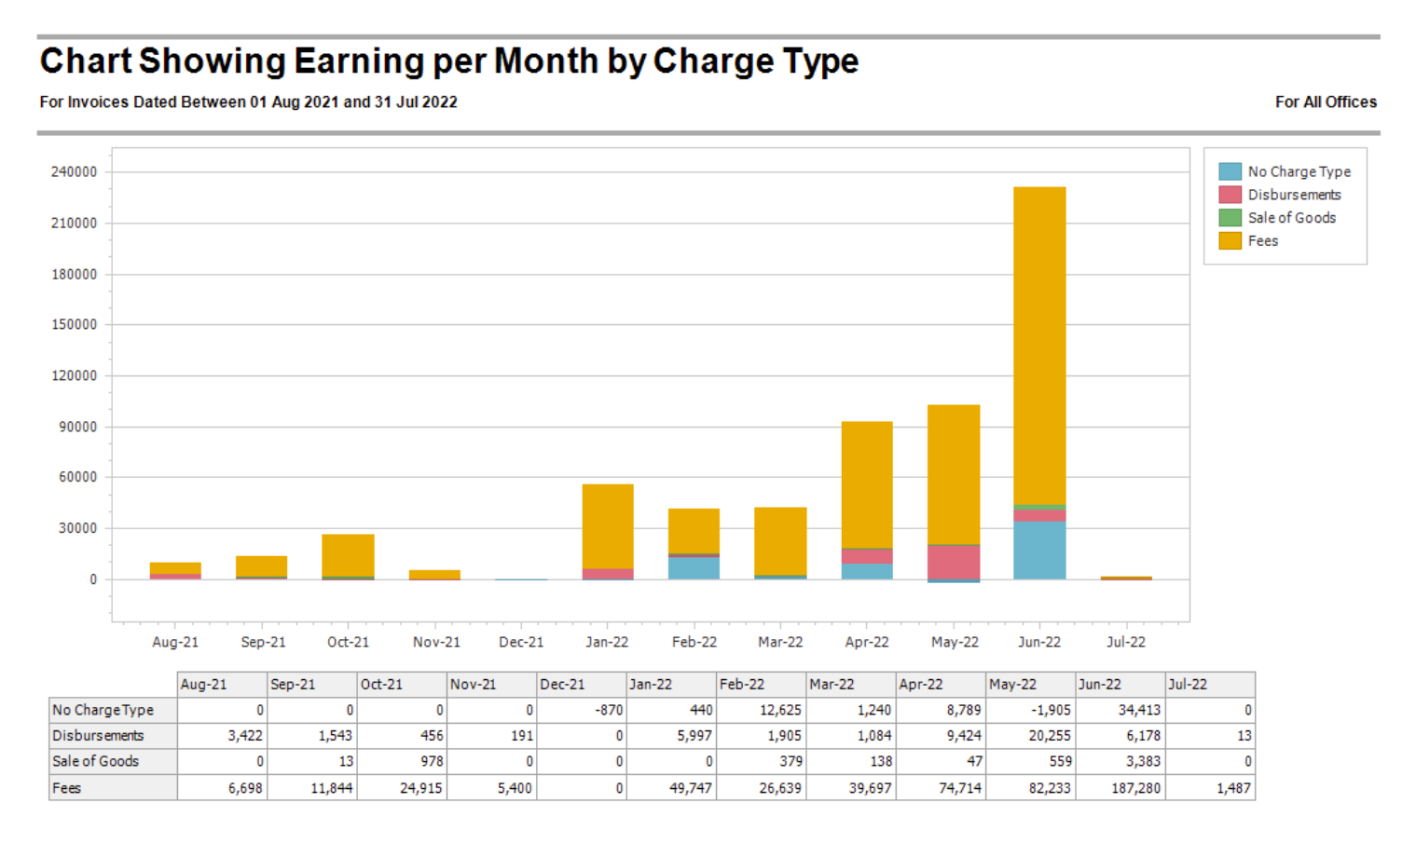
Data Features
Demographics Billing & Payment
Services Tenure & Charges

Slide 6
EDA Insights
High churn in month-to-month contracts
Higher churn for fiber optic users
Short tenure customers churn more

Slide 7
Preprocessing
Label Encoding
Scaling
Handling imbalance using SMOTEENN

Slide 8
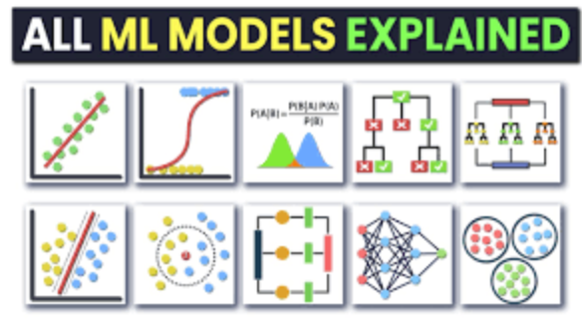
Models Used
Logistic Regression
SVM
Random Forest
Decision Tree
AdaBoost
Gradient Boosting

Slide 9
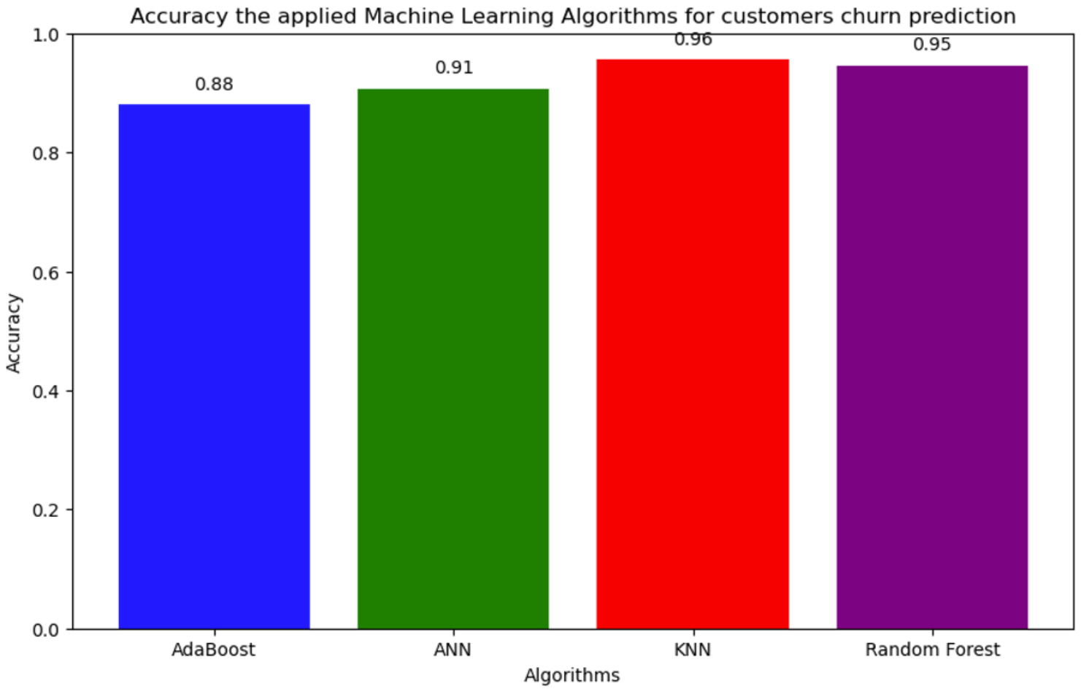
Model Performance
Best Accuracy ~80%
Random Forest & AdaBoost performed well

Slide 10
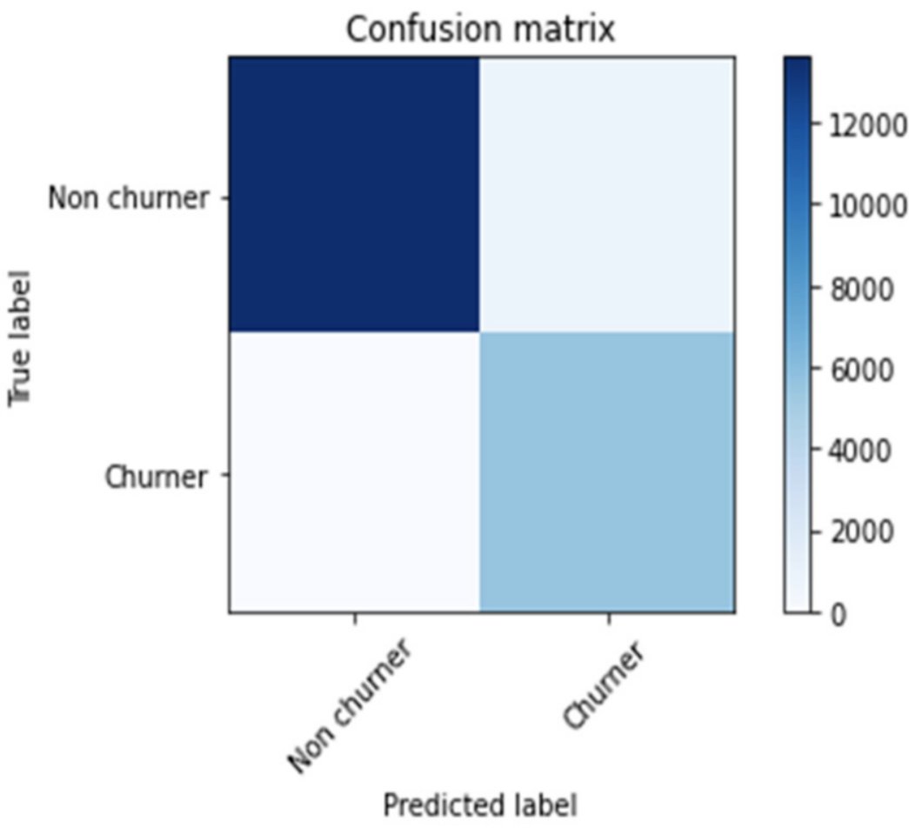
Evaluation Metrics
Accuracy
Precision
Recall
F1-score
ROC-AUC

Slide 11
SHAP Analysis
Tenure most important feature
Contract type influences churn
Monthly charges impact churn
Tenure most important feature
Contract type influences churn
Monthly charges impact churn
Business Insights

Slide 12
Conclusion
ML helps predict churn effectively
Insights help retention strategies

Slide 13
Student Performance Tracker
- A Python Programming Project

Slide 14
Problem Statement
Manual tracking of student performance is inefficient
Need a centralized system

Slide 15
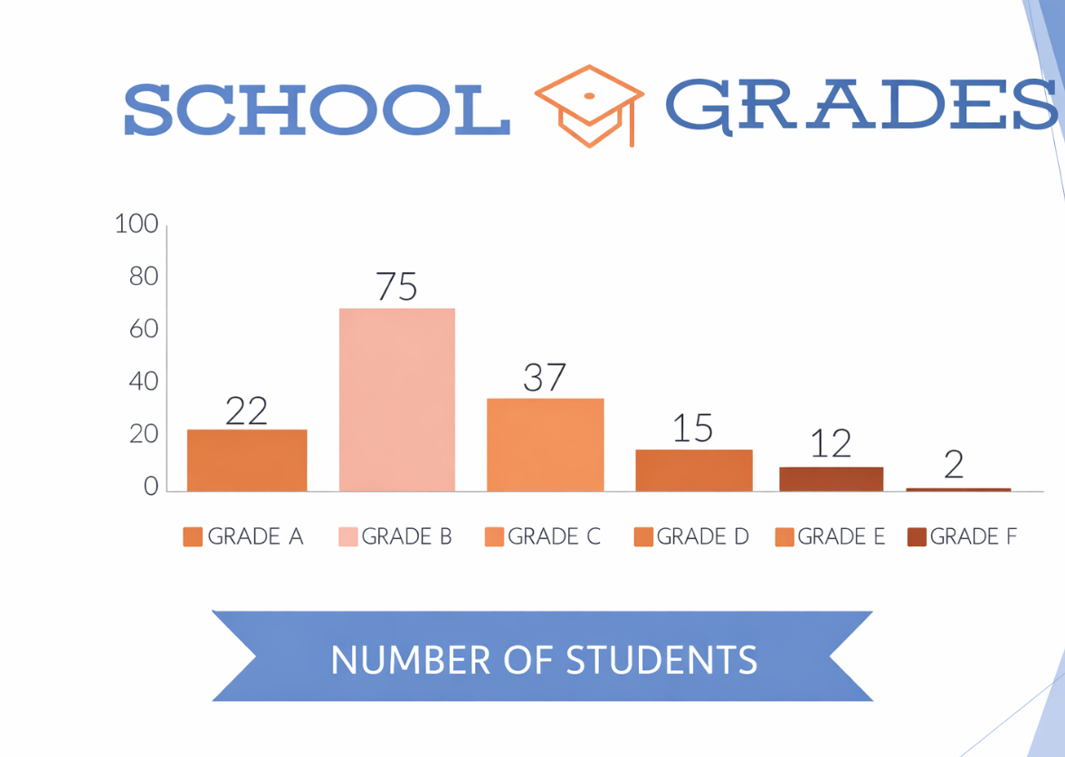
Project Objectives
Store student data
Track marks
Analyze performance

Slide 16
Key Features
Add/View student records
Performance calculation
User-friendly interface
System Workflow
Input student details
Store in database
Display results

Slide 17
Benefits
Saves time
Reduces errors
Centralized access
Future Scope
Charts & analytics
Login system
Cloud deployment

Slide 18
Conclusion
Efficient student tracking system
Practical academic use

Slide 19
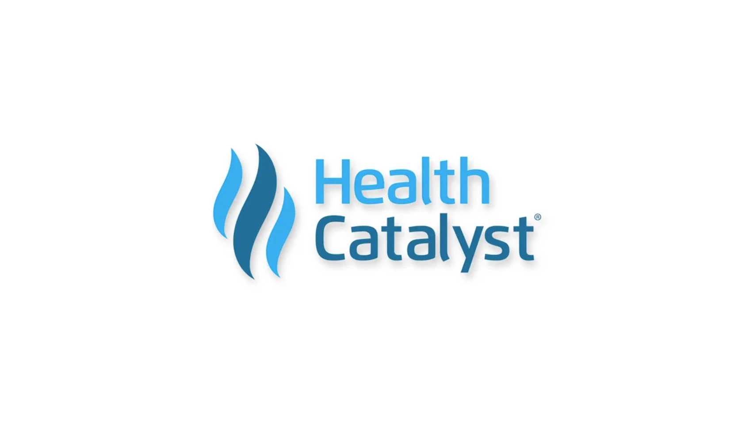
About Health Catalyst
Leading healthcare data and analytics company.
Mission: To be the catalyst for massive, measurable, data‑informed healthcare improvement.
Provides data, analytics platforms, and software to healthcare organizations.
Helps hospitals and health systems improve clinical, financial, and operational performance.
Focuses on data‑driven decision making to improve patient outcomes.

Slide 20
Thank You
Questions?

