Slide 1

PERSONAL PORTFOLIO
BY
KORADA VIJAYA ANJALI
ADITYA UNIVERSITY
21A91A6148

Slide 2
INDEX
INTRODUCTION
TECHNOLOGIES USED
METHODLOGY
DEPLOYMENT
RESULTS
CONCLUSION

Slide 3
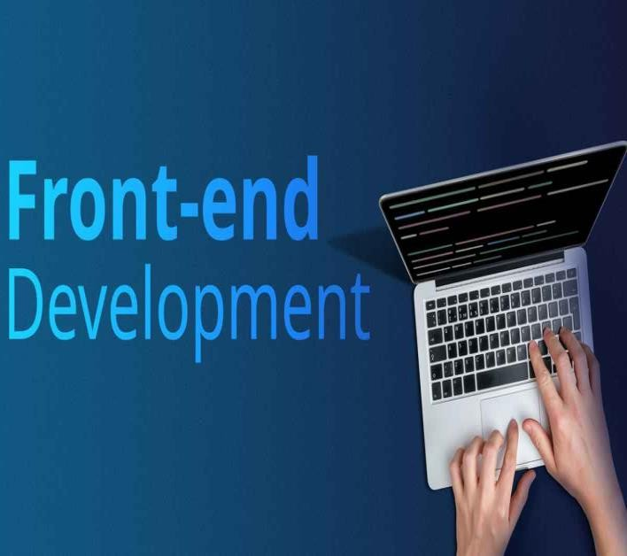
01. Introduction
This presentation provides an overview of a website I developed, which showcases my skills, experiences, and achievements.
Objective is to create a professional and engaging online presence that highlights my personal and professional journey, making it easier for potential employers, collaborators, and peers to learn about me and my
work.
It is a self development project and I did it solo for learning.

Slide 4
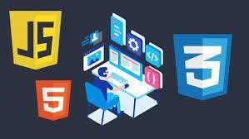
02.TECHNOLOGIES USED
HTML (Hyper text markup language)
CSS (Cascading Style Sheet)
JAVA SCRIPT

Slide 5
03. METHODOLOGY
Objective Definition: Clearly defining the goals and objectives of the project.
Scope Determination: Outlining the features and functionalities to be included in the project.
Technology Selection: Identifying and selecting the technologies and tools needed for the development process I choose HTML, CSS, JS.
Designing: Creating design mockups and wireframes to visualize the user interface and overall structure.
Development: Writing code and developing the actual project based on the established plan and design.
Testing: Conducting various types of testing (unit testing, integration testing, user testing) to ensure the project meets its requirements.
Final Testing: The final test is about weather we can download my resume from the website I created it was successful I am able to download it.

Slide 6
04. DEVELOPMENT
Home: Introduction and overview about me like my moto to live.
About: Insight into my background and career goals.
Download Button: It download my resume.
Skills: A detailed list of my skills and competencies.
Projects: Descriptions and outcomes of my key projects.
I create this website using HTML, CSS, JS.

Slide 7
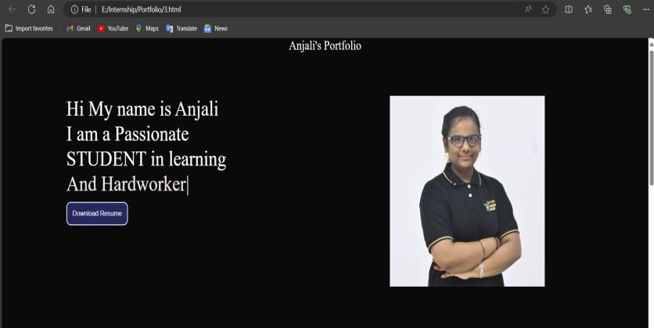
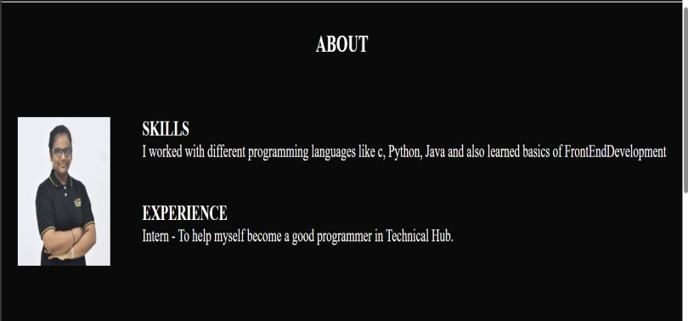

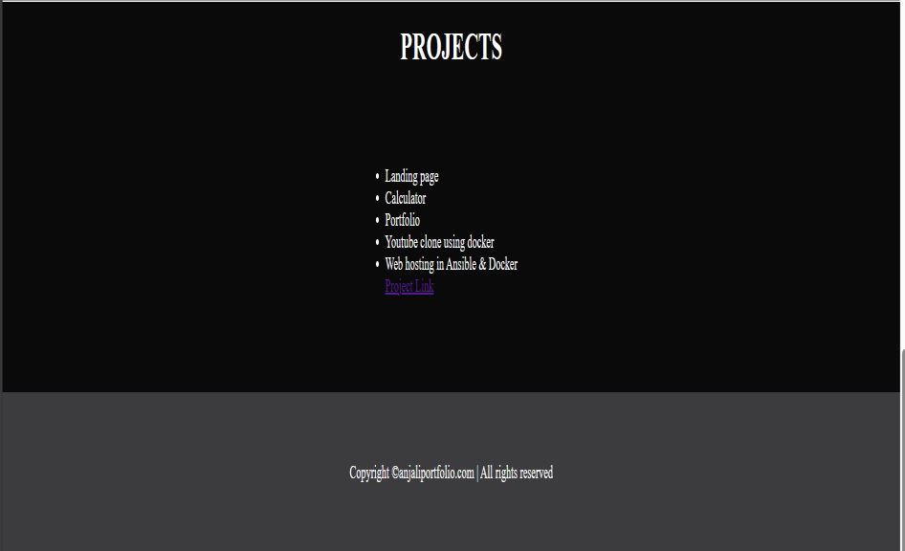
05.RESULTS

Slide 8
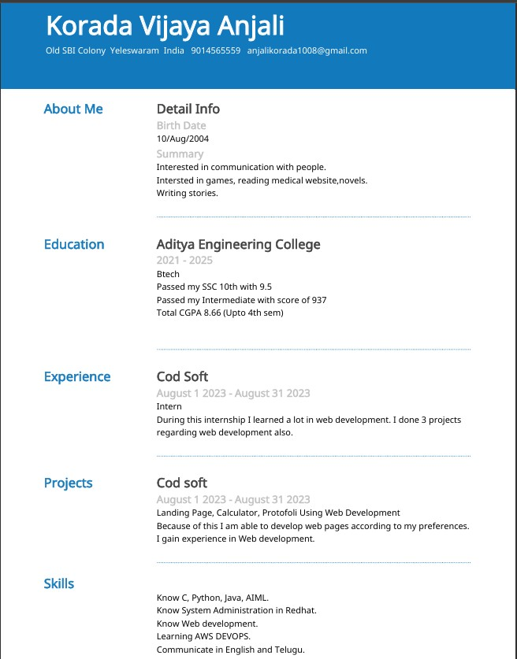
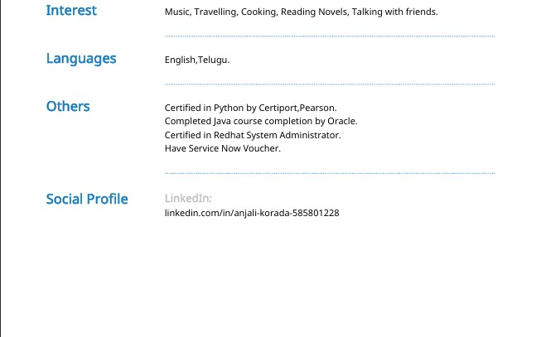

Slide 9
06. CONCLUSION
My personal portfolio project is a comprehensive representation of my skills, experiences, and aspirations. Using HTML, CSS, and JavaScript.
I created an engaging and user-friendly website that showcases my journey as a student and developer.
From detailed information about my background to a showcase of my projects, the portfolio serves as a
professional platform for potential employers and collaborators to learn about me.
This project not only highlights my technical abilities but also reflects my passion for continuous learning and growth in the field of web development. Thank you for exploring my portfolio.

Slide 10


