Slide 1
Crude Oil Price Prediction
Ms.Sakshi vidyadhar parab
Mr.Prasanth Junnada
Ms.Korasikha poojitha
Ms.Gudicinti Hari Priya
Ms.Dipali Naskar
Ms.Vojjala Varshini
Mrs.Arwa jafar ali

Slide 2
Exploratory Data Analysis(EDA)

Slide 3
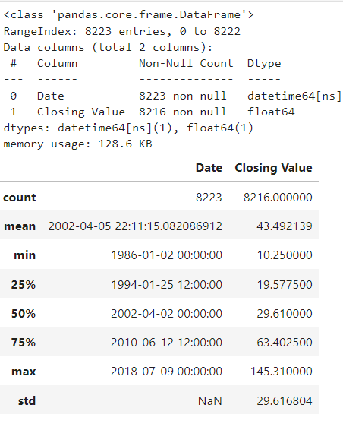
Data Description
Data set contains date column and
closing price column
We need to forecast/predict the crude oil price
Data Range is from Jan 1896 to July 2018
No of data points are 8223
No of columns are 2
Price statistics
Average/mean value is 43.492139 usd
Median value is 29.610000 usd
Minimum value is 10.250000 usd
Maximum value is 145.310000 usd
Maximum value might be an outlier
There are null values in closing price column

Slide 4
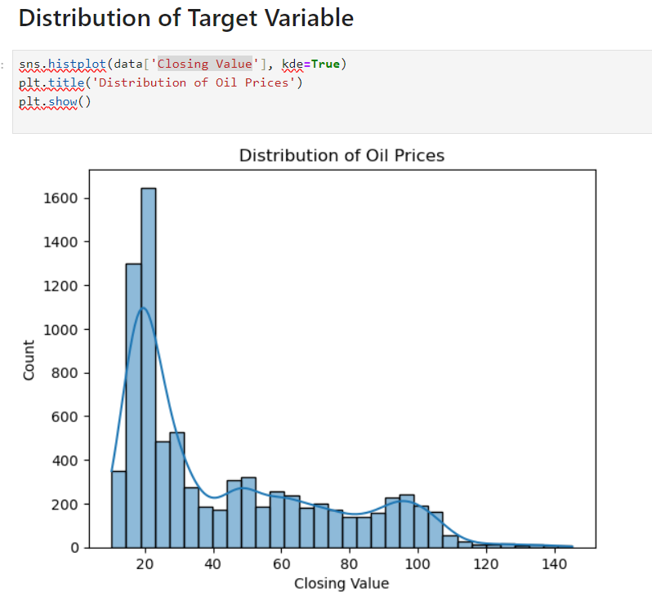
Distribution plot of closing values
Our Data is right skewed.
The long tail on the right-hand side, indicating that there are a few data points that are much larger than the majority of the data.

Slide 5
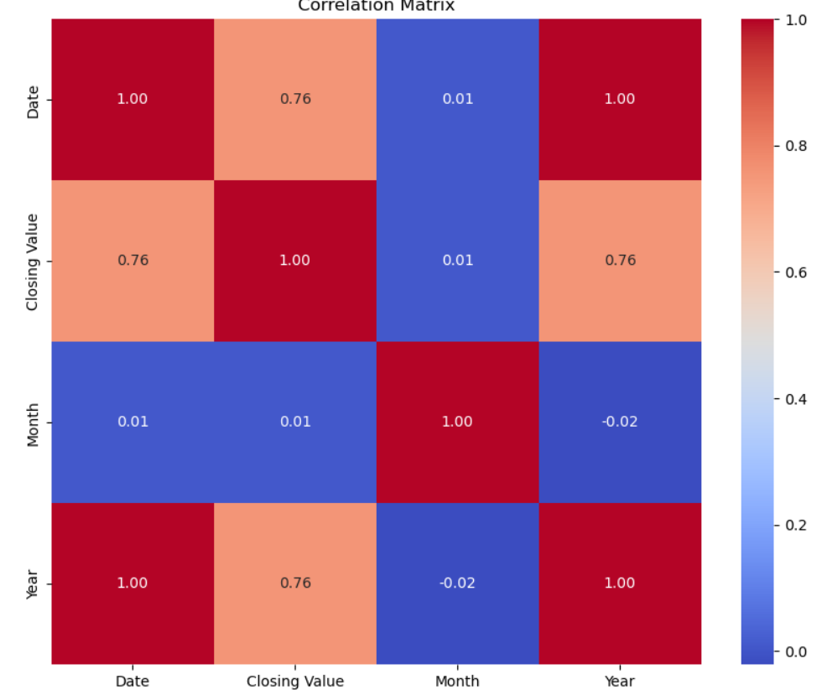
Performing Correlation Matrix
It indicates a perfect positive correlation.
And also it is indicating that our data data has linear relationship .

Slide 6
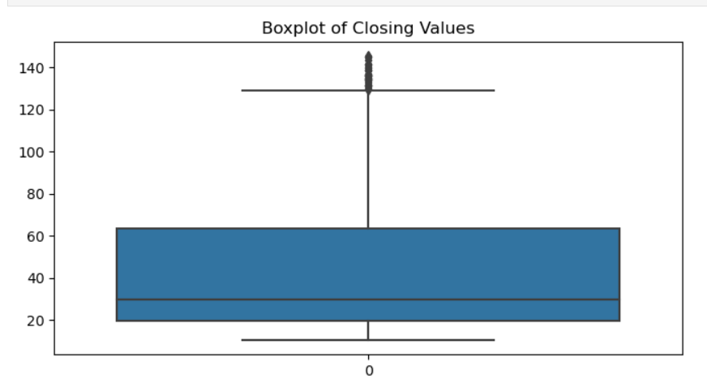
Boxplot to identify outliers
In our dataset after plotting the data we can see
outliers are exist.
outliers can also affect the performance and
accuracy of machine learning algorithms that are
designed to learn patterns and relationships in data..

Slide 7
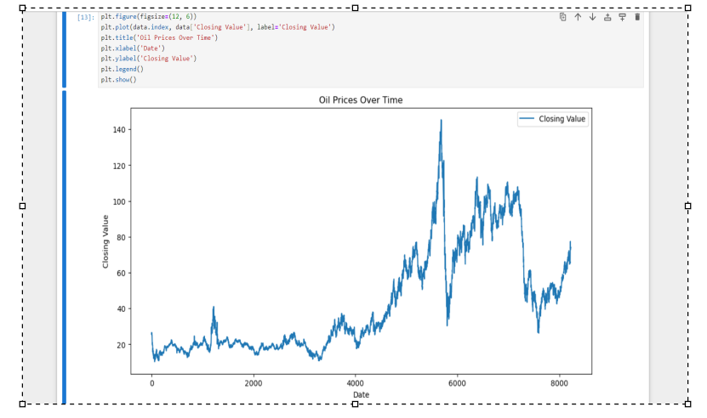
Plot Closing value over time
If we observe the plot in early 2009 the closing value is peaked suddenly and then after it got stabled normally..

Slide 8
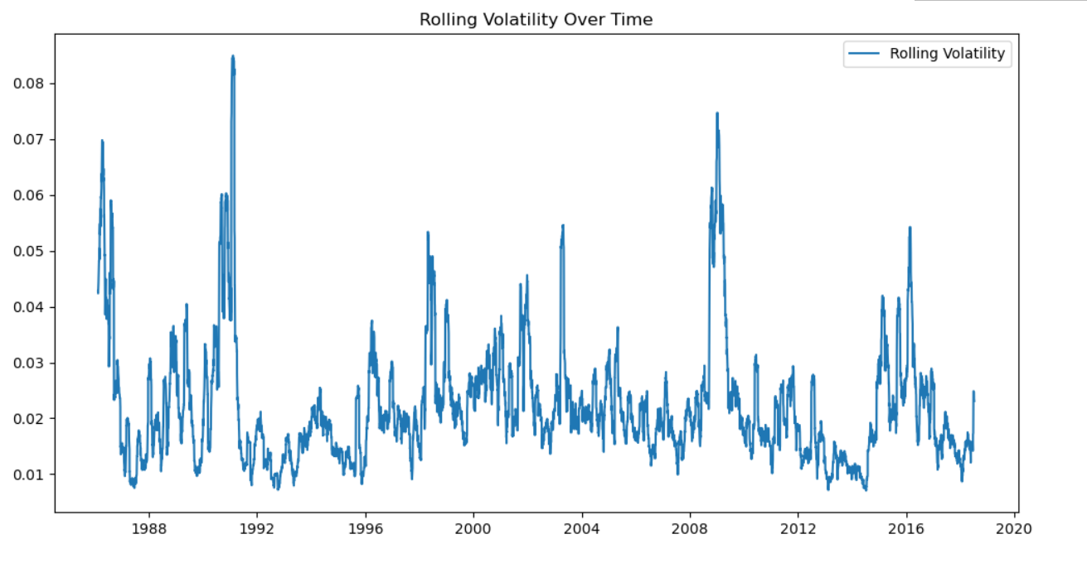
Rolling volatility
We can clearly see through the above graph that the rolling average has smoothened the closing values, and we can notice the peak more evidently.
With a smoother trend line, it may be easier to make more accurate predictions about oil pricing.
The smoothened trend line can be beneficial for long-term planning, helping stakeholders anticipate and prepare for sustained movements in oil prices. This is particularly relevant for industries that are sensitive to energy costs.

Slide 9
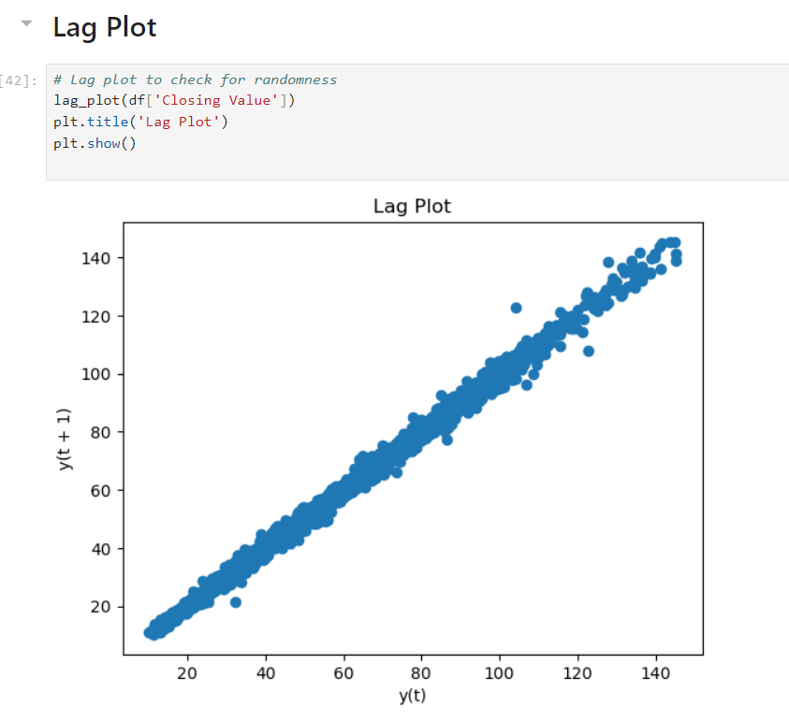
Lag Plot
Outliers are easily discernible on a lag plot.
Data shows a linear pattern, it suggests autocorrelation is present..

Slide 10
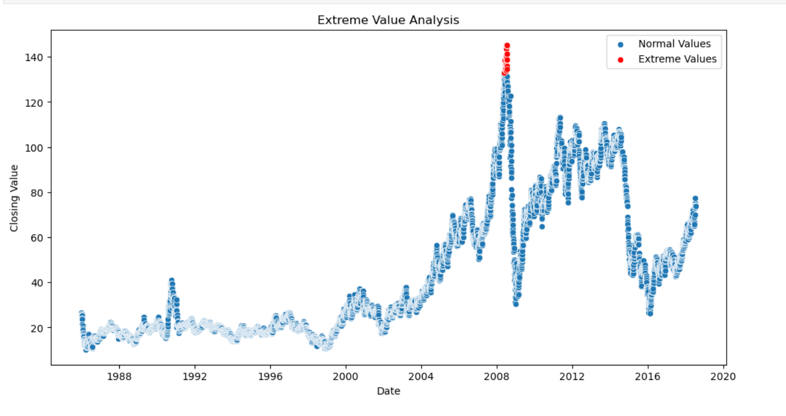
Identify extreme values using Z-Score
GPA(grade point average)seems to be fit for further analysis.
we can do the Anamoly detection: Trimming (removing outliers) and Capping (imputing outliers).

Slide 11
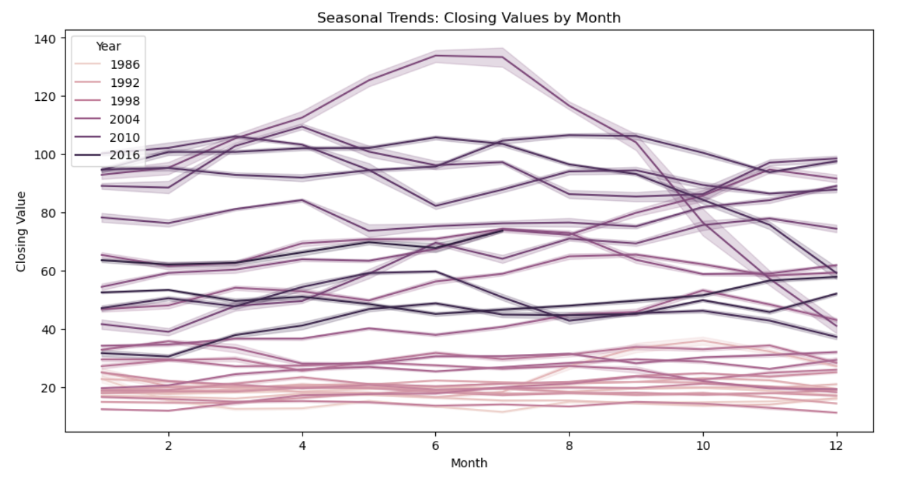
Analysing the oil price from 1986 to 2016
We can conclude that price of oil is increasing linearly from year 1986 to 2016.
A linear increase in oil prices may be indicative of consistent global economic growth, with higher demand for energy resources accompanying increased economic activities.

Slide 12
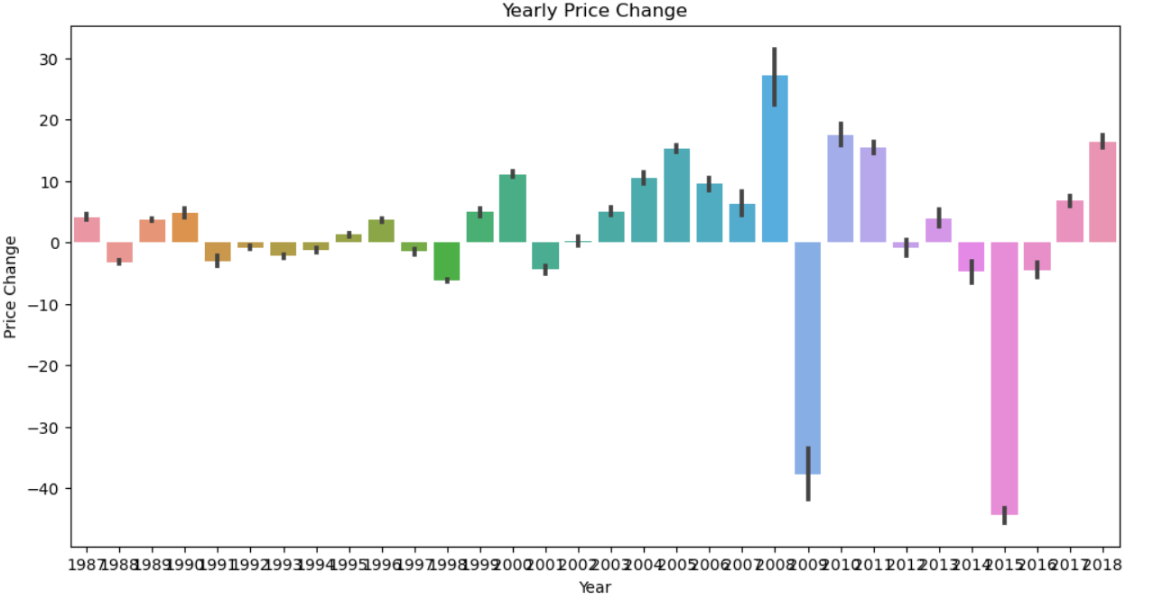
Yearly price change using bar plot
Analyzing the bar plot helps in gaining a long-term perspective on how prices have evolved over the years..
There are years with minimal or no price increase, it suggests periods of price stability.

Slide 13
Model Building

Slide 14
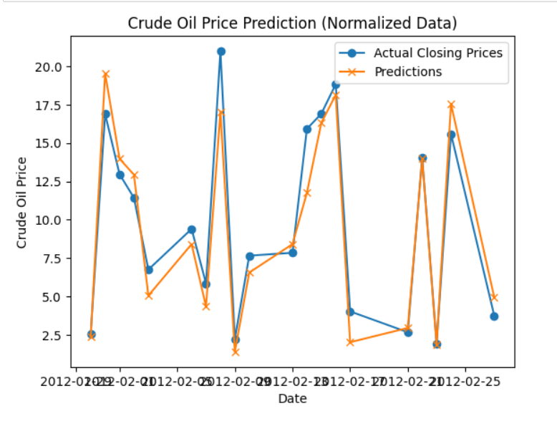
Normalized Data

Slide 15
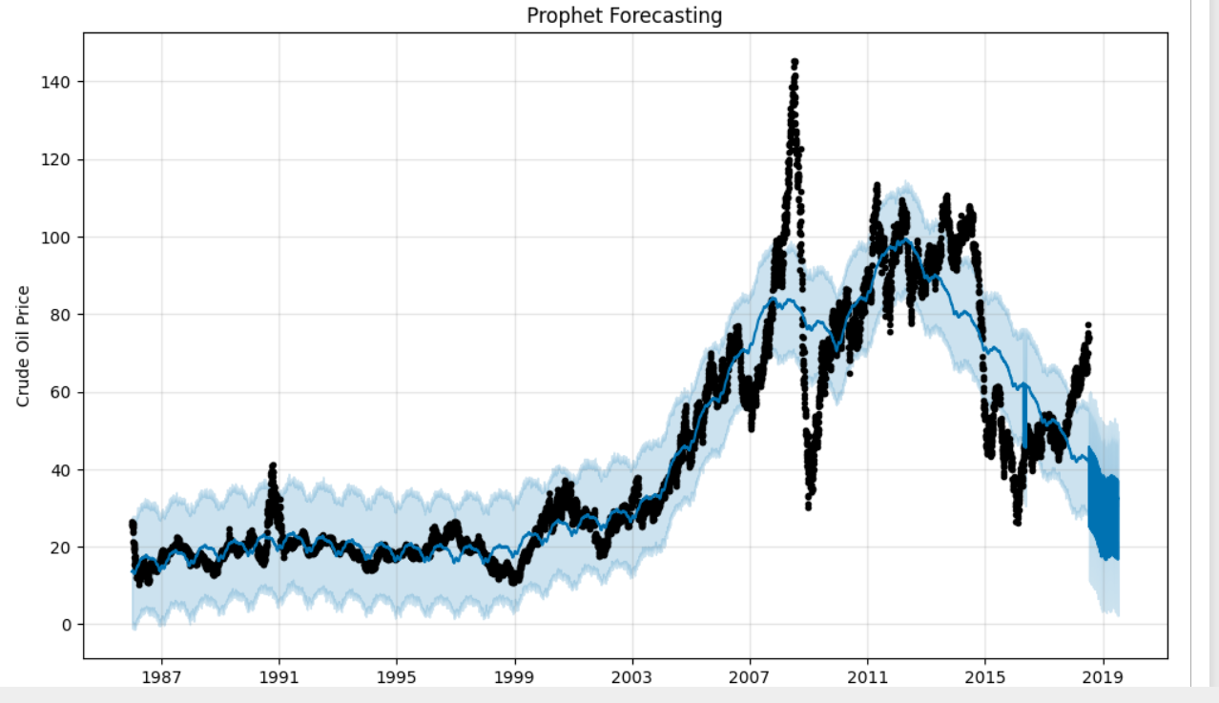
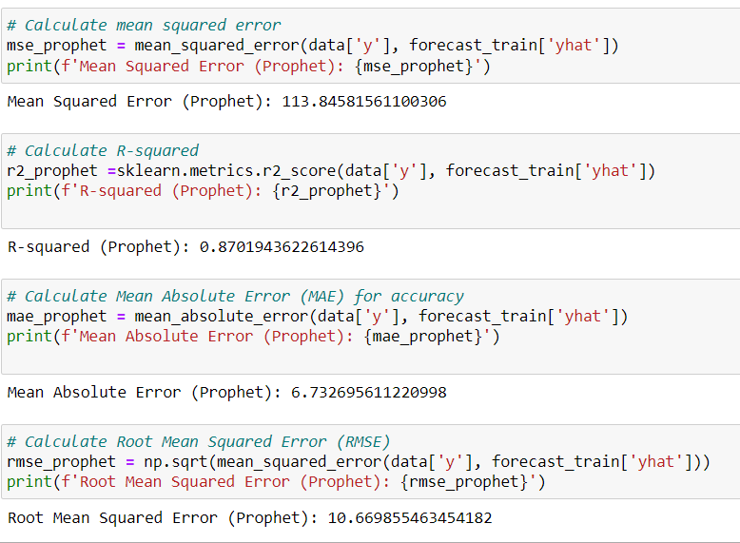
Prophet Forecasting
Prophet is an open-source software released by Facebook. Prophet is a procedure for forecasting time series data based on an additive model where non-linear trends are fit with yearly, weekly, and daily seasonality, plus holiday effects. It works best with time series that have strong seasonal effects and several seasons of historical data. Prophet is robust to missing data and shifts in the trend, and typically handles outliers well.

Slide 16
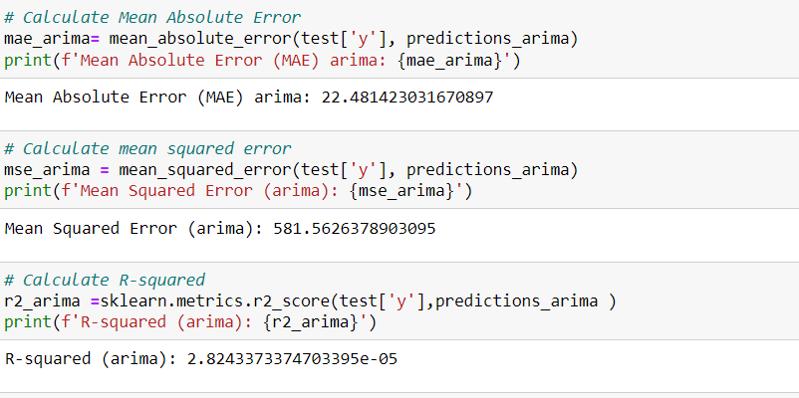
Arima Model
1.2549335034196767
Autoregressive Integrated Moving Average (ARIMA) Model:
ARIMA Model Evaluation:
MAE: 22.481423031670897
MSE: 581.5626378903095
RMSE: 2.8243373374703395e-05
An MAE of 22.4814 suggests that, on average, the model's predictions are off by approximately 1.0635 units.
An MSE of 581.5626 indicates the average squared difference between the predicted and actual values.
An RMSE of 2.8243 gives the average magnitude of the errors.

Slide 17
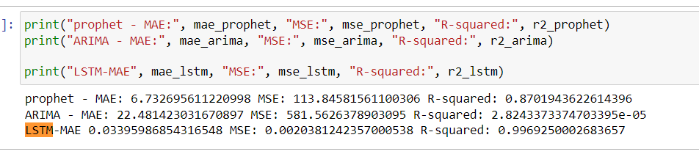
LSTM Model
The Long Short-Term Memory network, or LSTM network, is a recurrent neural network trained using Backpropagation Through Time that overcomes the vanishing gradient problem. It can be applied to time series forecasting.

Slide 18
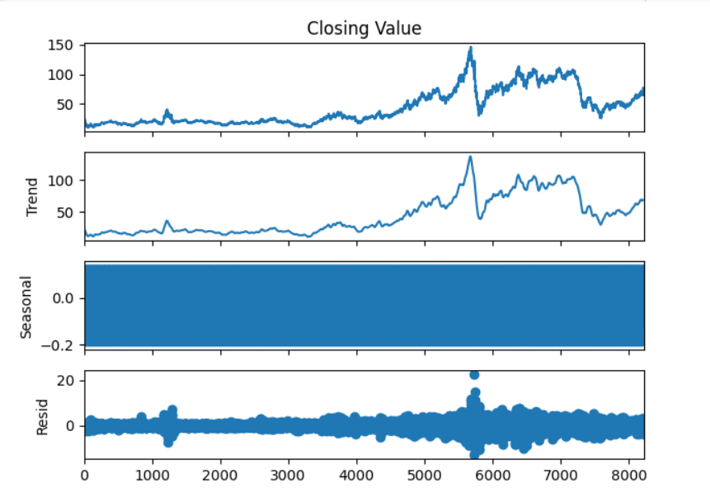
Time Series Decomposition
Trend: A trend is said to exist when there is a long-term increase or decrease in the time series data.
Seasonality: A seasonal pattern is observed when a time series is affected by seasonal factors occurring yearly, monthly, daily etc . Seasonality refers to a known frequency, e.g. Quarterly = 4,monthly =12
To extract the Trend, Seasonality and error we used the decompose() and forecast::stl() function to split our time series in to seasonality, trend and error components.
Observation:
1. Actual data
2. Trend : There is an Increasing Trend
3. Seasonality: There is Seasonality associated
4. Resid : Residual is the left over after decomposition of the two major components (Trend and Seasonality)

Slide 19
Test for Stationarity
Assumptions of ARMA model
Data should be Stationary: A Time series is said to be Stationary if its statistical properties like mean, variance, autocorrelation etc are all constant over time implying it does not have Trend or Seasonal effect. If a Trend appears and Stationarity is not evident, many of the computations throughout the process cannot be made and produce the intended results. Statistical modelling methods assume or require the time series to be stationary to be effective.
Data should be Univariate: ARMA works on a single variable. (Auto regression is all about regression with past values)
Test to Check for Stationarity:
Augmented Dickey-Fuller Test (ADF test)
Null Hypothesis (H0): The series is not stationary
p-value > 0.05
Alternate Hypothesis (H1): The series is stationary
p-value <= 0.05
A p-Value of less than 0.05 in adf.test() indicates that the time series is stationary.

Slide 20
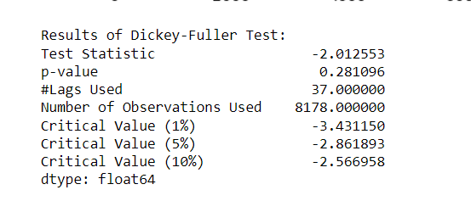
Observation:
We can see that p-value is 0.281, Hence p-value > 0.05, and we fail to reject the Null hypothesis.
Conclusion:
Our time series is Non-stationary. We need to make our non-Stationary time series to Stationary before we begin model building.

Slide 21
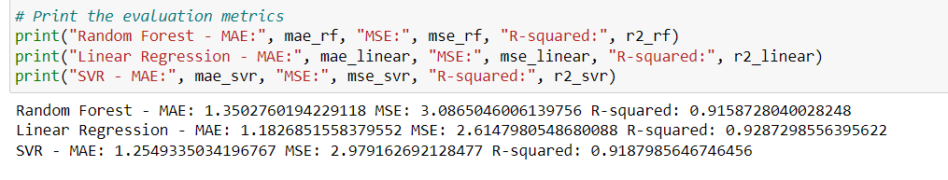
Linear Regression Model
Observation:
Mean Absolute Error (MAE):
MAE measures the average absolute difference between predicted and actual values.
Smaller MAE values indicate better performance.
Mean Squared Error (MSE):
MSE measures the average squared difference between predicted and actual values.
Smaller MSE values indicate better performance.
Root Mean Squared Error (RMSE):
RMSE is the square root of the MSE, providing a measure of the average magnitude of the errors.
Smaller RMSE values indicate better performance.

Slide 22
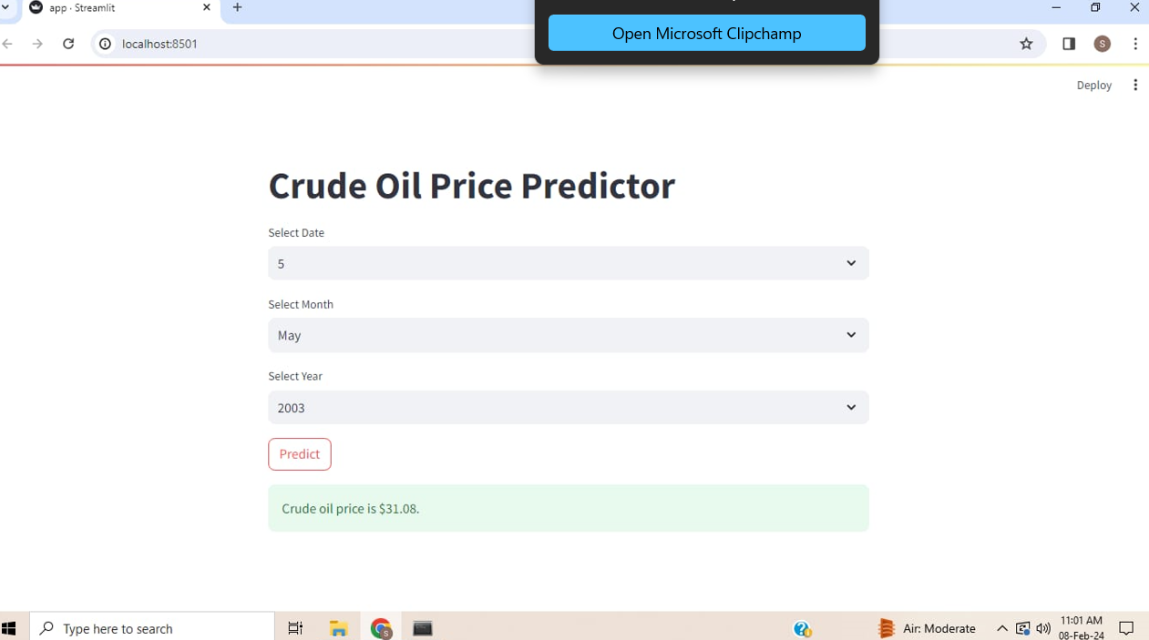
Project Deployment

Slide 23
CHALLENGES
Challenge 1: Missing Values
-Handling missing data in time series, impact on analysis.
Challenge 2: Feature Selection
-Choosing relevant predictors, avoiding multicollinearity.
Challenge 3: Hyperparameter Tuning
-Optimizing model parameters for improved performance.
Challenge 4: Model Interpretability
-Ensuring models are interpretable and provide actionable insights.

Slide 24
Thank You

