Slide 1
Computational Fluid Dynamic NFTs V0.0.12 Minting Dapp

Slide 2
Background

Slide 3
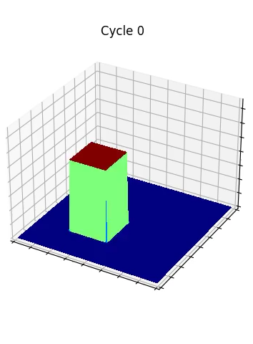
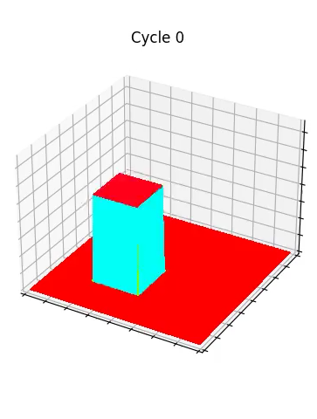
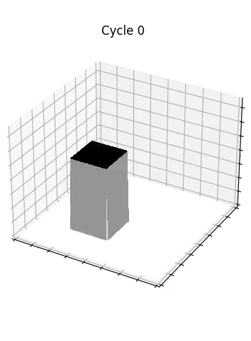
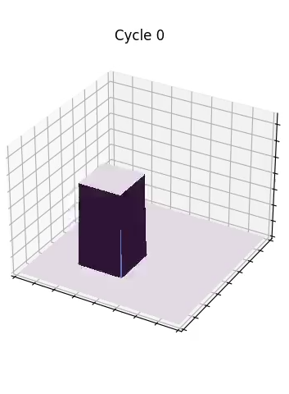
Banner

Slide 4
logo
Computational Fluid Dynamic NFTs

