Slide 1
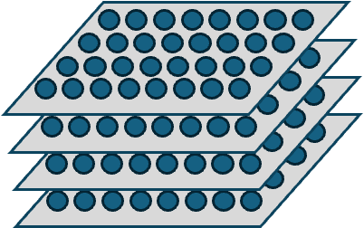
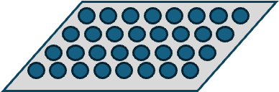
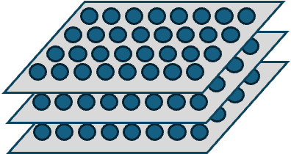



Output (one channel)
$$X$$
$$∗$$
$$W$$
Input: One Image or Tensor (e.g. 3 channels)
One Kernel (3 channels)
- learns one feature

Slide 2
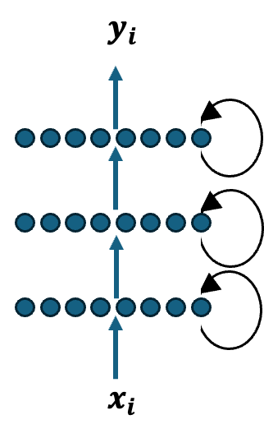


$$y_{i}$$
$$x_{i}$$

Slide 3
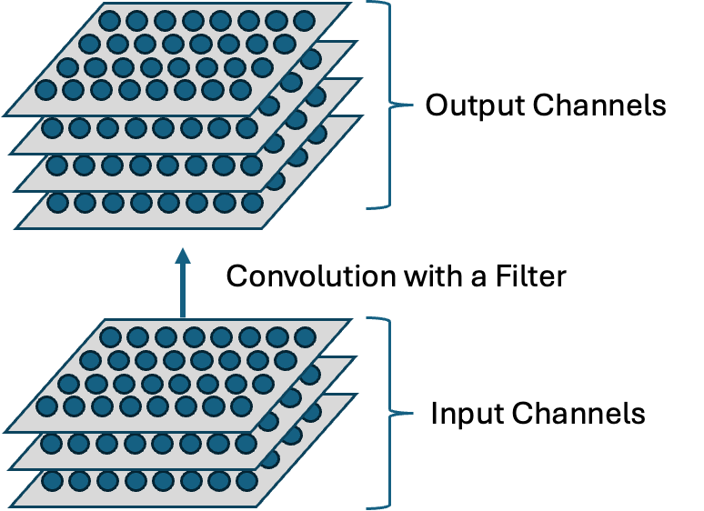

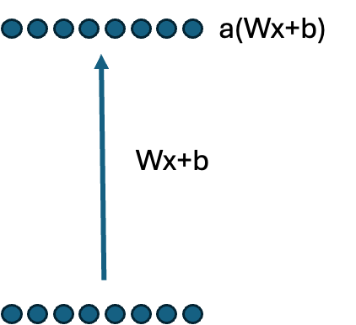
Output Channels
a(Wx+b)
Convolution with a Filter
Wx+b
Input Channels

Slide 4
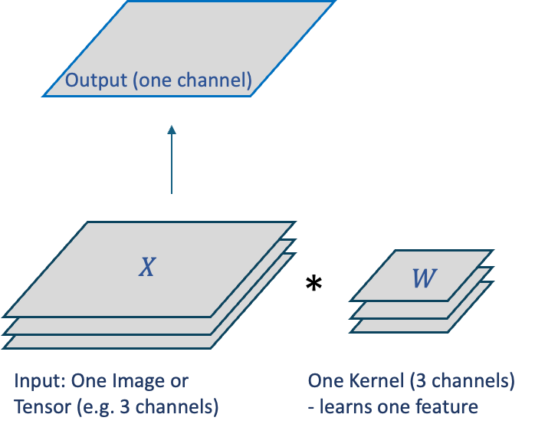

Slide 5
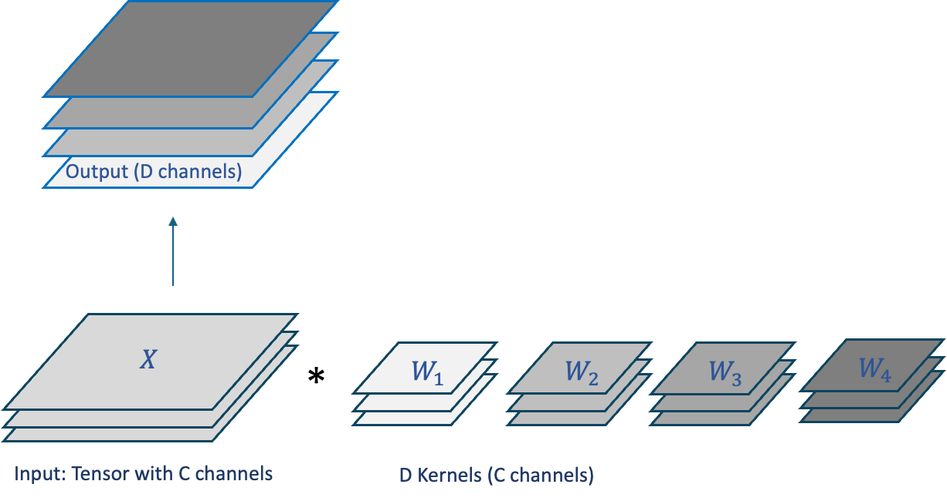




Output (D channels)
$$X$$
$$∗$$
$$W_{1}$$
$$W_{2}$$
$$W_{3}$$
$$W_{4}$$
Input: Tensor with C channels
D Kernels (C channels)

Slide 6
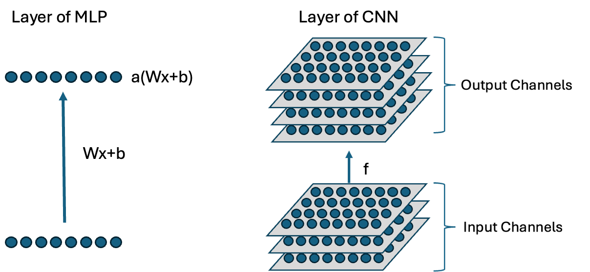
Layer of MLP
Layer of CNN
f

Slide 7
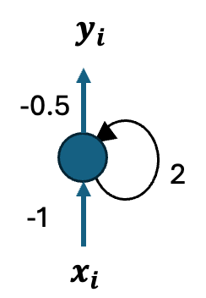

$$y_{i}$$
-0.5
2
-1
$$x_{i}$$

