Slide 1
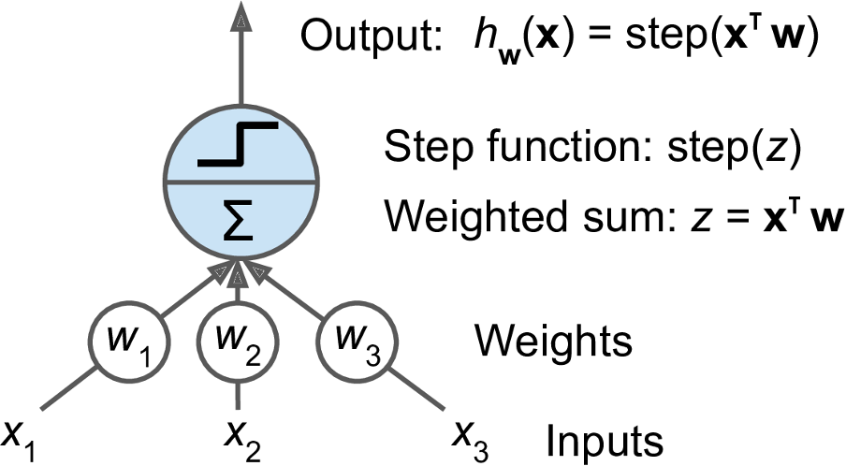
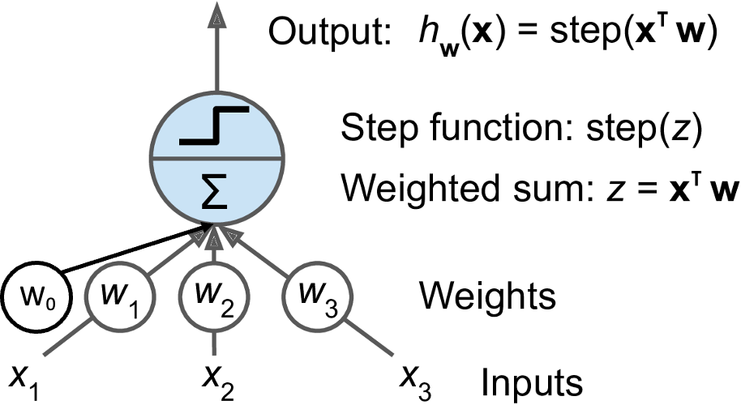

W₀

Slide 2
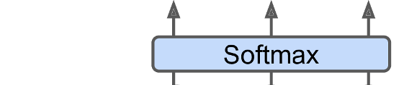
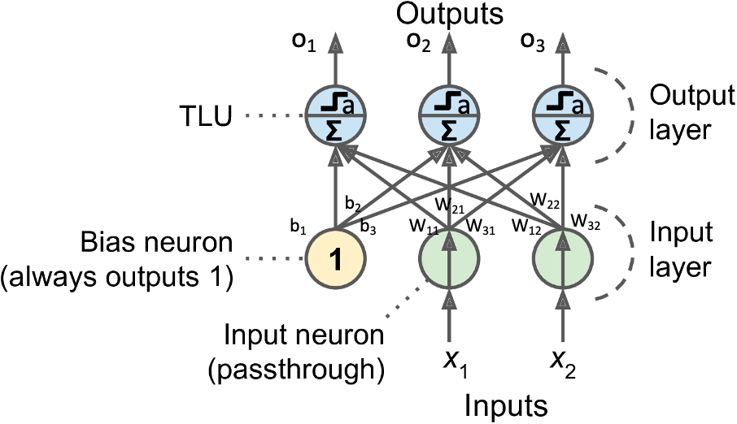

Slide 3
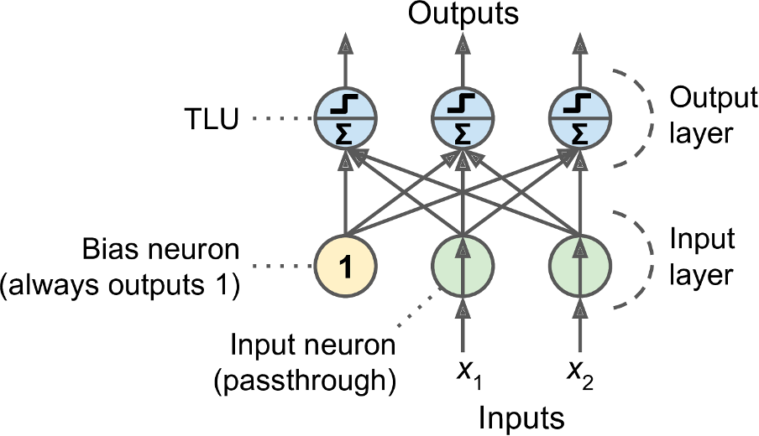
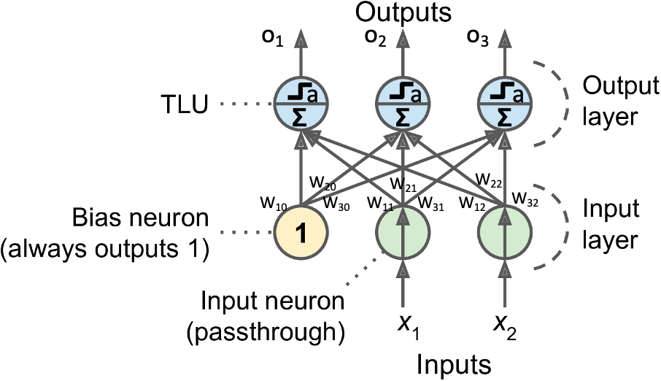
o₁
o₂
o₃
a
a
a
b₂
W₂₁
W₂₂
b₁
b₃
W₁₁
W₃₁
W₁₂
W₃₂
h₁

Slide 4
