Slide 1
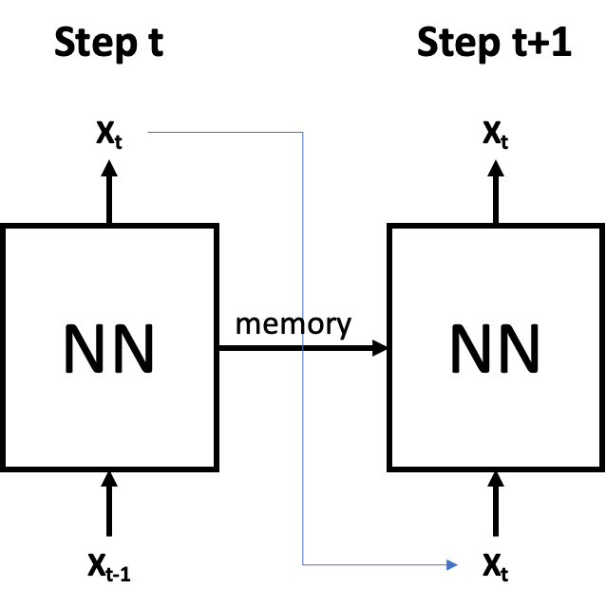
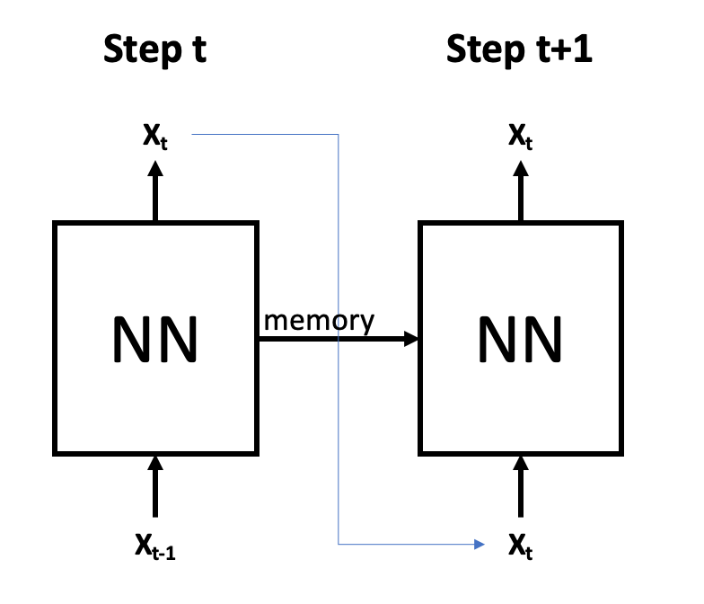
Step t
Step t+1
Y_{t-1}
y_{t}
NN
NN
memory
X_{t-1}
X_{t}

Slide 2
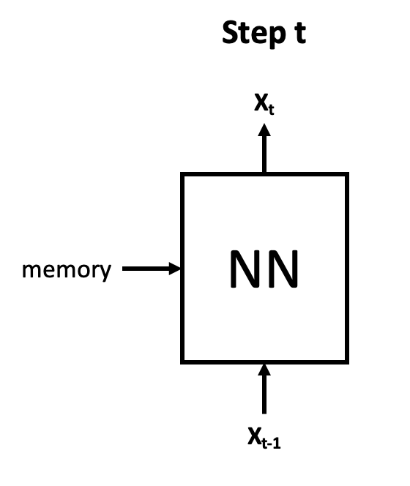
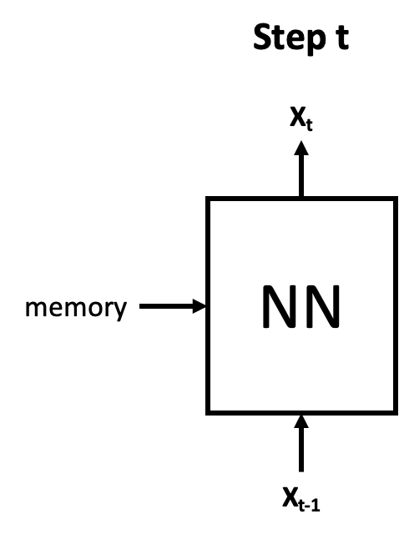
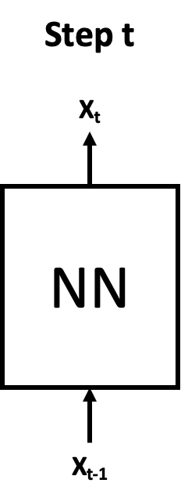
Step t
y_{t}
NN
memory
X_{t}

Slide 3
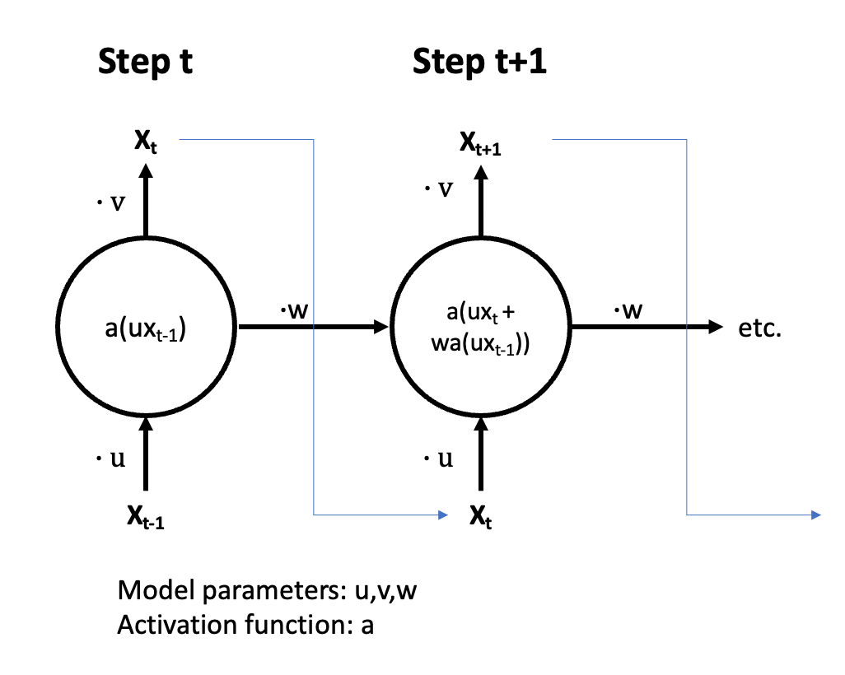
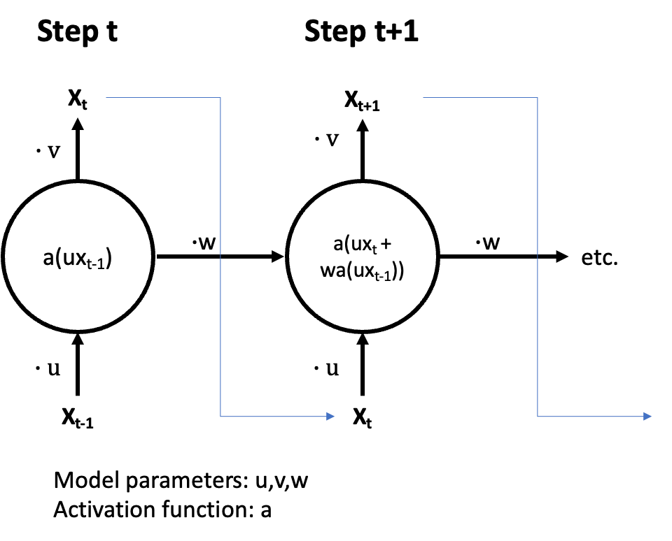
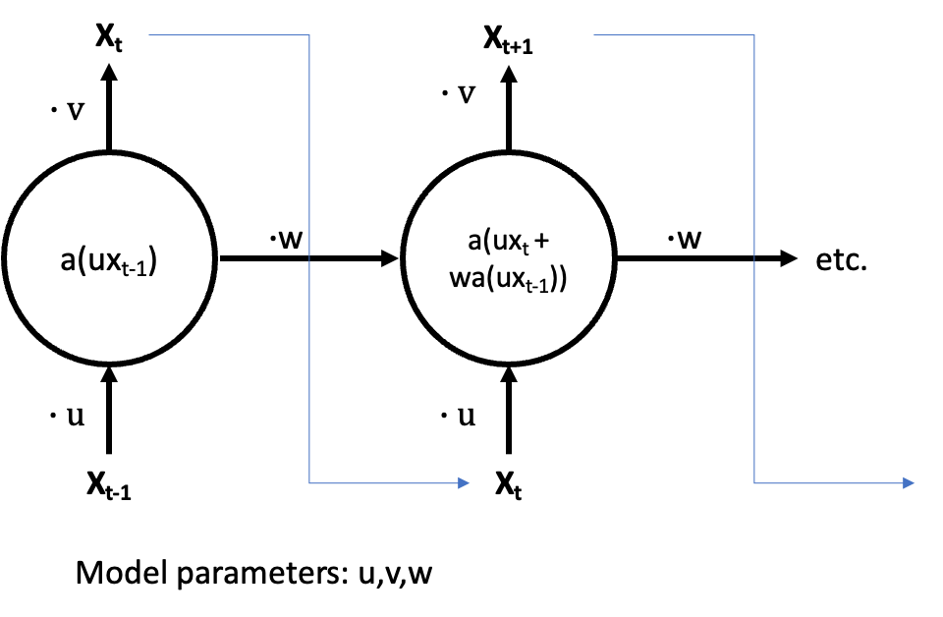






Step t
Step t+1
X_{t}
X_{t+1}
$$∙v$$
$$∙v$$
a(ux_{t-1})
a(ux_{t} + wa(ux_{t-1}))
$∙$w
$∙$w
etc.
$$∙u$$
$$∙u$$
X_{t-1}
X_{t}
Model parameters: u,v,w
Activation function: a

Slide 4
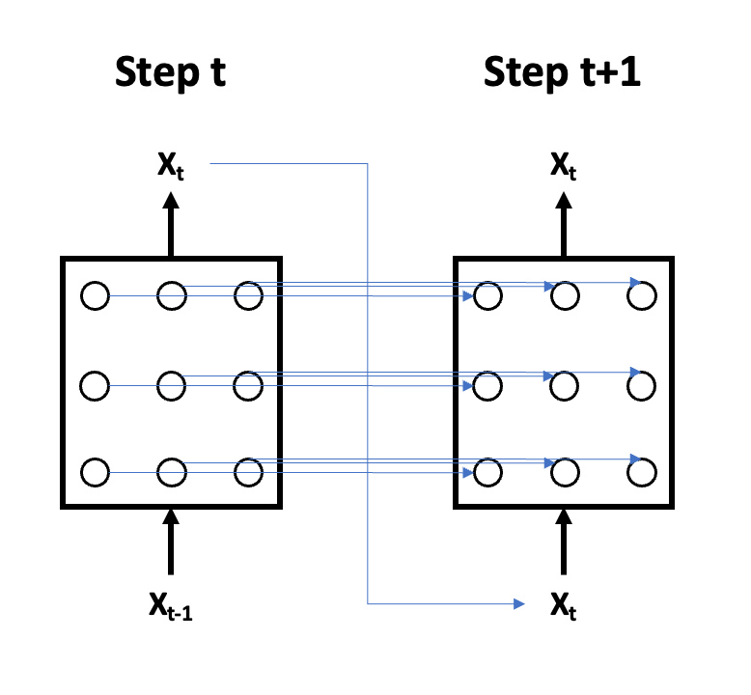
Step t
Step t+1
X_{t}
X_{t}
X_{t-1}
X_{t}

Slide 5
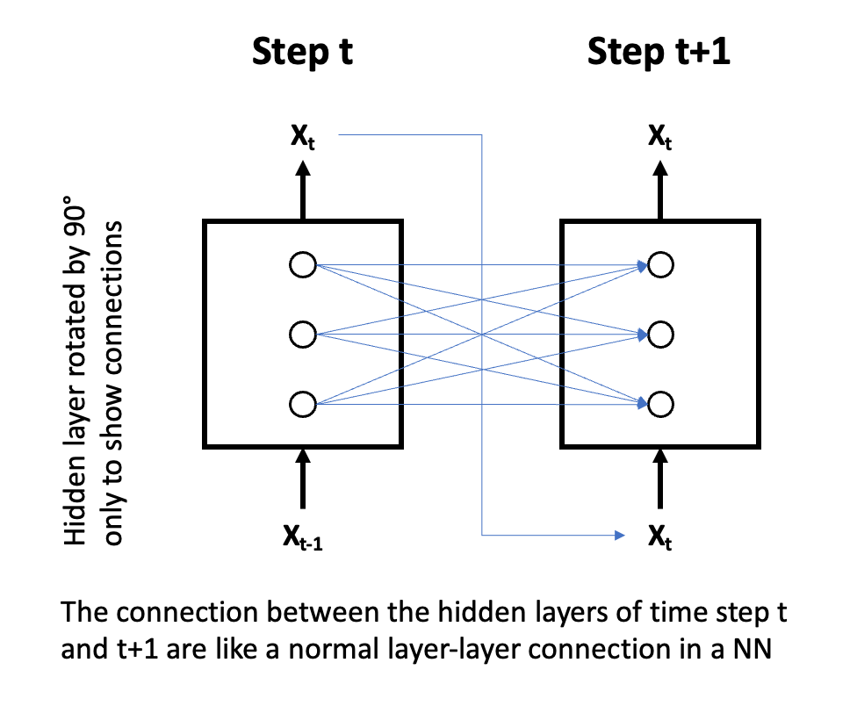
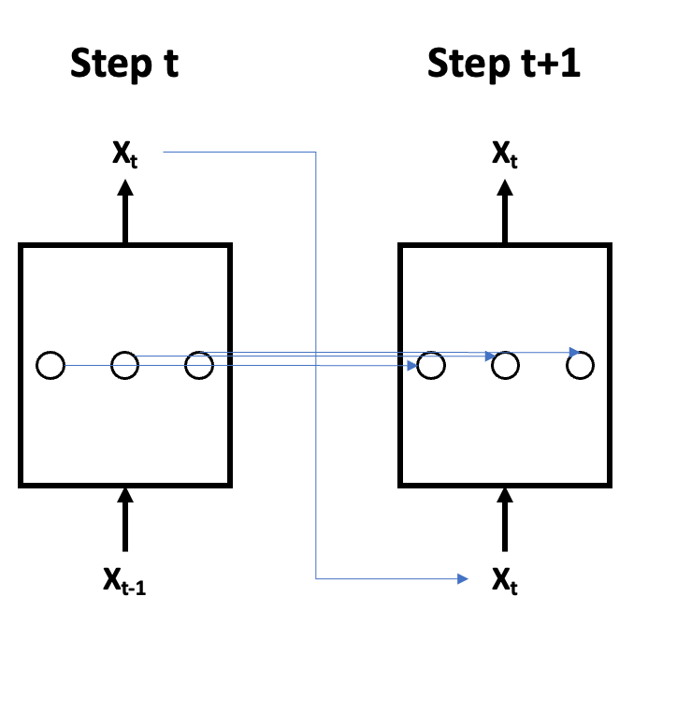
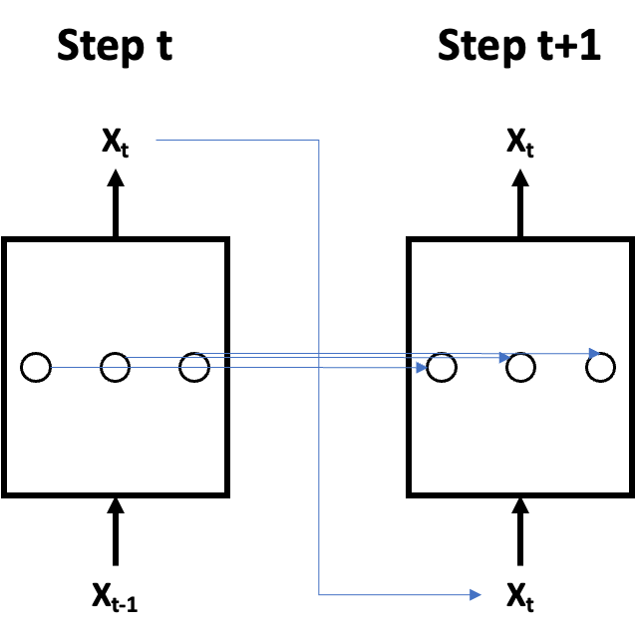
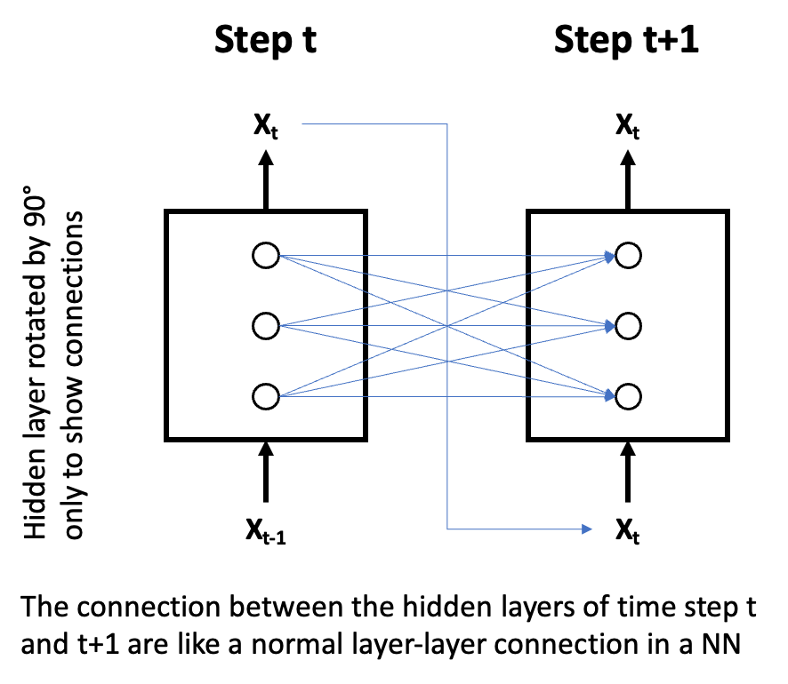
Step t
Step t+1
X_{t}
X_{t}
Step t
Step t+1
y_{t-1}
y_{t}
Hidden layer rotated by 90° only to show connections
X_{t-1}
X_{t}
X_{t-1}
X_{t}
The connection between the hidden layers of time step t and t+1 are like a normal layer-layer connection in a NN

Slide 6
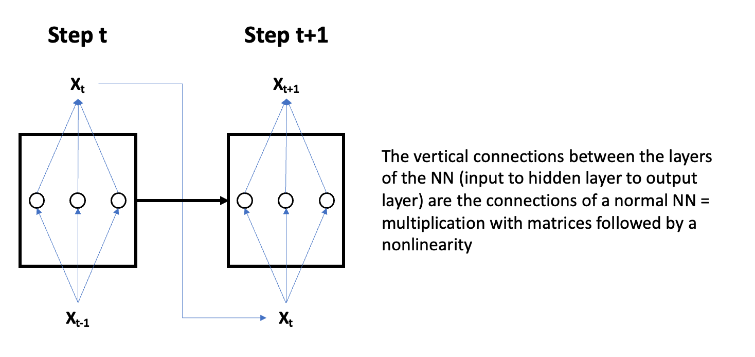
Step t
Step t+1
X_{t}
X_{t+1}
The vertical connections between the layers of the NN (input to hidden layer to output layer) are the connections of a normal NN = multiplication with matrices followed by a nonlinearity
X_{t-1}
X_{t}

Slide 7
Step t
Step t+1
X_{t}
output
hidden
input
X_{t-1}

