Slide 1
Hourly Energy Consumption Forecast
Machine Learning–Based Electricity Demand Forecasting
PJM West (PJMW) hourly electricity demand dataset
1

Slide 2
Team & Mentor Details
Project Name: Hourly Energy Consumption Forecast
Mentor / Guide: K.Dilavar Bassha
Team Members: Palem Soma Sekhar
Seetha Reddiar
Mallela Somanath
Vishal Parmar
Ailaveni Praveen
Richa Amardas Deshmukh
Dhanashree Korde
2

Slide 3
Project Objective
Forecast hourly electricity consumption for the PJM West region.
Understand demand behavior through time-based exploratory data analysis.
Engineer calendar, lag and rolling-statistic features.
Train and evaluate forecasting models using a chronological test set.
Deploy the forecasting workflow through a Streamlit application.
3

Slide 4
Dataset Details
Dataset: PJMW hourly electricity consumption.
Time span: 01-Apr-2002 to 03-Aug-2018.
Rows after timestamp de-duplication: 143,202.
Target variable: PJMW_MW — electricity demand in megawatts.
Observed range: 487 MW to 9594 MW; mean ≈ 5602 MW.
Chronological splitting is used to avoid future-data leakage.
4

Slide 5
Project Workflow
Data Loading → Data Cleaning → EDA → Feature Engineering
→ Model Training → Evaluation → Future Forecasting → Streamlit Deployment
5

Slide 6
EDA Objective
Exploratory Data Analysis
Understand the structure, quality and behavior of hourly electricity demand.
Identify hourly, weekly, monthly and seasonal patterns.
Check holidays, outliers, long-term trends and variable relationships.
Use EDA findings to guide feature engineering and model design.
6

Slide 7
Data Import & Initial Overview
Exploratory Data Analysis
143,202 timestamped observations after duplicate removal.
Datetime is converted to a time-series field and records are sorted chronologically.
PJMW_MW is the forecasting target.
The notebook uses pandas, NumPy, Matplotlib and Seaborn for analysis.
7

Slide 8
Data Quality Check
Exploratory Data Analysis
The project notes DST-related missing/duplicate timestamps.
Calendar-related gaps need careful treatment rather than blind random imputation.
Lag and rolling calculations naturally create initial missing rows.
Final modeling data removes rows with unavailable engineered features.
8

Slide 9
Time-Based Feature Creation
Exploratory Data Analysis
Calendar: Hour, Day, DayOfWeek, Month and Year.
Behavioral indicators: IsWeekend and IsHoliday.
Historical lags: 1h, 2h, 3h, 24h, 48h and 168h.
Rolling statistics: 24-hour mean, 168-hour mean and 24-hour standard deviation.
9

Slide 10
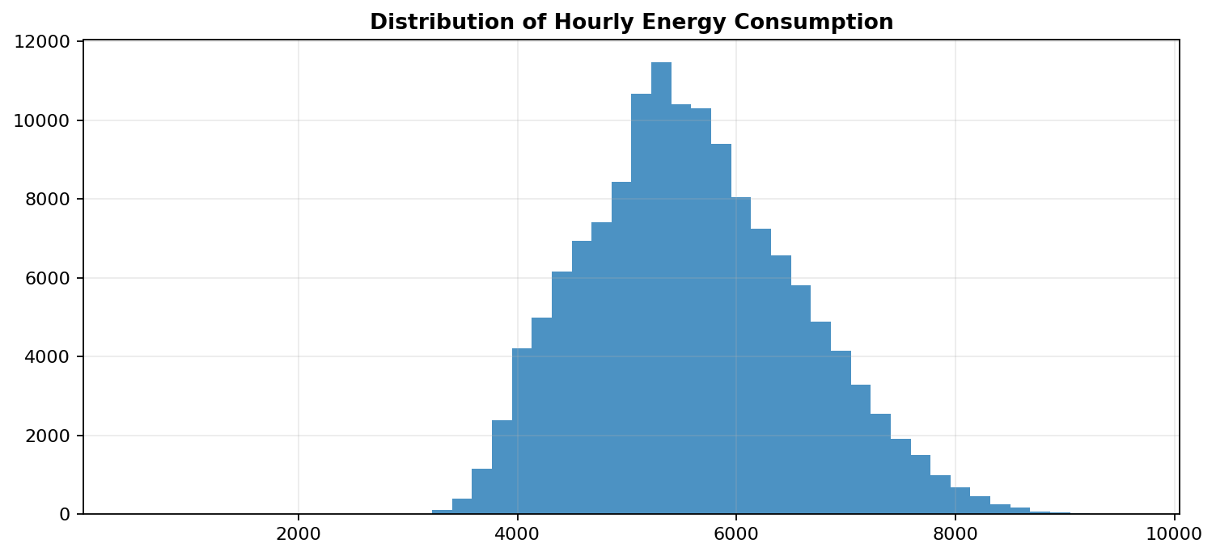
Overall Energy Consumption Distribution
Exploratory Data Analysis
The distribution shows the normal operating range of hourly demand.
Maximum observed demand is approximately 9594 MW.
Distribution analysis helps identify skewness and extreme observations.
10

Slide 11
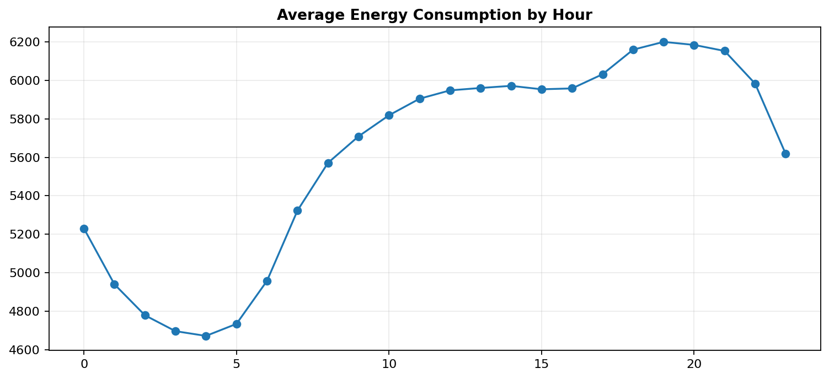
Average Consumption by Hour
Exploratory Data Analysis
Demand varies substantially across the 24-hour cycle.
The project EDA identifies lower early-morning demand and higher demand later in the day.
Hour is therefore an important forecasting feature.
11

Slide 12
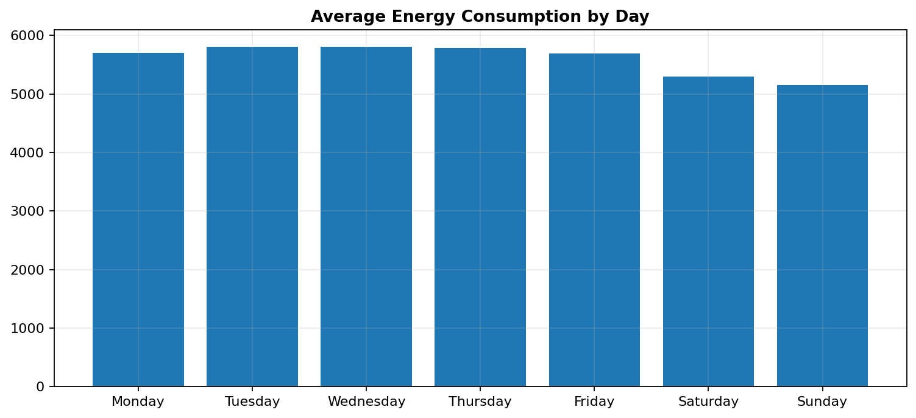
Day-of-Week Analysis
Exploratory Data Analysis
Average demand differs across weekdays and weekends.
DayOfWeek and IsWeekend capture weekly behavior.
Weekly patterns motivate the use of a 168-hour lag.
12

Slide 13
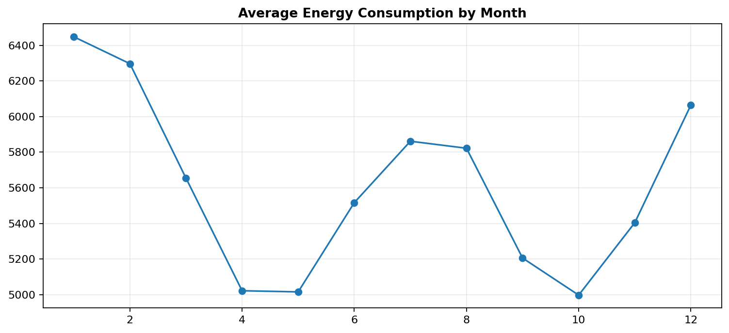
Monthly / Seasonal Analysis
Exploratory Data Analysis
Average consumption changes across the calendar year.
The project EDA notes higher winter demand and generally lower spring/autumn levels.
Month and Year are included as model inputs.
13

Slide 14
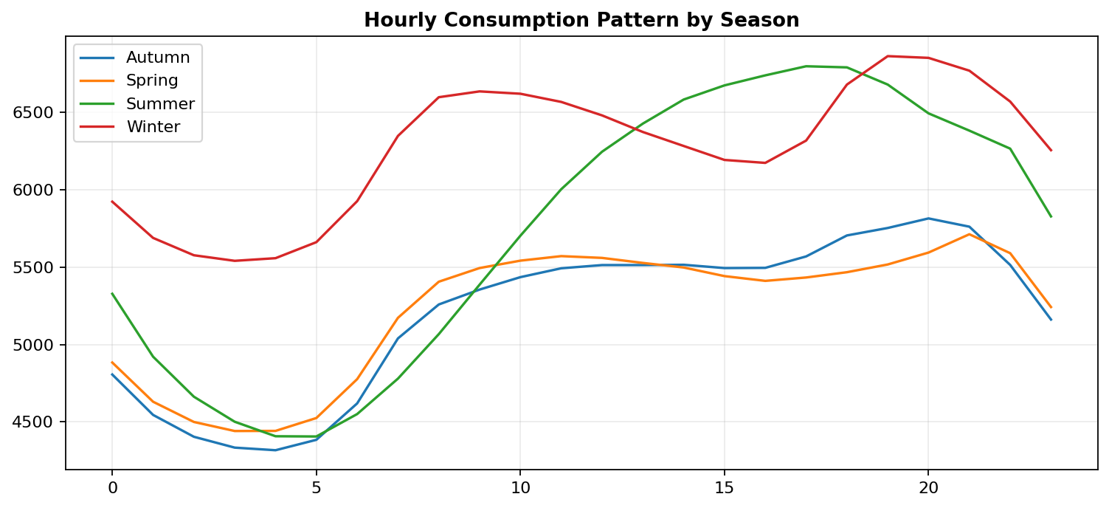
Seasonal Hourly Pattern
Exploratory Data Analysis
Hourly demand profiles vary by season.
The same hour can have different expected demand depending on season.
Calendar variables help the model capture these interactions.
14

Slide 15
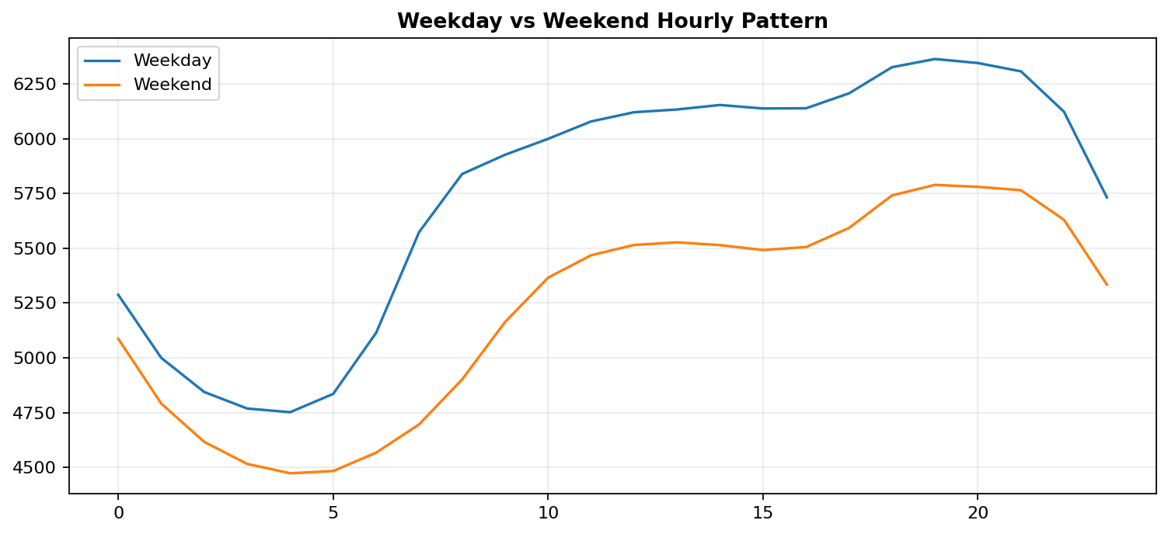
Weekday vs Weekend Pattern
Exploratory Data Analysis
Weekday and weekend profiles are not identical.
The project explicitly models IsWeekend and DayOfWeek.
This avoids treating all calendar days as behaviorally equivalent.
15

Slide 16
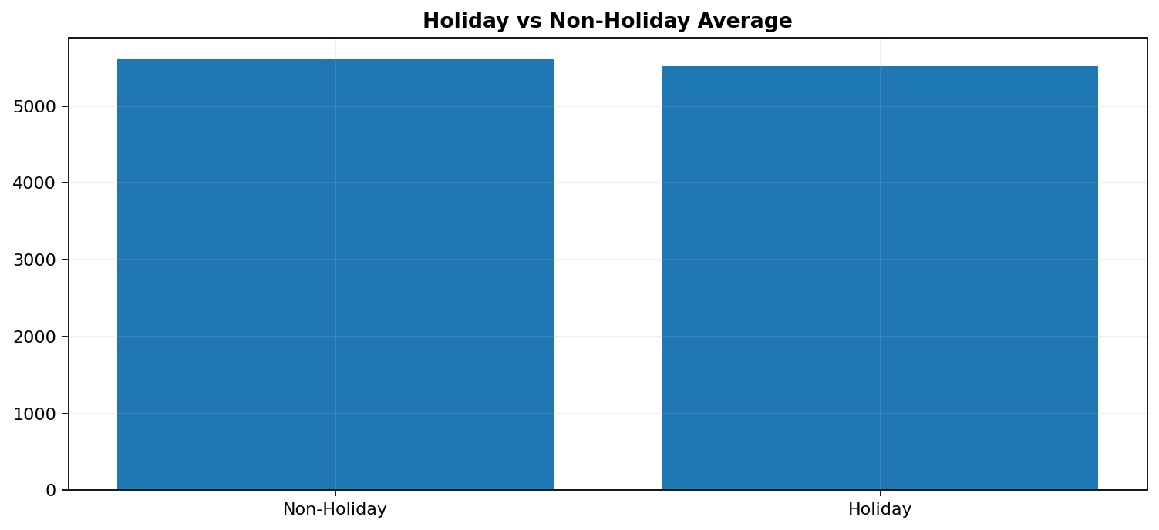
Holiday Analysis
Exploratory Data Analysis
The notebook identifies U.S. federal holidays across the dataset period.
Holiday demand is compared with non-holiday demand.
IsHoliday is included as a binary model feature.
16

Slide 17
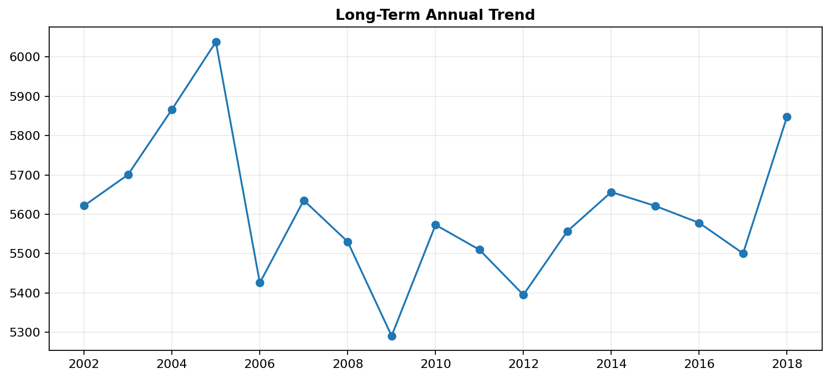
Long-Term Trend
Exploratory Data Analysis
Annual average consumption changes over the historical period.
The project notes that the long-term pattern is not a simple linear trend.
Year is retained as a feature.
17

Slide 18
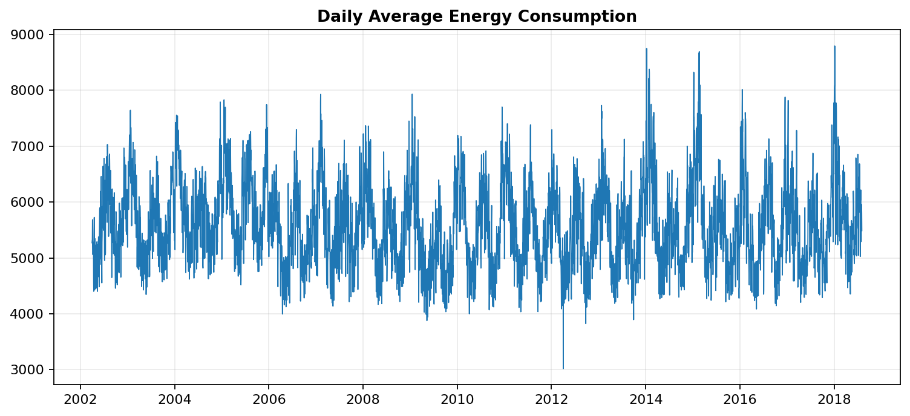
Daily Consumption Trend
Exploratory Data Analysis
Daily aggregation reveals broader fluctuations beyond hourly seasonality.
This view helps separate short-term and longer-term movement.
Rolling historical statistics are motivated by this behavior.
18

Slide 19
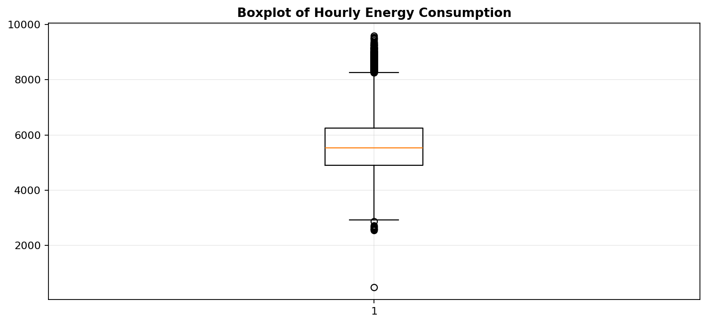
Outlier & Correlation Analysis
Exploratory Data Analysis
The boxplot is used to inspect extreme demand observations.
The project reports genuine high-demand periods rather than assuming every extreme is erroneous.
Correlation analysis is used to inspect calendar relationships.
19

Slide 20
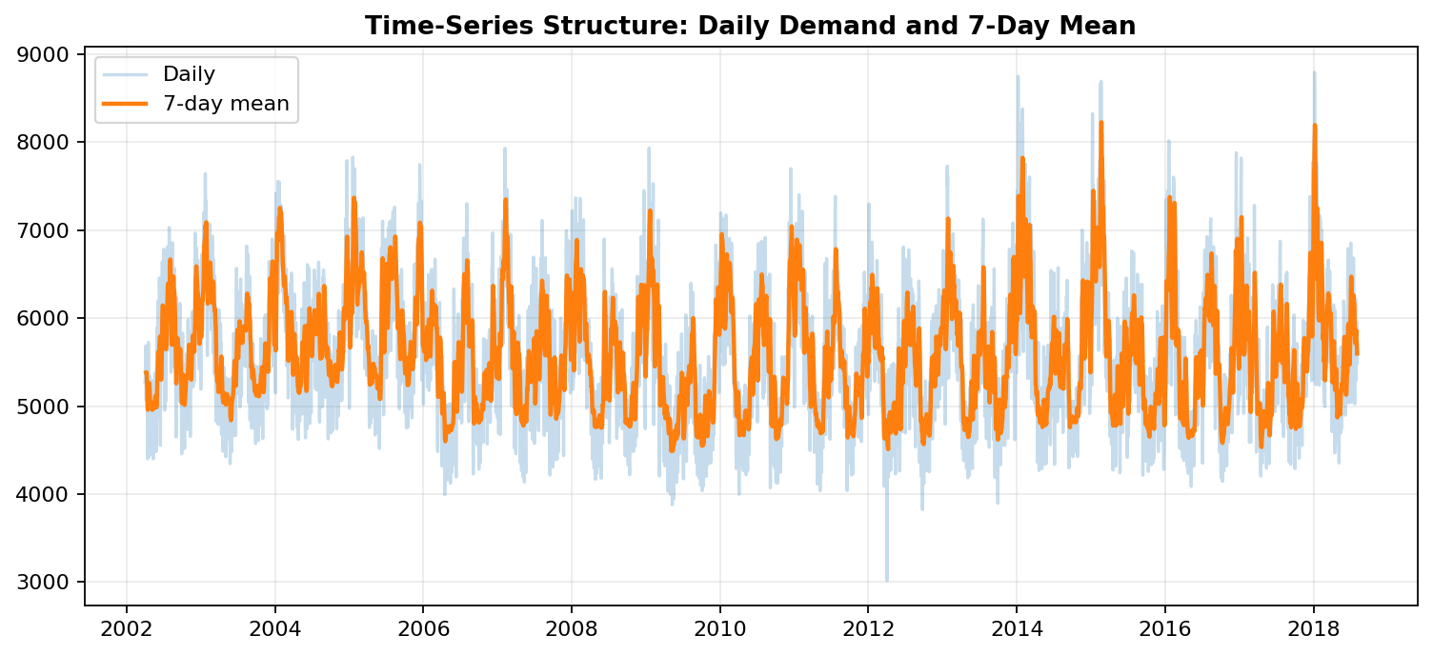
Time-Series Structure & Key EDA Findings
Exploratory Data Analysis
Strong hourly seasonality and clear calendar effects are present.
Weekday/weekend and holiday behavior differ.
Seasonal hourly profiles are different.
Lag and rolling features are justified by demand persistence.
EDA directly informed the final XGBoost feature set.
20

Slide 21
Model Building
Chronological split: the final one year is reserved for testing; random splitting is avoided.
16 model features: calendar indicators, lag variables and rolling statistics.
Models explored: Random Forest, XGBoost, ARIMA, SARIMAX, RNN and LSTM.
XGBoost settings in the project: 500 estimators, learning rate 0.05, max depth 7, subsample 0.8 and column subsampling 0.8.
Metrics used: MAE, RMSE, MAPE and R².
21

Slide 22
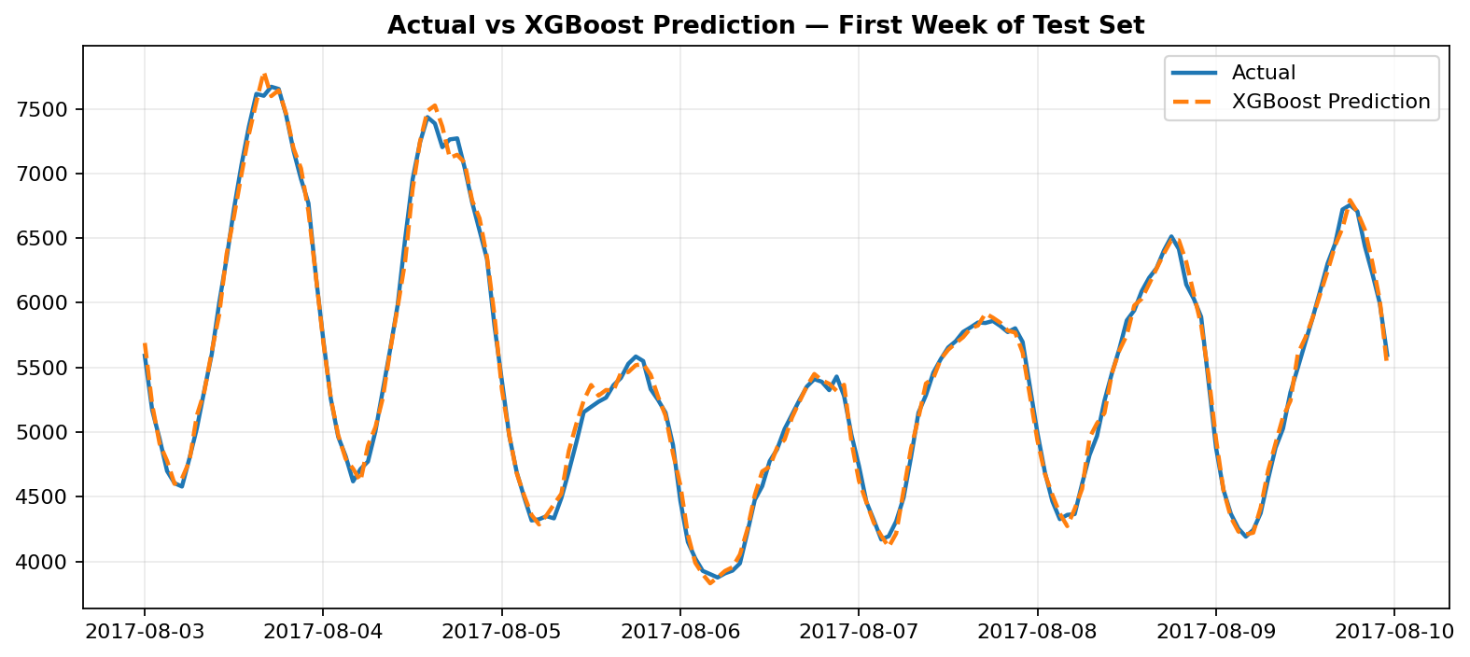
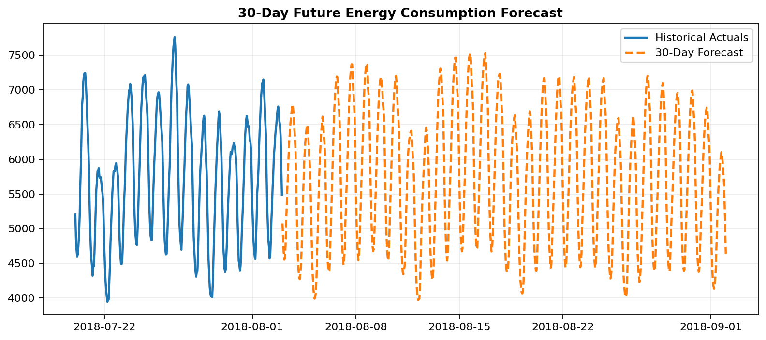
Final Model — XGBoost
Final deployed model: XGBoost Regressor.
The supplied project contains xgb_model.pkl and feature_columns.pkl.
Inputs combine calendar context, historical lags and rolling demand statistics.
Streamlit loads the saved model and feature list for forecasting.
The project supports recursive multi-step future forecasting.
22

Slide 23
Model Evaluation
MAE
52.95 MW
RMSE
70.87 MW
R²
0.9949
MAPE
0.92%
Test period: 03-Aug-2017 to 03-Aug-2018 — 8,760 hourly observations.
Metrics were recalculated from the supplied saved XGBoost model and supplied PJMW dataset.
MAE, RMSE and MAPE quantify error magnitude; R² summarizes explained variance.
These results apply to this held-out historical period and should not be assumed to generalize unchanged to other regions or future regimes.
23

Slide 24
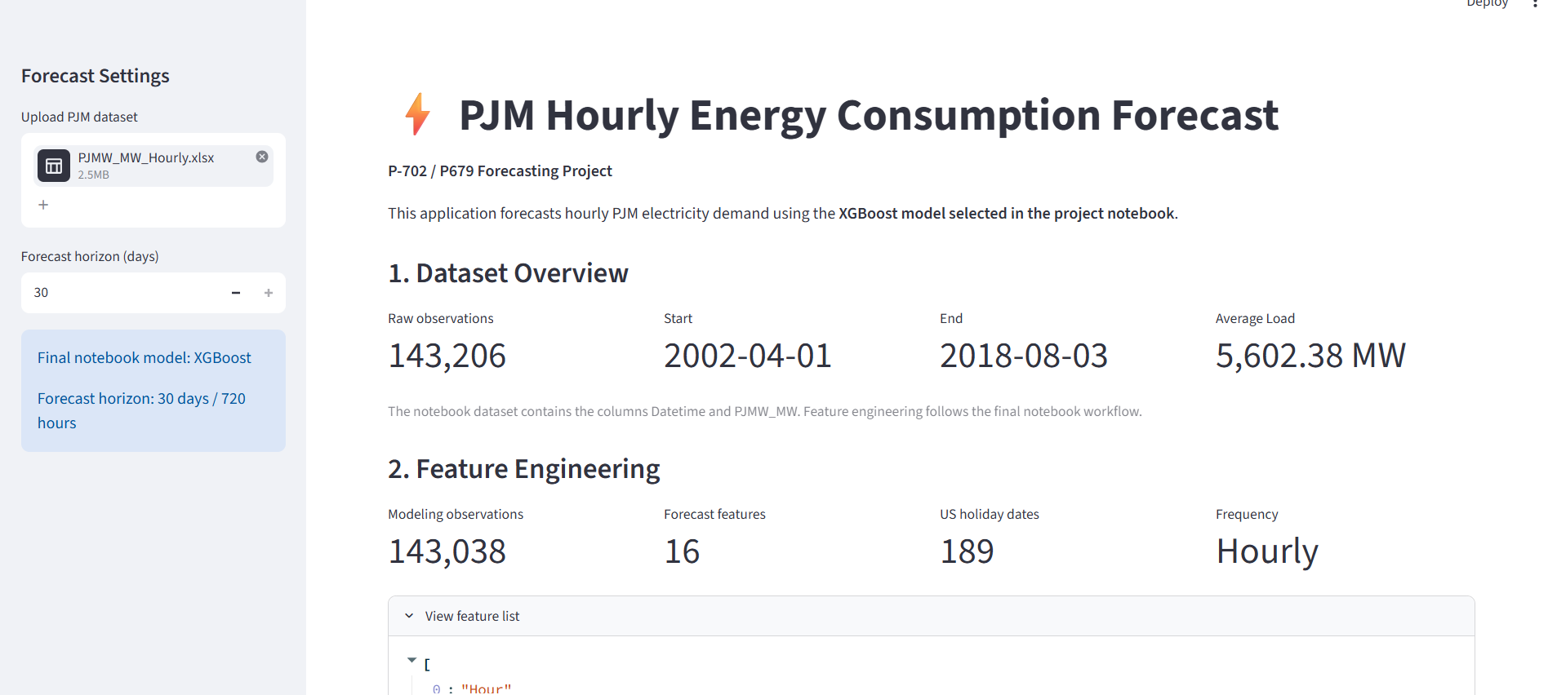
Streamlit App & Challenges
Recreated from the supplied Streamlit code; not an original screenshot.
24

Slide 25
THANK YOU
Questions & Discussion
Hourly Energy Consumption Forecast
25

