Slide 1
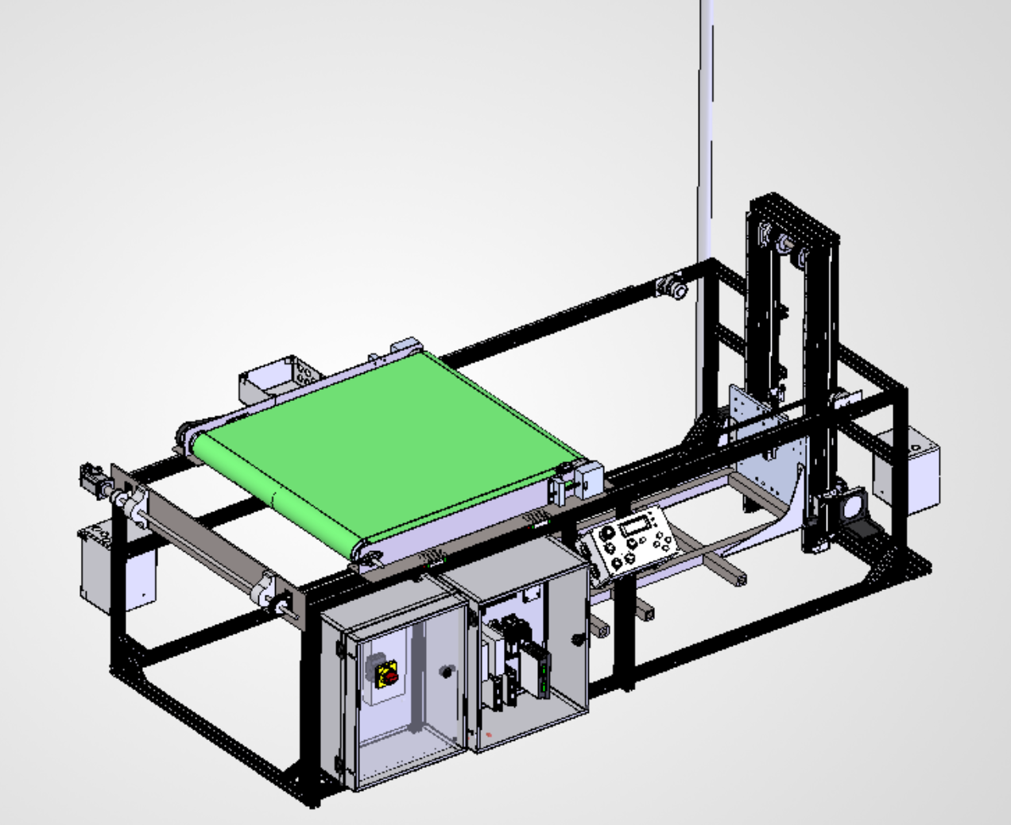
Kordian.
About Projects Skills Experience Goals Contact
View Resume
Projects page: new card (placed first)
A new "Featured" card leads the grid; the garden project card moves to second.
Featured
Automated T-Shirt Stacker
Automated Garden Watering System
Hobby Rocketry Components
Senior capstone: a machine that catches garments coming off a screen-printing dryer and builds neat, stable stacks automatically.
(existing card)
(existing card)
Mechanical
Electrical
Controls
Software
Manufacturing
Status: In fabrication. Prototype rollout Nov 2026, Design Fair Dec 2026.
View project →
Notes:
Projects grid: add the capstone card first with the Featured badge. Uses "Status:" instead of "Result:" until test results exist.

Slide 2
Kordian.
About Projects Skills Experience Goals Contact
View Resume
← Back to Projects
Team Project • Senior Capstone • January 2026 - December 2026
Automated T-Shirt Stacker
Senior capstone for a screen-printing shop. A shuttle conveyor catches garments off the dryer and lays them onto a self-lowering stack. Currently in fabrication.
Mechanical
Electrical
Controls
Software
Manufacturing
Project Overview
Built for Headwaters Studio, a screen-printing shop in Red Lodge, MT
Catches each garment leaving the dryer and builds a neat, stable stack with minimal operator involvement
Targets up to 200 garments/hour, youth S to adult 2XL, shirts and sweatshirts
Team of four: Kordian Cebulla, Audrey Ingraham, Katelyn Rutten, Nathanael Wilson. Advisor: Adam Michalson
Hero background image (dimmed on the site)
Notes:
Hero: dimmed hero-system-iso.png as the background, same as the garden page hero.

Slide 3
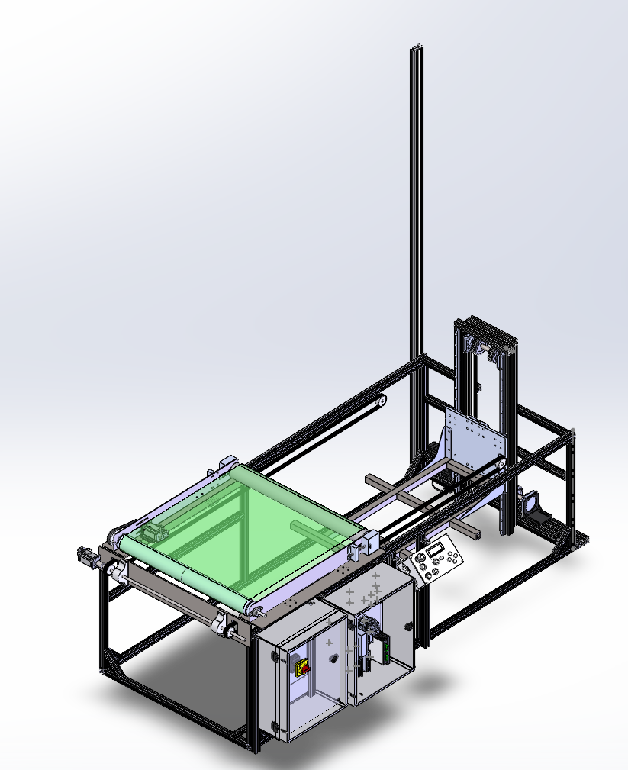
Kordian.
About Projects Skills Experience Goals Contact
View Resume
Section 1
Section 1
System Overview & Design Intent
System Overview
Section 2
Requirements
Section 3
The Problem
How It Works
Freshly printed and dried garments drop off the dryer conveyor into a basket. An operator has to keep pulling them out and stacking them by hand, which caps throughput, produces inconsistent stacks, and ties up a person at the dryer exit.
Section 4
System Architecture
Section 5
Frame & Platform
Section 6
Core Idea / Solution
Shuttle Conveyor
Section 7
A shuttle conveyor slides under the dryer exit to catch each garment, carries it over the stack, then pulls back while its belt runs forward, laying the garment flat with no relative motion instead of dropping it. The platform steps down as the stack grows, and a light and alarm call the operator when it's full.
Motion & Timing
Section 8
Electronics & Controls
Section 9
Integration & Validation
Section 10
Outcome (so far)
Status & Timeline
Passed its Critical Design Review in spring 2026 and is now in fabrication. Prototype rollout in November 2026, then testing against requirements before sponsor handoff at the December Design Fair.
Section 11
Team & Lessons
system-iso-rear.png

Slide 4
Kordian.
About Projects Skills Experience Goals Contact
View Resume
Section 2
Section 1
Requirements & Constraints
System Overview
Section 2
Requirements
Section 3
200
S → 2XL
24 in
$9,000
How It Works
Section 4
System Architecture
garments per hour (max)
youth to adult, shirts & sweatshirts
maximum stack height
total system budget
Section 5
Frame & Platform
Section 6
Shuttle Conveyor
Functional Requirements
Performance Targets
Constraints
Section 7
Motion & Timing
Transfer garments from the dryer conveyor into organized stacks
Throughput of up to 200 garments/hour
Detect and signal a completed stack
Fault detection with audible and visual alarms
Stack alignment ±1 in, repeatability ±0.5 in
Stable stacks: no tipping or misalignment
Near-continuous operation
Handle variation in garment size, weight, fabric, and feed rate
Footprint of about 2.4 m × 1.2 m
$9,000 total budget
Integrates with existing dryer, no permanent modification
Semi-autonomous with a simple UI
OSHA-compliant, reliable, easy to maintain
Section 8
Electronics & Controls
Section 9
Integration & Validation
Section 10
Status & Timeline
Section 11
Team & Lessons

Slide 5
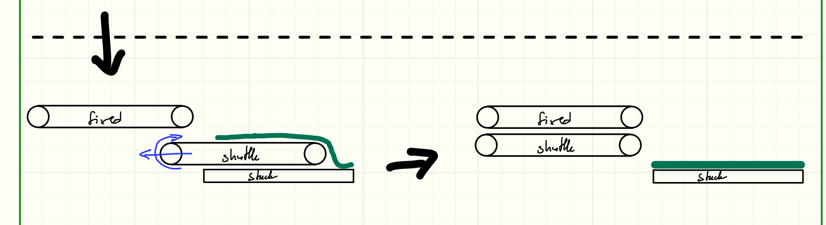
Kordian.
About Projects Skills Experience Goals Contact
View Resume
Section 3
Section 1
How It Works
System Overview
Section 2
Requirements
Section 3
1
Detect
2
Catch
3
Place
4
Lower & Alert
How It Works
Section 4
System Architecture
An infrared break-beam sees a garment leaving the dryer belt.
→
The shuttle translates under the dryer exit to receive the garment, then carries it over the stack.
→
The shuttle retracts while its belt conveys forward, laying the garment flat instead of dropping it.
→
A break-beam monitors stack height; the platform steps down, and a light and alarm signal a full stack.
Section 5
Frame & Platform
Section 6
Shuttle Conveyor
Section 7
Motion & Timing
Section 8
Electronics & Controls
Section 9
Integration & Validation
Section 10
Status & Timeline
Section 11
Team & Lessons
Placement sequence: receive, travel over the stack, then retract while conveying forward to lay the garment flat.

Slide 6
Kordian.
About Projects Skills Experience Goals Contact
View Resume
Section 4
Section 1
System Architecture
System Overview
Section 2
Controller-centric block diagram
Requirements
Section 3
How It Works
Section 4
Inputs / Sensors
Controller: Arduino Mega
Outputs / Actuators
System Architecture
Garment detection: IR break-beam
Stack height: IR break-beam
Shuttle home: Hall-effect sensors
Platform down: Hall-effect + limit switch
Operator panel: LCD, encoder, Start, Pause, Home, Reset
E-stop and fault inputs
Sequence control
Motion control (shuttle and lift)
Stack-height logic
Fault detection
Throughput monitoring
Menu, manual jog, and auto mode
Shuttle belt drive: NEMA 23 stepper
Shuttle translation: NEMA 23 stepper
Platform lift: NEMA 34 stepper with brake
Garment clamp: 2 servos
Stack light and audio alarm
Section 5
Frame & Platform
Section 6
Shuttle Conveyor
→
→
Section 7
Motion & Timing
Section 8
Electronics & Controls
Section 9
Integration & Validation
Section 10
Status & Timeline
Section 11
Team & Lessons
Power & Safety: 120 VAC in, stepped down to 36 / 24 / 5 V. A safety relay cuts motor power on E-stop, which is a hardware stop, not just a software command.

Slide 7
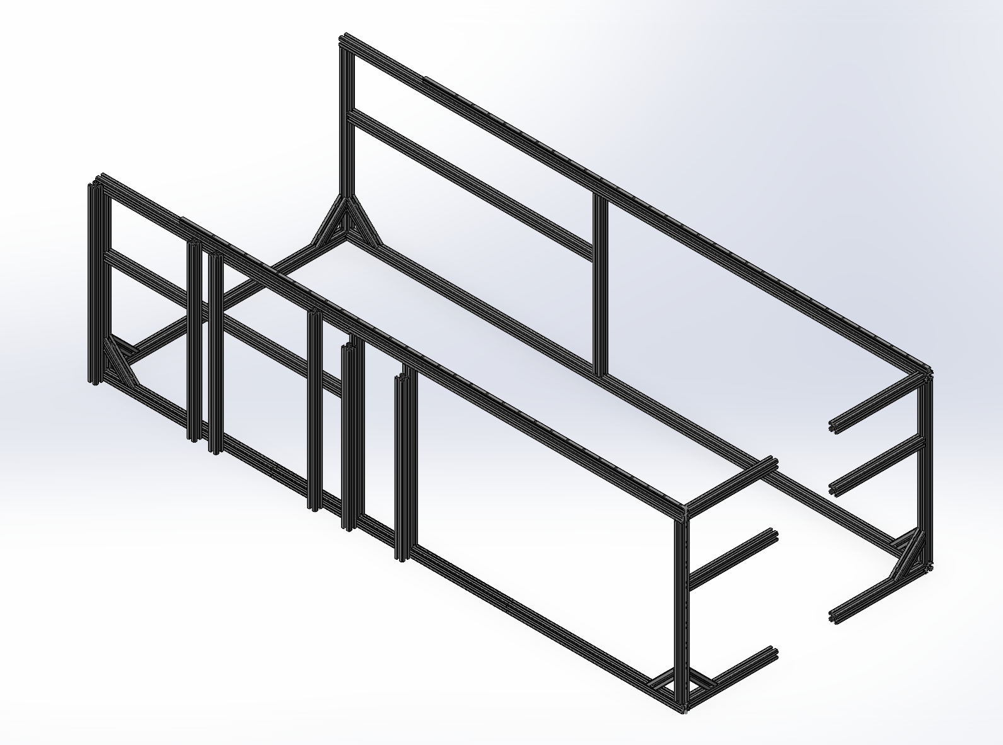
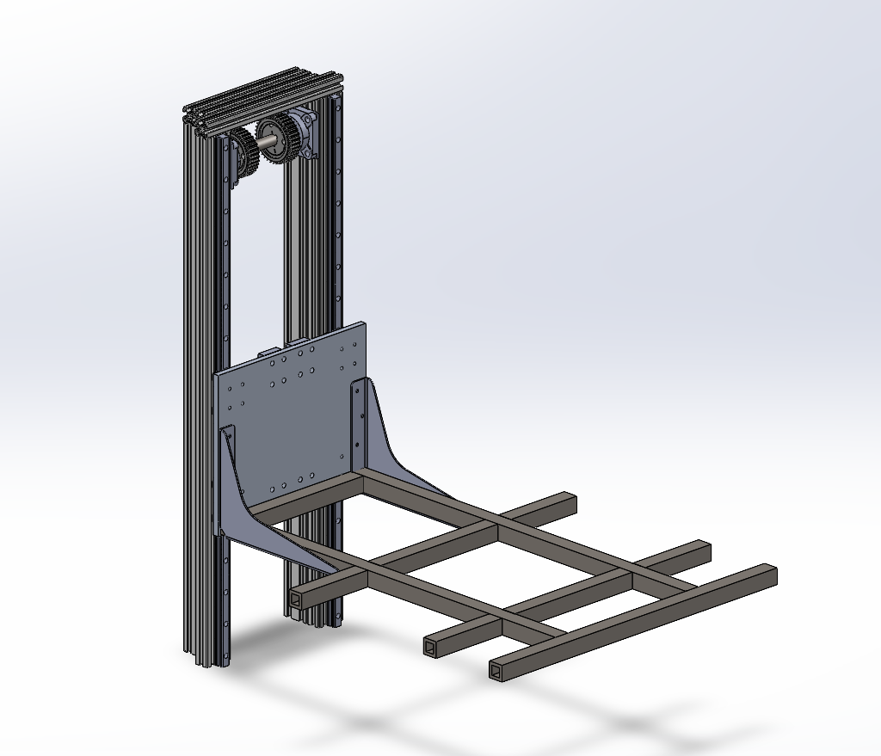
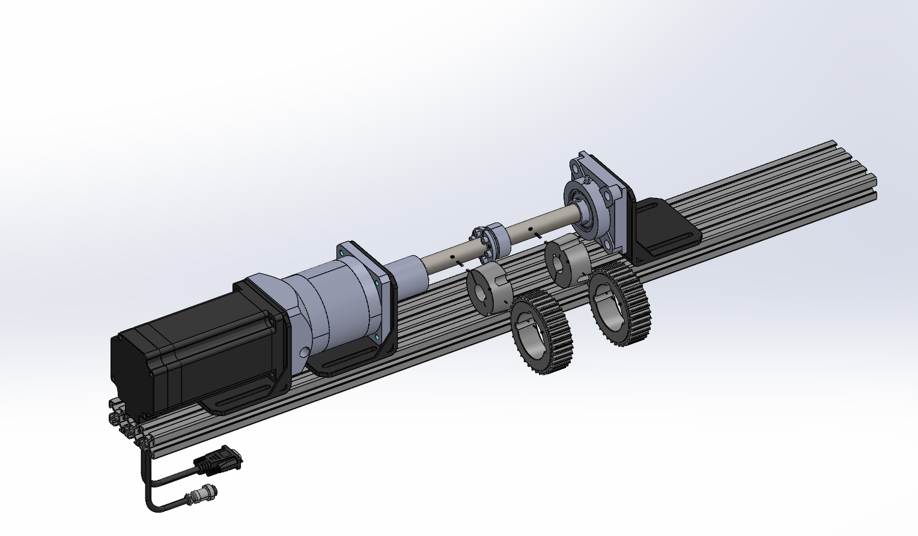
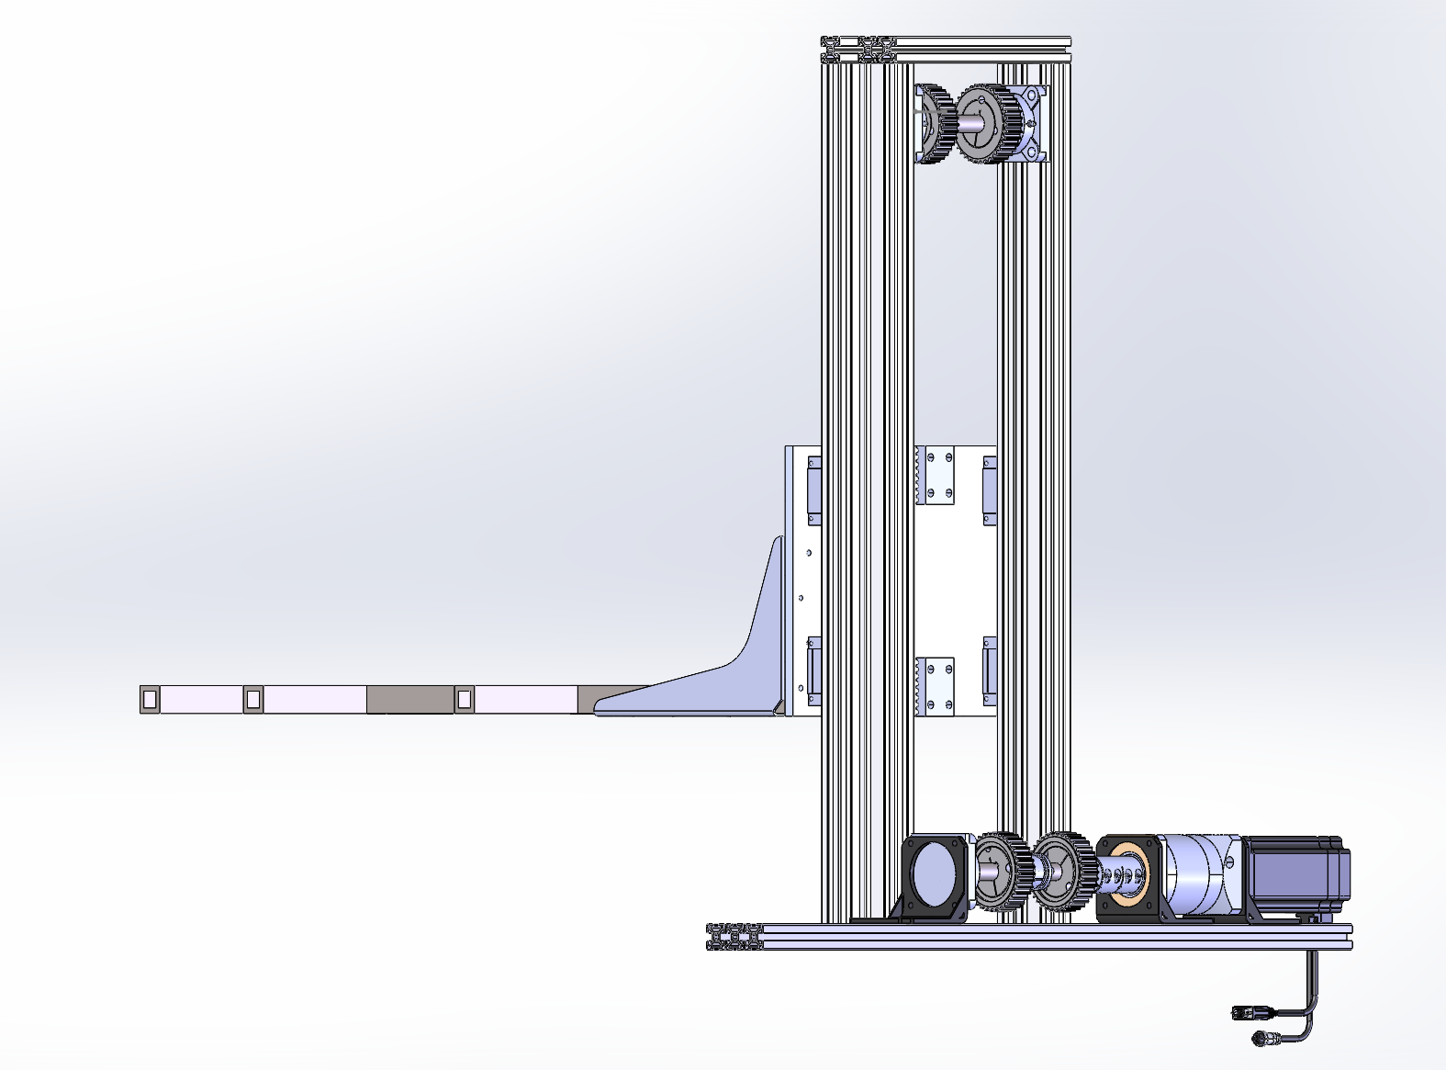
Kordian.
About Projects Skills Experience Goals Contact
View Resume
Section 5
Section 1
Frame & Stacking Platform Subsystem
System Overview
Section 2
Requirements
Purpose
Section 3
How It Works
Hold the stack at a constant placement height by lowering the platform as garments are added, on a rigid base that wraps around the dryer legs with no permanent installation.
Section 4
System Architecture
Section 5
Design
Frame & Platform
Section 6
Frame: 3030 aluminum extrusion (weight and cost)
Platform: 1012 CR steel tubing on 3060 masts
Guidance: HGR20 linear rails and bearing blocks
Drive: belt drive, NEMA 34 with 80 N·m brake
Shuttle Conveyor
Section 7
3030 aluminum frame
Lift platform carriage
Motion & Timing
Section 8
Electronics & Controls
Section 9
Alternatives Considered
Integration & Validation
Scissor lift and lead screw rejected. Scissor lifts have a nonlinear force profile and backlash at the pivots; a slight tilt in the first tier can wobble the platform over an inch. A lead screw is slower than a belt drive.
Section 10
Status & Timeline
Section 11
Team & Lessons
NEMA 34 lift drive + brake
Lift mast and carriage
Page also includes: full analysis results table (next slide) and lift-speed-curve.png

Slide 8
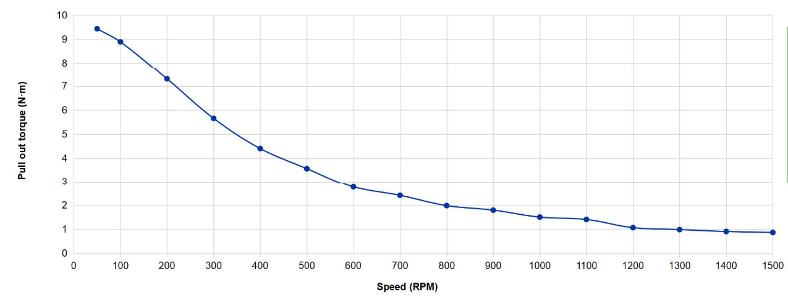
Kordian.
About Projects Skills Experience Goals Contact
View Resume
Section 5
Section 1
Frame & Stacking Platform: Analysis Results
System Overview
Section 2
Rendered as a table on the same section of the page
Requirements
Section 3
Check | Method / Load case | Result
Platform deflection | Euler–Bernoulli; 75 lb dead + 150 lb garments | < 0.1 in
Frame deflection | 1,000 lb distributed load | < 0.12 in
Linear bearings | HGR20 blocks | 6,240 lb static / 3,990 lb dynamic
Fasteners | M6 class 8.8; steel into aluminum | No failure or hole elongation
Machine walking | 400 lb machine, 50 lb shuttle at 271.9 in/s² | Stays put
Lift speed | Full-stack lift | < 10 s, motor in safe RPM range
Shaft torsion | Brake engagement at power loss; 4340 steel | Shear stress well below yield
Belts, bushings, keys | Power failure + emergency brake | Adequate factor of safety
How It Works
Section 4
System Architecture
Section 5
Frame & Platform
Section 6
Shuttle Conveyor
Section 7
Motion & Timing
Section 8
Lift motor speed vs. torque check
Electronics & Controls
Section 9
Integration & Validation
Section 10
Status & Timeline
Section 11
Team & Lessons

Slide 9
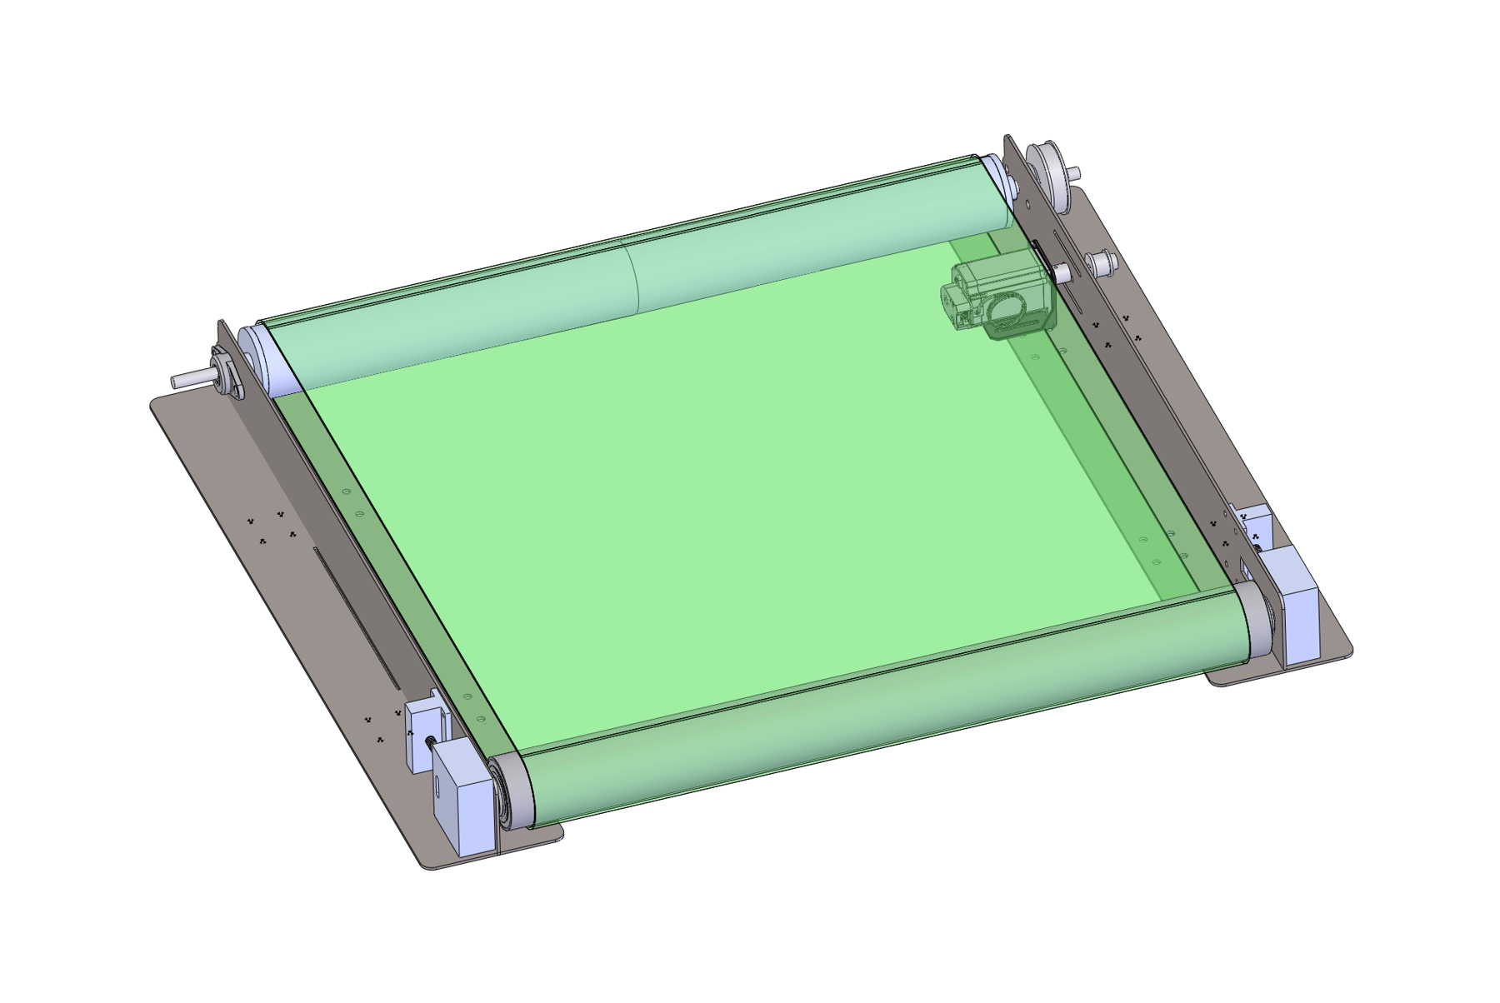
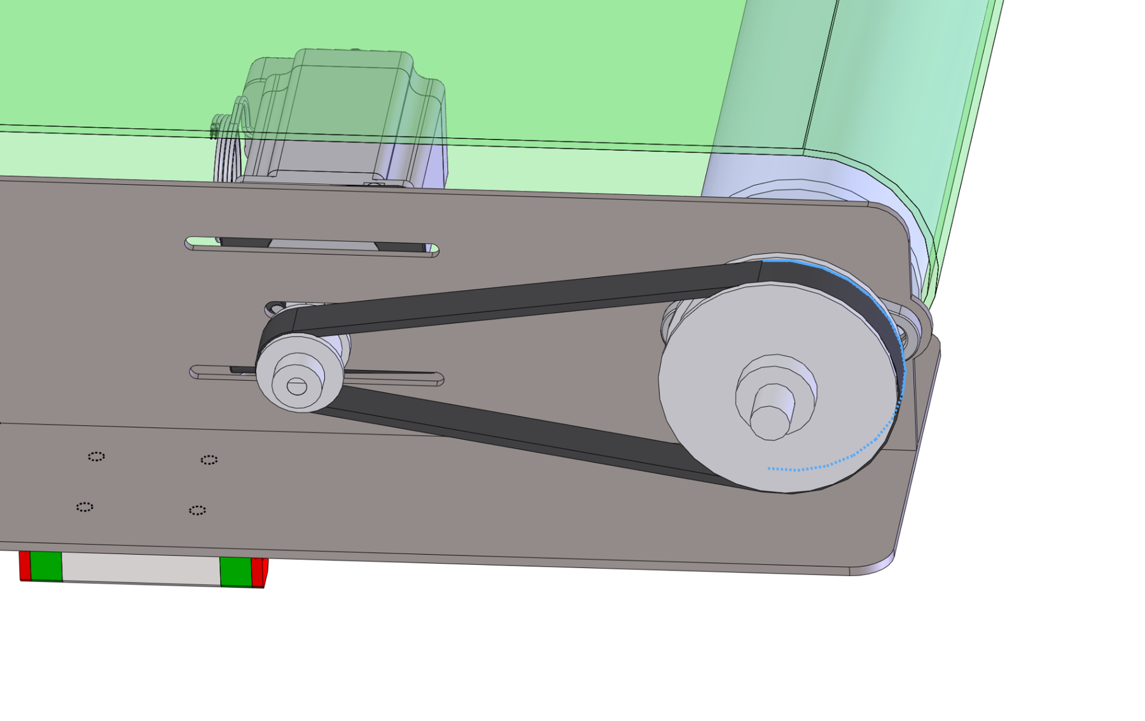
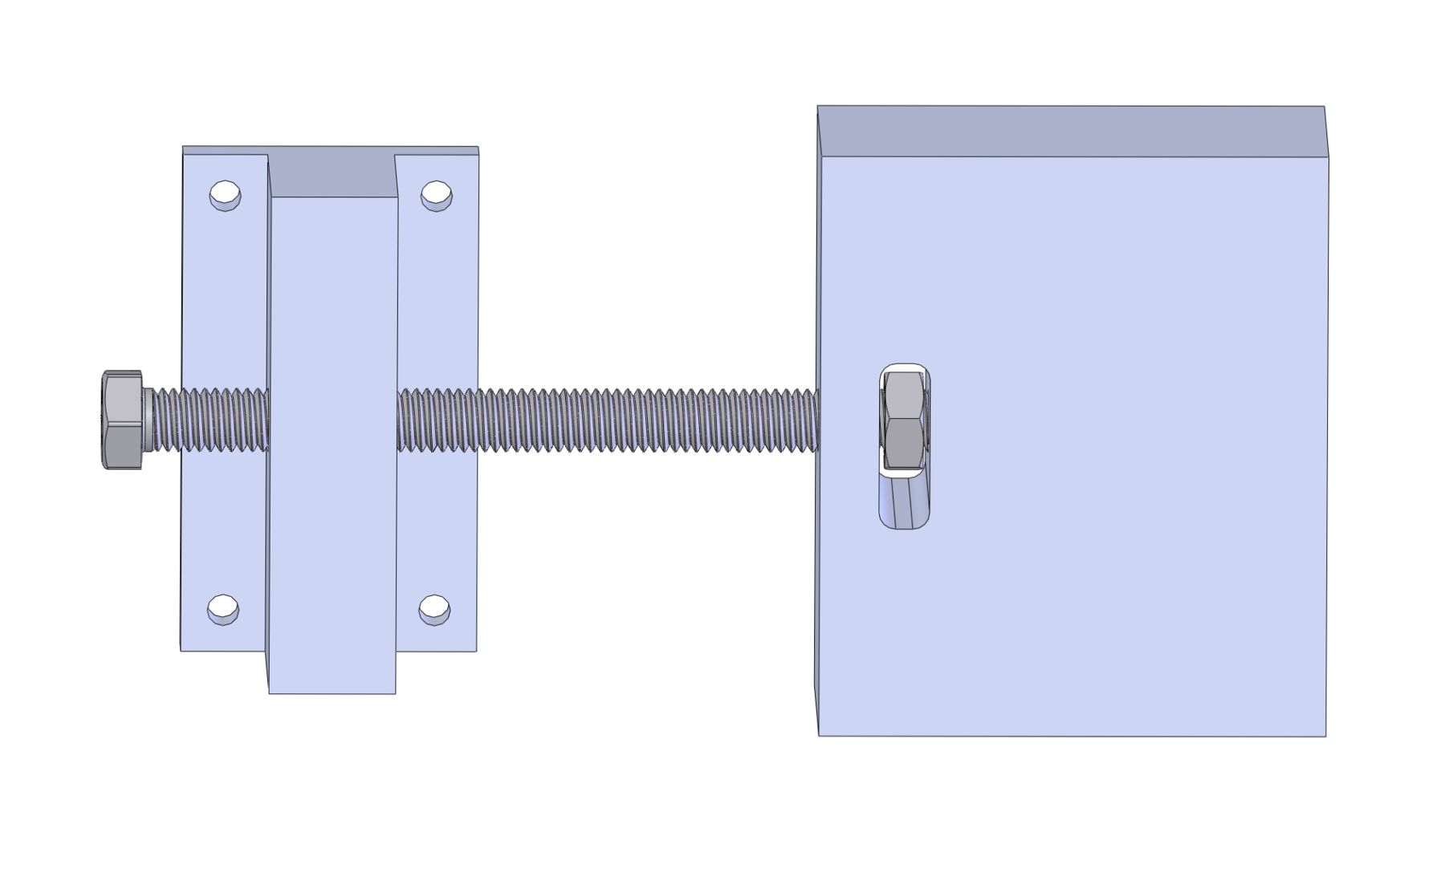
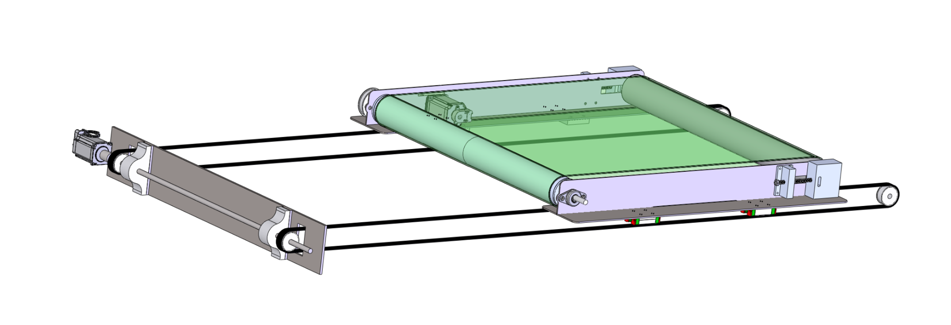
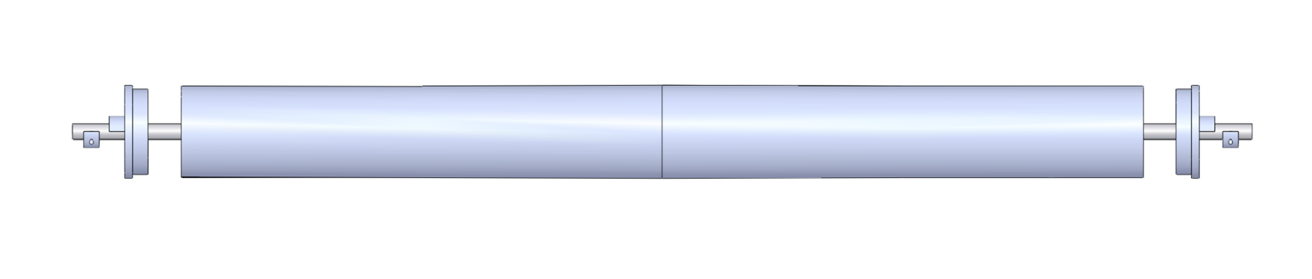
Kordian.
About Projects Skills Experience Goals Contact
View Resume
Section 6
Section 1
Shuttling Conveyor Subsystem
System Overview
Section 2
Requirements
Purpose
Section 3
How It Works
Receive each garment as it rolls off the dryer, carry it over the stack, and deposit it flat. Translating and conveying at the same time is what makes controlled placement possible.
Section 4
System Architecture
Section 5
Frame & Platform
Design
Section 6
Two drives: belt conveying (NEMA 23) and shuttle translation (NEMA 23, belt and pulley)
Rollers: crowning, live vs. dead axle, buy vs. make evaluated
Belt tensioning built into the roller mounts
Garment clamp: 2 servos sized for 1.25 lb upward resistance with high FoS
Inertia, acceleration torque, and speed checked against motor torque curves
Shuttle Conveyor
Section 7
Motion & Timing
Section 8
Shuttling conveyor assembly
Electronics & Controls
Section 9
Integration & Validation
Section 10
Status & Timeline
Belt drive
Belt tensioner
Section 11
Team & Lessons
Shuttle on rails
Conveyor roller

Slide 10
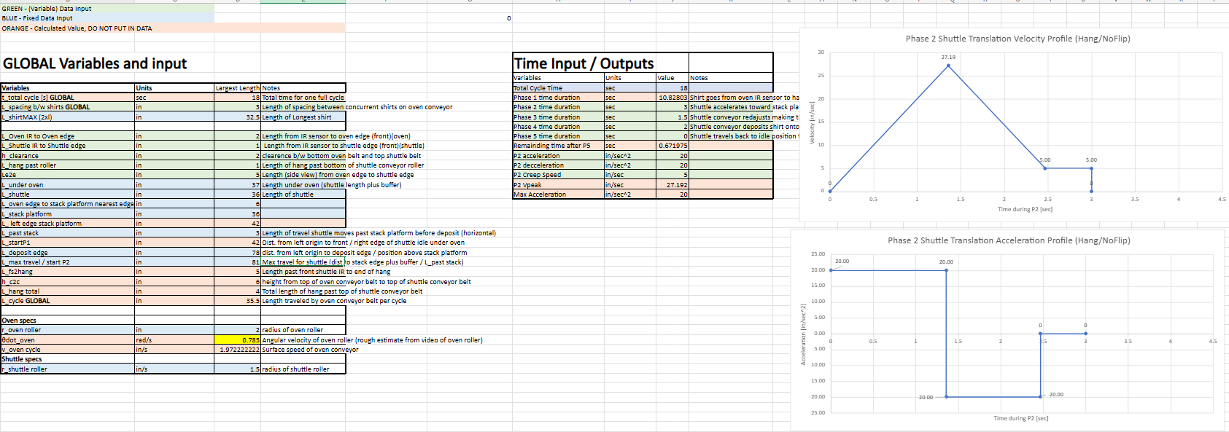
Kordian.
About Projects Skills Experience Goals Contact
View Resume
Section 7
Section 1
Motion & Timing Analysis
System Overview
Section 2
Built from a custom cycle-timing and motor-sizing calculator
Requirements
Section 3
18 s cycle per garment at 200/hr, split into five motion phases
How It Works
Section 4
1 · Feed
2 · Pull
3 · Readjust
4 · Deposit
Buffer
System Architecture
Section 5
10.83 s
3.00 s
1.50 s
2.00 s
0.67 s
Frame & Platform
Section 6
Shuttle Conveyor
Feed: Set by dryer belt speed (~2 in/s over 17 in)
Pull: 39 in: 20 in/s² to 27.2 in/s peak, decel, 5 in/s creep to limit switch
Readjust: Belt runs ~5 in to lay the hanging garment flat
Deposit: Belt and shuttle speed-matched at 22.5 in/s after a 0.4 s lead-in
Section 7
Motion & Timing
Section 8
Electronics & Controls
Section 9
Integration & Validation
Section 10
Status & Timeline
Section 11
Team & Lessons
Cycle-timing calculator: geometry inputs, phase durations, and Phase 2 velocity/acceleration profiles

Slide 11
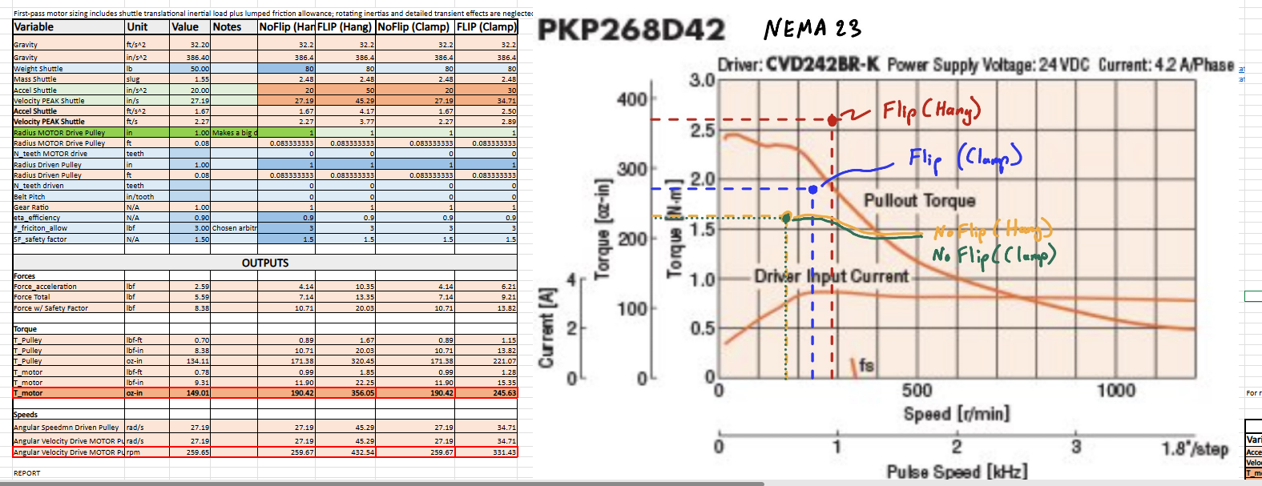
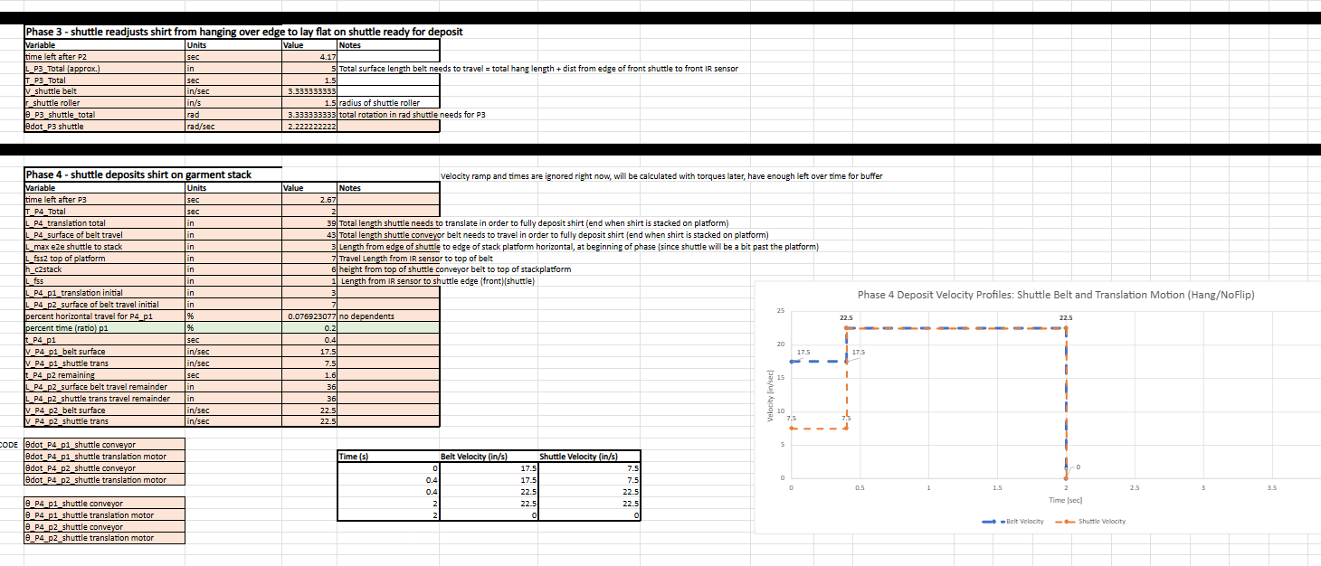
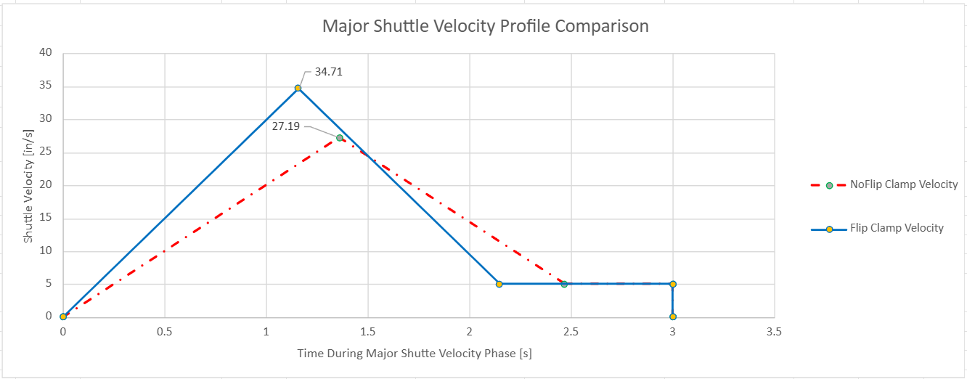
Kordian.
About Projects Skills Experience Goals Contact
View Resume
Section 7
Section 1
Motion & Timing: Shuttle Motor Sizing
System Overview
Section 2
Same section of the page, continued
Requirements
Section 3
Strategy | Accel (in/s²) | Peak (in/s) | Torque | Speed
No-Flip (Hang) | 20 | 27.2 | 190 oz-in | 260 rpm
No-Flip (Clamp) | 20 | 27.2 | 190 oz-in | 260 rpm
Flip (Clamp) | 30 | 34.7 | 246 oz-in | 331 rpm
Flip (Hang) | 50 | 45.3 | 356 oz-in | 433 rpm
How It Works
Section 4
System Architecture
Section 5
Frame & Platform
Section 6
Shuttle Conveyor
Section 7
Motion & Timing
Includes 50 lb shuttle inertia, friction allowance, 90% efficiency, and a 1.5 safety factor. Each point is plotted on the PKP268D42 NEMA 23 pull-out curve (24 VDC, 4.2 A/phase): No-Flip cases have margin; Flip (Hang) reaches the pull-out limit.
Section 8
Torque/speed requirements vs. NEMA 23 pull-out curve
Electronics & Controls
Section 9
Integration & Validation
Section 10
Status & Timeline
Section 11
Team & Lessons
Shuttle velocity profile comparison
Phase 4 deposit: speed-matched belt and translation

Slide 12
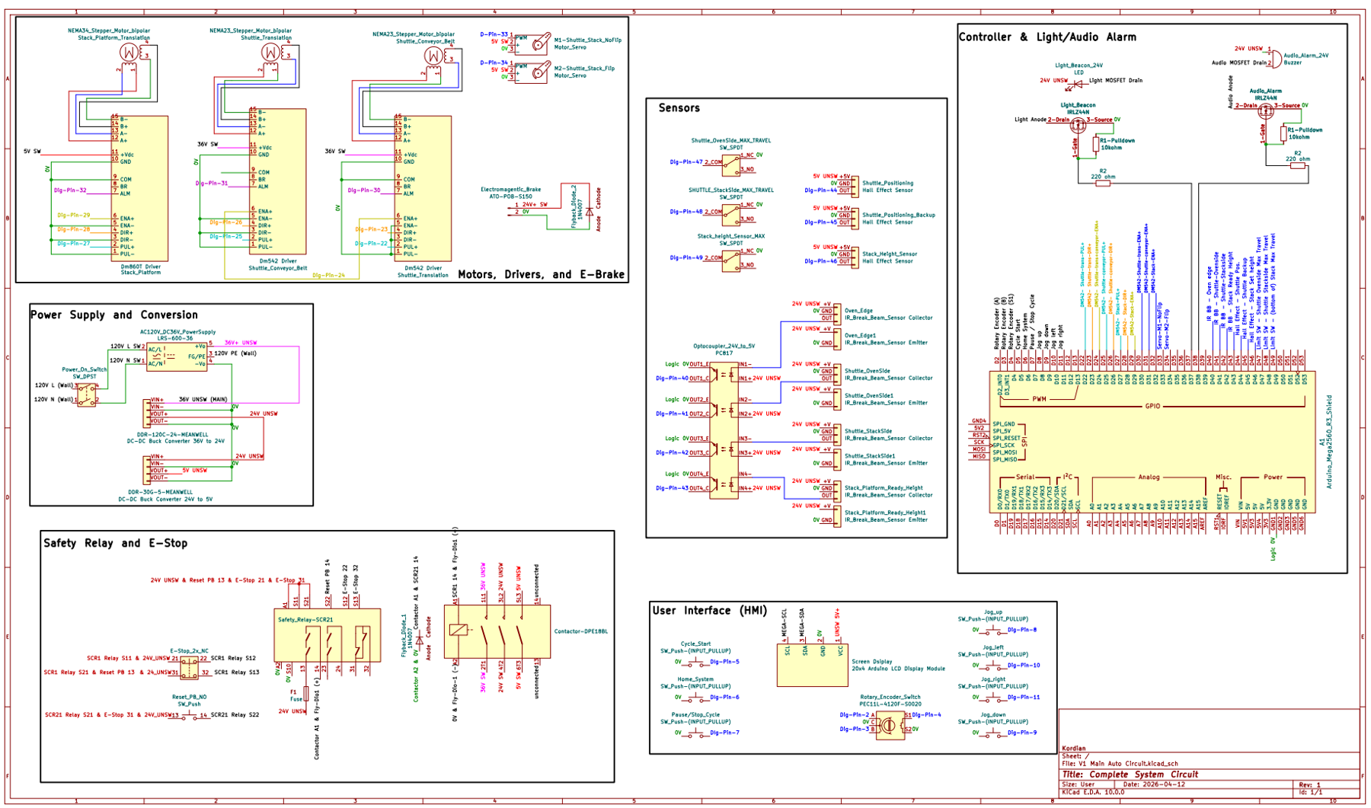
Kordian.
About Projects Skills Experience Goals Contact
View Resume
Section 8
Section 1
Electronics & Controls
System Overview
Section 2
Requirements
Section 3
Final Implementation
How It Works
Section 4
Controller: Arduino Mega for I/O count
Motors & drivers: DM542 / DM860T; NEMA 23 shuttle steppers, braked NEMA 34 lift with planetary gearbox
I/O: IRLZ44N MOSFETs, PC817 optocouplers
Sensors: IR break-beams, Hall-effect, limit switch, DS18B20
UI: LCD, encoder, Start, Pause, Home, Reset, E-stop
Safety: hardware E-stop via safety relay and contactor
System Architecture
Section 5
Frame & Platform
Section 6
Shuttle Conveyor
Section 7
Motion & Timing
Section 8
Electronics & Controls
My Role
Section 9
Owned electronics and controls: component selection, schematic, current budget, wiring, wire schedule, and BOM coordination across ~23 vendors. Designed every 3D-printed part: enclosures, junction boxes, and sensor mounts.
Integration & Validation
Section 10
Status & Timeline
Section 11
Team & Lessons
Complete system circuit

Slide 13
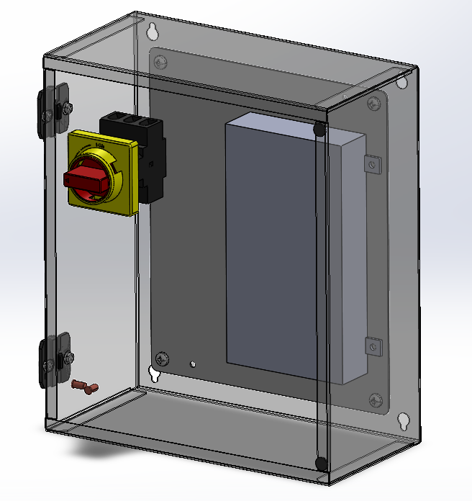
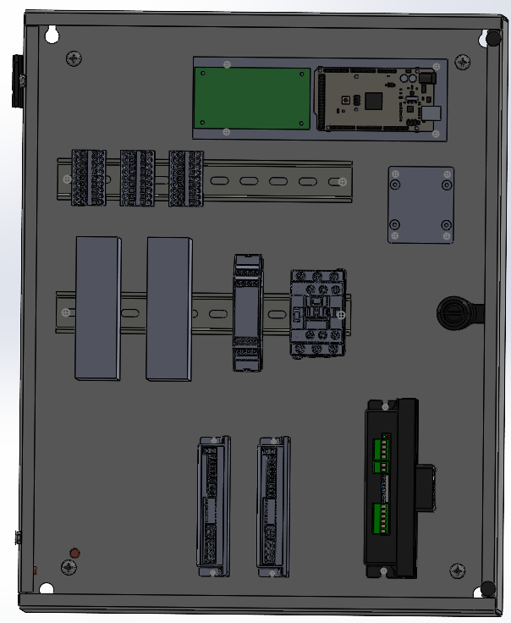
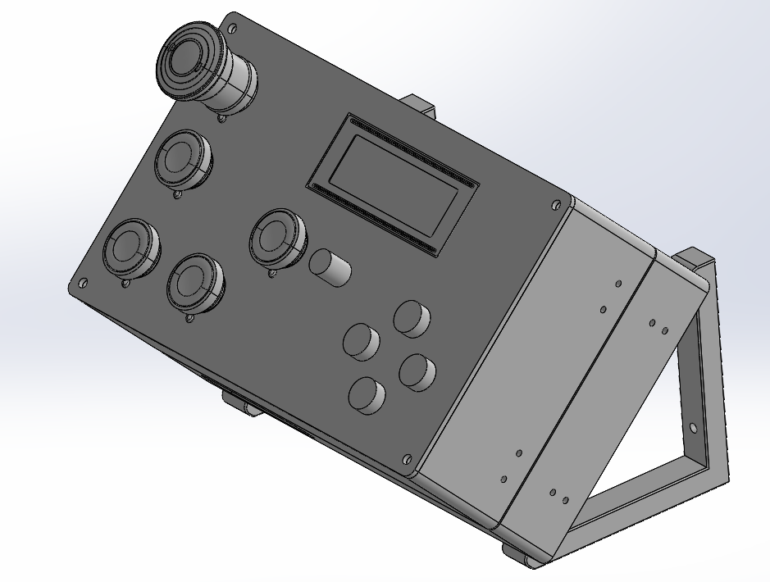
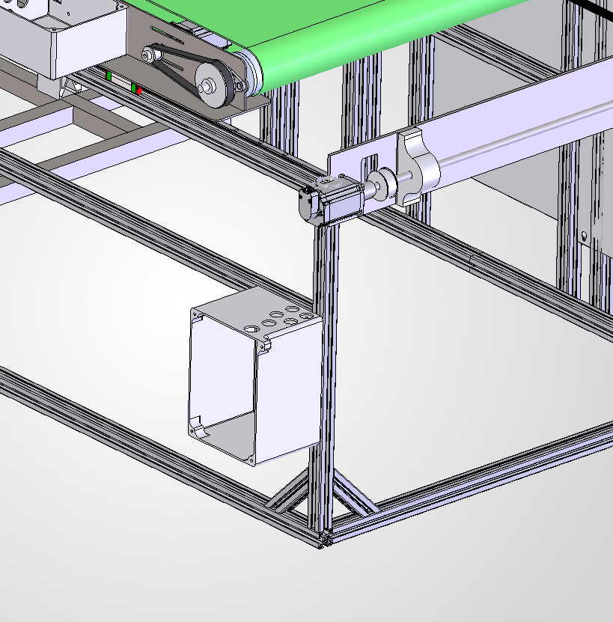
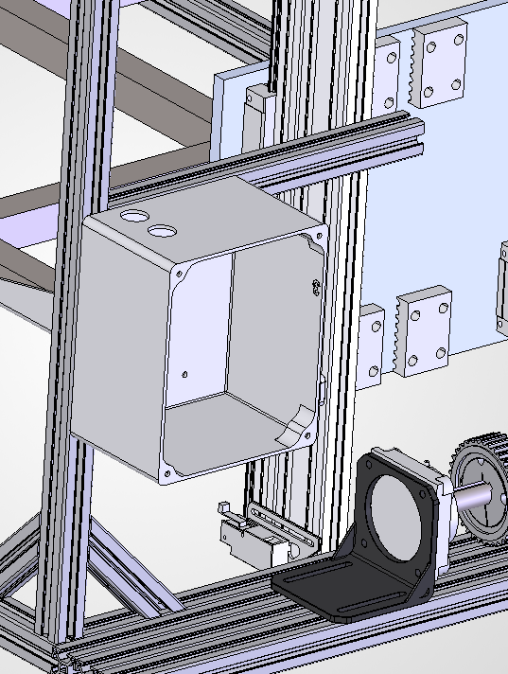
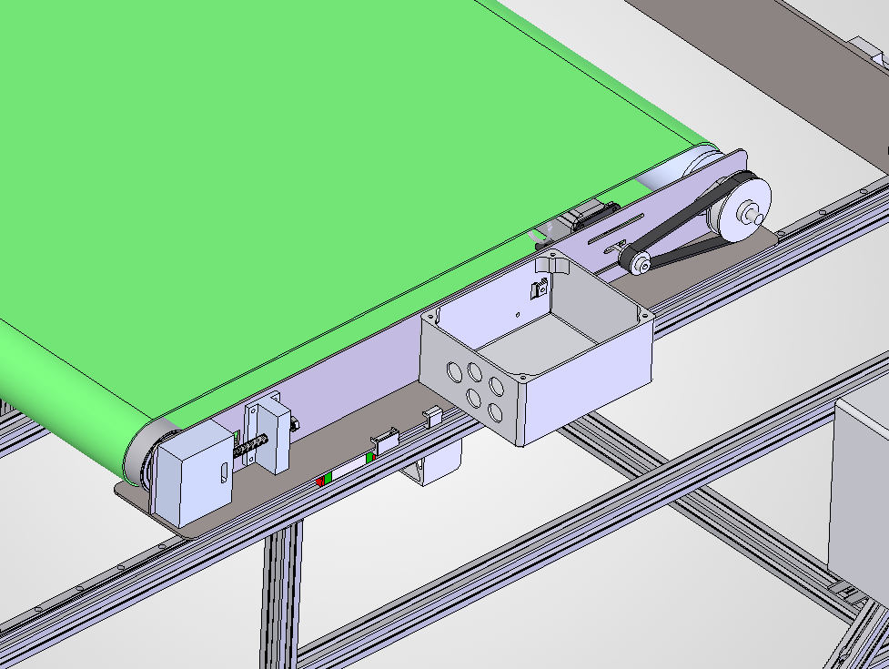
Kordian.
About Projects Skills Experience Goals Contact
View Resume
Section 8
Section 1
Electronics & Controls: Power & Enclosures
System Overview
Section 2
Same section of the page, continued
Requirements
Section 3
Current Budget
How It Works
Section 4
Load | Basis | 36 V equiv.
Stepper drivers | 4.2 + 4.2 + 6 A | 14.4 A
Light beacon | 24 V × 2 A | 1.5 A
E-brake | 24 V × 2 A | 1.5 A
Servo | 6 V × 1 A | 0.2 A
Smaller electronics | est. 10–30 W | 0.9 A
Theoretical max |  | 18.5 A
Realistic high draw | vs. 16.6 A supply | 12.54 A
System Architecture
Section 5
Frame & Platform
Section 6
Shuttle Conveyor
Section 7
Motion & Timing
Section 8
Power supply & switch
Main electronics
User interface
Electronics & Controls
Section 9
Integration & Validation
Section 10
Status & Timeline
Three main enclosures plus 3D-printed terminal-block junction boxes where cable runs branch off. Altech terminal blocks, Igus Chainflex and SOOW cable, PG cable glands, all documented in a wire schedule.
Section 11
Team & Lessons
Junction box: frame
Junction box: shuttle
Junction box: lift mast

Slide 14
Kordian.
About Projects Skills Experience Goals Contact
View Resume
Section 9
Section 1
Integration, Risks & Validation
System Overview
Section 2
Requirements
Section 3
Physical Integration
Functional Integration
How It Works
Section 4
Frame wraps around the dryer conveyor legs; no permanent installation
Shuttle aligned with the dryer belt, with clearance for a smooth transfer
Garment detection triggers the translate + convey sequence
Shuttle speed matched to the dryer, then tuned
Break-beam gives closed-loop stack height control
System Architecture
Section 5
Frame & Platform
Section 6
Shuttle Conveyor
Failure mode (FMEA) | RPN | Mitigation
Electrical failure | 216 | Environmental protection, ratings, fusing, wire mgmt
Debris / lint | 162 | Guide shields, cleaning intervals
Shuttle collision / height error | 144 | Break-beam line of sight, logic safeguards
Garment misplacement | 100 | Secondary sensing, controlled motion
Structural / fastener | 100–120 | FEA-informed design, locking fasteners
Section 7
Functional
Motion & Timing
Detection → transfer → placement → stack adjust
Section 8
Electronics & Controls
Performance
Section 9
Throughput vs. 200/hr; tune shuttle speed
Integration & Validation
Section 10
Stack Quality
Status & Timeline
Section 11
Alignment & stability; fail = collapse/tip
Team & Lessons
Reliability
Continuous run in lint; jams, faults, drift
Success criteria: 200 garments/hr, stable stacks with no toppling, minimal operator intervention.

Slide 15
Kordian.
About Projects Skills Experience Goals Contact
View Resume
Section 10
Section 1
Status & Timeline
System Overview
Section 2
Requirements
Section 3
Status:
Mid-fabrication (as of late September 2026)
How It Works
Current focus:
Frame and lift assembly, shuttle machining, enclosures and wiring
Section 4
System Architecture
Next:
Prototype rollout, testing against requirements, Design Fair handoff
Section 5
Frame & Platform
Section 6
Spring 2026 ✓
Sep–Oct 2026
Nov 3–5
November
Dec 10
Shuttle Conveyor
Section 7
Requirements, PDR/CDR, parts ordered
Fabrication and assembly
Prototype rollout
Testing against requirements
Design Fair & sponsor handoff
Motion & Timing
Section 8
Electronics & Controls
Section 9
Subsystem | Status
Frame & lift platform | Aluminum extrusion cuts complete; assembly underway
Shuttle conveyor | Material ordered, machining next
Electronics & enclosures | Enclosures and mounts printing, wiring instructions in progress
Control software | Begins after electrical assembly
Integration & Validation
Section 10
Status & Timeline
Section 11
Team & Lessons

Slide 16
Kordian.
About Projects Skills Experience Goals Contact
View Resume
Section 11
Section 1
Team & Lessons Learned
System Overview
Section 2
Requirements
Section 3
Working as a Team
Lessons Learned
How It Works
Section 4
Project management: Gantt chart, rotating team leader, weekly memos to sponsor and advisor
Working with a client: off-campus sponsor; needs written into Level 1 requirements signed by sponsor, advisor, and team
Teamwork: ownership split by subsystem, with effort on mechanical–electrical interfaces
Coordination: parts from ~23 vendors through the advisor, one shared BOM
Record and share design decisions more often, so everyone builds from the same design
One organized file structure with revision control for CAD, drawings, and analysis
Set an agenda for every meeting, with clear goals rather than open-ended discussion
Ask for help early; a quick question beats days spent stuck
System Architecture
Section 5
Frame & Platform
Section 6
Shuttle Conveyor
Section 7
Motion & Timing
Section 8
Electronics & Controls
Section 9
Integration & Validation
Section 10
Status & Timeline
Thanks to Paul Otsu and Headwaters Studio for sponsoring the project, and to our advisor, Adam Michalson.
Section 11
Team & Lessons

