Slide 1

Title
Name
Email address
Department of Computer Science
AGH University of Science and Technology
Krakow, Poland

Slide 2
Outline
Section 1
Section 2
…
Summary
References

Slide 3
Section 1
Please insert here the contents of this section
Please insert here the contents of this section
…..

Slide 4
Section 2
Please insert here the contents of this section
Please insert here the contents of this section
…..

Slide 5
Section …
Please insert here the contents of this section
Please insert here the contents of this section
…..

Slide 6
Summary
Conclusion 1
Conclusion 2
…..

Slide 7
References
Reference 1
Reference 2
…..

Slide 8
Sample slide
Current research objectives
Investigating applicability of cloud computing model for complex scientific applications
Optimization of resource allocation for applications on clouds
Resource management for services on heterogeneous resources
Urgent computing scenarios on distributed infrastructures
Billing and accounting models
Procedural and technical aspects of ensuring efficient yet secure data storage, transfer and processing
Methods for component dependency management, composition and deployment
Information representation model for cloud federating platform, its components and operating procedures

Slide 9
Sample slide
Cloud performance evaluation
Performance of VM deployment times
Virtualization overhead Evaluation of open source cloud stacks (Eucalyptus, OpenNebula, OpenStack)
Survey of European public cloud providers
Performance evaluation of top cloud providers (EC2, RackSpace, SoftLayer)
A grant from Amazon has been obtained
M. Bubak, M. Kasztelnik, M. Malawski, J. Meizner, P. Nowakowski and S. Varma: Evaluation of Cloud Providers for VPH Applications, poster at CCGrid2013 - 13th IEEE/ACM International Symposium on Cluster, Cloud and Grid Computing, Delft, the Netherlands, May 13-16, 2013

Slide 10
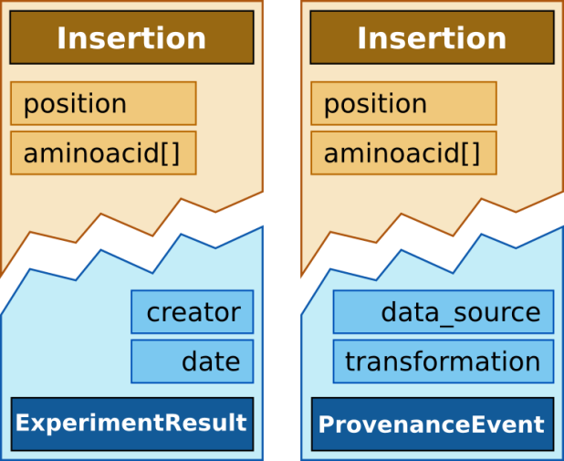
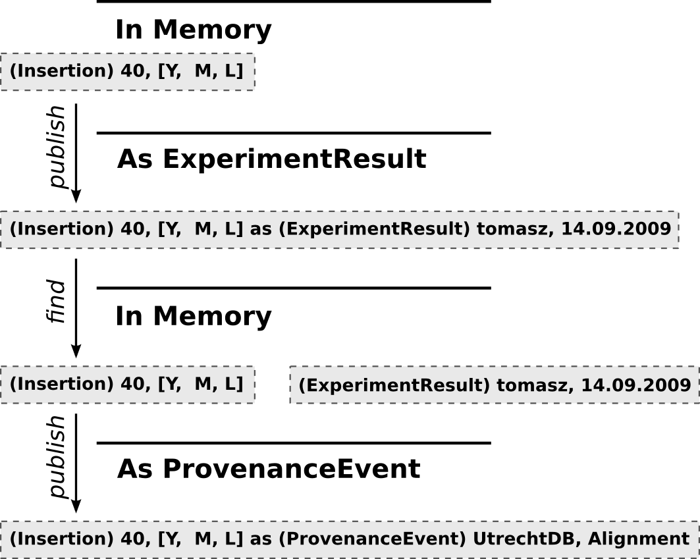
Sample slide
Semantic integration for science domains
Concept of describing scientific domains for in-silico experimentation and collaboration within laboratories
Based on separation of the domain model, containing concepts of the subject of experimentation from the integration model, regarding the method of (virtual) experimentation (tools, processes, computations)
Facets defined in integration model are automatically mixed-in concepts from domain model: any piece of data may show any desired behavior
Proposed, designed and deployed the method for 3 domains of science:
Computational chemistry inside InSilicoLab chemistry portal
Sensor processing for early warning and crisis simulation in UrbanFlood EWS
Processing of results of massive bioinformatic computations for protein folding method comparison
Composition and execution of multiscale simulations
Setup and management of VPH applications
T. Gubala, K. Prymula, P. Nowakowski, M. Bubak: Semantic Integration for Model-based Life Science Applications. In: SIMULTECH 2013 Proceedings of the 3rd International Conference on Simulation and Modeling Methodologies, Technologies and Applications, Reykjavik, Iceland 29 - 31 July, 2013, pp. 74-81

Slide 11
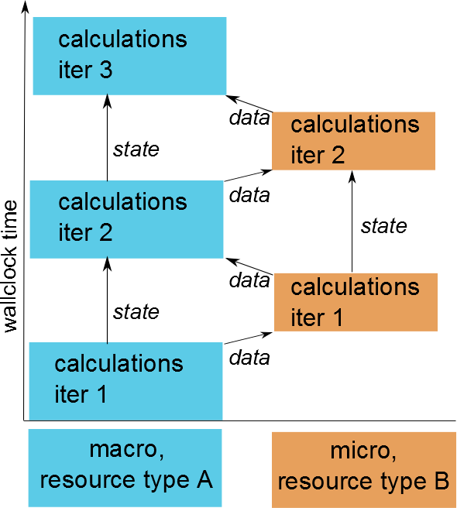
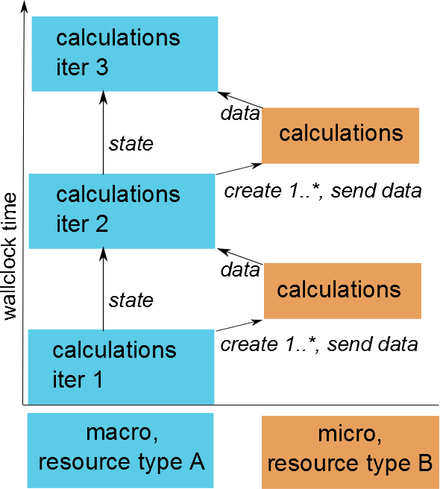
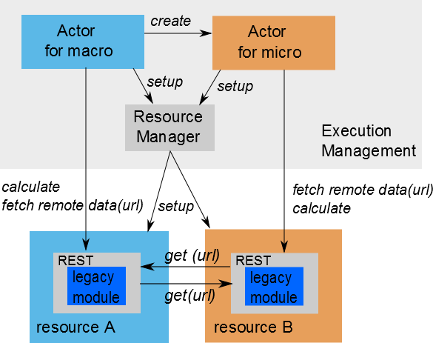
Sample slide
Effective management of multiscale computations
Support for typical interations in multiscale applications:
Macro module triggers micro module and wastes resources while waiting for its output
Macro module needs to trigger a dynamic number of micro modules
Research towards:
Usage of Akka actors and Spray toolkit features for effective management (a.o. support for a dynamic creation of new modules)
Grouping similar demanding (but not necessary connected) modules on the same resources to avaid waisting resources
Legacy applications issues
Example 1: Concurrect execution of macro and micro moduls in a loop
Example 2: Macro triggers a dynamic number of micro.
A proposal of the architecture of management system

Slide 12
Sample slide
References
K. Rycerz, E. Ciepiela, D. Harezlak, T. Gubała, G. Dyk, J. Meizner, M. Bubak, J. Borgdorff, A. G. Hoekstra: An Environment for Programming and Execution of Multiscale Applications, ACM Transactions on Modeling and Computer Simulation (in review)
B. Bodziechowski, E. Ciepiela, M. Bubak: Assessment of Software Quality with Static Source Code Analysis: GridSpace2 Case Study, abstract for Cracow Grid Workshop 2012, 22-24 October 2012, Kraków, Poland (2012)
K. Rycerz, D. Harężlak, G. Dyk, E. Ciepiela, T. Gubała, J. Meizner, and M. Bubak: Programming and Execution of Multiscale Applications, abstract for Cracow Grid Workshop 2012, 22-24 October 2012, Kraków, Poland (2012)
J. Borgdorff, C. Bona-Casas, M. Mamonski, K. Kurowski, T. Piontek, B. Bosak, K. Rycerz, E. Ciepiela, T. Gubala, D. Harezlak, M. Bubak, E. Lorenz, A. G. Hoekstra: A Distributed Multiscale Computation of a Tightly Coupled Model Using the Multiscale Modeling Language. In: Procedia CS 9, pp. 596-605 (2012)
K. Rycerz and M. Bubak: Building and Running Collaborative Distributed Multiscale Applications. In: W. Dubitzky, K. Kurowsky, B. Schott (Eds) Large-Scale Computing Techniques for Complex System Simulations, Chapter 6, pp. 111-130. J. Wiley and Sons ( Dec 2011)
K. Rycerz, M. Nowak, P. Pierzchala, M. Bubak, E. Ciepiela and D. Harezlak: Comparision of Cloud and Local HPC approach for MUSCLE-based Multiscale Simulations. In Proceedings of The Seventh IEEE International Conference on e-Science Workshops, Stockholm, Sweden, 5-8 December 2011. IEEE Computer Society, Washington, DC, USA, 81-88 (2011)

