Slide 1

Employee Management System using SQL

Slide 2
Introduction
The Employee Management System using SQL is a project designed to analyze and manage employee-related data in an organization. It works on datasets like employees, departments, payroll, leaves, and qualifications.
Using SQL queries such as joins, group by, count, average, and sum, the system extracts meaningful insights from the data. This helps in understanding employee distribution, salary patterns, and overall organizational performance.
The project demonstrates the practical use of SQL in real-world data analysis.

Slide 3

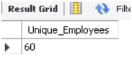
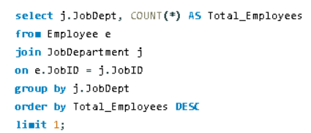
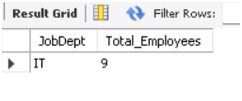
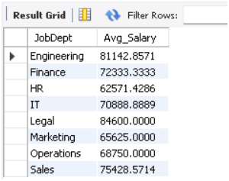
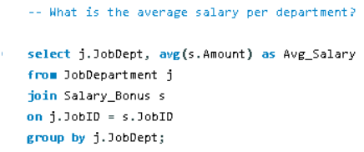
Employee Insights
Queries
Results

Slide 4
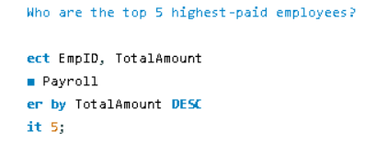
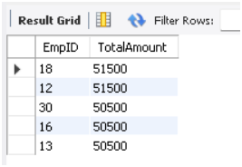

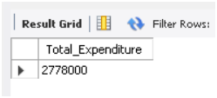
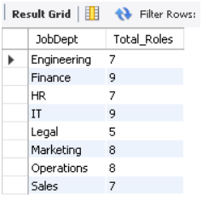

Employee Insights
Queries
Results

Slide 5
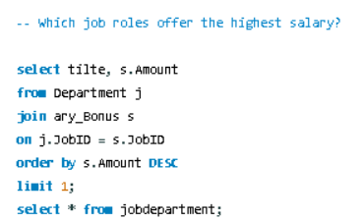
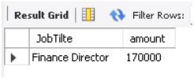
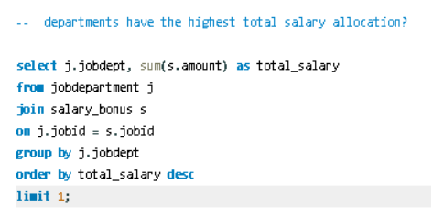
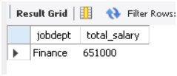
Job Role And Department Analysis
Queries
Results

Slide 6

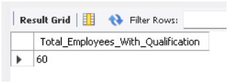
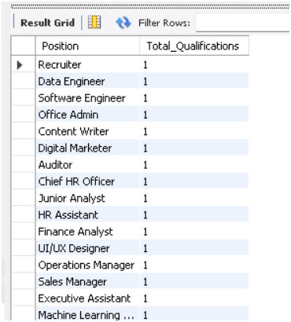
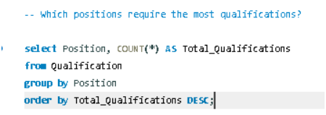
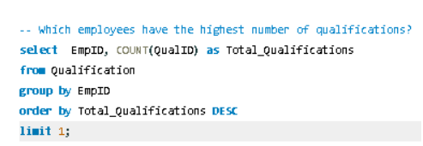

Qualification And Skills Analysis
Queries
Results

Slide 7

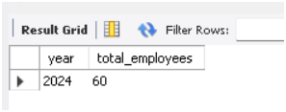
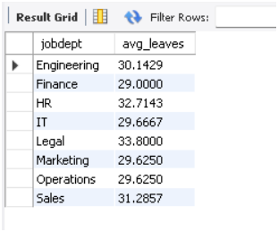
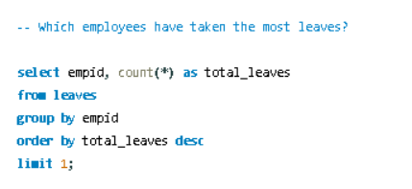
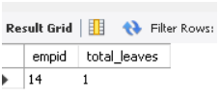
Leave And Absence Patterns
Queries
Results

Slide 8
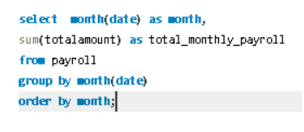
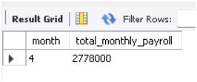
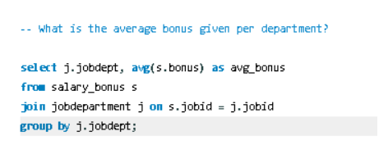
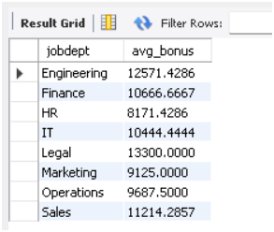
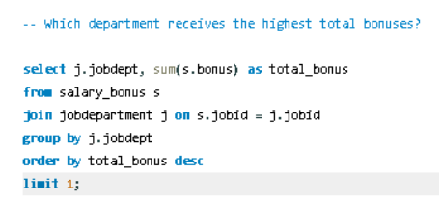

Payroll And Compensation Analysis
Queries
Results

Slide 9

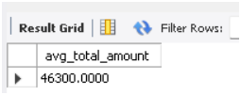
Payroll And Compensation Analysis
Queries
Results

Slide 10
Conclusions
Successfully analyzed employee data using SQL
Extracted insights on salary, departments, and leaves
Applied SQL concepts like joins, group by, count, avg, sum
Improved understanding of real-world data analysis
Demonstrated how SQL helps in decision-making

Slide 11
Thank You…

