Slide 1

Digital Design
With an Introduction to the Verilog HDL, VHDL, and SystemVerilog
6th Edition, Global Edition
Chapter 06
Registers and Counters

Slide 2
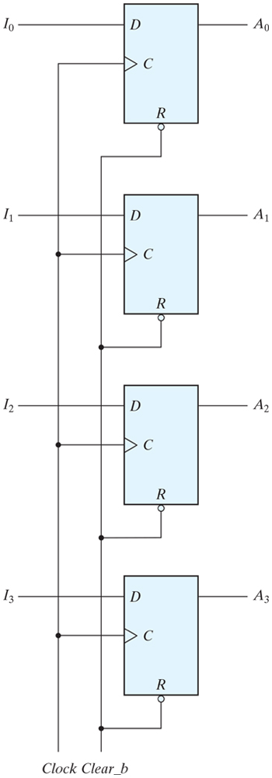
Four-bit register

Slide 3
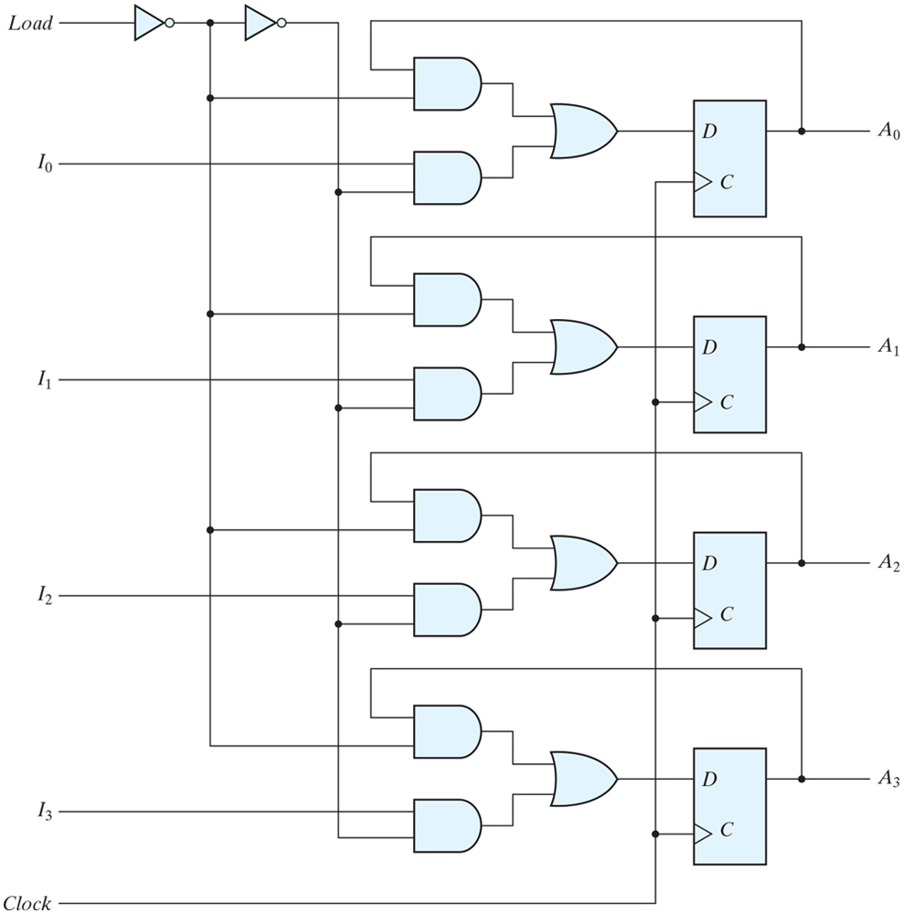
Four-bit register with parallel load

Slide 4
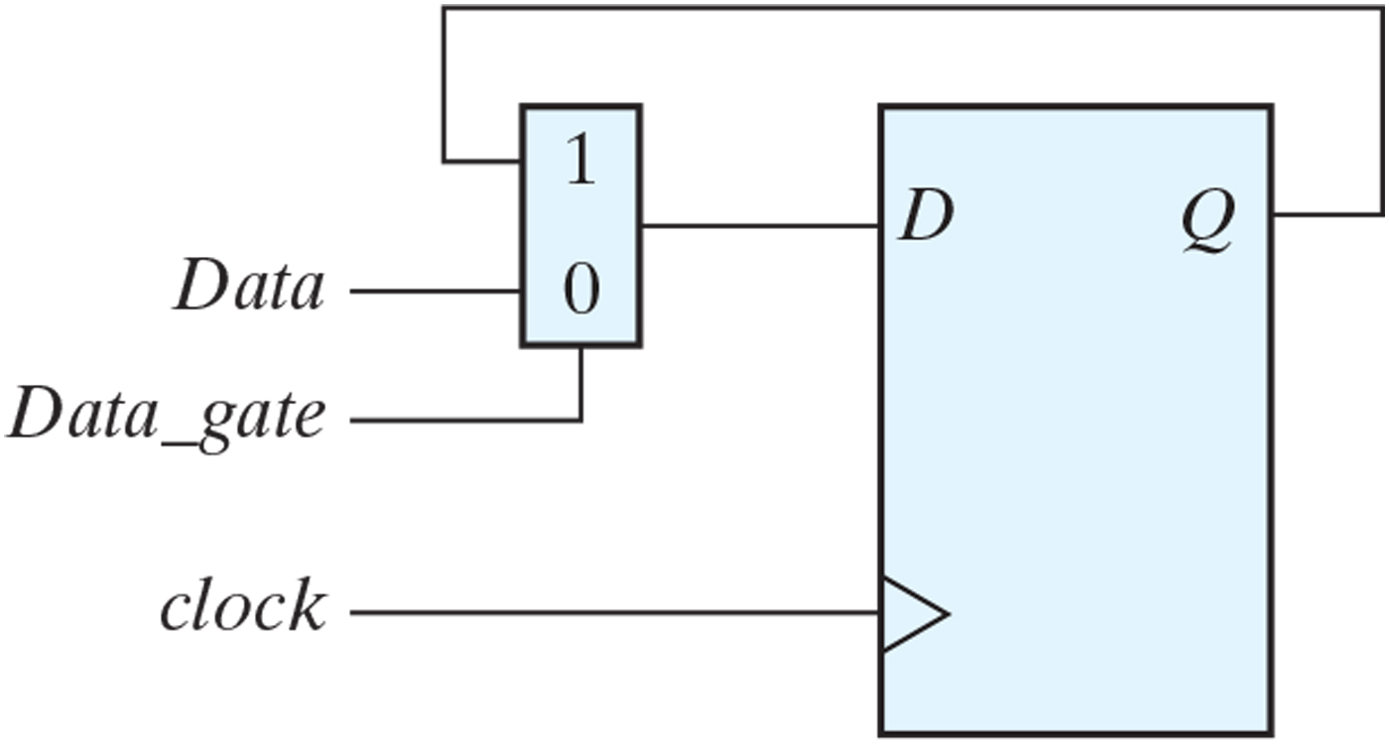
Exploiting MUX for Load

Slide 5
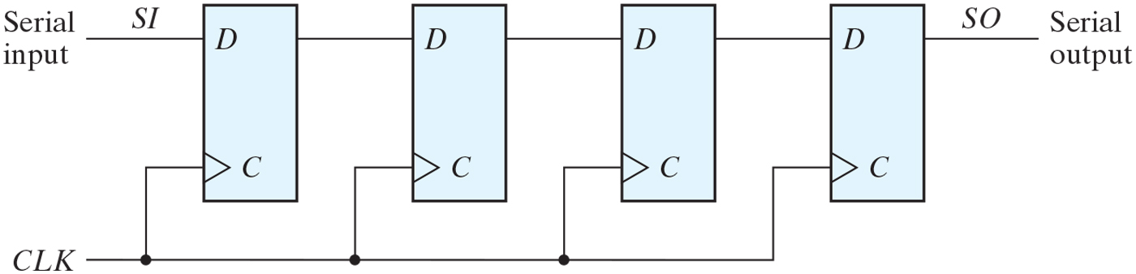
Four-bit shift register

Slide 6
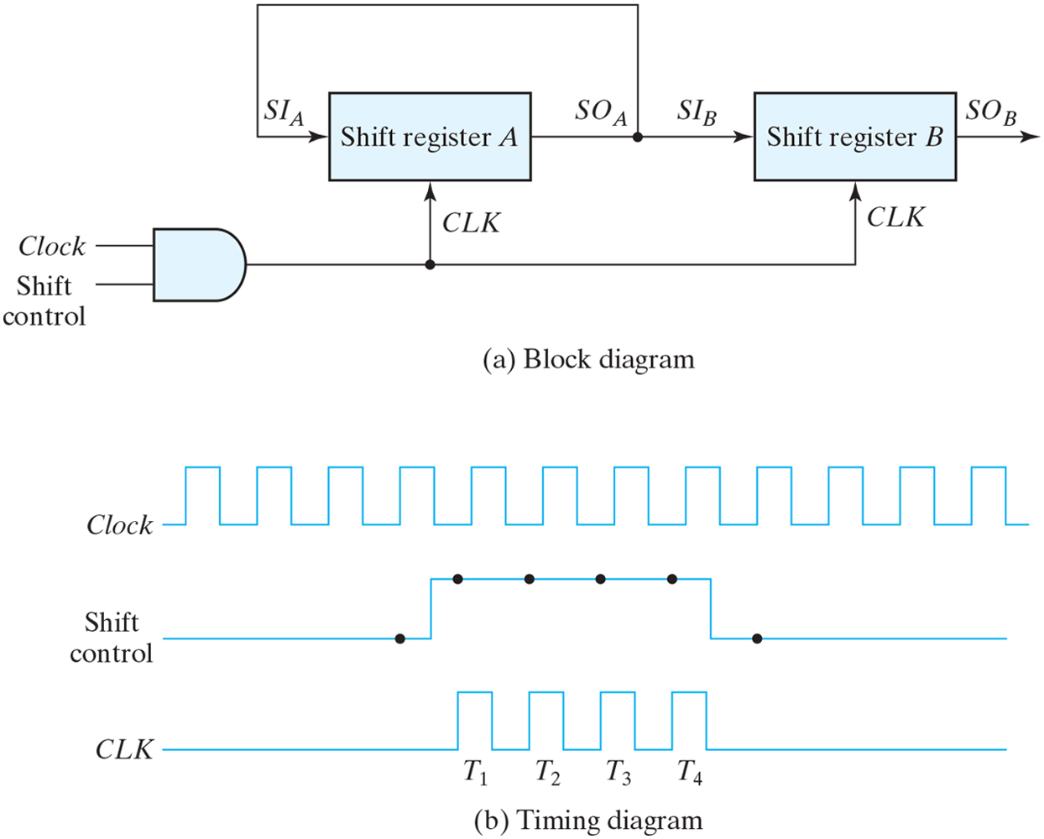
Serial transfer from register A to register B.

Slide 7
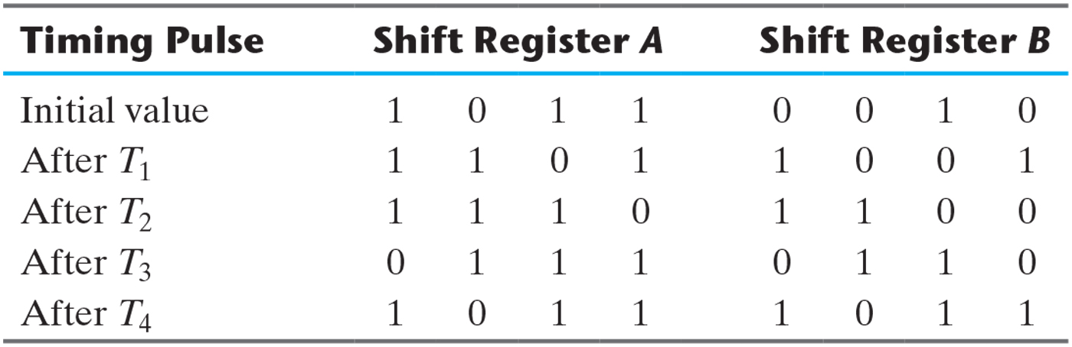
Serial-Transfer Example.

Slide 8
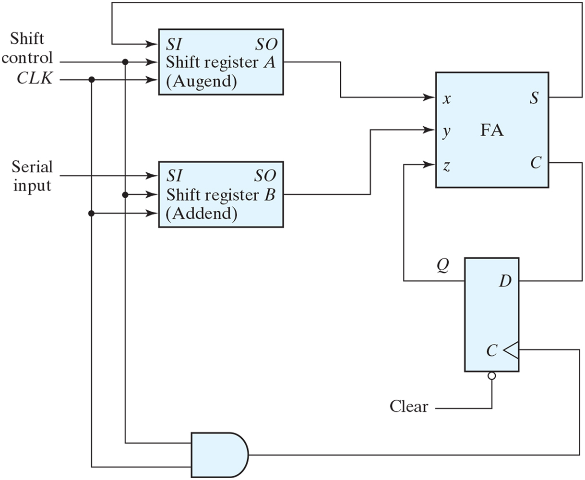
Serial adder.

Slide 9
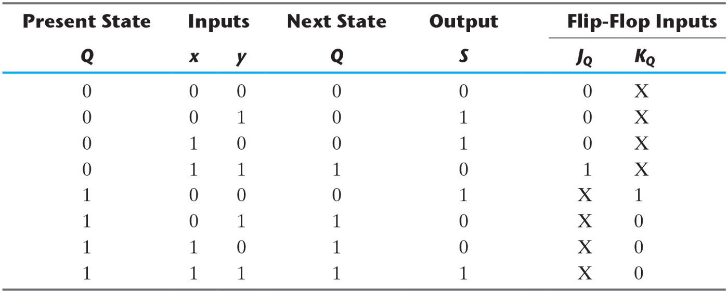
State Table for Serial Adder w/ JK FF

Slide 10
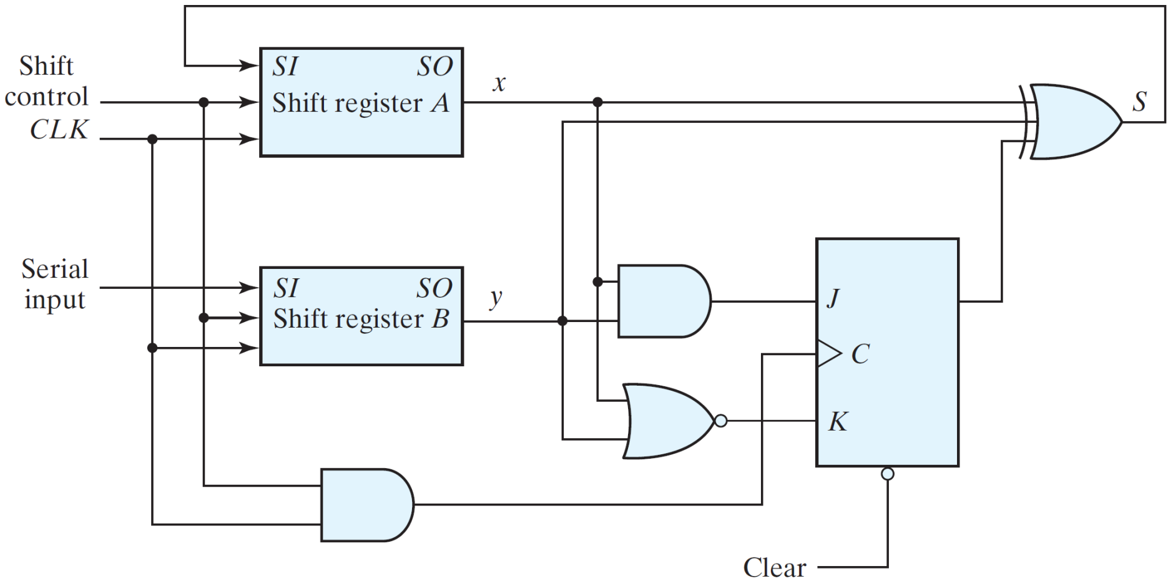
Second form of serial adder.

Slide 11
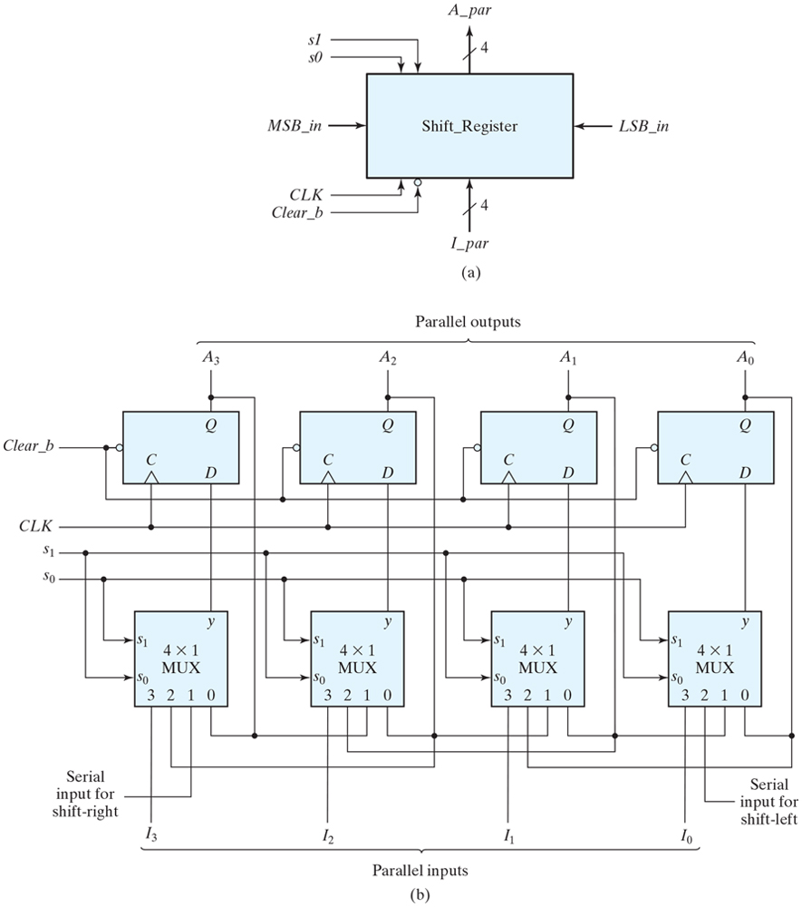
Four-bit universal shift register.

Slide 12
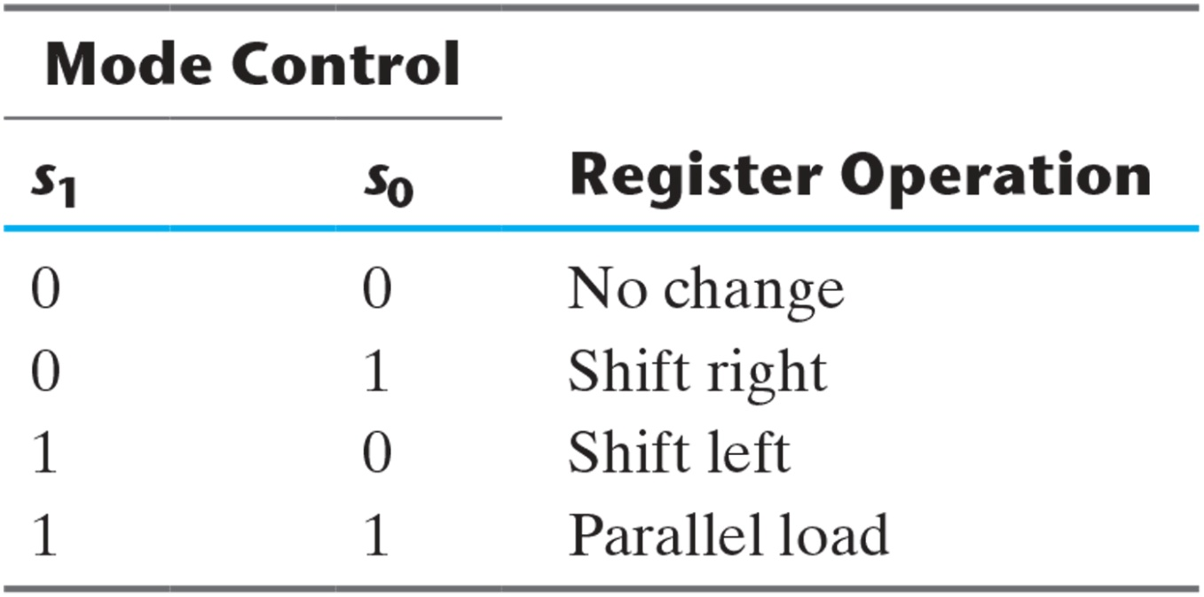
Function Table for the Register of Fig. 6.7.

Slide 13
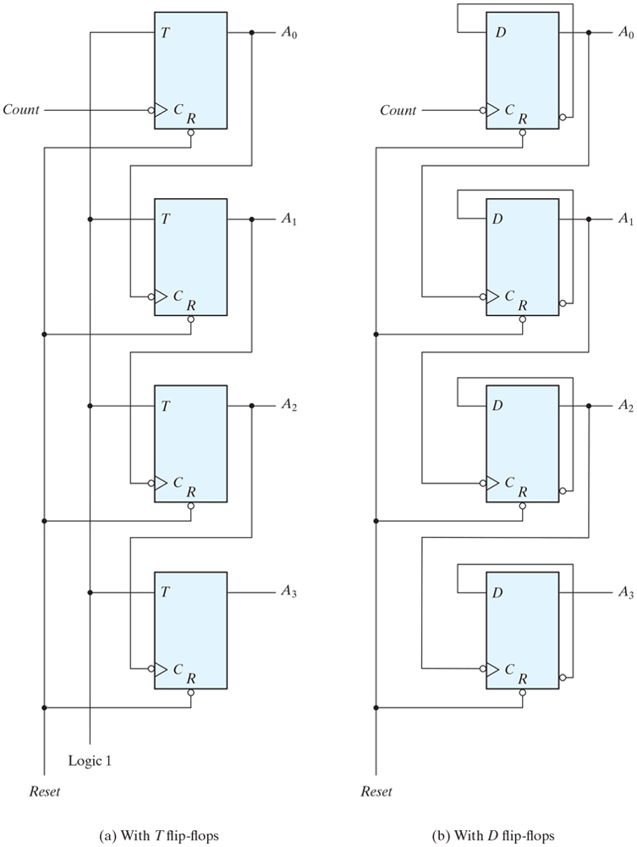
Four-bit binary ripple counter.

Slide 14
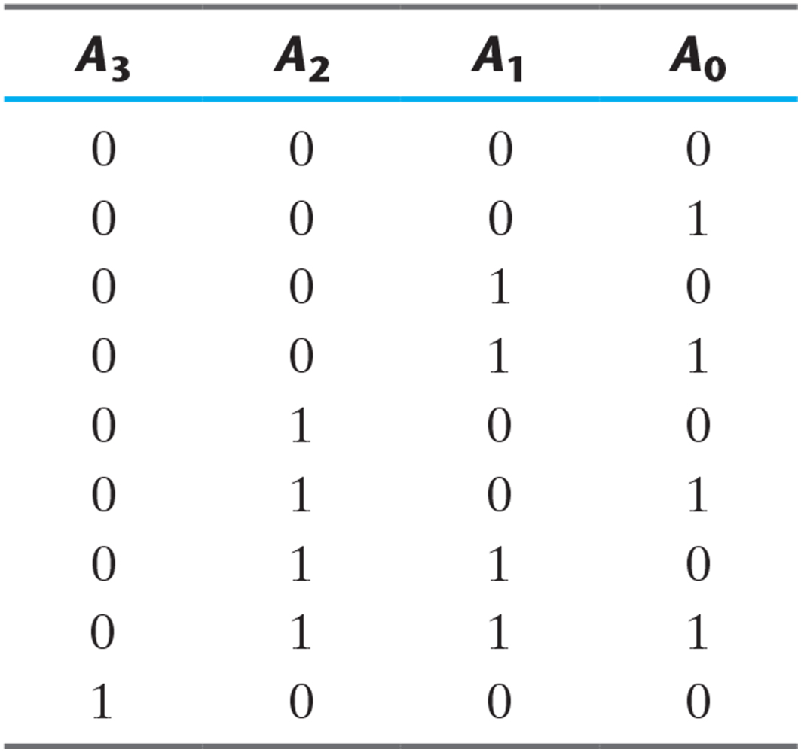
Binary Count Sequence.

Slide 15
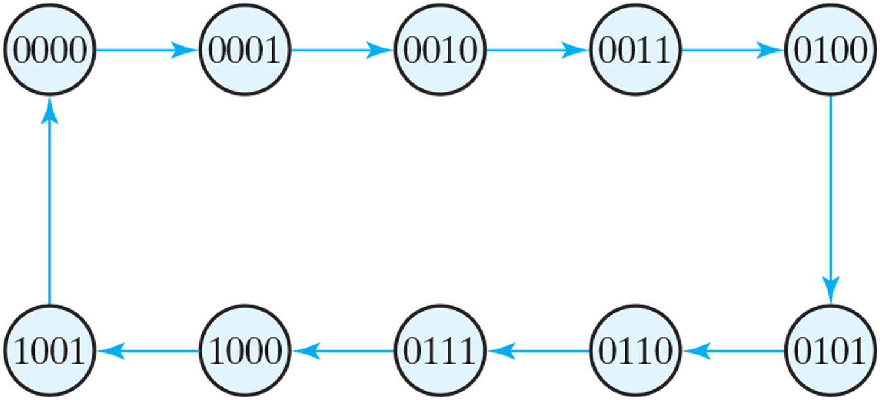
State diagram of a decimal BCD counter.

Slide 16
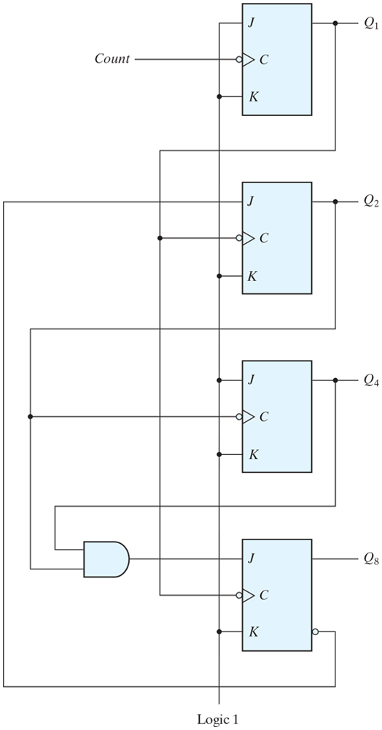
BCD ripple counter.

Slide 17
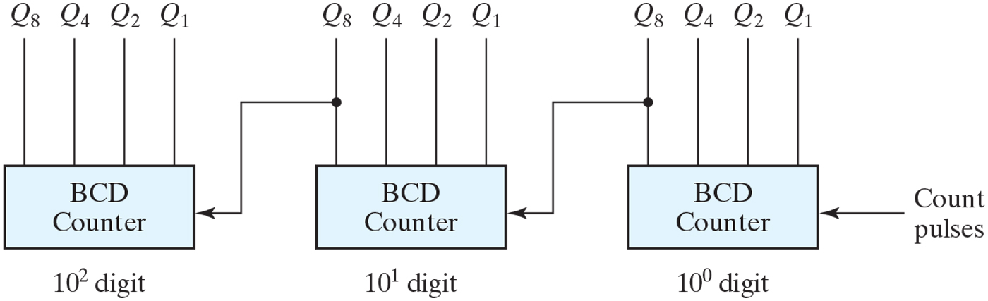
Block diagram of a three-decade decimal BCD counter.

Slide 18
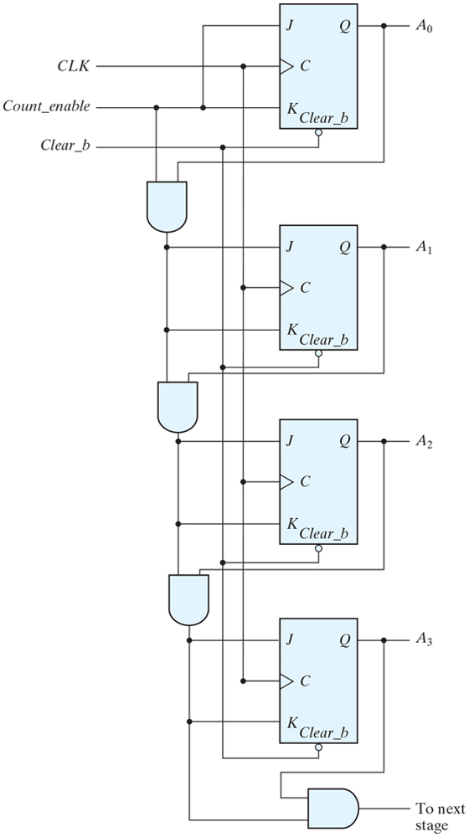
Four-bit synchronous binary counter.

Slide 19
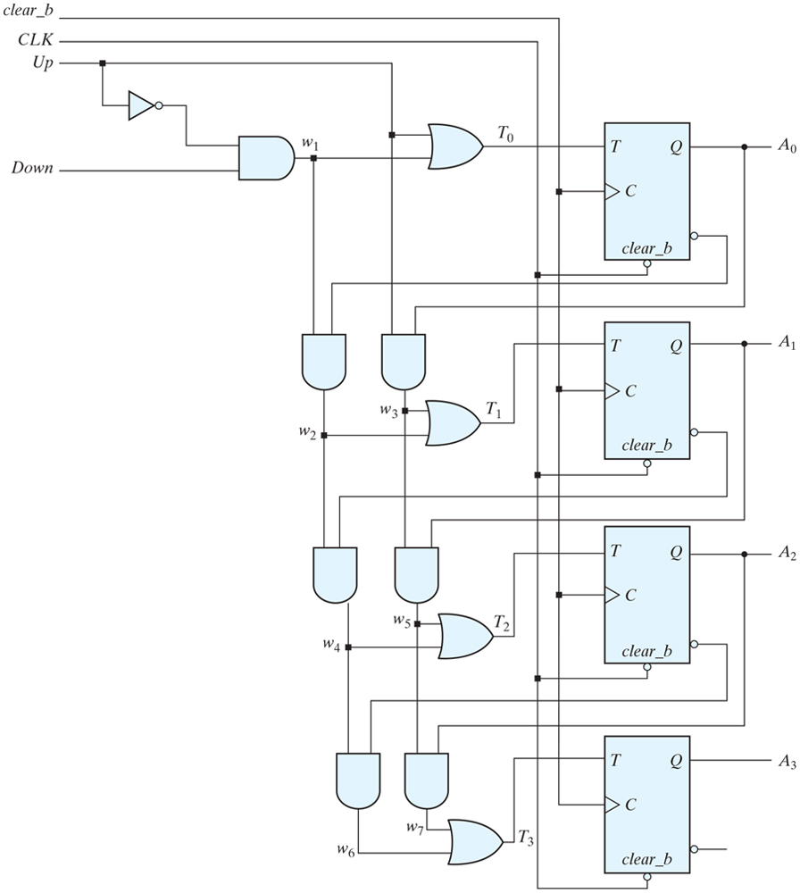
Four-bit up–down binary counter.

Slide 20
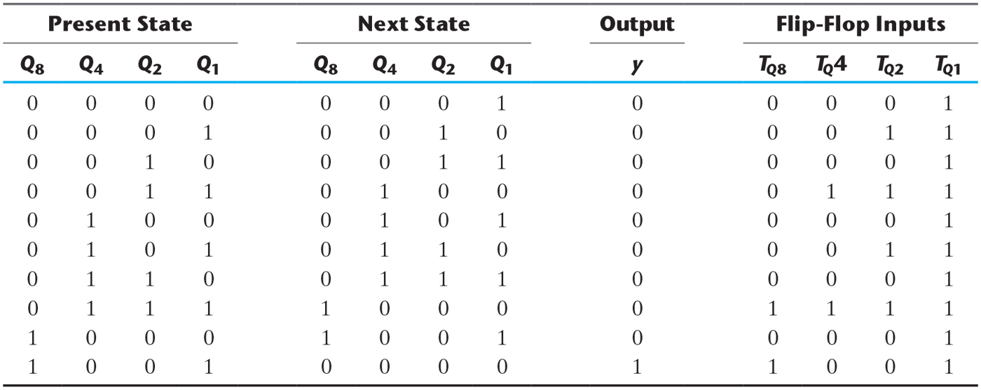
State Table for BCD Counter.

Slide 21
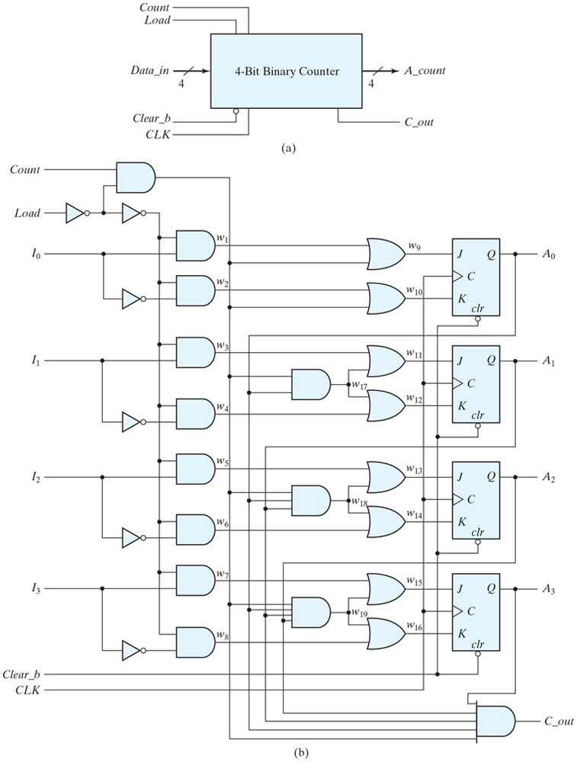
Figure 6.14 Four-bit binary counter with parallel load.

Slide 22
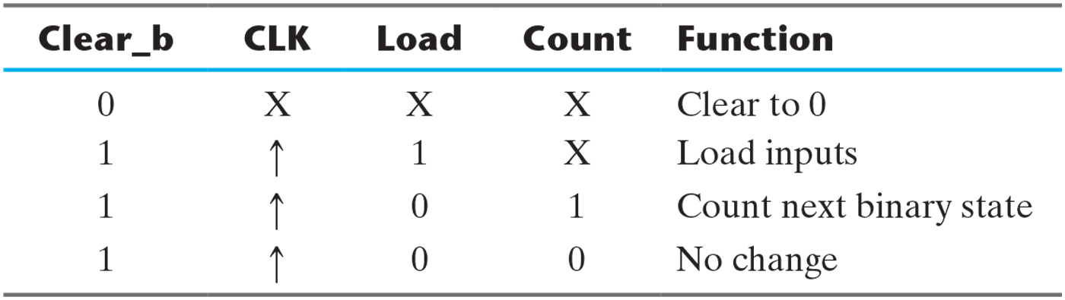
Function Table for the Counter of Fig. 6.14.

Slide 23
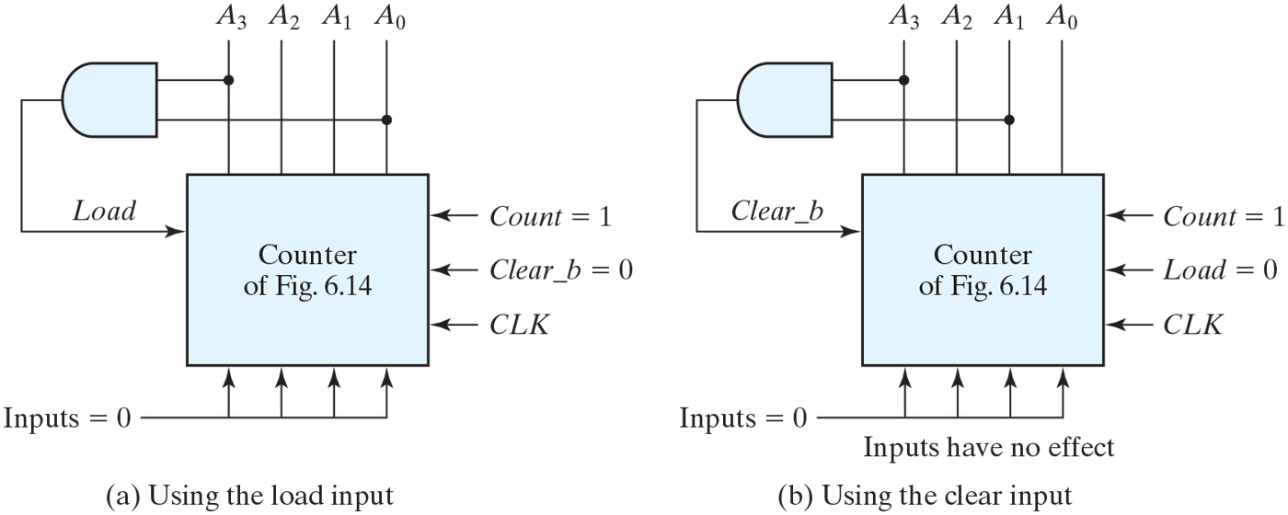
Two ways to achieve a BCD counter using a counter with parallel load.

