Slide 1
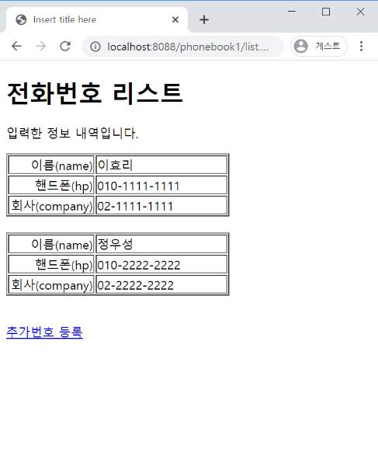
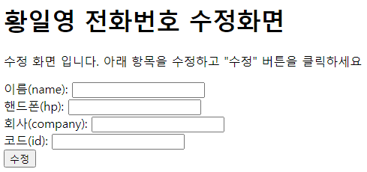
phonebook2 분석(1)
01
Request(요청)
Request header
파라미터: action=uform
Request body
분석-수정폼(uform)
http://localhost:8088/phonebook2/pbc?action=uform
Tomcat
phonebook2
controller(servlet)객체
phoneDao 객체
request
uform
phoneDao
..
getPerson()
Response(응답)
response
Response header
Response body
(html)
*포워드
request
response
updateForm.jsp
객체
[수정]
DB
Request(요청)
Response(응답)
Request header
파라미터: action=uform
Request body
어트리뷰트:”pVo”,personVo
Response header
Response body
(html)

Slide 2
phonebook2 분석(2)
01
Request(요청)
분석-수정(update)
Request header
파라미터: action=update
Request body
Tomcat
phonebook2
http://localhost:8088/phonebook2/pbc?action=update
contoller(servlet)객체
phoneDao 객체
rquest
update일때
phoneDao
insert일때
delete일때
..
personUpdate()
Response(응답)
response
Response header
Response body
(html)
http://localhost:8088/phonebook2/pbc?action=list
DB

Slide 3
phonebook2 분석(3)
01
Request(요청)
분석-삭제(delete)
Request header
파라미터: action=delete
Request body
Tomcat
phonebook2
http://localhost:8088/phonebook2/pbc?action=delete
controller(servlet)객체
phoneDao 객체
request
delete 일때
phoneDao
..
personDelete()
Response(응답)
response
Response header
Response body
(Redirect code)
http://localhost:8088/phonebook2/pbc?action=list
DB

