Slide 1

Capstone 1
Tractor TEK Data Project
Presented by: Andrew Korenak
3/10/2022
Notes:
Hello, and welcome to the capstone 1 Tractor Tek data project.
(Next slide).

Slide 2

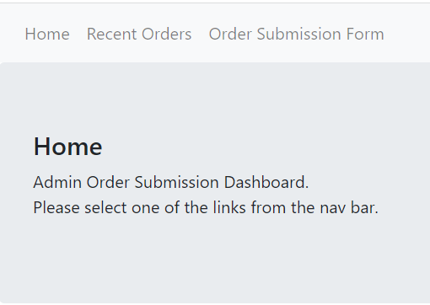
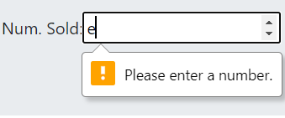
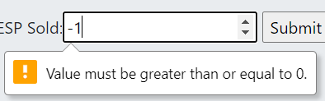
TractorTEK Database and Web App Project
Web App: Admin Submission Dashboard
Simple Design
Non Distracting Color Palate
Clear Navigation
Clean Layout
Form Validation
Prevents Bad Data
Provides Feedback
Hello, My name is Andrew.
Notes:
My name is Andrew Korenak, my picuture is there on the left. I would like to talk to you today about the web app sales tracking system, database health checker, and excel dashboard requested by Tractor TEK with an emergency 3 day deadline.
The Web App I created to fulfill the requirements runs on Flask and uses SQLalchemy for connections to the database for Create Read Update and Delete (CRUD) functionality.
It is simple in design, with an intentionally non distracting color palate, simple navigation and minimalistic layout. It provides the functionality required of adding sales entries into the database while also preventing unexpected data in its forms while providing feedback to reflect user input.
(next slide)

Slide 3
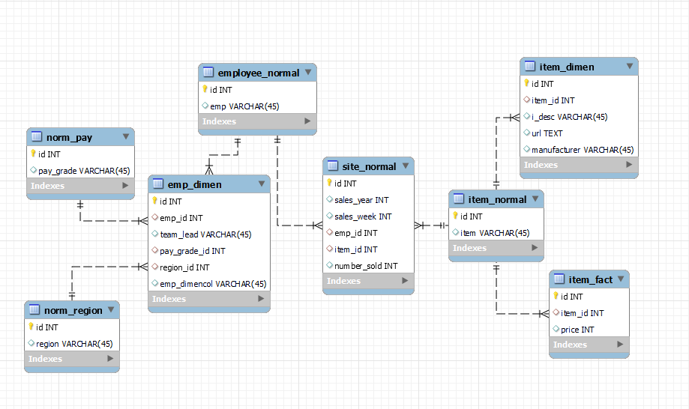
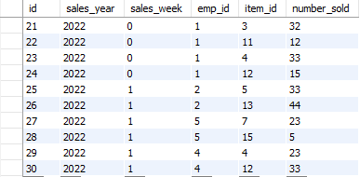
Database Connectivity
App to MySQL
PK FK Relationships
Normalized App Output
Notes:
The app connects directly to a MySQL database. The left image is the normalized output of the web app into the database, with the right image showing connections between the tables. Employee and Item information are stored off to the side in connected dimension and fact tables to enable an OLTP model.
The historic tables stored in the database are not included in this relationship map, only those related to the app. However, those tables have been converted from the original Excel backup into CSV then into data frames with pandas and have been uploaded to the MySQL server.
With greater time than 3 days for the project I would have extended mapping to include historic tables and relations. I also would have liked to expand on the sales week and sales year functionalities of my app to provide better insights on the data in the future.
MySQL schema dump files have been provided for the tables in my database in the github repository.
(The keys and relationships were configured server side rather than app side… So they would not be mapped If someone were to just pluck this project off github and try running it.)

Slide 4
Live Demo
APP, Jupyter, Excel Dashboard
Notes:
I am going to be jumping around a lot of screens in the next few minutes here. So please speak up if any of the screenshares break or fail.

Slide 5
Q & A

Slide 6
Problems in production
Time Management:
What I wanted to do vs what I had the time to do.
Overcoming Knowledge Barriers:
Extracurricular Learning
Learn By Doing
Notes:
There was so much more that could have been done, but early on I realized that I could not afford to do too much extra if I wanted to fulfill all basic requirements within a 3 day span.
Having Learned Advanced Excel, MySQL, Python, and the use of tools such as Flask and its many importable libraries in the span of 4 weeks meant that some deeper areas of learning were neglected in the breakneck pace of learning. However, this project was a great opportunity to extend into unknown areas and continue to learn the deeper aspects of SQL but especially that of python.

Slide 7
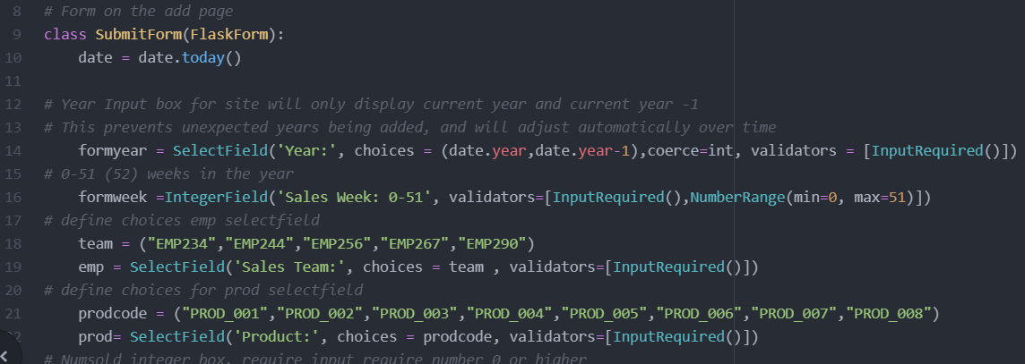
Potential Project Expansion Goals
Notes:
Right now if product offerings or employee lists were to change, it would require manual editing of the code. Given greater time to work on the project I would have liked the code to make references back to the tables to self create variables rather than me manually assigning variables.
For instance my drop down menu to select employee. That could reference the length of the employee column, pull an appropriate number of entities to create the allowed list for the SelectField box. In this way if a sales team were added or removed from the database it could reflect in the app without the need for manual change. However, this one change would cause a cascade of failures which would require multiple other changes such as could the need for a table with all employees, past and present to avoid confusion with current records that may end up decoupled from employe_id, and the need for I more flexible code elsewhere to re-normalize the data.

Slide 8
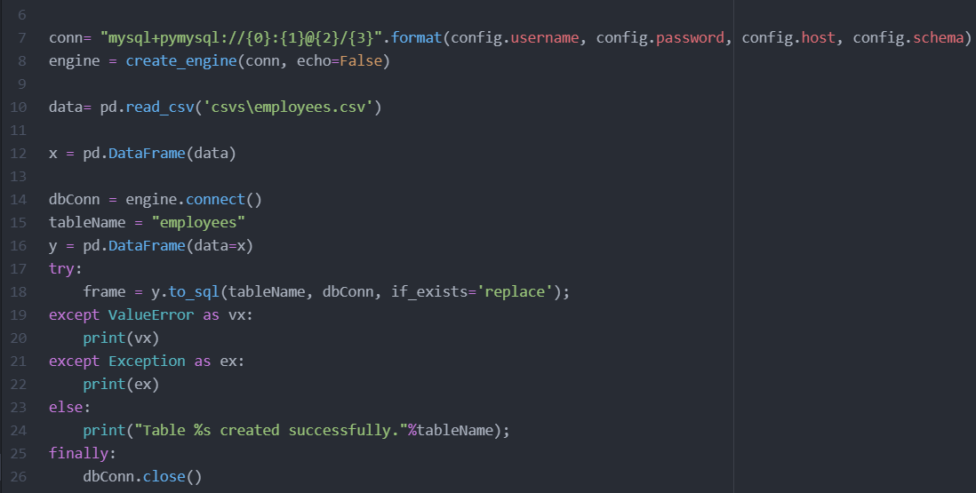
Handling of Historic Data
MySQL storage
CSV Sheets:
After conversion to CSV the contents of historical tables and sales were sent to to MySQL through the use of pandas data frames.​
Notes:
How I uploaded my csv historic information into MySQL

Slide 9
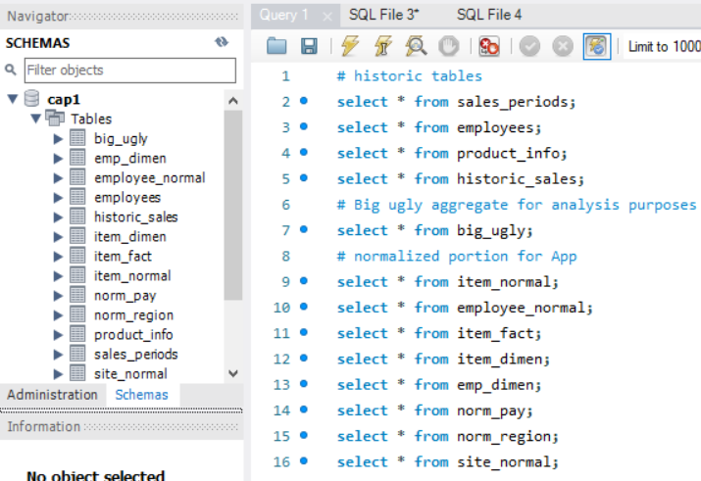
Tables in Database
Notes:
A Workbench overview of tables in MySQL

Slide 10
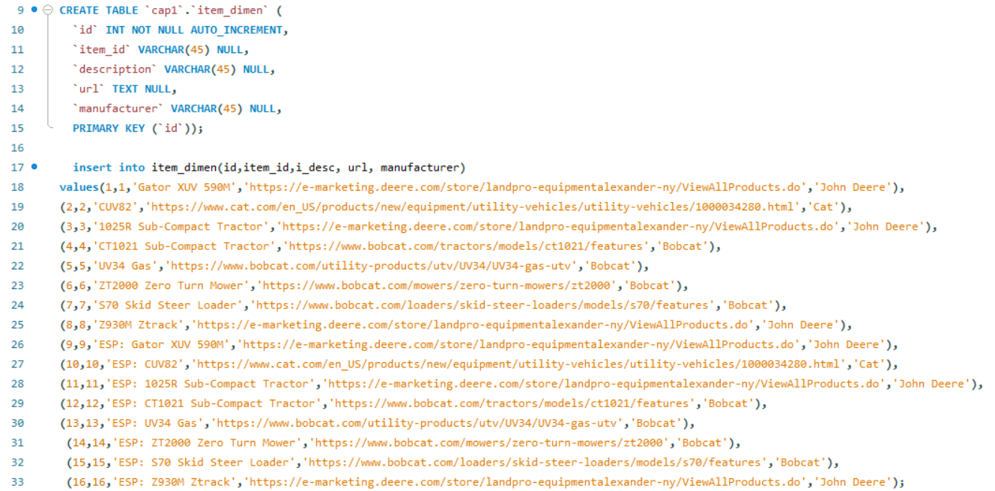
SQL use
Create and fill a table with data
Notes:
An example of SQL use in creating a item_dimensions table

Slide 11
Thank You

