Slide 1

Capstone 2
InformatiTEK Data Visualization Project
Presented by: Andrew Korenak
3/31/2022
Notes:
Hello, and welcome to capstone 2, InformatiTek data visualization project.
(Next slide).

Slide 2
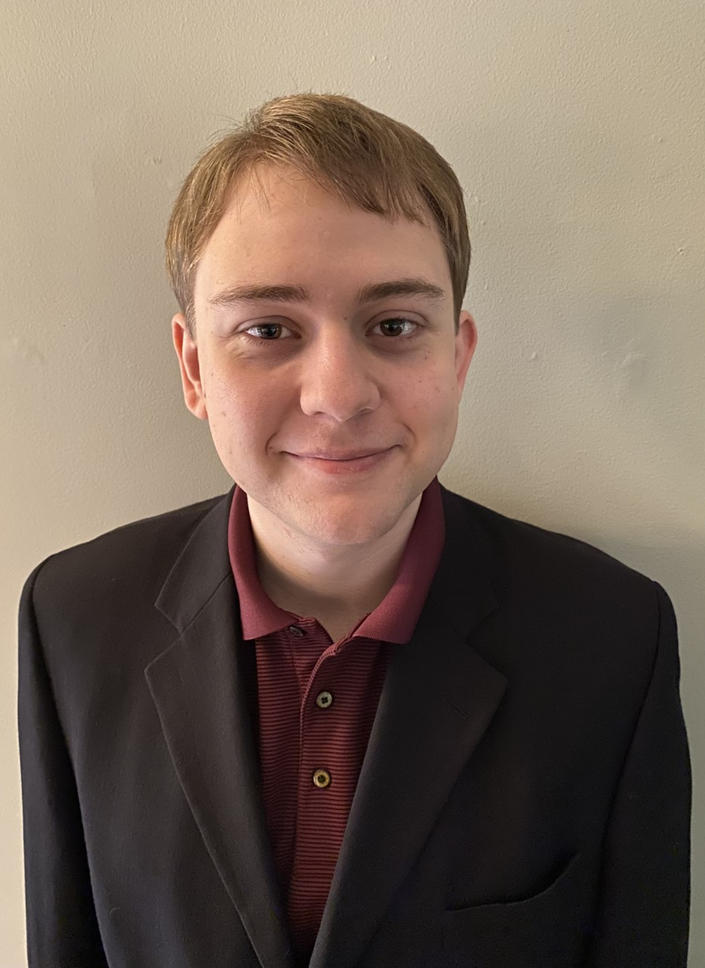
InformiTEK Data Vis.
Web App: Admin Submission Dashboard
Unique Dataset
EEG (Electroencephalogram)
“Brainwaves”
De-mystifying and Simplifying
Boil it Down
Pick Focus Carefully.
Hello, My name is Andrew.
Notes:
In the prompt a unique and individually complete visualization was requested to add to a portfolio for InformiTEK . My submission to the data viz portfolio is a unique dataset dealing with EEG or Electro Encephalo Gram data. In layman's terms electrical activity of the brain or “brainwaves”.
With EEG data it would be easy to deliver complex or confusing visualizations that looked great, but revealed very little. However, to appeal to a wider audience or one with little to no knowledge one must be able to boil things down and pick an area to focus on to provide simplicity.
(next slide)

Slide 3
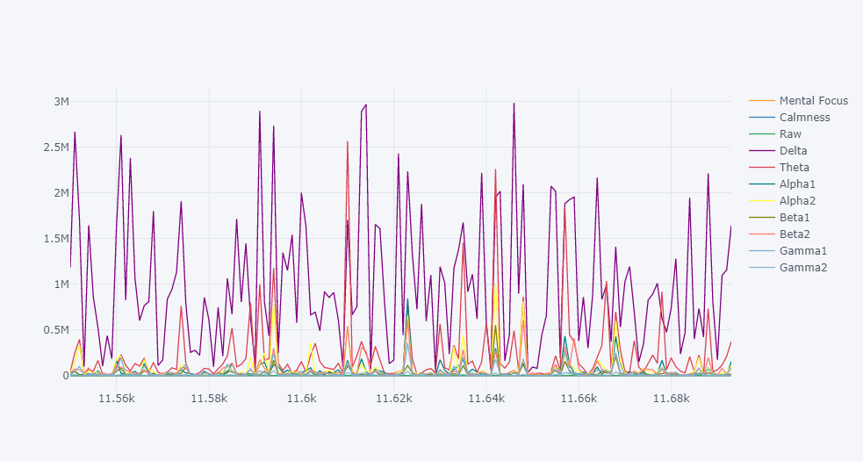
Not This
How to use this template
There are many layout options you can use for each of your slides
Slides 5-13 are layout templates. They state the font colors and styles to use.
Suggest copying and pasting the slide you want and then modifying
Slide 14 is a divider if you wanted to have sections to your presentation
After you are done creating your presentation, delete any unused slides
Notes:
So I will skip past the more incomprehensible graphs like this.
(Next Slide)

Slide 4
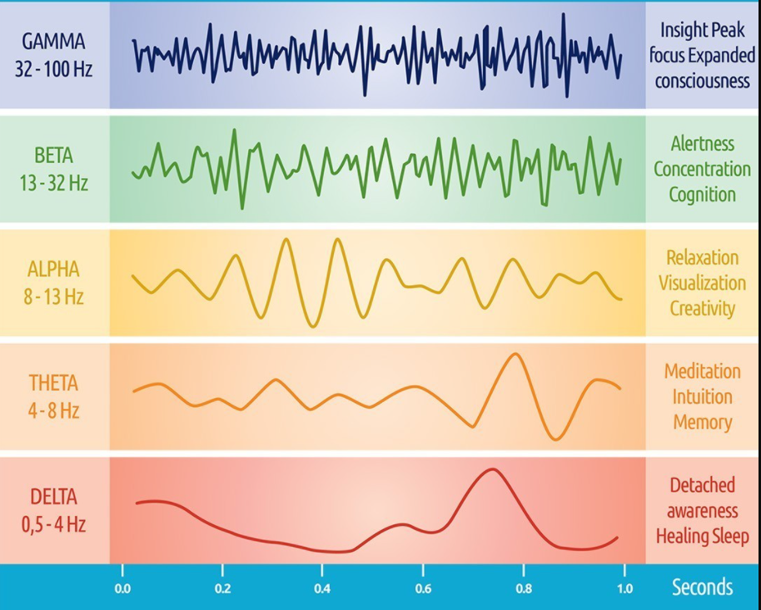
Not This Either
Notes:
Or trying to force you all to learn the concepts at an accelerated pace. Even though this visual actually does a decent job at simplification.
(Next Slide)

Slide 5
The Simplification
Boling it down and picking the focus
Was the Subject Confused?
True (Confused).
False (Not Confused).
Alpha1 Alpha2 Beta1 Beta2…
Mental Focus
Calmness
Notes:
Keeping the medical terminology to a minimal we will instead focus on Whether or not the subject was confused, and their levels of mental focus and calmness which are derived from the otherwise confusing measures of raw brainwave data.

Slide 6
The Study Behind the Dataset
Subjects
Videos
Sampling
Notes:
The study consists of 10 college students and the data collected by sensor headwear. They were tasked with watching videos on topics they were both familiar with and videos on topics they were unfamiliar with. All of these videos started half way through, in an attempt to facilitate confusion in those that the subject was unfamiliar with. The brainwaves of each student was sampled and recorded every half second with only a minute of each being recorded in the data table. This means our 12,000 row table is really broken down into 100 combinations of subject ID and video ID consisting of 120 rows each.

Slide 7
The Data
Analysis and Cleanup
Analysis Tools
Juypter Notebook
Pandas
Plotly
Seaborn
Matplotlib
Sklearn
Final Cleanup and Formatting
Power Query
Notes:
I initially ran some basic analysis on my data set though the use of several python libraries in a Notebook environment. This analysis helped me identify data quality, avoid future impediments by making corrections, test assumptions, and even run some basic machine learning models for binary classification.
However, in the end the final work to prepare the data for visualization in Power BI was done through Power Query.

Slide 8
The Planning Process
Potential for Changing Requirements
Rubric
Understanding
New Ideas
Reactiveness
Agile-Like Methods
Iterative Process
Notes:
In planning for the project I knew there may be change involved. The potential that requirements may change part way through, due to either a change in the rubric, increased understanding of a concept, or new ideas that could be incorporated into the project.
To address that I needed a flexible method of development in which a change in requirements could be responded to in a rapid and effective manner.
While this was not a team project, I still decided that a agile-like approach would be superior to something like a waterfall method.
I knew my first pass would be massively different from my final pass, so I allowed myself to work and plan in an iterative manner to enable identification of changes in scope, parts of the project that needed fine tuning, or areas that had not yet been addressed by my initial plans.

Slide 9
Live Demo
Power BI
Notes:
With that we will move on to the dashboard.

Slide 10
Thank You
Q&A

