Slide 1
ROOKIES
Team Members:
ABHISHEK KORI
ARVIND JHA
SHREYASH DHAKE
SPARSH THAKUR
TARUN CHANDNANI

Slide 2

PROBLEM STATEMENT
COMPARING ALL THE FACTORS THAT MAKES THE DIFFERENCE (IN LITERACY RATE) BETWEEN KERALA AND BIHAR.
MEASURES TO IMPROVE THE FEMALE LITERACY RATE AND LITERACY RATE IN RURAL AREAS.

Slide 3
SOLUTION OVERVIEW
Incentivize children at every level from primary to higher secondary.
Bringing in online platforms for primary education to area not accessible to schools.
Running awareness campaign across India ranging from rural to urban population.
For Females Exclusively
Increase no. of girl's toilet in schools.
Increase no. of female faculty at all levels.
Organizing regular interactive session with parents of children.

Slide 4
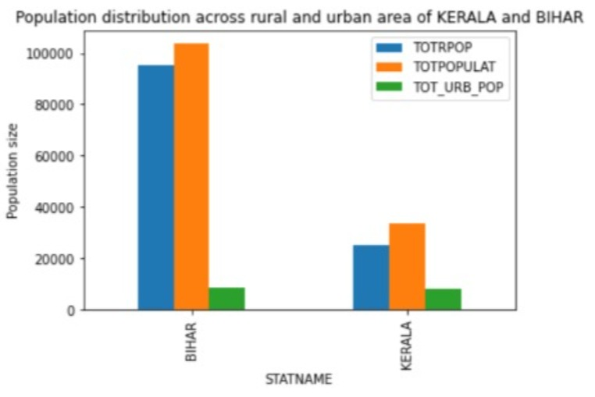
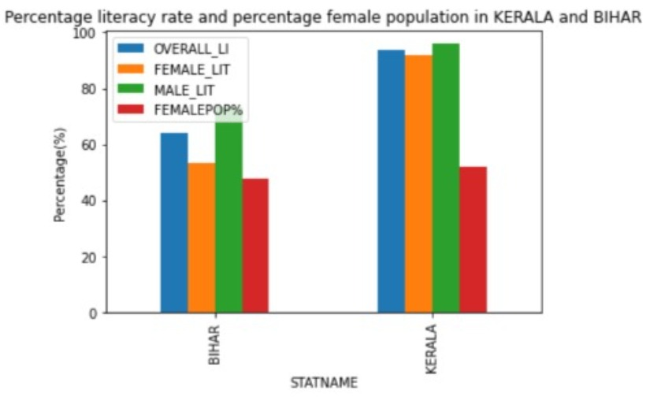
DETAILED WORKING
Total population count in BIHAR much higher than KERALA
*Solutions*
Population control measure.
Running awareness campaign.
KERALA has much higher literacy rate and better FEMALE Population percentage as compared to BIHAR
*Suggestion*
Measure to control female feticide and increase female enrollment in school
Increase more female faculty
Introduce female toilets in every school

Slide 5
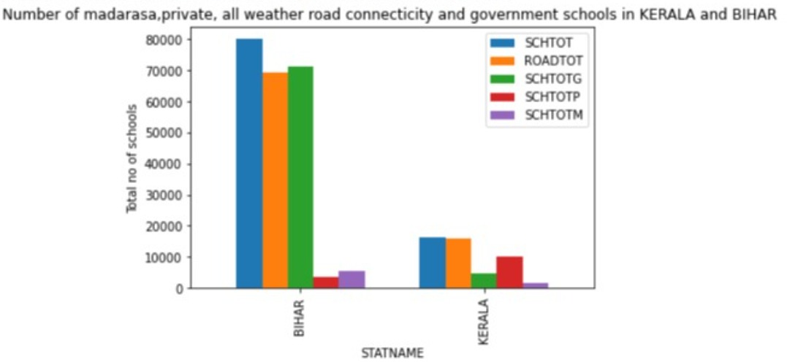

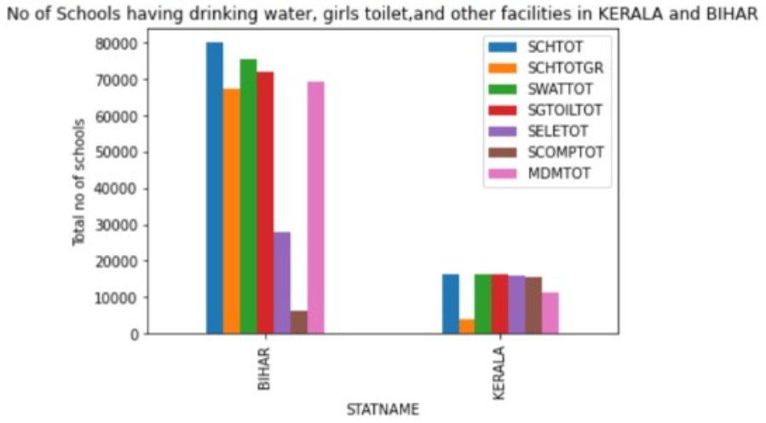
School in BIHAR having less all whether road connectivity as compared to KERALA.
Solution :
I) Increase all whether road connectivity
ii) Share of total private school in KERALA much higher as compared to BIHAR. Solutions: Allow and encourage to open private school in BIHAR
Number of school having drinking water, electricity, girl's toilet, computer and mid-day meals availability in BIHAR is less as compared to KERALA.
Solutions:
Increase number of school having
Girl's toilet
Drinking water
Mid-day meal
Computer literacy
Electricity

Slide 6
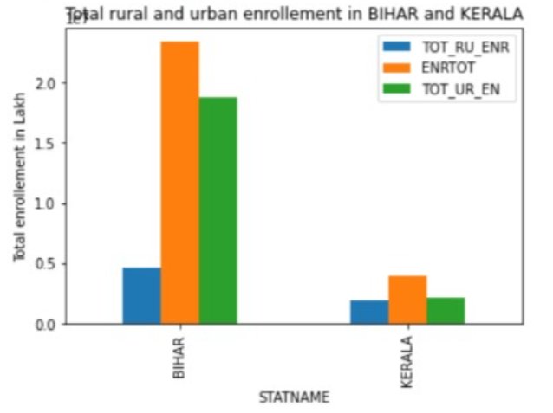
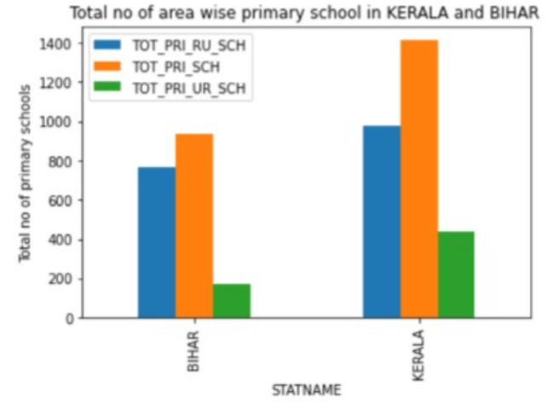
Total rural enrollment in Bihar is very less as compared to KERELA
*Solutions:*
Incentivize kids at every level
Bring in more technology
Efficient functioning of the already present schools
Increase the number of schools and teachers
Area wise total proportionate primary school in BIHAR is much less as compared to KERALA
*Solutions:*
Implement technology to indulge maximum end-user
Efficient use of the funds already available

Slide 7
UNIQUENESS OF SOLUTION
Thorough scrutiny across all parameters.
Identifying major pain points and giving specific solution for each of them.
Visualization of data through various chart to understand the root cause.

