Slide 1


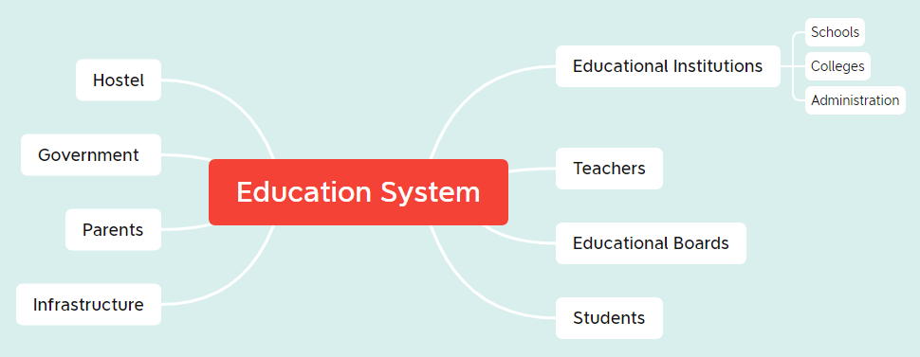
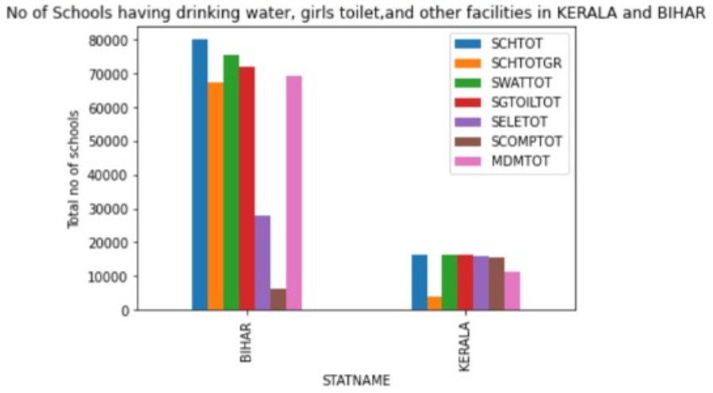
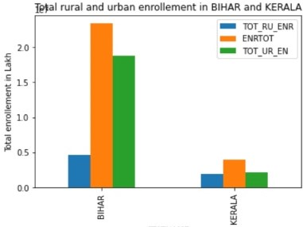

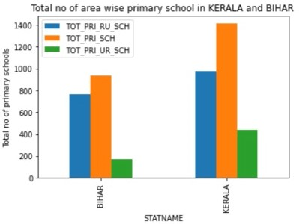
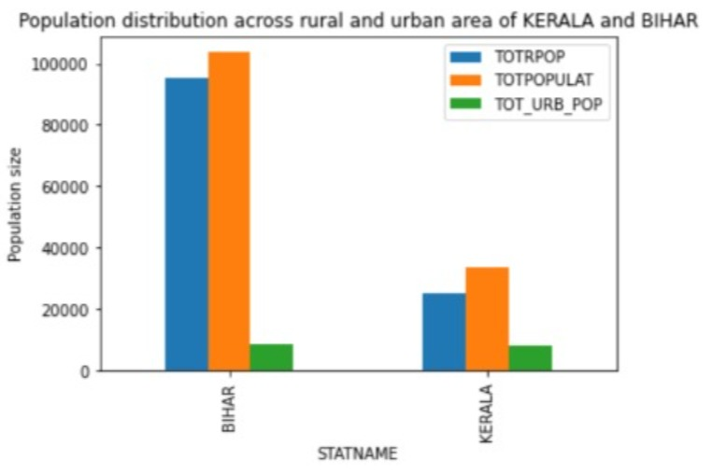
Education System in India
Questions:
What are all the factors that makes the difference (in literacy rate) between Kerala and Bihar?
What could be done to improve the female literacy rate and literacy rate in rural area?
Track Name: Analytics using Python
Team Name: Rookies
Team Group Pic
Insights Garnered:
Population of Bihar is more as compared to Kerela even then Kerela has much higher literacy rate and better female literacy number
1)Total rural enrollment in Bihar is very less while in KERALA it is proportional
2) Number of schools in proportion to population is very less in Bihar
Solutions:
1) Providing midday meals
2) Providing better infrastructure especially better washrooms for female students
3) Providing better connectivity to schools

