Slide 1
BBA/MBA Student Data Analytics
HiGen Labs — Data Analytics Assessment
Samaksh Kori
BSc Computer Science, Hansraj College, University of Delhi

Slide 2
Objective & Data Collection Method
Objective
Collection Method
Collect BBA/MBA student data from public sources
Clean and standardize the dataset
Run exploratory analysis & visualize trends
Report insights and employability recommendations
Apify Google Search Scraper queried for public LinkedIn profiles (BBA/MBA students, India)
API/credit limits hit mid-collection → only a partial set of live leads returned
Realistic synthetic records generated to reach analysis-ready volume
Disclosed openly in the written report (see Limitations)

Slide 3
Dataset Overview
932
10
64.4%
35.6%
Cleaned Records
Data Fields
MBA Students
BBA Students
Fields collected: Student Name, College/University, Degree, Specialization, Graduation Year, Location, Skills, Certifications, Internship Experience, LinkedIn Profile URL.
Cleaning steps: removed duplicates (LinkedIn URL key), dropped rows missing name/college, standardized college names & skill vocabulary, filled non-critical blanks with sensible defaults.

Slide 4
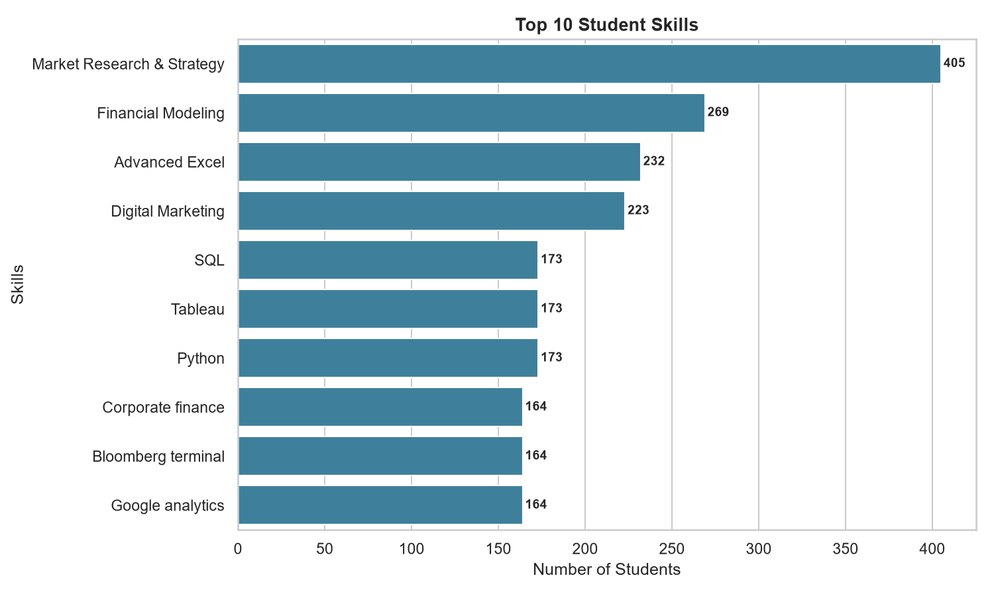
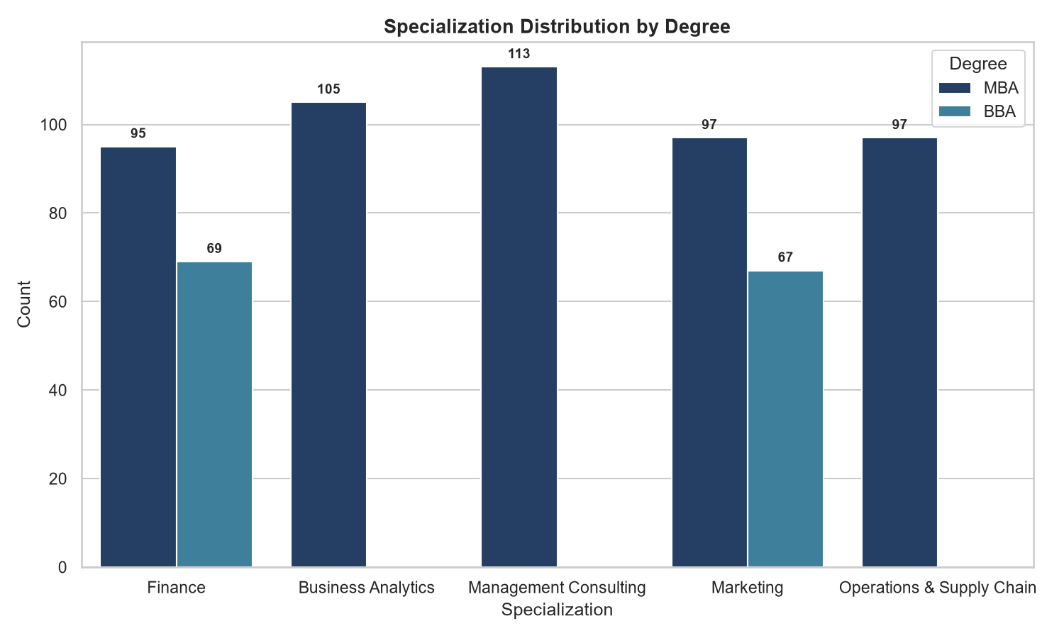
Top Skills & Specializations

Slide 5
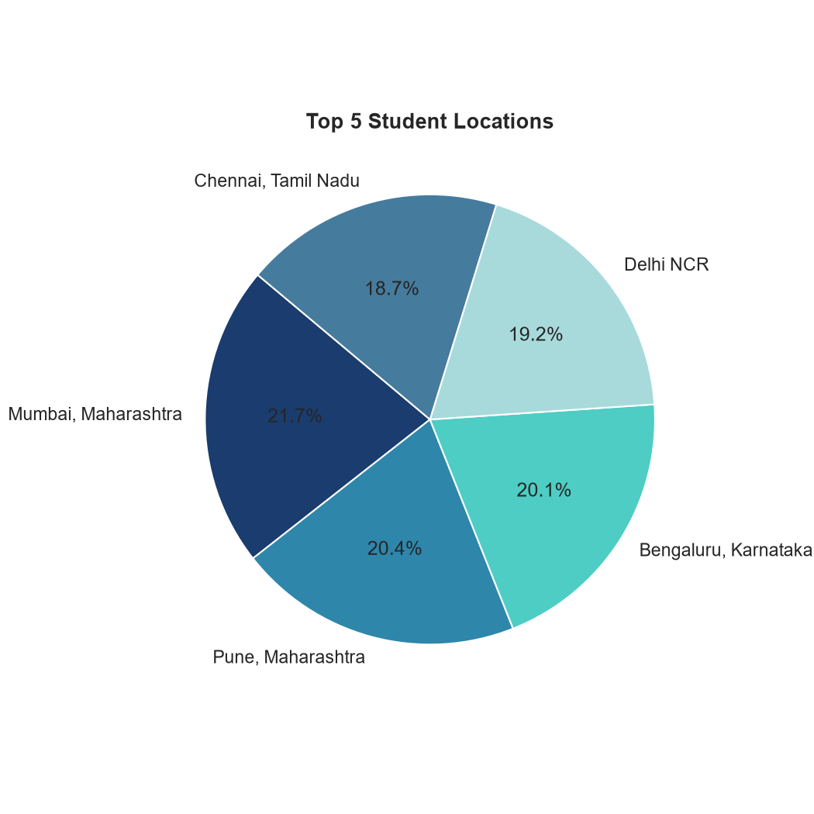
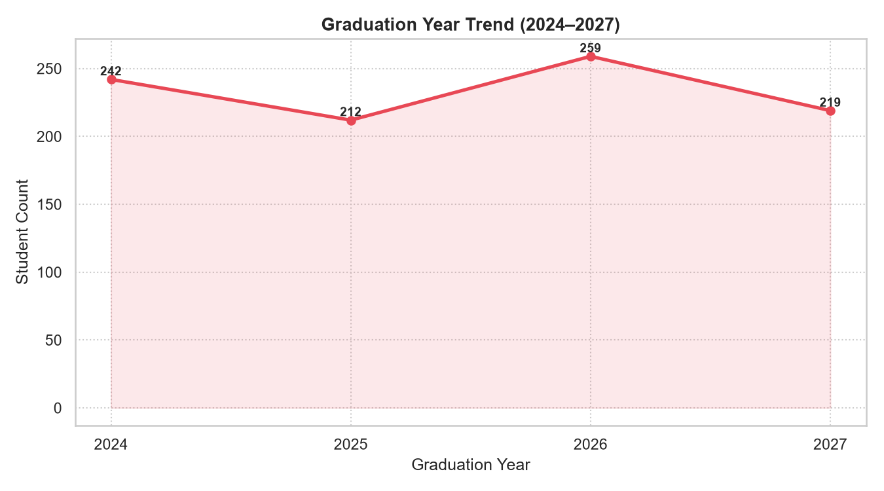
Location & Graduation Year Trend

Slide 6
Key Findings
Market Research & Strategy and Financial Modeling are the leading skills; SQL/Python/Tableau form a smaller, even analytics base.
Finance & Marketing are the most broadly popular specializations; Consulting and Business Analytics skew almost entirely MBA.
Students are spread fairly evenly across Mumbai, Pune, Bengaluru, Delhi NCR & Chennai — no single dominant hub.
Internship & certification activity is near-universal in this dataset — a baseline expectation, not a differentiator.

Slide 7
Recommendations for Employability
1
Go deep on one analytics tool (SQL, Python or Tableau) instead of staying surface-level across many.
2
Encourage BBA students into Business Analytics & Operations — currently MBA-dominated specializations.
3
Focus on internship quality (brand, duration, ownership) since having an internship is now standard.
4
Pick one relevant, recognized certification aligned to target specialization rather than several generic ones.
Note: dataset includes synthetic fill-records due to API limits hit during live scraping — see report for full disclosure.

