Slide 1
Comprehensive Digital Marketing Project phase 2
TEAM ID :- LTVIP2023TMID10382
TEAM LEADER :- KORIKANA SIRISHA
TEAM MEMBERS :-KONADA JOSHNA
KONDAGORRI MADHURI
KONDALA DEVI
KUNA SOWJANYA

Slide 2
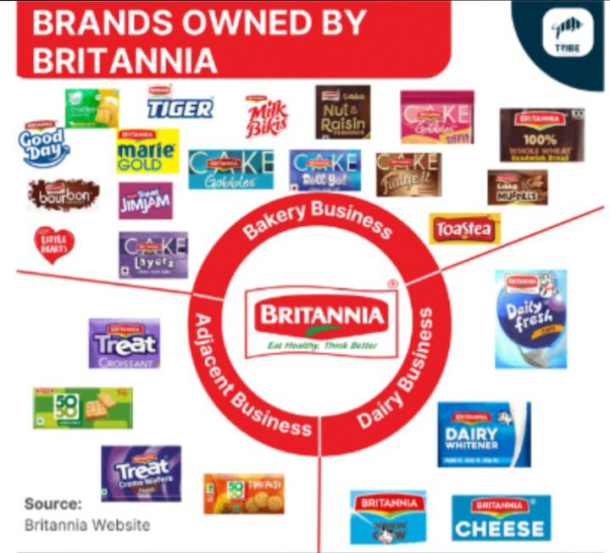
Brand :- Britannia

Slide 3
Part1: Brand Study, Competitor Analysis & Buyer’s/ Audience’s Persona

Slide 4
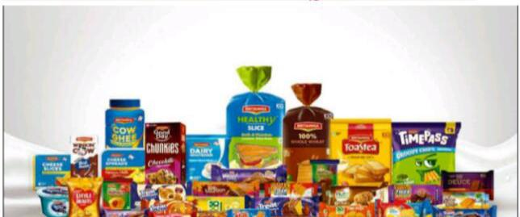
Brand Study

Slide 5
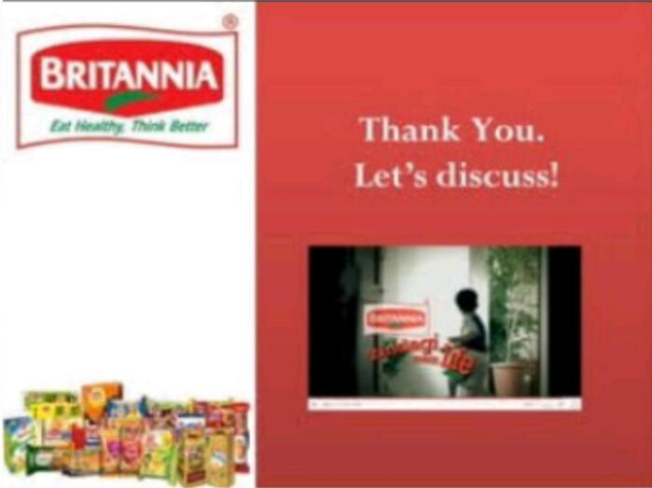
Research Brand
Britannia industries Limited is an Indian food company founded in 1892, known for its wide range of products including biscuits, bread, cakes, dairy, and snacks. It's a prominent player in the Indian food industry, with a strong emphasis on quality and innovation. The brand also engages in CSR initiatives and has shown an interest in sustainability practices.

Slide 6
Mission /Values
Britannia Industries Limited is an Indian food-products corporation. Its mission and values may have evolved since then, but based on the information available up until that time, Britannia's mission was generally focused on providing high-quality, nutritious, and affordable food products to its consumers.
Some of the core values that Britannia emphasized included:
1. Consumer-Centricity: Placing the needs and preferences of consumers at the forefront of their business operations.
2. Integrity: Upholding ethical and transparent business practices in all aspects of their operations.
3. Innovation: Commitment to continuous improvement and development of new and better products.
4. Quality: Ensuring that their products meet high standards of quality and safety.

Slide 7
USP of Britannia Brand
Britannia's Unique Selling Proposition (USP) lies in several key areas:
Heritage and Trust: Britannia has a long-standing history and heritage in the Indian market, which has built a strong foundation of trust among consumers.
Product Range: They offer a wide range of products spanning various categories like biscuits, cakes, bread, dairy, and more, catering to diverse consumer preferences.
Quality Assurance: Britannia is known for its commitment to maintaining high-quality standards in its products, ensuring consumer satisfaction and safety.
Innovation: The company has a track record of introducing innovative products and flavors, which keeps consumers engaged and interested in theirofferings
.Nutritionall Focus: Britannia has made efforts to promote healthier eating habits by introducing products with added nutritional benefits, catering to health-conscious consumers.
Affordability: They offer a range of products at different price points, making them accessible to a wide spectrum of consumers.
Market Presence: Britannia has a strong distribution network, ensuring that their products are widely available across the country.

Slide 8
Analyze Brand Tone and Identity
Brand Tone:
Britannia's brand tone can be analyzed as follows:
Reliable and Trustworthy: Britannia's tone exudes reliability and trust. With a long history in the Indian market, it has built a reputation for providing quality products that consumers can depend on.
Approachable: The brand communicates in a friendly and approachable manner. Its messaging aims to resonate with a wide audience, from children to adults.
Innovative: Britannia projects an innovative spirit, often introducing new products and flavors to keep up with evolving consumer preferences.
Nutrition-Focused: The brand emphasizes health and nutrition, especially in recent years. It promotes products that cater to the growing demand for healthier eating options.

Slide 9
Brand Identity:
Britannia's brand identity can be analyzed as follows:
Heritage and Tradition: This heritage is often visible in its packaging and marketing materials, evoking a sense of tradition and trustworthiness.
Color Palette: The brand typically uses a vibrant color palette in its packaging, which can vary depending on the product line. Bright colors like red and yellow are common, conveying energy.
Logo: The iconic Britannia logo features the image of a lion holding a cocoa twig. This symbolizes strength, pride, and the company's association with quality cocoa products.
Product Range: Britannia's diverse range of products, including biscuits, cakes, bread, dairy, and more, reflects its commitment to catering to various consumer preferences.
Slogan: "Eat Healthy, Think Better" - This slogan reflects Britannia's emphasis on providing nutritious food options that contribute to overall well-being and cognitive health.

Slide 10
Smart Goals and KPI of Britannia Brand
The five SMART goals and their corresponding KPIs for the Britannia brand:
1.Goal: Increase Market Share
KPIs: Market Share Percentage, Growth in Market Share, Customer Acquisition Rate
2.Goal: Enhance Brand Awareness
KPIs: Brand Awareness Score, Website Traffic and Engagement, Social Media Reach and Engagement
3.Goal: Improve Customer Satisfaction
KPIs: Customer Satisfaction Scores (CSAT), Net Promoter Score (NPS), Customer Retention Rate
4.Goal: Expand Product Line
KPIs: Number of New Product Lines Introduced, Sales Revenue from New Product Lines, Customer Adoption Rate for New Products
5.Goal: Improve Sustainability Practices
KPIs: Carbon Emission Reduction Percentage, Sustainable Packaging Usage Percentage, Waste Reduction Percentage.

Slide 11

Buyer's/ Audience's Persona

Slide 12
The target audience for the Britannia brand encompasses a diverse group of consumers. This includes:
1. Age Group
2. Demographics
3. Psychographics
4. Behaviors
5. Interests

Slide 13
1. Age Group:
* Primary focus on children, adolescents, and young adults (5-35 years old).
* Secondary appeal to older adults seeking trusted, nostalgic brands.
2. Demographics:
* Gender: Both male and female.
* Income: Middle to upper-middle class, with some products catering to a broader range.
3. Psychographics:
* Lifestyle: Individuals with active, dynamic lifestyles, seeking quick and convenient snack solutions.
* Values: Those who appreciate quality, trust, and reliability in their food choices.

Slide 14
4.Behaviors:
* Brand Loyalty: Customers who value brand reputation and have a history of purchasing Britannia products.
* Impulse Buyers: Products designed to cater to impulse purchases in supermarkets and convenience stores.
5. Interests:
Nutritional value, convenience, and versatility in breakfast choices.
Taste, convenience, affordability, and variety in snacking options.

Slide 15
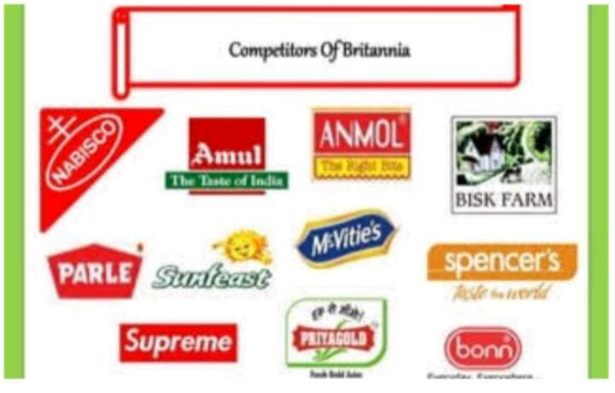
Competitor Analysis

Slide 16
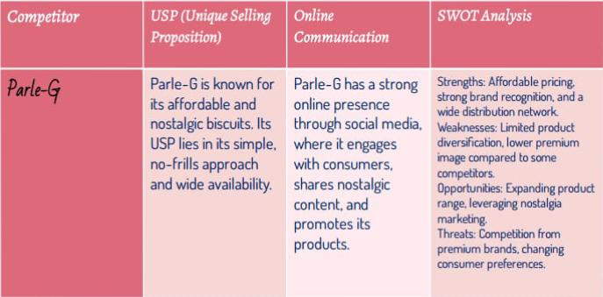

Slide 17
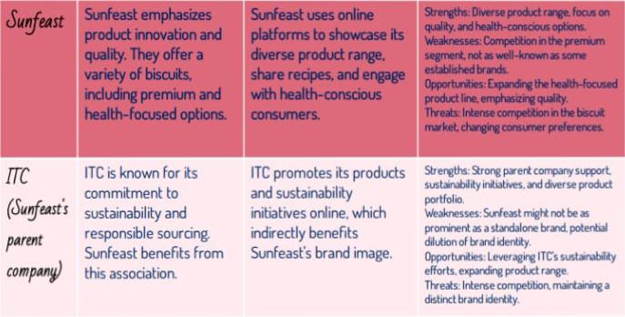

Slide 18
Part 2: SEO & Keyword Research

Slide 19
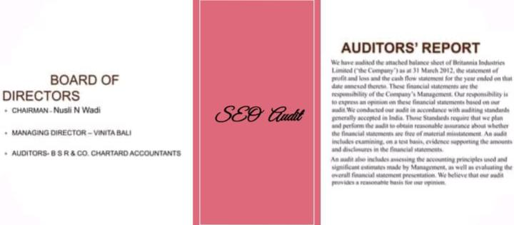

Slide 20


Slide 21
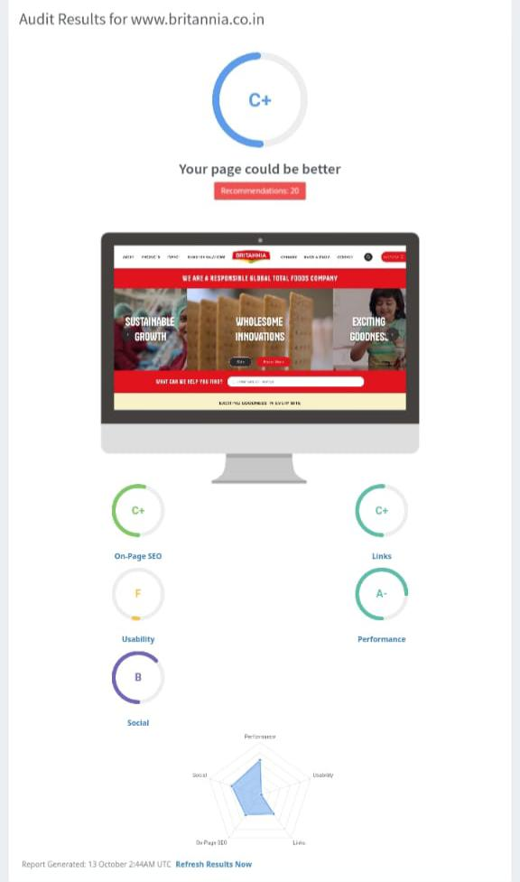

Slide 22
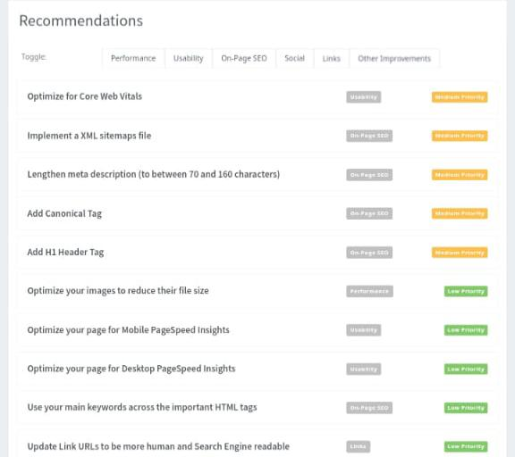

Slide 23
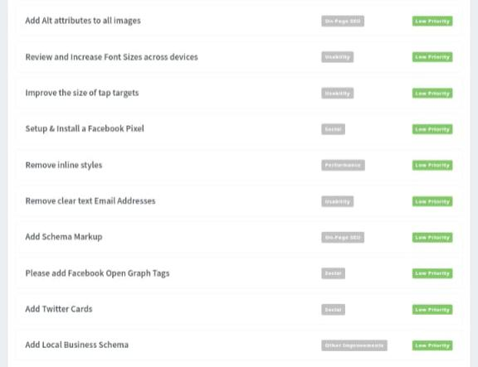

Slide 24
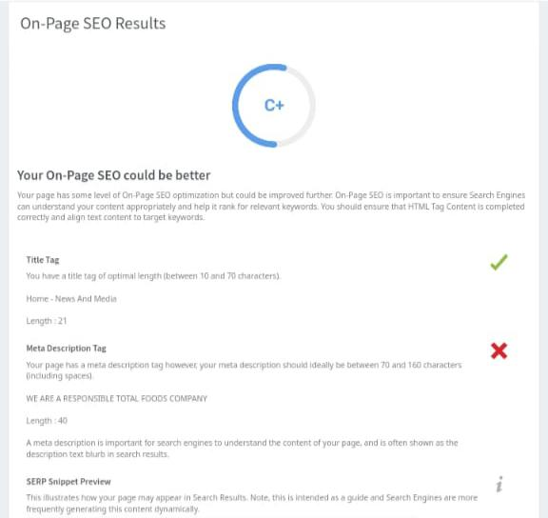
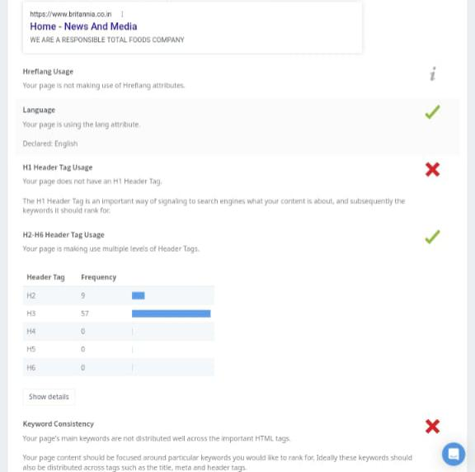

Slide 25
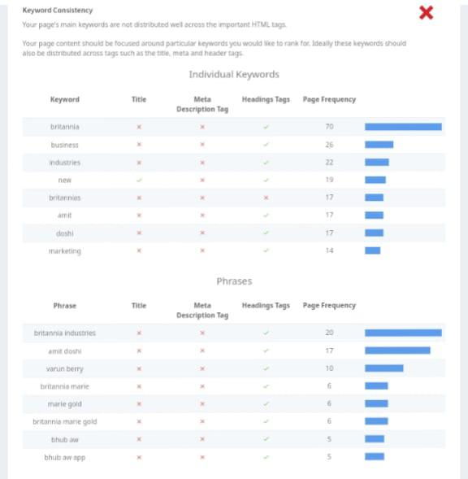
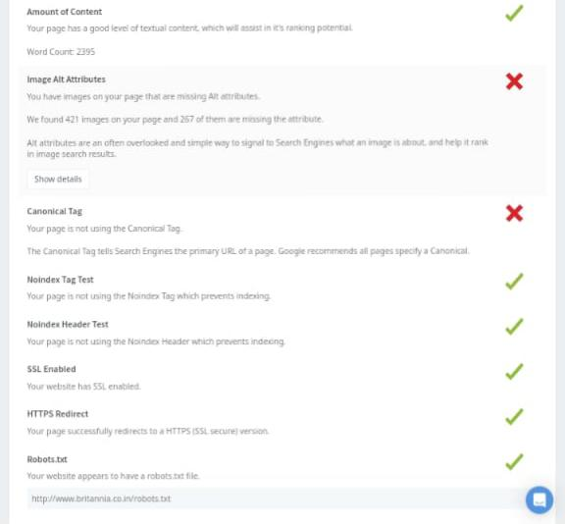

Slide 26


Slide 27
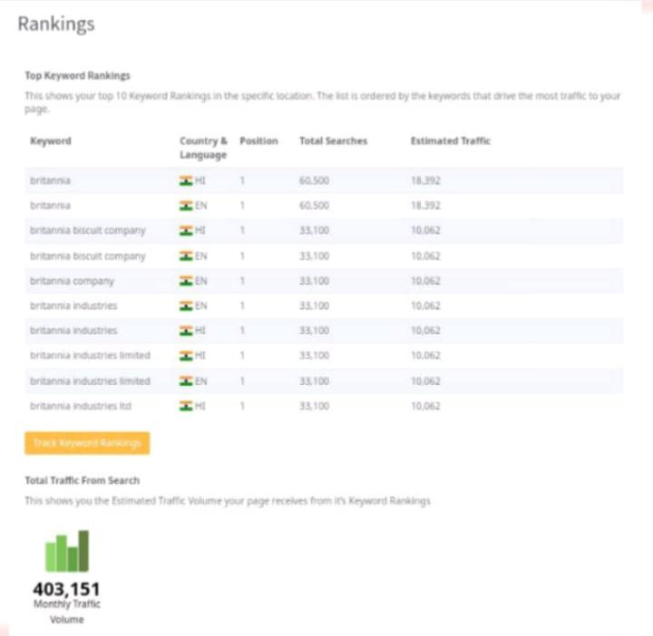
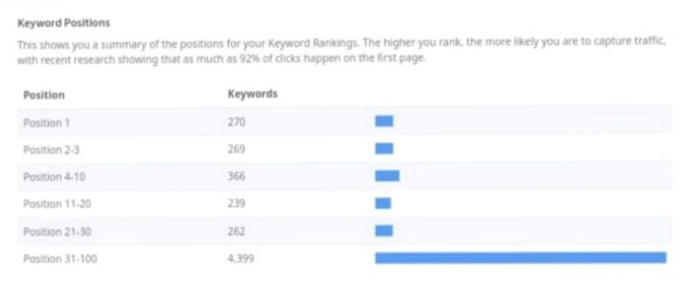

Slide 28


Slide 29
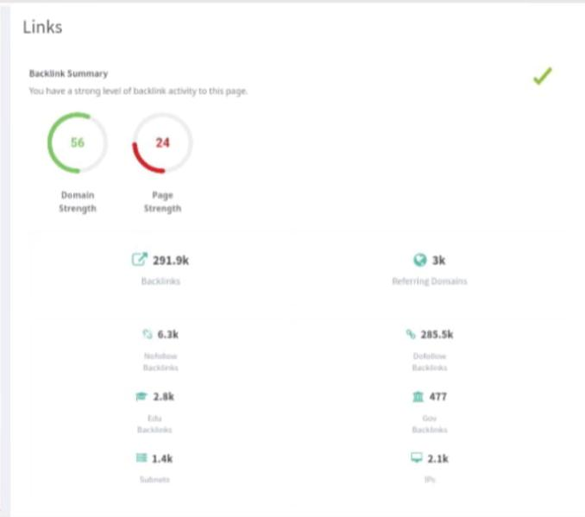
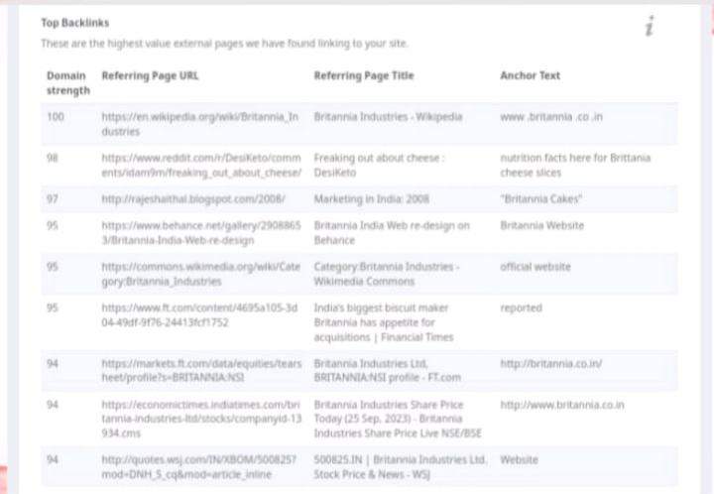

Slide 30
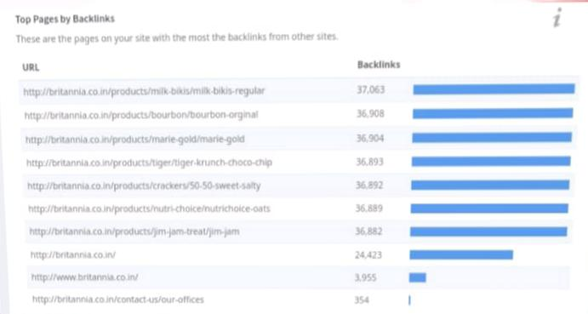
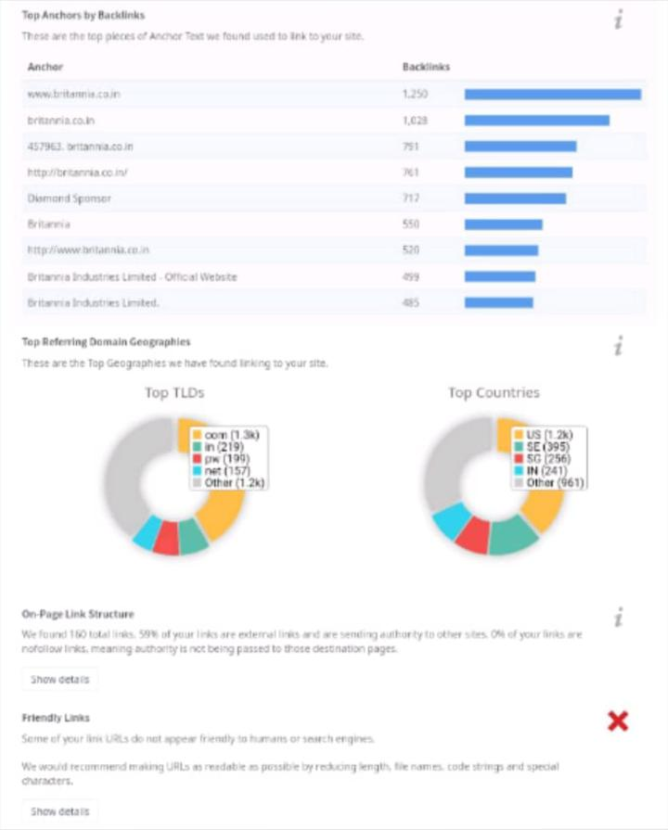

Slide 31


Slide 32
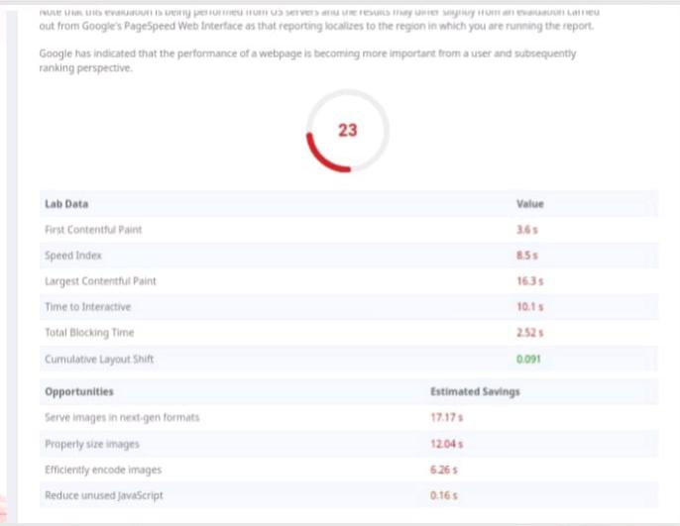
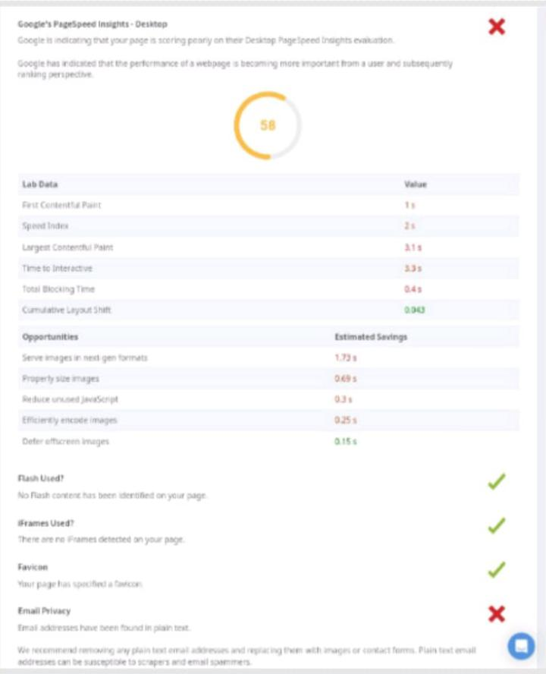

Slide 33
Keyword Research

Slide 34
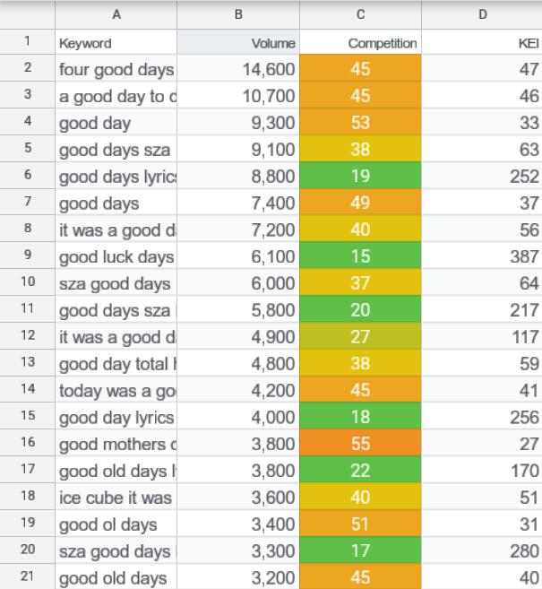

Slide 35


Slide 36
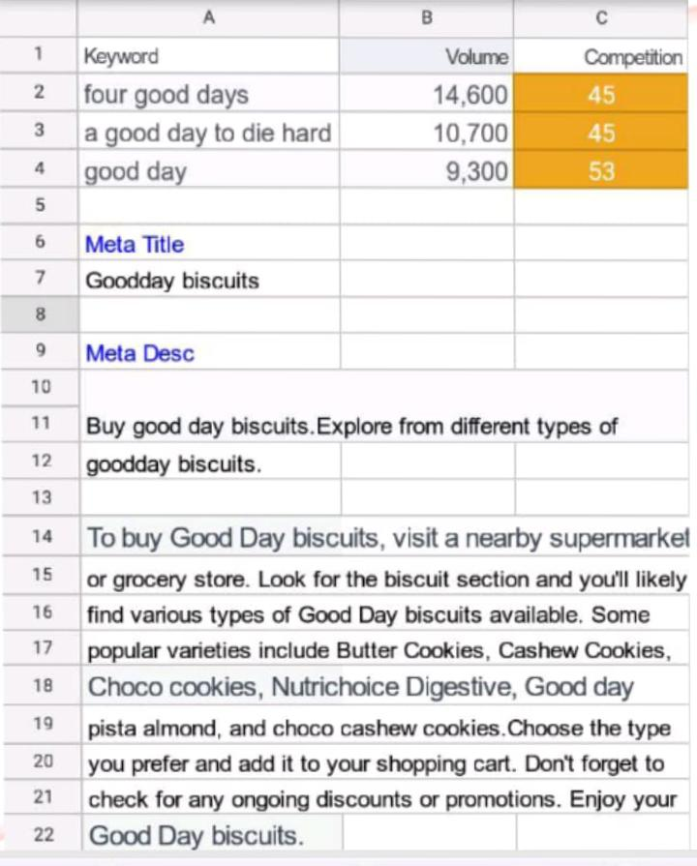
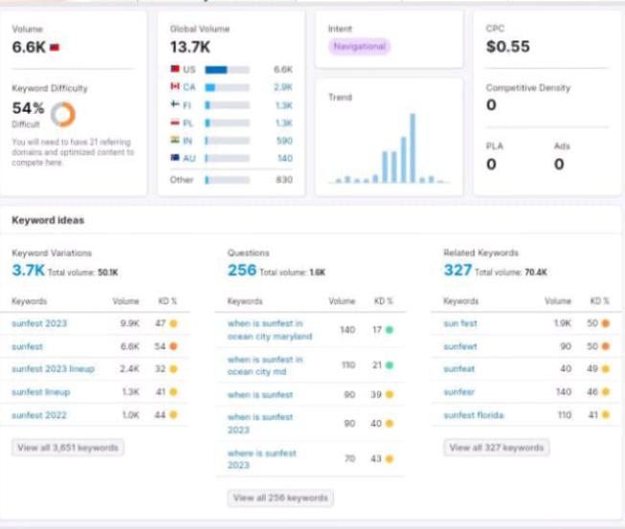

Slide 37
part3 : Content Idea and Market Strategies

Slide 38
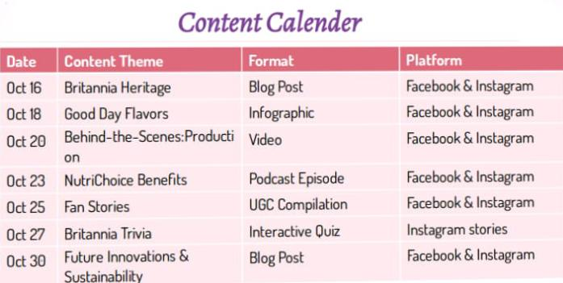

Slide 39
Content Ideas and Marketing Strategies
The Britannia brand's content and marketing journey highlighted the importance of diversity in content, from history to culture.
Challenges included finding the right balance between depth and accessibility.
Adapting to social media algorithm changes and maintaining consistent engagement proved challenging.
Lessons learned: prioritize data-driven decisions, foster community engagement, and remain adaptable to changes in the digital landscape.

Slide 40
Part3 : Content Creation and Curation

Slide 41

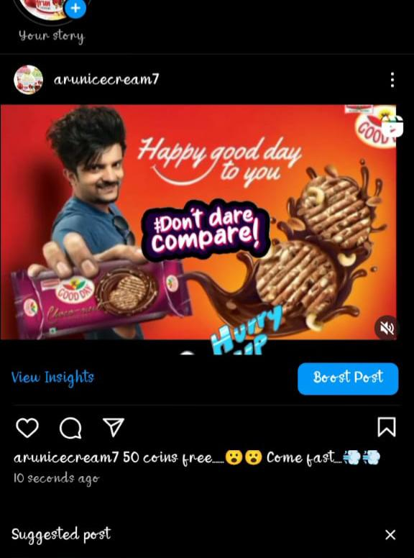
Format 1: Recipe Videos
Content Idea: Britannia Good Day Cookie Ice Cream Sandwich Recipe
Caption: 🍪 Beat the heat with this delightful treat! Try our Britannia Good Day Cookie Ice Cream Sandwich recipe. It's a perfect blend of crunch and creaminess. Swipe left for step-by-step instructions. #BritanniaRecipes #GoodDayDelights
CTA: "Tag a friend you'd share this delicious treat with and let us know how yours turned out! 🍦🍪"

Slide 42
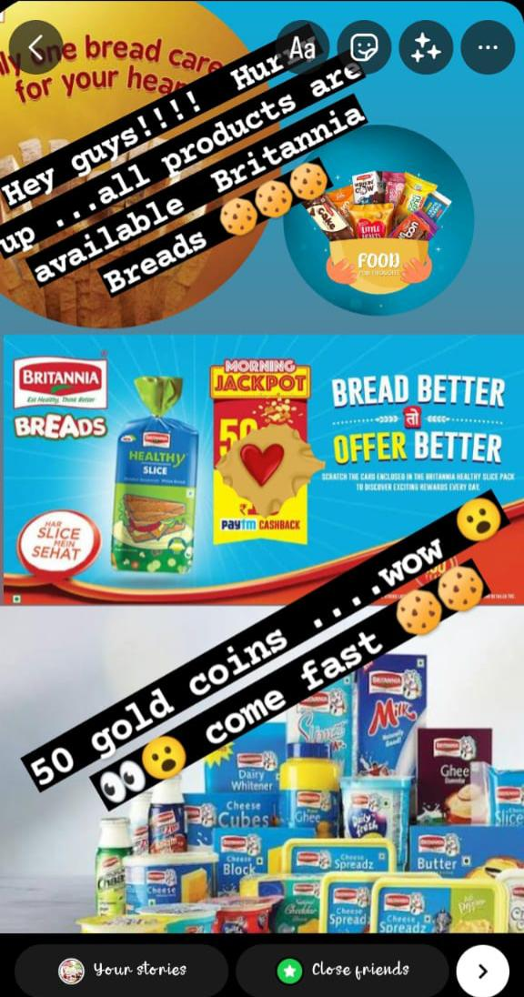
Format 2: Product Spotlight
Content Idea: Britannia NutriChoice Digestive Biscuits - Healthy Snacking
Caption: 💪 Boost your daily nutrition with Britannia NutriChoice Digestive Biscuits! Packed with fiber and essential nutrients, they make for a guilt-free snack option. Discover more about the health benefits below. #HealthySnacking #NutriChoice
CTA: "Swipe left to learn why our Digestive Biscuits should be a part of your daily routine! Have you tried them yet? Share your thoughts! 🌾"

Slide 43
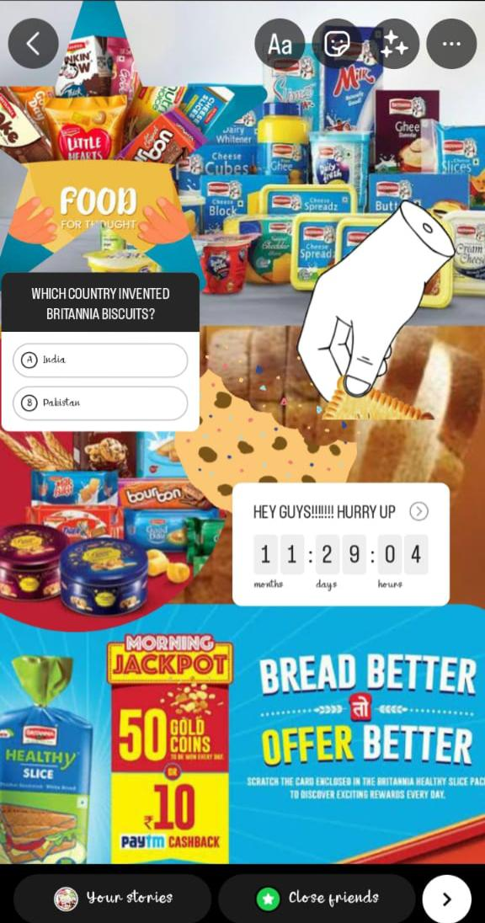
Format 3: Interactive Polls/Quizzes
Content Idea: Pick Your Favorite Britannia Cake Flavor!
Caption: 🍰 It's time for a sweet showdown! Cast your vote for the ultimate Britannia Cake flavor. Swipe left to choose, and let's see which one comes out on top! #BritanniaFavorites #CakeWars
CTA: "Vote now and comment below with your all-time favorite cake flavor! Did your pick win the race? 🎂"

Slide 44


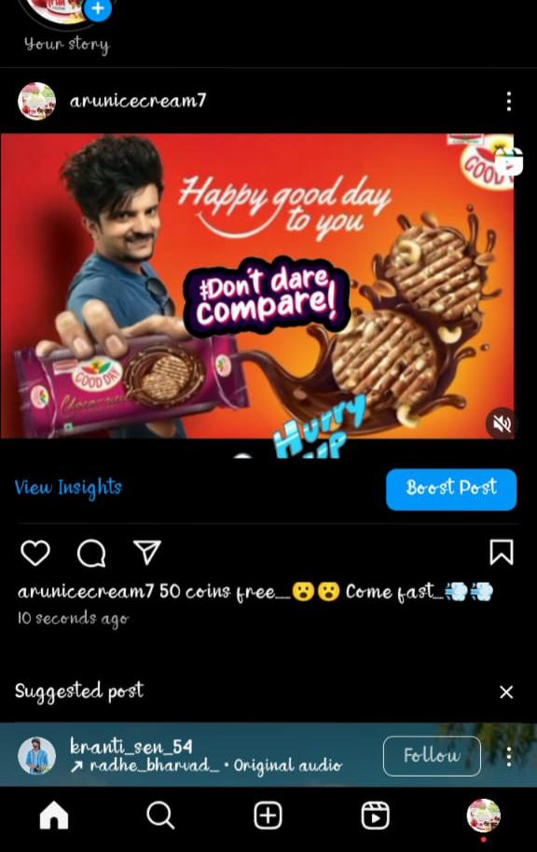
Link for Britannia reel:-
https://www.instagram.com/s/aG lnaGxpZ2h0OjE4MDI2MjUzMzUyNjc4MjE5?story_media_id=3212703474005602818_62409136794&igshid=MzRlODBiNWFlZA==
Link for Britannia story :- https://instagram.com/stories/arunicecream7/3212703474005602818?igshid=MTc4MmM1YmI2Ng==

Slide 45


