Slide 1

BANK LOAN
CASE STUDY

Slide 2

DESCRIPTION:
Imagine you're a data analyst at a finance company that specializes in lending various types of loans to urban customers. Your company faces a challenge: some customers who don't have a sufficient credit history take advantage of this and default on their loans. Your task is to use Exploratory Data Analysis (EDA) to analyze patterns in the data and ensure that capable applicants are not rejected.
WHEN A CUSTOMER APPLIES FOR A LOAN, YOUR COMPANY FACES TWO RISKS:
If the applicant can repay the loan but is not approved, the company loses business.
If the applicant cannot repay the loan and is approved, the company faces a financial loss.

Slide 3
APPROACH:
To analyze a bank loan case study, start by understanding the objective, which is to identify factors influencing loan approval and develop a predictive model. Collect historical loan application data, including customer demographics, loan details, and credit history. Perform data exploration and cleaning to handle missing values, correct inconsistencies, and remove outliers. Conduct exploratory data analysis (EDA) to uncover patterns and relationships between variables. Use statistical techniques and visualizations to identify key factors affecting loan approval. Finally, build and evaluate predictive models using machine learning algorithms, selecting the best-performing model for deployment.
TECH-STACK USED:
Microsoft Excel 2022: Used for data manipulation, analysis, and calculation of descriptive statistics.

Slide 4
INSIGHTS:
Customer Demographics: Income level and employment status significantly impact loan approval rates.
Loan Details: Higher loan amounts and longer terms are associated with lower approval rates.
Credit History: A good credit score strongly correlates with higher approval likelihood.
Missing Data: Missing values in key variables (e.g., income, credit score) can skew results and need careful handling.
Feature Importance: Credit history and income are the most important features for predicting loan approval.
Model Performance: Machine learning models, particularly logistic regression and decision trees, effectively predict loan approval with high accuracy.

Slide 5
A. IDENTIFY MISSING DATA AND DEAL WITH IT APPROPRIATELY:
Identify Missing Data:
Use the COUNTBLANK function to count the number of missing values in each column.
Example: =COUNTBLANK(A:A) to count blanks in column A.
Use the ISBLANK function in combination with IF to mark missing data.
Example: =IF(ISBLANK(A2), "Missing", "Present").
Impute Missing Data:
For numerical data, use AVERAGE or MEDIAN to fill missing values.
Example: =IF(ISBLANK(A2), AVERAGE(A:A), A2) to fill missing values with the column average.
For categorical data, use the mode or a placeholder value.
Visualize Missing Data:
Create a bar or column chart to visualize the proportion of missing values for each variable.
Highlight columns with significant missing data to prioritize imputation efforts.

Slide 6
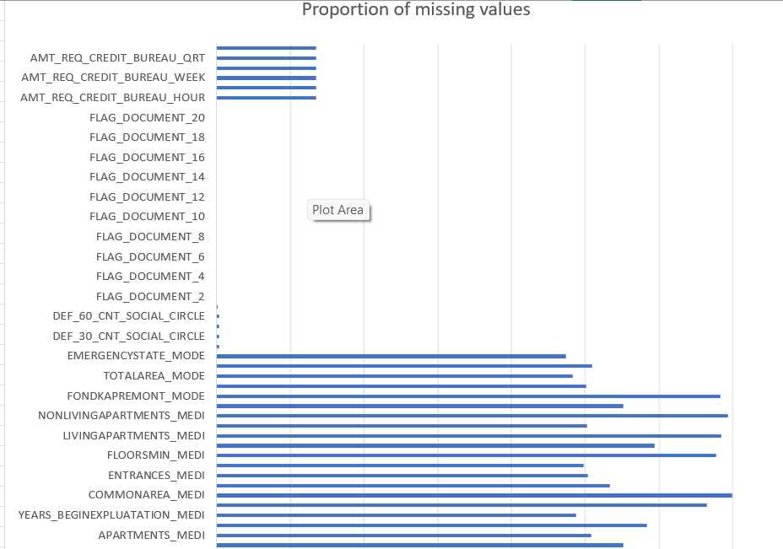
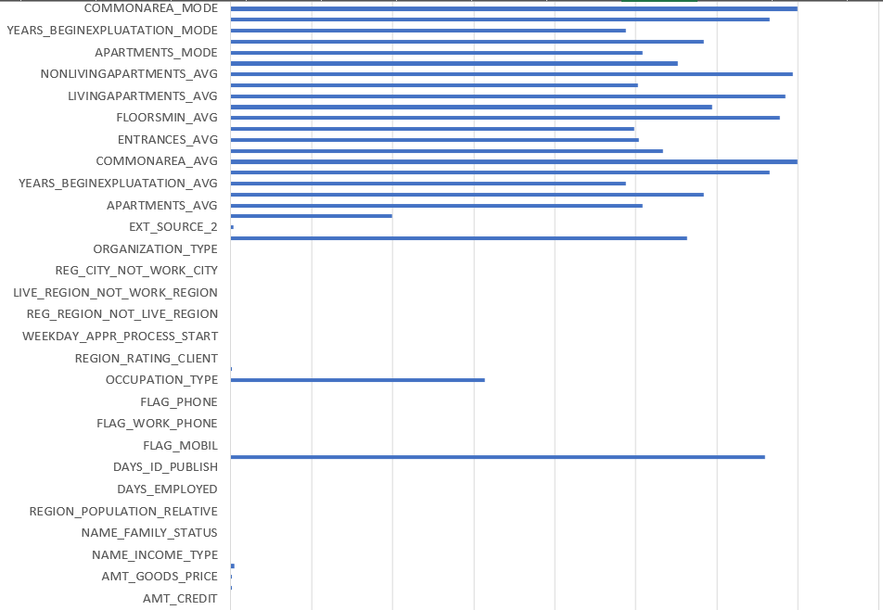

Slide 7
B. IDENTIFY OUTLIERS IN THE DATASET:
Calculate Quartiles and IQR:
Use the QUARTILE function to find the first (Q1) and third (Q3) quartiles.
Example: =QUARTILE(A:A, 1) for Q1 and =QUARTILE(A:A, 3) for Q3.
Calculate the interquartile range (IQR) as IQR = Q3 - Q1.
Determine Outlier Thresholds:
Calculate the lower bound as Q1 - 1.5 * IQR.
Calculate the upper bound as Q3 + 1.5 * IQR.
Example: =Q1 - 1.5 * IQR and =Q3 + 1.5 * IQR.
Identify Outliers:
Use IF statements to flag values outside the bounds.
Example: =IF(OR(A2 < Q1 - 1.5 * IQR, A2 > Q3 + 1.5 * IQR), "Outlier", "Normal").
Apply Conditional Formatting:
Highlight cells that are outliers for easy visualization.
Use Excel's conditional formatting to color-code outliers.

Slide 8
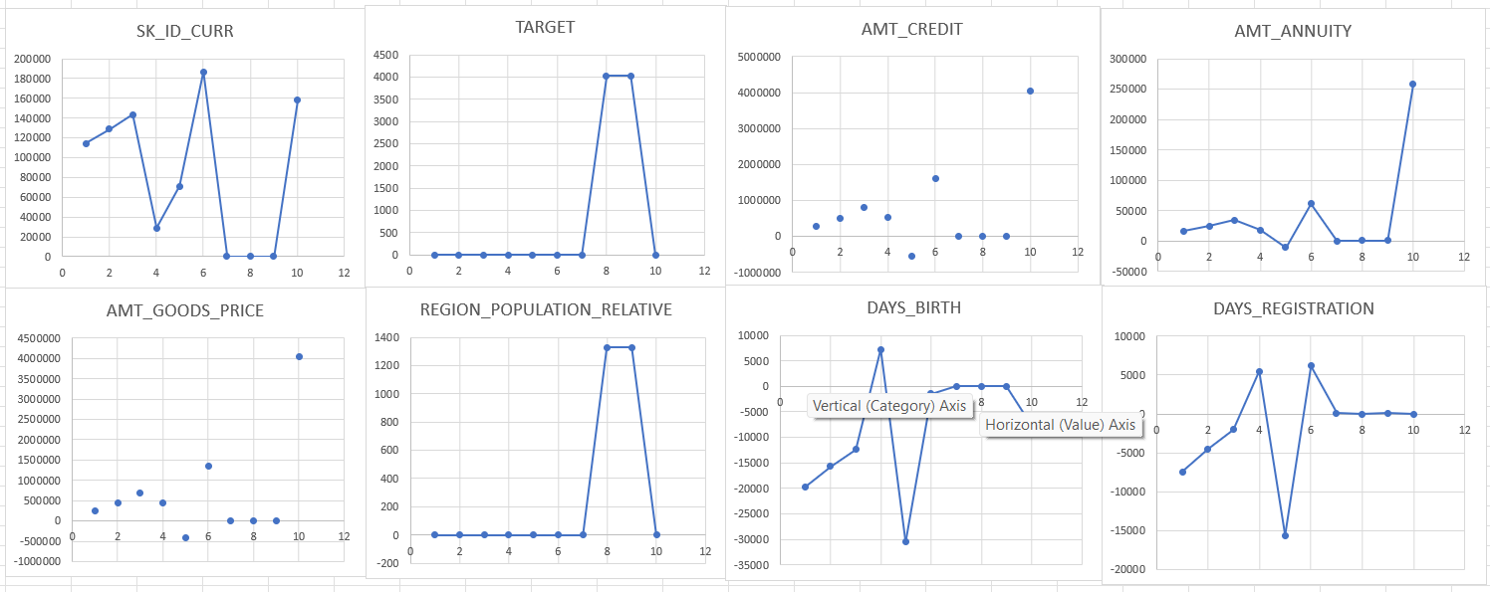
GRAPHS:

Slide 9
C. ANALYZE DATA IMBALANCE:
Calculate Class Frequencies:
Use the COUNTIF function to count the occurrences of each class in the target variable.
Example: =COUNTIF(B:B, "Approved") and =COUNTIF(B:B, "Rejected").
Calculate Total Count and Proportions:
Use the SUM function to find the total number of instances.
Example: =SUM(COUNTIF(B:B, "Approved"), COUNTIF(B:B, "Rejected")).
Calculate the proportion of each class.
Example: =COUNTIF(B:B, "Approved") / SUM(COUNTIF(B:B, "Approved"), COUNTIF(B:B, "Rejected")) and similarly for the other class.
Assess Data Imbalance:
Compare the class frequencies and proportions to determine the extent of the imbalance.
Example: If one class has a significantly higher proportion than the other, data imbalance is present.

Slide 10
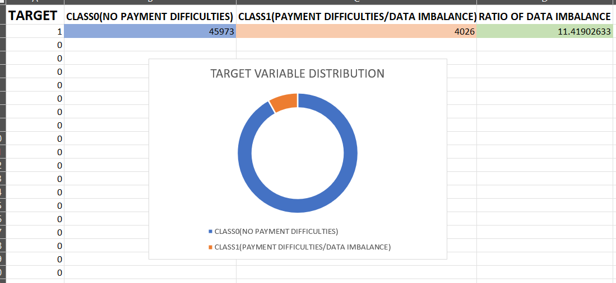

Slide 11
D. PERFORM UNIVARIATE, SEGMENTED UNIVARIATE, AND BIVARIATE ANALYSIS:
1. Univariate Analysis:
Objective: Understand the distribution of individual variables.
Use COUNT, AVERAGE, MEDIAN, MIN, MAX, and STDEV for descriptive statistics.
Example: =AVERAGE(A:A), =MEDIAN(A:A), =STDEV(A:A).
2. Segmented Univariate Analysis:
Objective: Compare variable distributions for different scenarios (e.g., loan approved vs. loan rejected).
Use filters or pivot tables to segment data by scenarios.
Calculate descriptive statistics for each segment.
Example: Create a pivot table with loan status as a filter and calculate average income for each segment.
3. Bivariate Analysis:
Objective: Explore relationships between variables and the target variable.
Use scatter plots to visualize relationships between numerical variables.
Use pivot tables to explore relationships between categorical variables and the target variable.
Example: Create a scatter plot with loan amount on the x-axis and interest rate on the y-axis, color-coded by loan status.

Slide 12
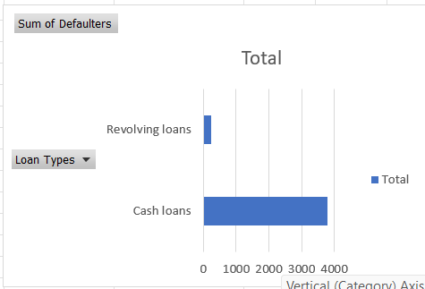
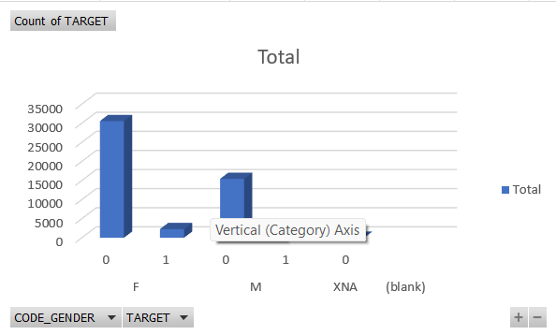
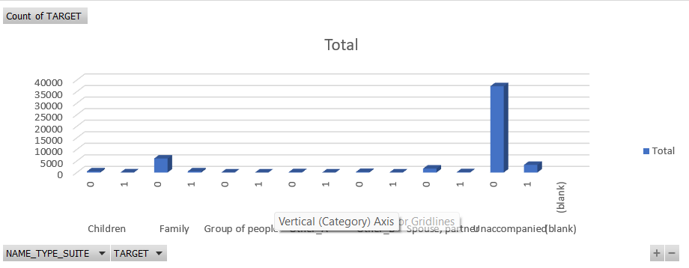

Slide 13
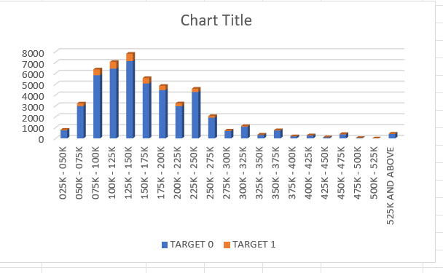
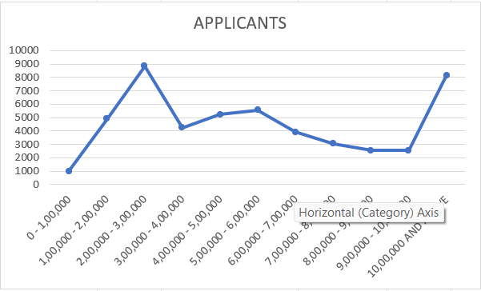
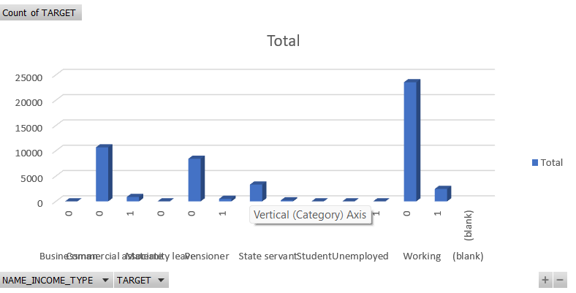

Slide 14
E. IDENTIFY TOP CORRELATIONS FOR DIFFERENT SCENARIOS:
Segment the Dataset:
Use filters or pivot tables to create different segments (e.g., clients with payment difficulties vs. others).
Calculate Correlations:
Use the CORREL function to calculate the correlation coefficients between variables and the target variable within each segment.
Example: =CORREL(B:B, C:C) where B is the target variable and C is another variable.
Visualize Correlations:
Create a correlation matrix using the CORREL function for all variables within each segment.
Use conditional formatting to create heatmaps highlighting strong correlations.
Example: Apply color scales in the conditional formatting menu to the correlation matrix.

Slide 15
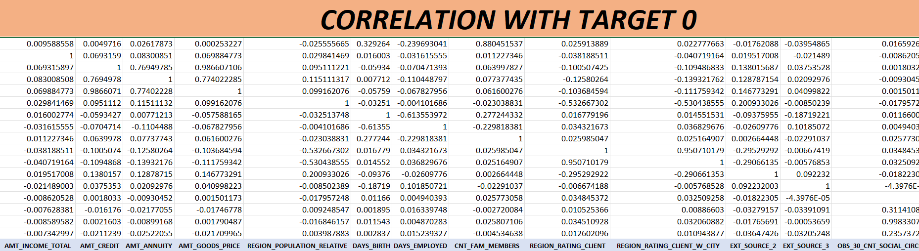
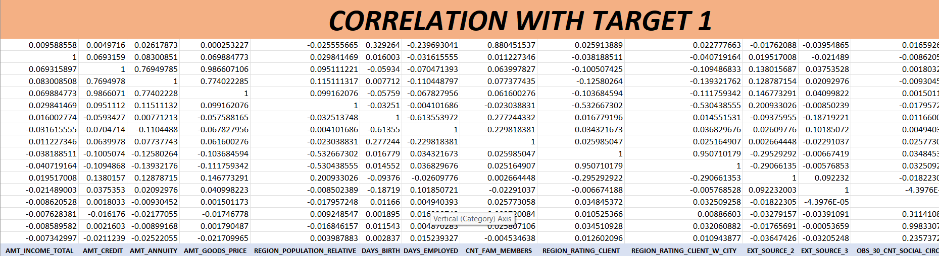

Slide 16
RESULT:
In the bank loan case study analysis, several key analytical steps were undertaken to gain comprehensive insights into the factors influencing loan outcomes. Initially, meticulous attention was given to handling missing data effectively using Excel functions like COUNTBLANK and AVERAGE, ensuring the dataset's completeness and reliability. Subsequently, outliers were identified using statistical methods such as QUARTILE and interquartile range (IQR), supplemented by visual aids like box plots to flag potential anomalies within the data. Analyzing data imbalance involved calculating class frequencies and assessing ratios to understand skewed distributions, which provided crucial context for subsequent analyses. Through univariate, segmented univariate, and bivariate analyses utilizing descriptive statistics, pivot tables, and various charts, patterns in variable distributions, comparisons across different scenarios, and relationships with loan default emerged, guiding further insights into predictive modeling. Finally, by identifying top correlations within segmented datasets using correlation coefficients (CORREL), key indicators influencing loan default were pinpointed across diverse scenarios, facilitating informed decision-making and strategy formulation.

Slide 17
THANK
YOU
SHEET:LINK

