Slide 1
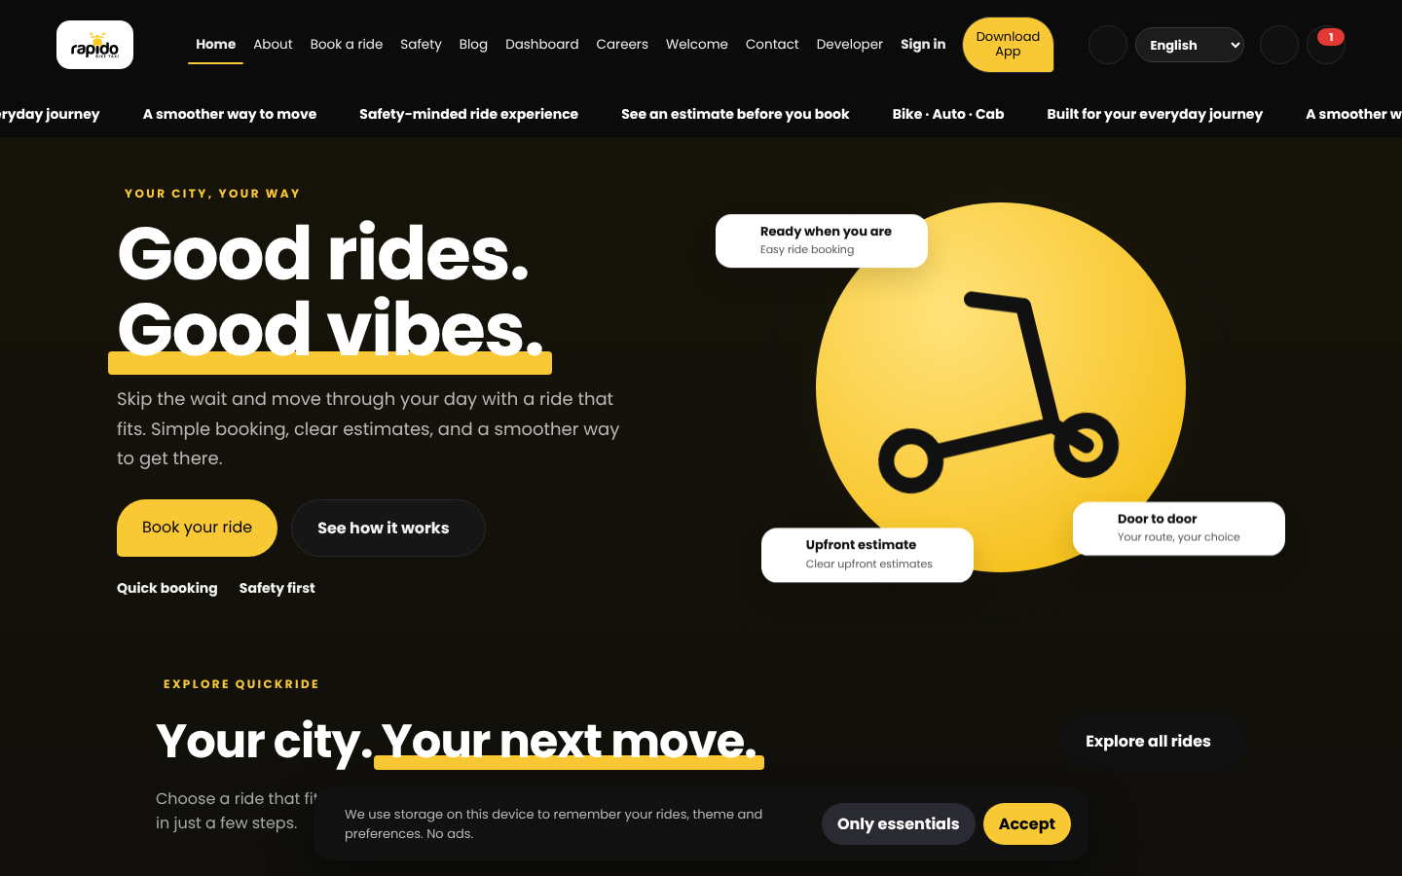
RAPIDO Ride Platform
Version 3.1: project overview, screens and setup
Plain HTML, CSS and JavaScript front end with a Node.js and Express API
Bike-taxi booking demo | Independent portfolio project

Slide 2
What the project covers
17
3
4
30 s
HTML pages
roles: rider, captain, admin
ride types: Bike, Bike Plus, Auto, Cab
captain acceptance window
Booking flow with pickup and drop-off search, live fare estimate and a 4-step ride tracker
Role-based dashboards for riders, captains and administrators
Careers, safety, press, blog, contact and developer pages
Optional Node.js API for shared rides, accounts, captain requests and ratings
Browser-only demo mode that keeps data in localStorage when the API is not running
RAPIDO Ride Platform v3.1 | 2

Slide 3
Ride types and fare model
Ride type | Base fare | Per km | Example: 10 km
Bike | ₹25 | ₹9 | ₹115
Bike Plus | ₹35 | ₹12 | ₹155
Auto | ₹30 | ₹14 | ₹170
Cab | ₹50 | ₹18 | ₹230
Fare = base + per km x road distance, rounded and never below the base fare
Road distance comes from OSRM. If routing is unavailable, the straight-line distance is multiplied by 1.3
Default rates from server.js; administrators can change them through the pricing endpoint
RAPIDO Ride Platform v3.1 | 3

Slide 4
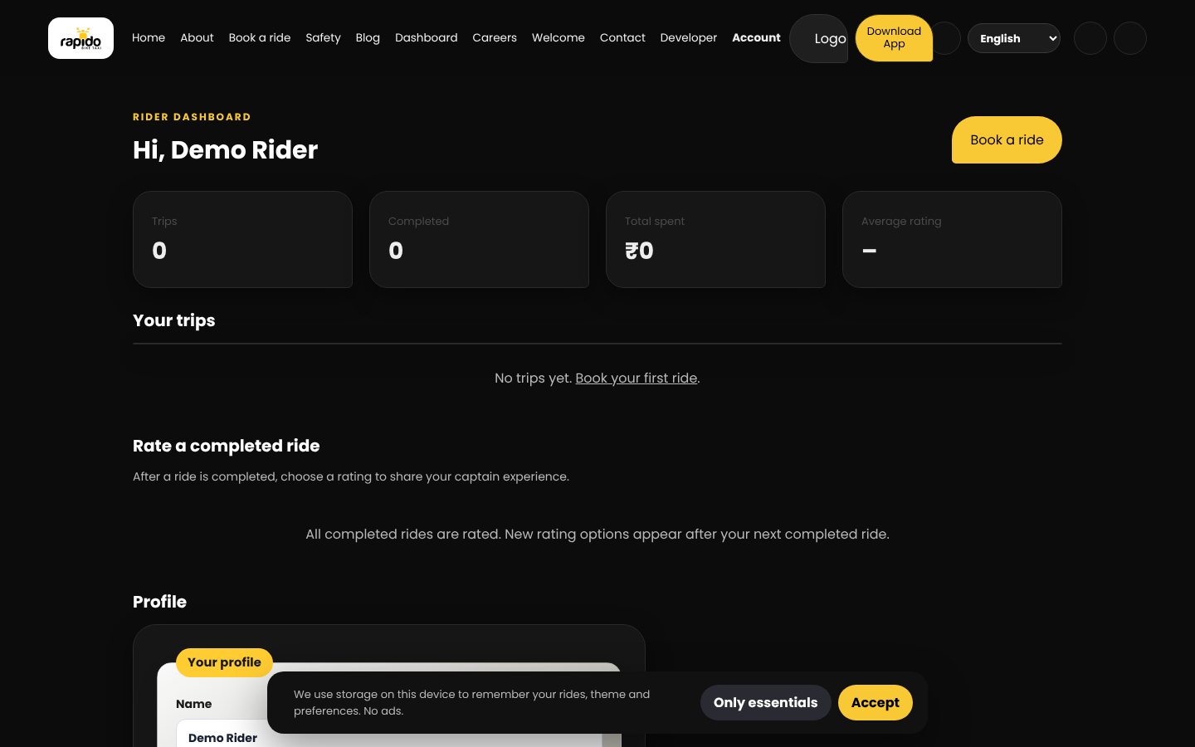
Rider dashboard
Trip count, completed rides, total spend and average rating
Booking shortcut and trip history
Rate completed rides with 1 to 5 stars
Profile card and saved places
RAPIDO Ride Platform v3.1 | 4

Slide 5
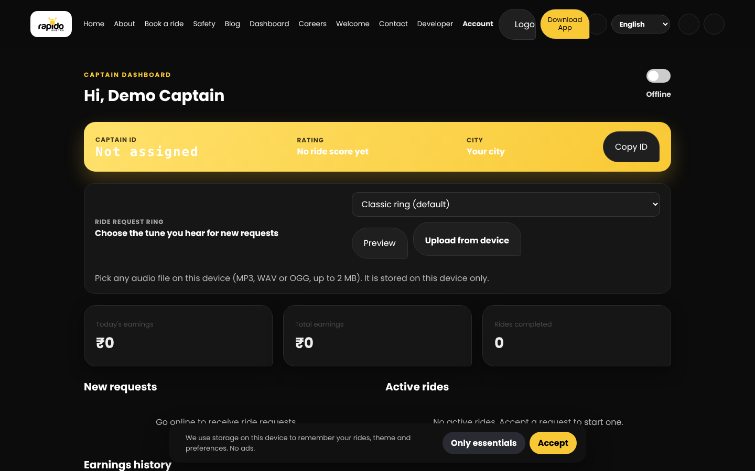
Captain dashboard
Accept ride requests within the 30-second window
Move rides through accepted, in-progress and completed
Earnings are shown at 80% of each completed fare
Ratings from completed rides
RAPIDO Ride Platform v3.1 | 5

Slide 6
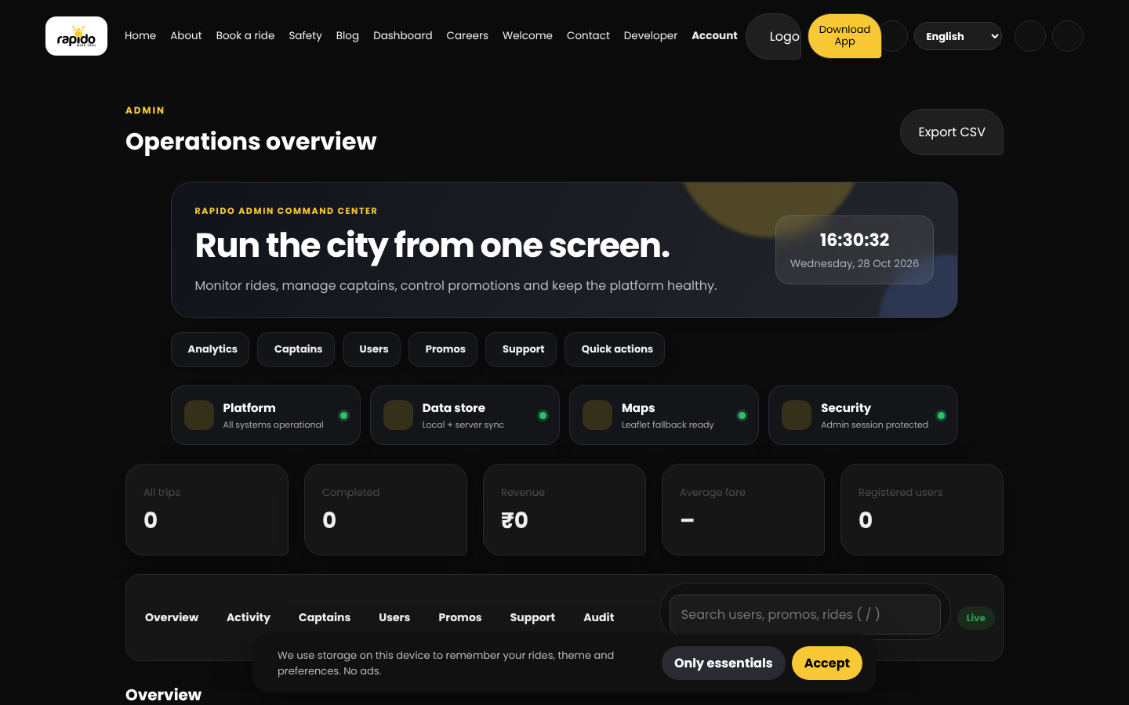
Admin command center
Live KPIs: trips, completed rides, revenue and users
Seven-day ride analytics and a ride status view
Captain approval, user block and unblock, promo codes
CSV export, audit log and Ctrl+K command drawer
RAPIDO Ride Platform v3.1 | 6

Slide 7
Three ways to sign in
1
2
3
Rider
Captain
Admin
Mobile number plus OTP. The demo OTP is 123456, and the demo number is 9876543210.
Sign in with a generated CAP-XXXXXXXX ID. Captain accounts are created at sign-up.
Separate admin login. Credentials are set in the .env file (ADMIN_PHONE and ADMIN_PASSWORD).
The browser demo simulates sign-in. Production needs a real SMS or authentication provider.
RAPIDO Ride Platform v3.1 | 7

Slide 8

Supporting pages
Safety: emergency contacts, SOS alert and a pre-ride checklist
Careers: search, filters, applications with a reference number
Welcome page: animated route and call to action
Developer page: project details and links
RAPIDO Ride Platform v3.1 | 8

Slide 9
How the pieces fit together
Browser pages
Express API
JSON data store
HTML, CSS and vanilla JS. localStorage works as a fallback when the API is down.
server.js: auth, rides, captain and admin routes, pricing and support.
data/database.json is created on first start. Replace it with a real database for production.
External services (need internet)
OpenStreetMap Nominatim: place search (India)
OSRM: road distance
Leaflet with Esri tiles: map
Google Fonts and cdnjs: fonts and icons
RAPIDO Ride Platform v3.1 | 9

Slide 10
API endpoints (server.js)
Area | Endpoints
Health and pricing | GET /api/health, GET /api/pricing
Accounts | POST /api/auth/register, /rider-login, /captain-login, /login, /admin-login; GET /api/auth/me; POST /api/auth/logout
Rides | GET and POST /api/rides; PATCH /api/rides/:id/status; POST /api/rides/:id/rating
Captain and admin | GET /api/captain/summary; GET /api/admin/summary, /users, /rides; PUT /api/admin/pricing
Public forms | POST /api/support; POST /api/newsletter
Captain requests expire after 30 seconds without acceptance. Expired rides are cancelled and the rider is notified.
RAPIDO Ride Platform v3.1 | 10

Slide 11
Run it locally
# Full mode with the API
npm install
cp .env.example .env # set JWT_SECRET, ADMIN_PHONE, ADMIN_PASSWORD
npm start # http://localhost:3000
# Static mode (no API, browser data only)
python3 -m http.server 8000 # http://localhost:8000
Requires Node.js. Dependencies: express and dotenv.
RAPIDO Ride Platform v3.1 | 11

Slide 12
Limitations and next steps
Current limits
Next steps
Sign-in and OTP are simulated
Data is a JSON file, not a database
Home page and booking use different Auto and Cab rates
UPI payments open a link, but the server does not confirm them
Maps and routing need an internet connection
Connect an SMS provider for real OTP sign-in
Move data to PostgreSQL or another managed database
Use one shared rate table for every page
Verify payments with a payment provider
Add automated tests for the API and booking flow
RAPIDO Ride Platform v3.1 | 12

