Slide 1
Real-Time Human Activity Recognition
from Smartphone Sensors
CRISP-DM Final Report (HW4) — Evaluation & Deployment
Almog Tal · Daniel Korkevados · Lior Sulshtein · Ilay Damari
Introduction to Data Science in Industry · Ben-Gurion University
Notes:
Opening. display deck. We interleave: a few slides, then jump into the notebook, then back. Nothing is presented "all slides first, then code".

Slide 2
Part 1 · Motivation
Smartphone sensors can monitor activity without cameras or wearables — if the model generalizes to new users
Phones already carry an accelerometer and a gyroscope — no extra hardware.
Goal: a working prototype that labels a person's activity in near real time.
The hard part is generalization: it must work on people it never trained on.
Business value: passive, private activity monitoring for health and context apps.
Notes:
Set up the business problem before the question slide.

Slide 3
Part 1 · Research question
Research question
Can a Transformer label six activities from 2.56 s of raw, 9-channel
sensor signal — accurately enough for real-time use on unseen people?
Sub-question: does adding frequency (FFT) information help over the raw time signal?
Sub-question: which sensors actually matter?
Notes:
State the question explicitly; everything after answers it.

Slide 4
Part 1 · Data
UCI HAR gives 10,299 windows from 30 subjects, split subject-disjoint
30 volunteers, waist-mounted phone, 50 Hz; 9 inertial channels.
Windows of 128 samples = 2.56 s; six activities (walk ×3, sit, stand, lie).
Split is subject-disjoint: 21 train / 9 test — test subjects are never seen.
We hold the test set back and score it only once.
↪ SWITCH TO NOTEBOOK Section 2 — Exploratory Data Analysis (scroll to the pre-run output)
Notes:
Then jump to the notebook EDA section and walk the graphs live.

Slide 5
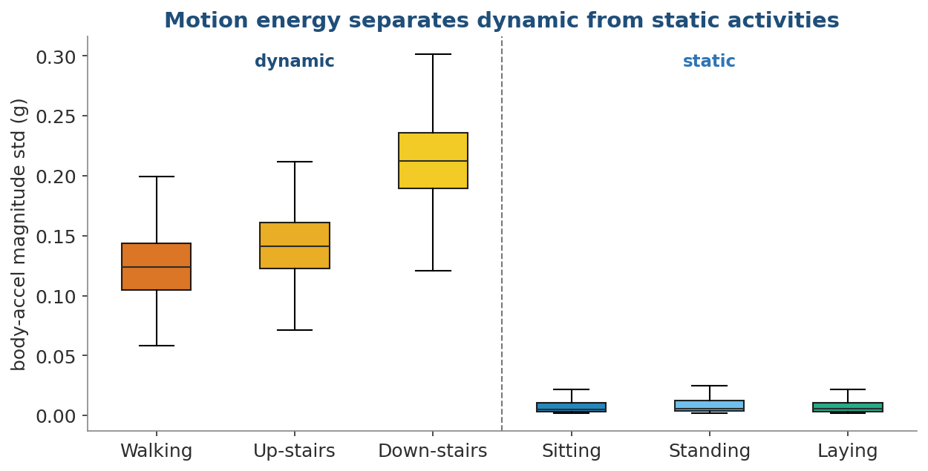
Part 1 · EDA
Motion energy splits dynamic from static; gravity direction splits the postures
What to see
Within-window acceleration variance is high for walking, near-zero for static.
Sitting/standing/laying differ mainly by which axis gravity falls on.
This is why static postures are the hard part of the problem.
Data: UCI HAR (Anguita et al., 2013).
Notes:
One of two EDA anchors we discuss after the live walk-through.

Slide 6
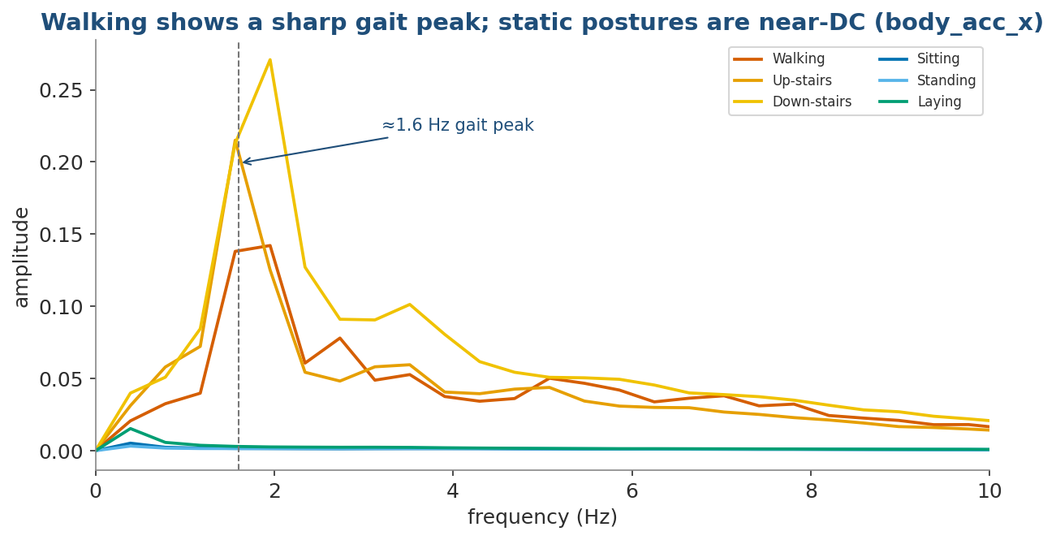
Part 1 · EDA
Walking shows a sharp ~1.6 Hz gait peak while static postures are near-DC
What to see
The frequency domain cleanly separates motion from stillness.
Motivates a model that can look at the spectrum, not only the time signal.
Directly informs our Fourier+Transformer design.
Data: UCI HAR (Anguita et al., 2013).
Notes:
Second EDA anchor; bridges into the modeling approach.

Slide 7
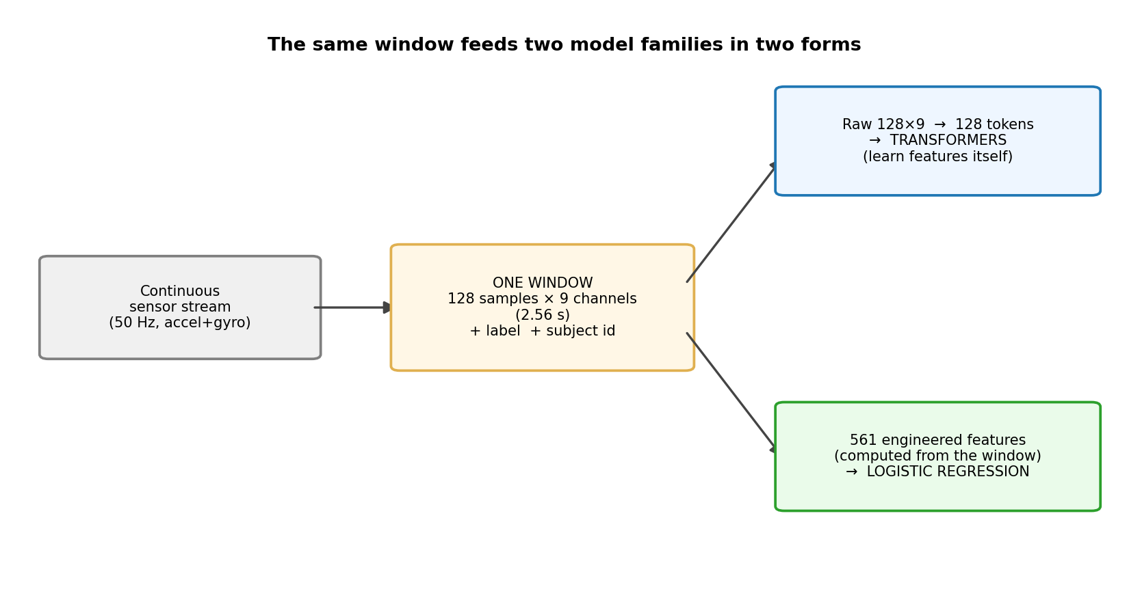
Part 2 · Models
We compare classical baselines with raw-signal Transformers, including a dual-branch Fourier+Transformer
What to see
Each window feeds three views: 6 features, 165 Fourier features, raw 128×9.
Flagship: a Transformer that attends over time AND over the FFT, then fuses.
No hand-engineering for the deep models — they learn from raw signal.
↪ SWITCH TO NOTEBOOK Section 3 — model architecture (code) (scroll to the pre-run output)
Notes:
Jump to the notebook and show the FourierTransformer source live.

Slide 8
Part 2 · Evaluation
Models are tuned on held-out subjects and judged once on 9 unseen test subjects by macro-F1
Subject-disjoint validation — no subject leaks between train and validation.
Macro-F1 weights all six classes equally, so small classes can't be ignored.
The official test split is used a single time, for the final numbers only.
Notes:
Keep this short; it earns the credibility of the results that follow.

Slide 9
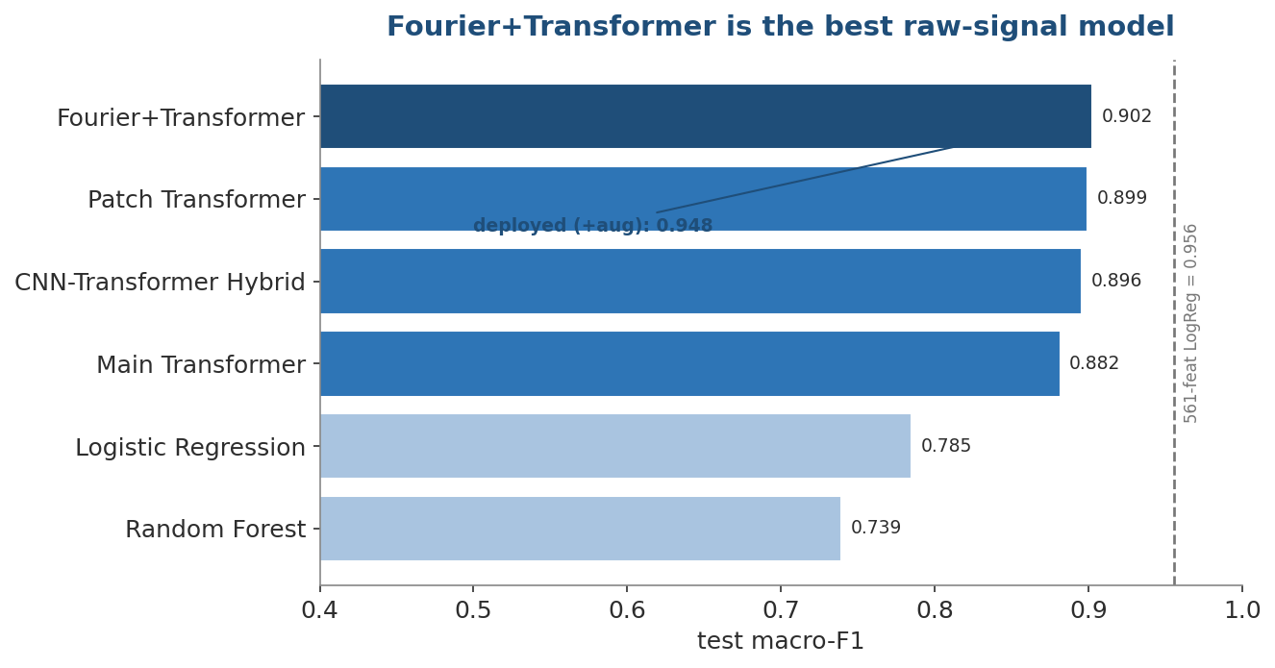
Part 2 · Results
The Fourier+Transformer is the best raw-signal model — 94.8% on unseen subjects
What to see
Beats the time-only Transformer and the classical 6-feature baselines.
Deployed checkpoint (with augmentation) reaches 94.8% accuracy / 0.948 F1.
Engineered-feature baselines (dashed) stay competitive — an honest caveat.
Our results on the UCI HAR test split (2,947 windows).
↪ SWITCH TO NOTEBOOK Section 6 — live inference demo (scroll to the pre-run output)
Notes:
Jump to notebook sections 5-6: run inference live, show 94.8% and the report.

Slide 10
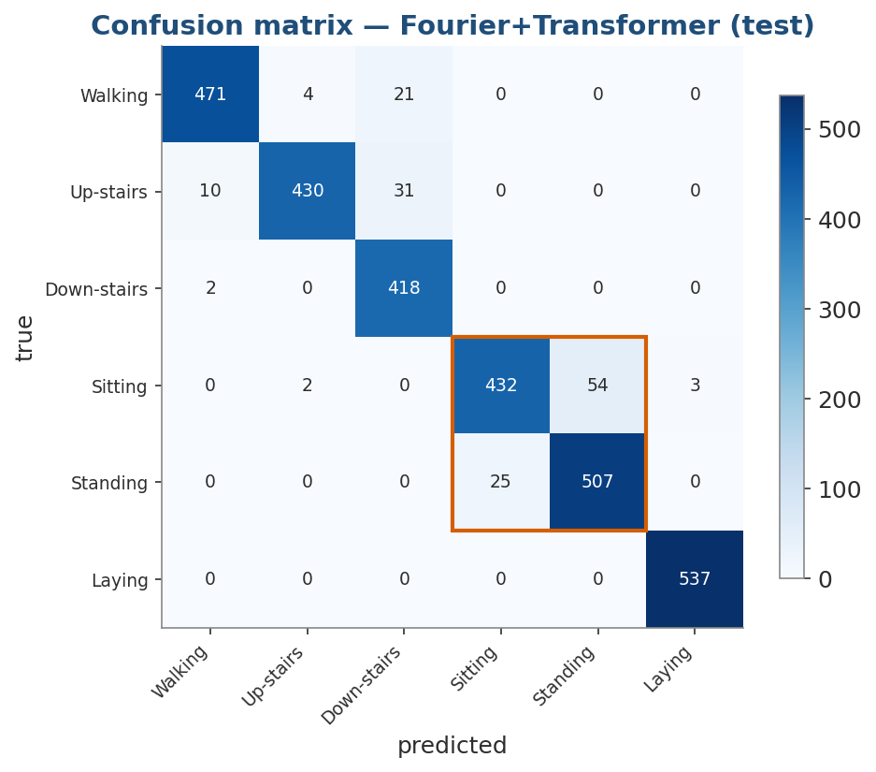
Part 2 · Results
Errors are confined to sitting ↔ standing; dynamic vs static separation is essentially perfect
What to see
Zero confusion between the walking group and the static group.
Laying is classified perfectly (537/537).
The only real error is the near-DC sitting/standing pair (boxed).
Our results on the UCI HAR test split (2,947 windows).
Notes:
Tie the residual error back to the EDA: sit/stand are both near-DC.

Slide 11
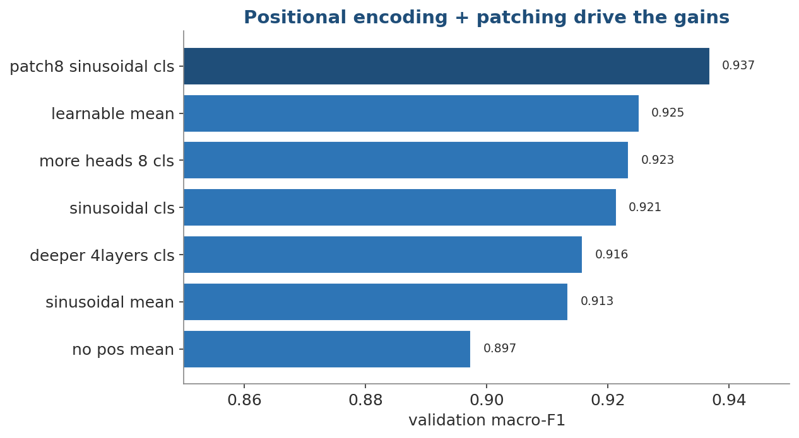
Part 2 · Results
Positional encoding and patching drive the gains; extra depth does not
What to see
Removing positional encoding hurts the most.
Patch-8 tokens beat per-timestep tokens.
4 layers / 8 heads add little over the 2-layer, 4-head model.
Validation macro-F1, architecture ablation.
Notes:
Justifies the small, efficient architecture we ship.

Slide 12
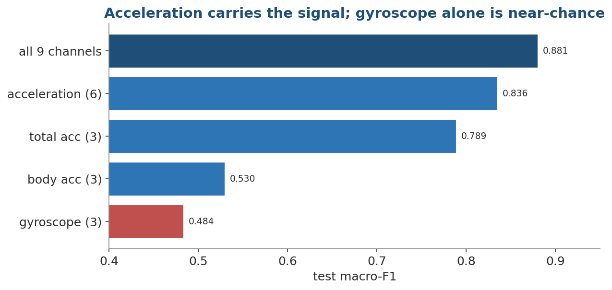
Part 2 · Results
Acceleration carries the signal; gyroscope alone is near-chance — but all sensors together win
What to see
All 9 channels give the best score.
Acceleration alone is strong; gyroscope alone collapses to ~0.48 F1.
Confirms which signals a deployment must capture.
Test macro-F1, sensor ablation.
Notes:
Practical guidance for what to log on the phone.

Slide 13
Part 3 · Evaluation
All five business success criteria from HW1 are met
Working pipeline raw sensors → activity label ✓
Standard metrics on a subject-disjoint split (accuracy, P/R/F1, confusion) ✓
Separates the main activities — 0% dynamic↔static error ✓
Limitations discussed (UCI vs live phone: orientation & sampling shift) ✓
Reproducible, readable code (helper modules, fixed seed, notebooks) ✓
Notes:
This is the CRISP-DM Evaluation (5.1) verdict: objectives met.

Slide 14
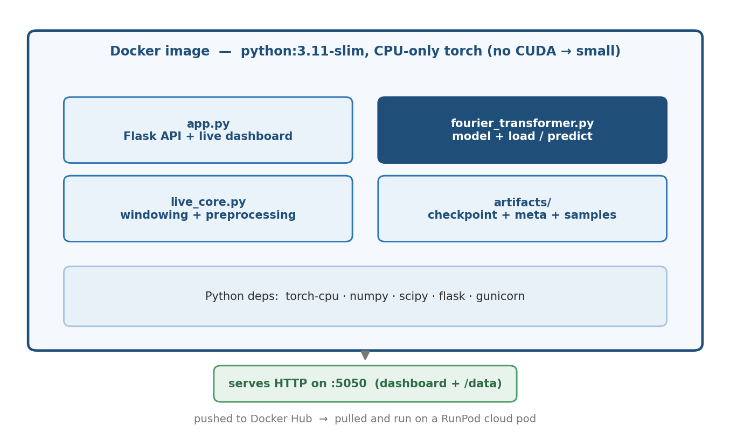
Part 3 · Deployment
The model ships as a self-contained Docker container that runs anywhere
What to see
One image bundles the Flask API, the model code, the preprocessing and the trained checkpoint.
Base python:3.11-slim with a self-contained torch install — no local setup needed.
Pushed to Docker Hub, then pulled and run on a cloud RunPod pod.
Exposes HTTP on :5050 — a live dashboard plus a /data ingest endpoint, served by gunicorn.
Notes:
CRISP-DM Deployment (6.1): what the container holds, and where it runs. We publish the image to Docker Hub and run it on a RunPod pod.

Slide 15
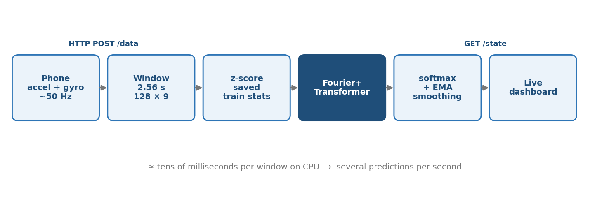
Part 3 · Deployment
Inference runs window-by-window: phone stream to activity label in real time
What to see
The phone HTTP-POSTs accelerometer + gyroscope (~50 Hz) to /data.
The server forms the last 2.56 s as a 128×9 window and z-scores it with the saved training stats.
The Fourier+Transformer outputs six probabilities; an EMA smooths them over time.
The dashboard polls /state — tens of milliseconds per window on CPU.
Notes:
CRISP-DM Deployment (6.1): the request → prediction → dashboard loop. The live preprocessing matches training exactly, so no normalisation is refit at serve time.

Slide 16
Part 3 · Deployment
Cross-device orientation shift is the main deployment risk — monitor confidence and retrain on in-the-wild data
Risk: a new phone/position changes which axis gravity falls on.
Monitor prediction confidence and calibration (ECE) on the live stream.
Trigger retraining when confidence drifts or new users/devices appear.
Next steps: add orientation-invariant features and collect more subjects.
Notes:
CRISP-DM Monitoring (6.2) and Next steps (5.3).

Slide 17
Conclusions
1. A Transformer reads raw sensor windows well: the Fourier+Transformer reaches 94.8% accuracy on unseen subjects.
2. Frequency information matters: fusing the FFT branch fixes the sitting/standing confusion and lifts macro-F1.
3. The system is deployable: it predicts in real time on CPU and meets every business success criterion.
Code & notebooks reproduce every figure · daniel / almog / lior / ilay
Notes:
Conclusions stay up during discussion, then we run the live demo.

Slide 18
Live demo
Real-time activity recognition from my phone
The same service from the previous slides, running on a RunPod GPU pod (image pulled from Docker Hub).
The phone streams its accelerometer + gyroscope to the pod's public URL.
The model predicts the activity live in the browser dashboard.
Move → walk, sit, lie down — the prediction follows in real time.
Notes:
Demo runs on RunPod (not the laptop): deploy the Docker Hub image on a pod, expose :5050, open the pod's HTTPS dashboard URL, point the phone's Sensor Logger HTTP push at <pod-url>/data, then demonstrate. Steps in DEPLOY_RUNPOD.md.

Slide 19
References
Anguita, D., Ghio, A., Oneto, L., Parra, X., & Reyes-Ortiz, J. L. (2013). A Public Domain Dataset for Human Activity Recognition Using Smartphones. ESANN.
Vaswani, A. et al. (2017). Attention Is All You Need. NeurIPS.
Naegle, K. M. (2021). Ten simple rules for effective presentation slides. PLOS Computational Biology, 17(12).
Wirth, R. & Hipp, J. (2000). CRISP-DM: Towards a Standard Process Model for Data Mining.

