Slide 1
COE 372 Sem2, 2022/23
Digital Systems Design Methodologies

Slide 2
Lecture Overview
VLSI
VLSI Design
Design Abstraction Levels
Design Tools
Design Methodologies
Complexity and Design
Design Hierarchy and Modularity
Summary

Slide 3
VLSI: Very Large Scale Integration
Integration: Integrated Circuits
multiple devices on one substrate
How large is Very Large?
SSI (small scale integration)
7400 series
MSI (medium scale)
74000 series
LSI
VLSI
ULSI/SLSI/GSI

Slide 4
VLSI Design
The real issue with VLSI is about designing systems on chips (SOCs).
SOC designs are complex
To manage complexity of design, one needs
to use structured design techniques, and
sophisticated design tools
Another fact is that technology becomes out of date sooner
So develop and use techniques that will transcend today’s technology

Slide 5
The Process of VLSI Design
Consists of many different representations/Abstractions of the system (chip) that is being designed
System Level Design
Architecture / Algorithm Level Design
Digital System Level Design
Logical Level Design
Electrical Level Design
Layout Level Design
Semiconductor Level Design (possibly more)
Each abstraction/view is itself a Design Hierarchy of refinements which decompose the design

Slide 6
Design Abstraction Levels

Slide 7
Computer Aided Design tools
Tools
Editors
Simulators
Libraries
Module Synthesis
Place/Route
Chip Assemblers
Silicon Compilers
Experts
Logic design
Electronic/circuit design
Device physics
Artwork
Applications – system design
Architectures

Slide 8
VLSI Design Methodologies
Methodologies which are based on:
System Level Abstractions vs. Device Characteristic Abstractions
Logic structures and circuitry change slowly over time
trade-offs do change, but the choices do not
Scalable Designs
Layout techniques also change slowly
But the minimum feature size steadily decreases with time (also Voltage, Die Size, etc.)

Slide 9
VLSI Design Flow (1)
(Y-chart representation)

Slide 10
The Y-chart Representation (1)
The Y-chart consists of three major domains
Behavioral domain,
Structural domain,
Geometrical layout domain.

Slide 11
The Y-chart Representation (2)
The design flow starts from the algorithm that describes the behavior of the target chip. The corresponding architecture of the processor is first defined.
It is mapped onto the chip surface by floorplanning. The next design evolution in the behavioral domain defines finite state machines (FSMs) which are structurally implemented with functional modules such as registers and arithmetic logic units (ALUs).
These modules are then geometrically placed onto the chip surface using CAD tools for automatic module placement followed by routing, with a goal of minimizing the interconnects area and signal delays. The third evolution starts with a behavioral module description.

Slide 12
The Y-chart Representation (3)
Individual modules are then implemented with leaf cells. At this stage the chip is described in terms of logic gates (leaf cells), which can be placed and interconnected by using a cell placement & routing program.
The last evolution involves a detailed Boolean description of leaf cells followed by a transistor level implementation of leaf cells and mask generation. In standard-cell based design, leaf cells are already pre-designed and stored in a library for logic design use.

Slide 13
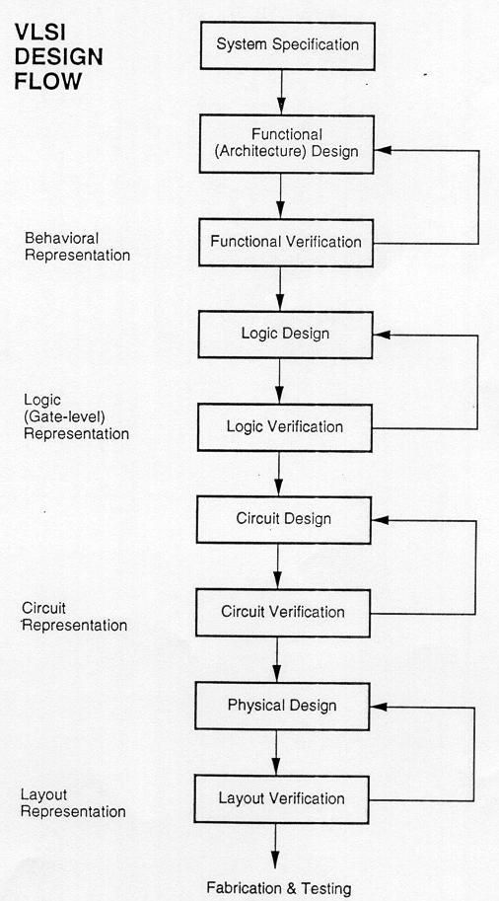
VLSI Design Flow (2)

Slide 14
VLSI Design Flow (3)
The design flow is divided in the two parts:
Front End Design:
Front-end design includes most of the steps in the flow prior to physical design. (system specification and functional design)
Back End Design:
Starting with physical design and beyond is considered the back-end of the design flow.

Slide 15
Design hierarchy & modularity

Slide 16
Complexity and Design
Creating a design team for a VLSI project
Needing hundreds of engineers, scientists, and technicians
Needing hierarchy design and many different “Level Views”
Everyone of each level depends upon the Computer-Aided Design (CAD) tools
Each member gets the opportunity to study small sections of the system

Slide 17
Design Hierarchy (1)
System specifications: is defined in both general and specific terms, such as functions, speed, size, etc.
Abstract high-level model: contains information on the behavior of each block and the interaction among the blocks in the system
Logic synthesis: To provide the logic design of the network by specifying the primitive gates and units needed to build each unit

Slide 18
Design Hierarchy (2)
Circuit design: where transistors are used as switches and Boolean variables are treated as having signal values varying between two levels of voltage
Physical design: the network is built on a tiny area on a slice of silicon
Manufacturing: a completed design process is moved on to the manufacturing line

Slide 19
Design Hierarchy (3)
Hierarchical design
Top-down design
The initial work is quite abstract and theoretical and there is no direct connection to silicon until many steps have been completed
Acceptable in modern digital system design
Co-design strategy of combining HW/SW is critical
Similar to Cell-based Design Flow
Bottom-up design
starts at the silicon or circuit level and builds primitive units such as logic gates, adders, and registers as the first steps
Acceptable for small projects
Similar to Full-custom Design Flow

Slide 20
Design Hierarchy (4)

Slide 21
Design Hierarchy (Example) (1)

Slide 22
Design Hierarchy (Example) (2)
Based on “divide and conquer”
Dividing a module into sub- modules and then repeating this operation on the sub-modules until the complexity of the smaller parts becomes manageable.
On previous slide, CMOS four-bit adder is split into its components.
The adder can be decomposed progressively into one-bit adders, separate carry and sum circuits, and finally, into individual logic gates. At this lower level of the hierarchy, the design of a simple circuit realizing a well-defined Boolean function is much easier to handle than at the higher levels of the hierarchy.

Slide 23
ASIC Types
At the engineering level, Application Specific ICs are classified by the approach used to implement and build the circuit
Full-custom Design: where every circuit is custom designed for the project
Extremely tedious
Time-consuming process
Semi-custom Design: to reduce design workload and time
Use a group of primitive predefined cells as building blocks (cells) from a cell library

Slide 24
Modularity and other Concepts
The hierarchical design approach reduces the design complexity by dividing the large system into several sub-modules. Usually, other design concepts and design approaches are also needed to simplify the process.
Regularity
Locality

Slide 25
Modularity
Modularity in design means that the various functional blocks which make up the larger system must have well-defined functions and interfaces.
Modularity allows that each block or module can be designed relatively independently from each other.
All of the blocks can be combined with ease at the end of the design process, to form the large system.
The concept of modularity enables the parallelisation of the design process.

Slide 26
Regularity
Decomposition of a large system in simple and similar blocks as much as possible.
Example:
Design of array structures consisting of identical cells—such as a parallel multiplication array.

Slide 27
Locality
The concept of locality also ensures that connections are mostly between neighbouring modules, avoiding long-distance connections as much as possible.

Slide 28
Summary (1)
VLSI
How large is integration?
VLSI Design
Flow and process
Design Abstraction Levels
System
Module
Gate
Circuit
Device
Design Tools

Slide 29
Summary (2)
Design Methodologies
System level and Device characteristics Abstractions
Scalable designs
Y-chart
Complexity and Design
Design project team
Design Hierarchy and Modularity
Modularity
Regularity
Locality

