Slide 1
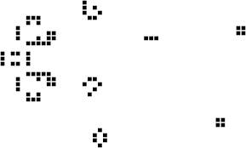
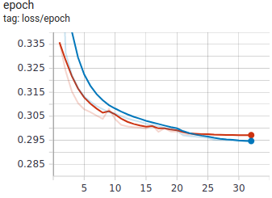



Reverse Game of Life 2020
Kortlin Thompson
The Approach
This approach was provided by Yakubenko Oleksii. [1]
Since delta determines how many states away the end board is from the start board, we can use an iterative reverse model delta times to predict what the start state is.
Since this can be shown as a one-channel image, we can use a CNN model as the model for this structure.
End State
Encoder
The Problem
Given the end board of Conway’s Game of Life. Find the starting board that results in the end board.
Reverse One
Iteration Model
Reverse One
Iteration Model
Reverse One
Iteration Model
Reverse One
Iteration Model
Reverse One
Iteration Model
Decoder
Decoder
Decoder
Decoder
Decoder
Delta=1 state
Delta=2 state
Delta=3 state
Delta=4 state
Delta=5 state
The Results
The following are the accuracy for each delta step and the overall accuracy.
delta=1 accuracy: 90.56%
delta=2 accuracy: 86.93%
delta=3 accuracy: 85.42%
delta=4 accuracy: 85.14%
delta=5 accuracy: 84.88%
All data accuracy: 86.6%
The accuracy is obtained from comparing the correct solution kaggle provided to the trained data that the model obtained.
Analysis
The Loss for validation and training data for each epoch
Red
Valid
Blue
Train
The Loss for both the validation and training data are pretty close to each other showing that they aren’t overfitting or underfitting.
Conclusion
The accuracy of using this model is pretty good with about 86.6% accuracy. The ranking for this submission is shown below.
This model is a good base line and can be improved to obtain a better accuracy.
The Rules
There are four rules determining the next state of the game board.
Overpopulation: If a living cell is surrounded by more than three living cells, it dies.
Stasis: If a living cell is surrounded by two or three living cells, it survives.
Underpopulation: If a living cell is surrounded by fewer than two living cells, it dies.
Reproduction: If a dead cell is surrounded by exactly three cells, it becomes a live cell.
References
1. Oleksii, Y. (2020, September 03). [CRGL2020] Iterative CNN Approach. Retrieved November 24, 2020, from https://www.kaggle.com/yakuben/crgl2020-iterative-cnn-approach

