Slide 1
Chapter 3:
DIGITAL LOGIC DESIGN ( ce_118 )
Register Transfer
Specification & Design
(part_2)

Slide 2
Outline
Register Transfer (RT) design:
FSMD model
RT specification with
Static-action tables
ASM charts
Procedure for synthesis from RT specification
Design Optimization through
Register sharing
Functional unit sharing
Bus sharing
Unit chaining and Multiclocking
Design Pipelining
Unit pipelining
Control pipelining
Datapath pipelining
Scheduling of flowcharts
Notes:
Các kiểu Mergin có tính kế thừa và liên tục

Slide 3
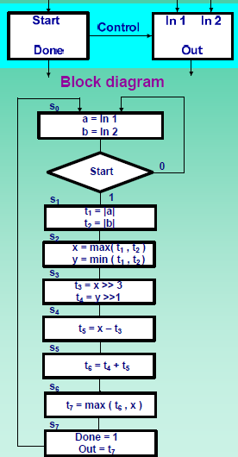
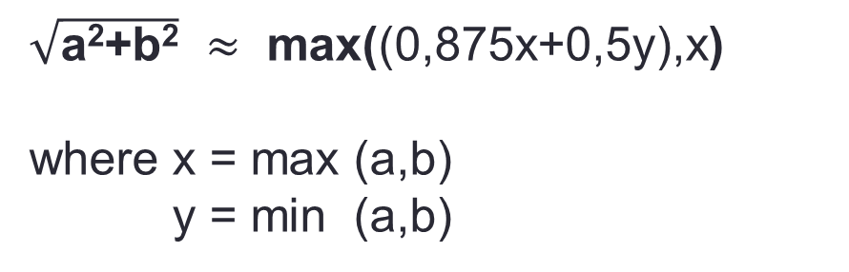
Register-transfer synthesis (synthesis from ASM chart)
Register sharing
Functional unit sharing
Bus sharing (datapath conectivity)
$\sqrt{\text{a}\text{2}\text{+}\text{b}\text{2}}$ $≈$ max((0,875x+0,5y),x)
where x = max (a,b)
y = min (a,b)
ASM Chart of Square-root approximation
Notes:
0.875*x = x – 0.125*x = x – x>> 3
0.5y = y*2^-1 = y >> 1

Slide 4
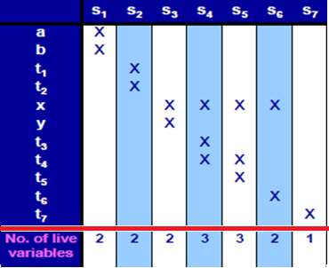
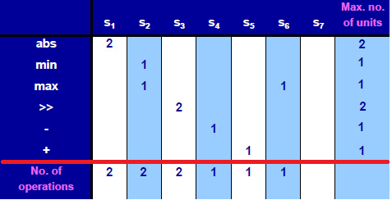
Resource usage in square-root approximation
Variable usage (register/memory sharing)
ASM Chart of Square-root approximation
Operation usage (functional-unit sharing)

Slide 5
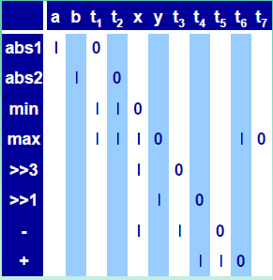
Connectivity requirements
Connectivity table (bus sharing)
ASM Chart of Square-root approximation

Slide 6
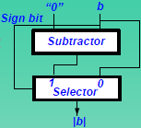
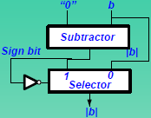
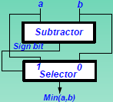
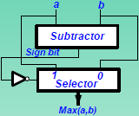
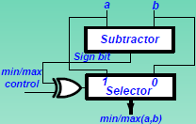
Simple library components
a) Absolute value unit (version 1)
b) Absolute value unit (version 2)
(c) Min unit
(d) Max unit
(e) Min/Max unit

Slide 7


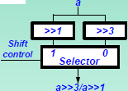

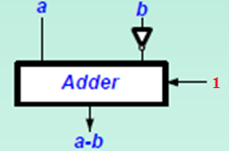

Simple library components (cont.)
(f) 1-bit right shifter
(g) 3-bit right shifter
(h) 1-bit/3-bit right shifter
(i) Adder
(j) Subtractor
(k) Adder/Subtractor

Slide 8
Register sharing (Variable merging)
Grouping of variables with non-overlapping lifetimes in a register
Variables that are not used (write or read) in the same state are called non-overlapping lifetime variables.
Lifetime of a variable: set of states in which the variable is alive. It is from the first state that the variable is written (write state) to the last state that variable is used (read state), include all states between the first and last state.
Grouping reduces number of registers needed in the design → Reduce area and cost
Two algorithms:
left-edge
graph-partitioning

Slide 9
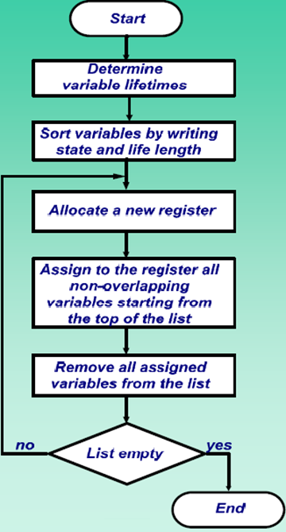
Left-edge algorithm
Create variables usage table
Sort list of variables

Slide 10
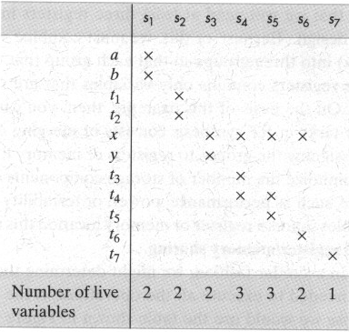
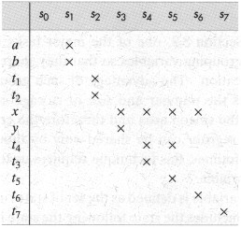
Register sharing with left-edge algorithm
Creating priority list
Sorted list of variables
Variable usage table
Priority order for 2 variables have the same write state:
The variable with the longer lifetime
The priority will be assigned at random
Notes:
Nếu 2 biến cùng xuất hiện trên 1 state thì biến nào tồn tại lâu hơn thì xếp trên

Slide 11
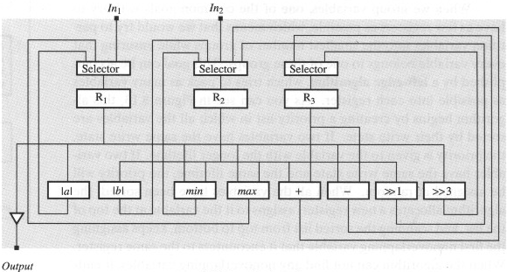
Register sharing with left-edge algorithm
R1 = {a, t1, x, t7}
R2 = {b, t2, y, t4, t6}
R3 = {t3, t5 }
Register assignments
Sorted list of variables
x
t2
b
t6
a
t1
y
t4
t5
t3
t7
Left-edge algorithm
Datapath schematic

Slide 12
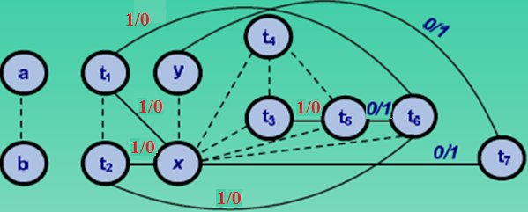
Compatibility graph for register sharing
(Variables) compatibility graph
Compatibility graph: nodes and edges
- Node represents a variable
- Edge: incompatibility edge and priority edge
+ Incompatibility edge (dashed line): connect 2 nodes indicates 2 variables with overlapping lifetimes
+ Priority edge: connect 2 nodes indicates 2 non-overlapping lifetime variables that serve as the same source (input) or same destination (output) to the same functional units or units in used library.
Priority weight (s/d) on priority edge: the number of selector inputs can be saved
s is equal to the number of the same functional units that use both nodes as right operands (input).
d is equal to the number of the same functional units that generate results (output) for both nodes

Slide 13
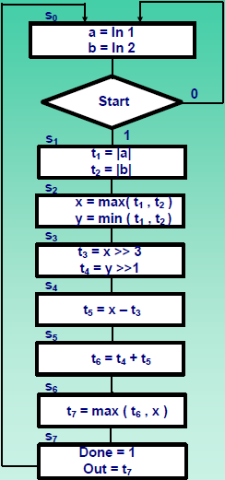
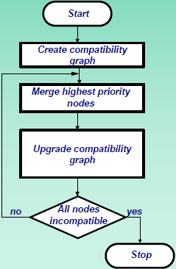
Graph-partitioning algorithm
Variable usage (register/memory sharing)
ASM Chart (square-root approximation)
(a) Initial (varialbes) compatibility graph
Notes:
t1, x are all inputs of the same MIN/MAX unit (1/0): do cả t1 và x đều là toán hạng bên phải (inputs) của phép cộng/trừ nên s=1 (nếu t1 và x đều là toán hạng của một phép khác, vd add/sub thì giá trị s sẽ được cộng thêm). Do t1 và x không là kết quả (outputs) của chung phép toán nào nên d = 0
t2, x are all inputs of the same MIN/MAX unit (1/0)
t1, t6 are all inputs of the same MIN/MAX unit (1/0)
t2, t6 are all inputs of the same MIN/MAX unit (1/0)
x, t7 are all outputs of the same MIN/MAX unit (0/1). Do x và t7 đều là kết quả (outputs) của bộ MIN/MAX nên d = 1
y, t7 are all outputs of the same MIN/MAX unit. (1/0)
t3, t5 are all inputs of the same SUB/ADD unit (0/1). Do t3 và t5 đều là kết quả (outputs) của bộ SUB/ADD nên d = 1
t5, t6 are all outputs of the same SUB/ADD unit (0/1). Do t5 và t6 đều là kết quả (outputs) của bộ SUB/ADD nên d = 1

Slide 14
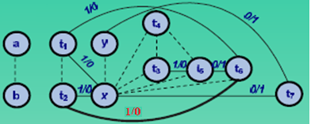
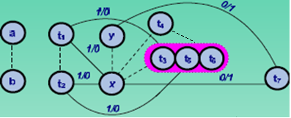
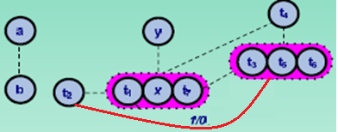
Graph-partitioning algorithm for SRA
Initial compatibility graph
(b) Compatibility graph after merging t₃, t₅ and t₆
ASM Chart
(c) Compatibility graph after merging t₁, x and t₇

Slide 15
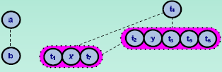
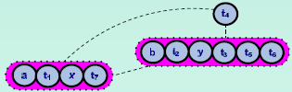
Graph-partitioning algorithm for SRA
(d) Compatibility graph after merging t₂ and y
(e) Final compatibility graph
ASM Chart

Slide 16
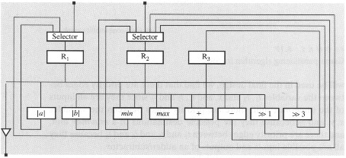
Register assignment generated by the graph-partitioning algorithm
R1 = [a , t1 , x , t7]
R2 = [b , t2 , y , t3 , t5 , t6]
R3 = [t4]
Compare selector input numbers with Datapath generated by the left-edge algorithm??? (slide 11)
Register assignments
Datapath

Slide 17
Functional-unit sharing (operator merging)
Group non-concurrent operations
Each group shares one functional unit
Sharing reduces number of functional units
Prioritized grouping by reducing connectivity
Clustering algorithm used for grouping

Slide 18
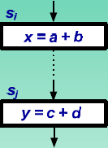
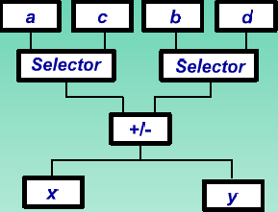
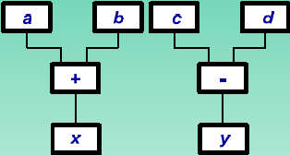
Functional-unit sharing
-
Partial ASM Chart
Non-shared design
Shared design

Slide 19
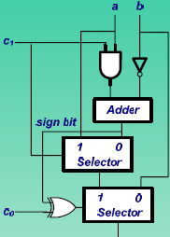
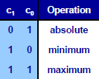
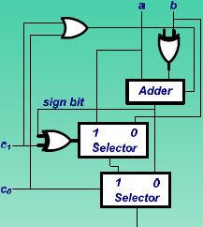
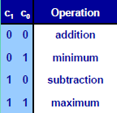
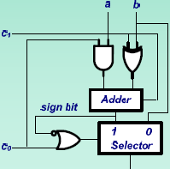
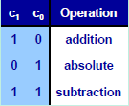
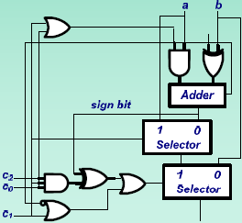
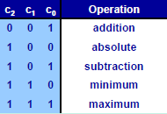
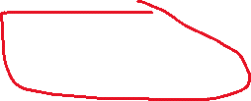
Complex library components
Unit for computing minimum,
maximum and absolute value
Unit for computing addition,
subtraction, minimum and maximum
Unit for computing addition,
subtraction, and absolute value
Unit for computing addition, subtraction,
minimum, maximum and absolute value

Slide 20
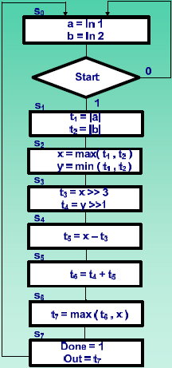
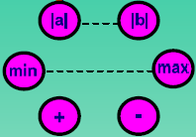
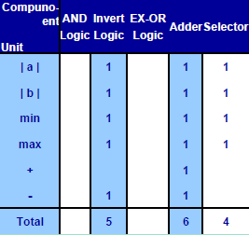
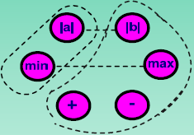
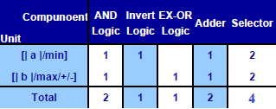
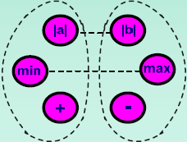
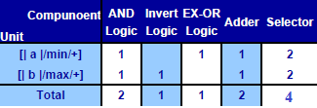
Operator merging for SRA implementation
Compatibiltity graph
(single function unit)
(b) Cost table graph (a)
(c) Merging altermative
(simple merging operator)
(d) Cost table graph (c)
ASM Chart
(f) Cost table graph (e)
(e) Merging altermative
(simple merging operator)
Notes:
Cost table graph (c) trên slide/trong sách bị sai
[|a|, min] 1 1 0 1 2
Sửa: [|a|, max] 1 2 0 1 2

Slide 21
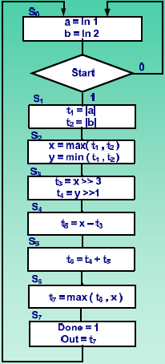
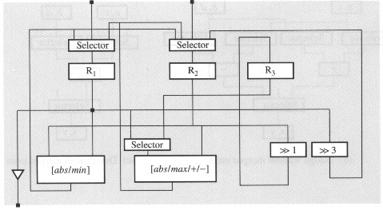
Datapath connectivity
R1 = [a , t1 , x , t7]
R2 = [b , t2 , y , t3 , t5 , t6]
R3 = [t4]
Compare selector input numbers with Datapath in slide 17???
(c) Merging altermative
(simple merging operator)
ASM Chart
Datapath schematic
Notes:
Datapath trên slide/trong sách bị sai
Sửa: [abs/min] → [abs/max]; [abs/max/+/-] → [abs/min/+/-]

Slide 22
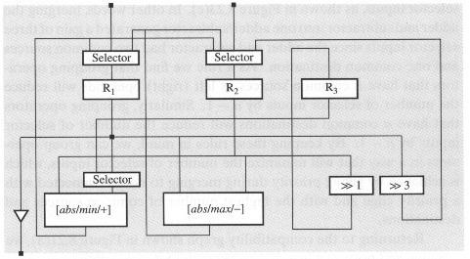
Datapath connectivity
R1 = [a , t1 , x , t7]
R2 = [b , t2 , y , t3 , t5 , t6]
R3 = [t4]
Compare selector input numbers with Datapath in slide 17 ???
(e) Merging altermative
(simple merging operator)
ASM Chart
Datapath schematic

Slide 23
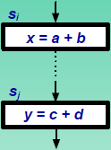
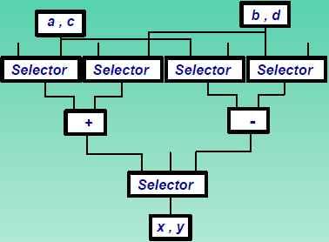
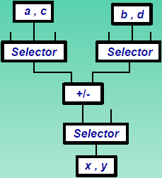
Priorities in unit merging
(a) Partial ASM Chart
(b) Design without merged units
(c) Design with merged units

Slide 24

Compatibility graph for functional-unit sharing
Compatibility graph: nodes and edges
- Node represents a operator
- Edge: incompatibility edge and priority edge
+ Incompatibility edge (dashed line): connect 2 nodes indicates 2 operators that are occurred concerrently in the same state.
+ Priority edge: connect 2 nodes indicates 2 operators that have the operator’s similarity in construction (depend on component libraries) or the substantially reduce the cost (depend on priority weight) of the datapath’s connection.
Priority weight (s/d) on priority edge: the number of connections can be saved
s is equal to the number of common sources between two operators
d is equal to the number of common destinations between two operators.
(Operators) compatibility graph
Note: If the ASM chart has more than one operator (e.g max) in ASM chart, the maximum value of s or d from each one to other operator will be chosen.

Slide 25

Unit merging for SRA datapath
R1 = [a , t1 , x , t7]
R2 = [b , t2 , y , t3 , t5 , t6]
R3 = [t4]
Register assignment in register sharing with graph-partitioning algorithm (slide16)
ASM Chart
(Operators) Compatibility graph
Notes:
Dựa vào các thanh ghi R1, R2, R3 của phương pháp phân hoạch đồ thị

Slide 26



Unit merging for SRA datapath
Sách sai
(a) Compatibility graph
(b) Compatibility graph
after merging of + and – (operator’s similarity grouping)
(c) Compatibility graph
after merging of min, + and –
(datapath’s connection grouping)
(d) Final graph partitions
(datapath’s connection grouping)
ASM Chart
Notes:
Operator’s similarity grouping: group theo cùng chức năng
Datapath’s connection grouping: group theo ưu tiên số lượng lớn connection
→ Trong thực tế thì group theo cả 2 cách trên

Slide 27

SRA datapath generated by prioritized partitioning (use register and functional-unit sharing)
R₁ = [ a, t₁, x, t₇ ]
R₂ = [ b, t₂, y, t₃, t₅, t₆ ]
R₃ = [ t₄ ]
AU₁ = [ |b| / min / + / - ]
AU₂ = [ |a| / max ]
SH₁ = [ >>1 ]
SH₂ = [ >>3 ]
(a) Register and functional unit allocation
Compare selector input numbers with Datapath in slide 17,22,23 ???
(b) Datapath schematic

Slide 28
Bus sharing ( connection merging )
Group connections that are not used concurrently
Each group forms a bus
Connection merging reduces number of wires
Clustering algorithm is demonstrated

Slide 29

Compatibility graph for bus sharing
Compatibility graph: nodes and edges
- Node represents each connection
- Edge: incompatibility edge and priority edge
+ Incompatibility edge (dashed line): connect 2 nodes whenever their corresponding connections do not originate from the same source, but are used at the same time.
+ Priority edge: connect 2 nodes whenever their corresponding connections have a common source or a common destination.
Priority weight (s/d) on priority edge: No → using a graph-patitioning algorithm to group connections in a way that will maximize the number of priority edges included in all groups.
(connection) compatibility graph
Connection sources: outputs of register and functional units / input of circuit
Connection destinations: inputs of register and functional units

Slide 30


Connection merging in SRA datapath
R1 = [a, t1, x, t7]
R2 = [b, t2, y, t3, t5, t6]
R3 = [t4]
ASM Chart
(b) Connectivity usage table
Notes:
Connection sources: outputs of register and functional units / input of circuit
Connection destinations: inputs of register and functional units
Cách tạo ra Connectivity usage table:
Ví dụ xét tại state s1:
Sử dụng khối tính |a| và khối |b|
Khối |a| nằm trong khối [abs/max], mà giá trị input a thì xuất phát từ thanh ghi R1, nên C là một connection source
Khối |b| nằm trong khối [abs/min/+/-], mà giá trị input b thì xuất phát từ thanh ghi R2, nên F là một connection source
I là một output của khối [abs/max] và là input của R1, nên I là một connection destination
J là một output của khối [abs/min/+/-] và là input của R2, nên J là một connection destination
Như vậy đối với state s1, sử dụng các connections sau: C, F, I, J
Làm tương tự cho các state khác

Slide 31


Connection merging in SRA datapath
R1 = [A, C, D, H]
R2 = [B, F, G]
R3 = [E]
Sách sai
(c) Compatibility graph
for input buses (AU and SH inputs)
(d) Compatibility graph
for output buses (AU and SH outputs)
(b) Connectivity usage table
Notes:
- Edge: incompatibility edge and priority edge
+ Incompatibility edge (dashed line): connect 2 nodes whenever their corresponding connections do not originate from the same source, but are used at the same time.
+ Priority edge: connect 2 nodes whenever their corresponding connections have a common source or a common destination.

Slide 32
Connection merging in SRA datapath
(d) Compatibility graph
for output buses
(c) Compatibility graph
for input buses
Bus1 = [ A, C, D, E, H ]
Bus2 = [ B, F, G ]
Bus3 = [ I, K, M ]
Bus4 = [ J, L, N ]
(e) Bus assignment

Slide 33






Connection merging in SRA datapath
Bus1 = [ A, C, D, E, H ]
Bus2 = [ B, F, G ]
Bus3 = [ I, K, M ]
Bus4 = [ J, L, N ]
Bus assignment
Đổi thành
(f) Bus oriented datapath

Slide 34
Register merging
Group register with non-overlapping accesses
Each group assigned to one register file
Register grouping reduces number of ports, and therefore number of buses
Demonstration with clustering algorithm

Slide 35




Register merging
R1 = [ a, t1, x, t7 ]
R2 = [ b, t2, y, t3, t5, t6 ]
R3 = [ t4 ]
(a) Register assignment
(b) Register access table
(c) Compatibility graph
Ko cần TRI ở đây
ASM Chart
(d) Datapath schematic

Slide 36
Bài tập
Viết chương trình tạo datapath tính tổng a²i (i = 1 .. 100).
Viết giải thuật bằng mã giả.
Chuyển mã giả sang sơ đồ ASM.
Lập bảng trạng thái
Chia sẻ thanh ghi? (nếu có).
Chia sẻ chức năng? (nếu có).
Chia sẻ bus? (nếu có).

